Slide 1


Finance and Risk Analytics
View in Power BI
Presented By
SACHIN SONAVANE
Rohit Nayak
Last data refresh:
11/14/2023

Slide 2
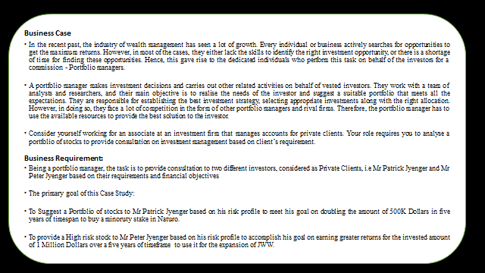
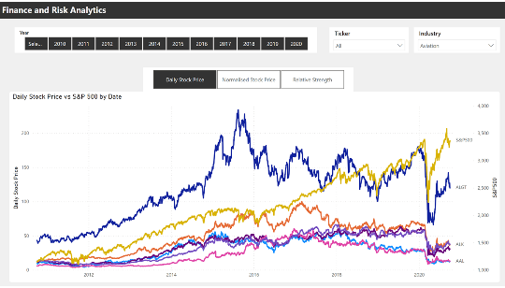
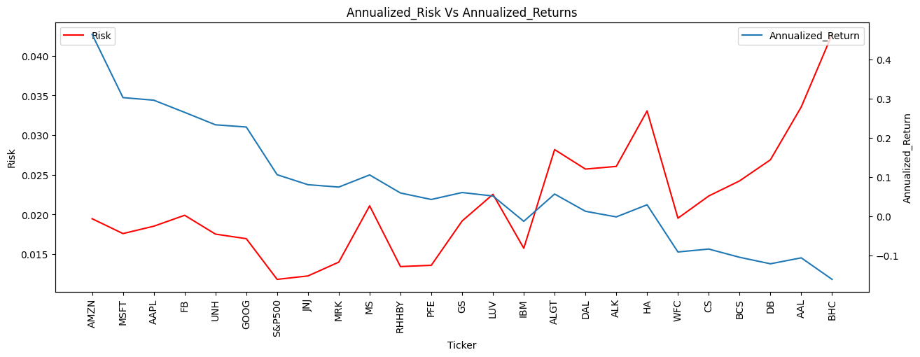
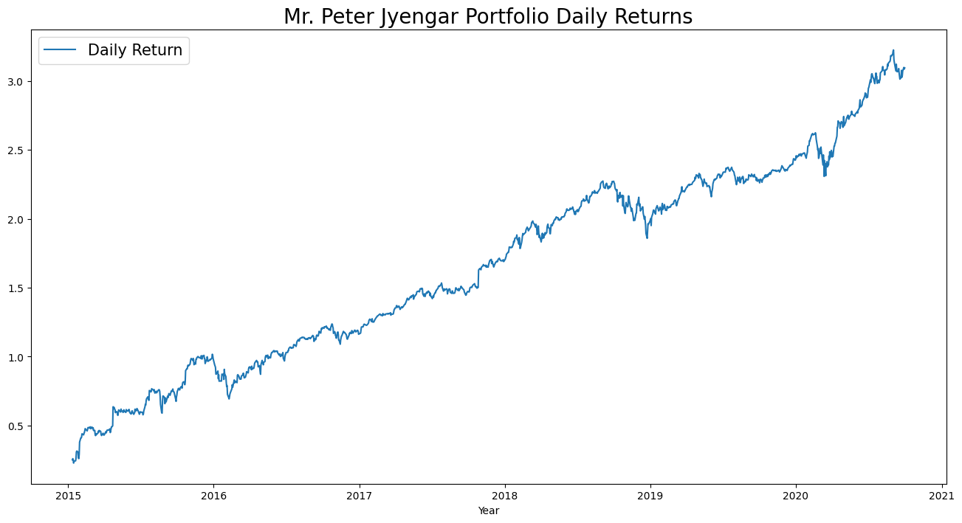
Business Case Understanding
Understand the business context investor persona and investment goals of the investor
Data Analysis and Visualization
Determine the key risk and return metrics for the stocks. Compare the same vis-a—vis the market index
Selection of Stocks by Risk and Return
Use the risk and return metrics to shortlist the stocks which meet the investor’s financial goals
Portfolio Development
Allocate the funds to the chosen stocks and create the portfolio. Measure the portfolio risk and return metrics

Slide 3
Business Case
In the recent past, the industry of wealth management has seen a lot of growth. Every individual or business actively searches for opportunities to get the maximum returns. However, in most of the cases, they either lack the skills to identify the right investment opportunity, or there is a shortage of time for finding these opportunities. Hence, this gave rise to the dedicated individuals who perform this task on behalf of the investors for a commission - Portfolio managers.
A portfolio manager makes investment decisions and carries out other related activities on behalf of vested investors. They work with a team of analysts and researchers, and their main objective is to realise the needs of the investor and suggest a suitable portfolio that meets all the expectations. They are responsible for establishing the best investment strategy, selecting appropriate investments along with the right allocation. However, in doing so, they face a lot of competition in the form of other portfolio managers and rival firms. Therefore, the portfolio manager has to use the available resources to provide the best solution to the investor.
Consider yourself working for an associate at an investment firm that manages accounts for private clients. Your role requires you to analyse a portfolio of stocks to provide consultation on investment management based on client’s requirement.
Business Requirement:
Being a portfolio manager, the task is to provide consultation to two different investors, considered as Private Clients, i.e Mr Patrick Jyenger and Mr Peter Jyenger based on their requirements and financial objectives
The primary goal of this Case Study:
To Suggest a Portfolio of stocks to Mr Patrick Jyenger based on his risk profile to meet his goal on doubling the amount of 500K Dollars in five years of timespan to buy a minoruty stake in Naturo.
To provide a High risk stock to Mr Peter Jyenger based on his risk profile to accomplish his goal on earning greater returns for the invested amount of 1 Million Dollars over a five years of timeframe to use it for the expansion of JWW.
Business Case Understanding

Slide 4
Business Case Objective
Analyse a portfolio of stocks to provide consultation on investment management based on client’s requirement. My task is to provide consultation to two different investors, Mr Patrick Jyenger and Mr Peter Jyenger based on their requirements and financial objectives.
Mr Patrick Jyenger wants to invest $500K in equities, he has been conservative investor during his all life and expects doubling his capital with less risk in 5 years time.
Mr Peter Jyenger wants to invest $1 million in equities, he has been high risk investor during his all life, prefers high return investment and expects high return his capital with high risk in 5 years time.
Objective

Slide 5
S&P 500
Industry
ETL
Exploratory Data Analysis
Industry
Aviation
Finance
Healthcare & Pharmaceuticals
Technology
Industry
S&P500
Portfolio Analysis
Data Analysis and Visualization

Slide 6

Data Analysis and Visualization

Slide 7
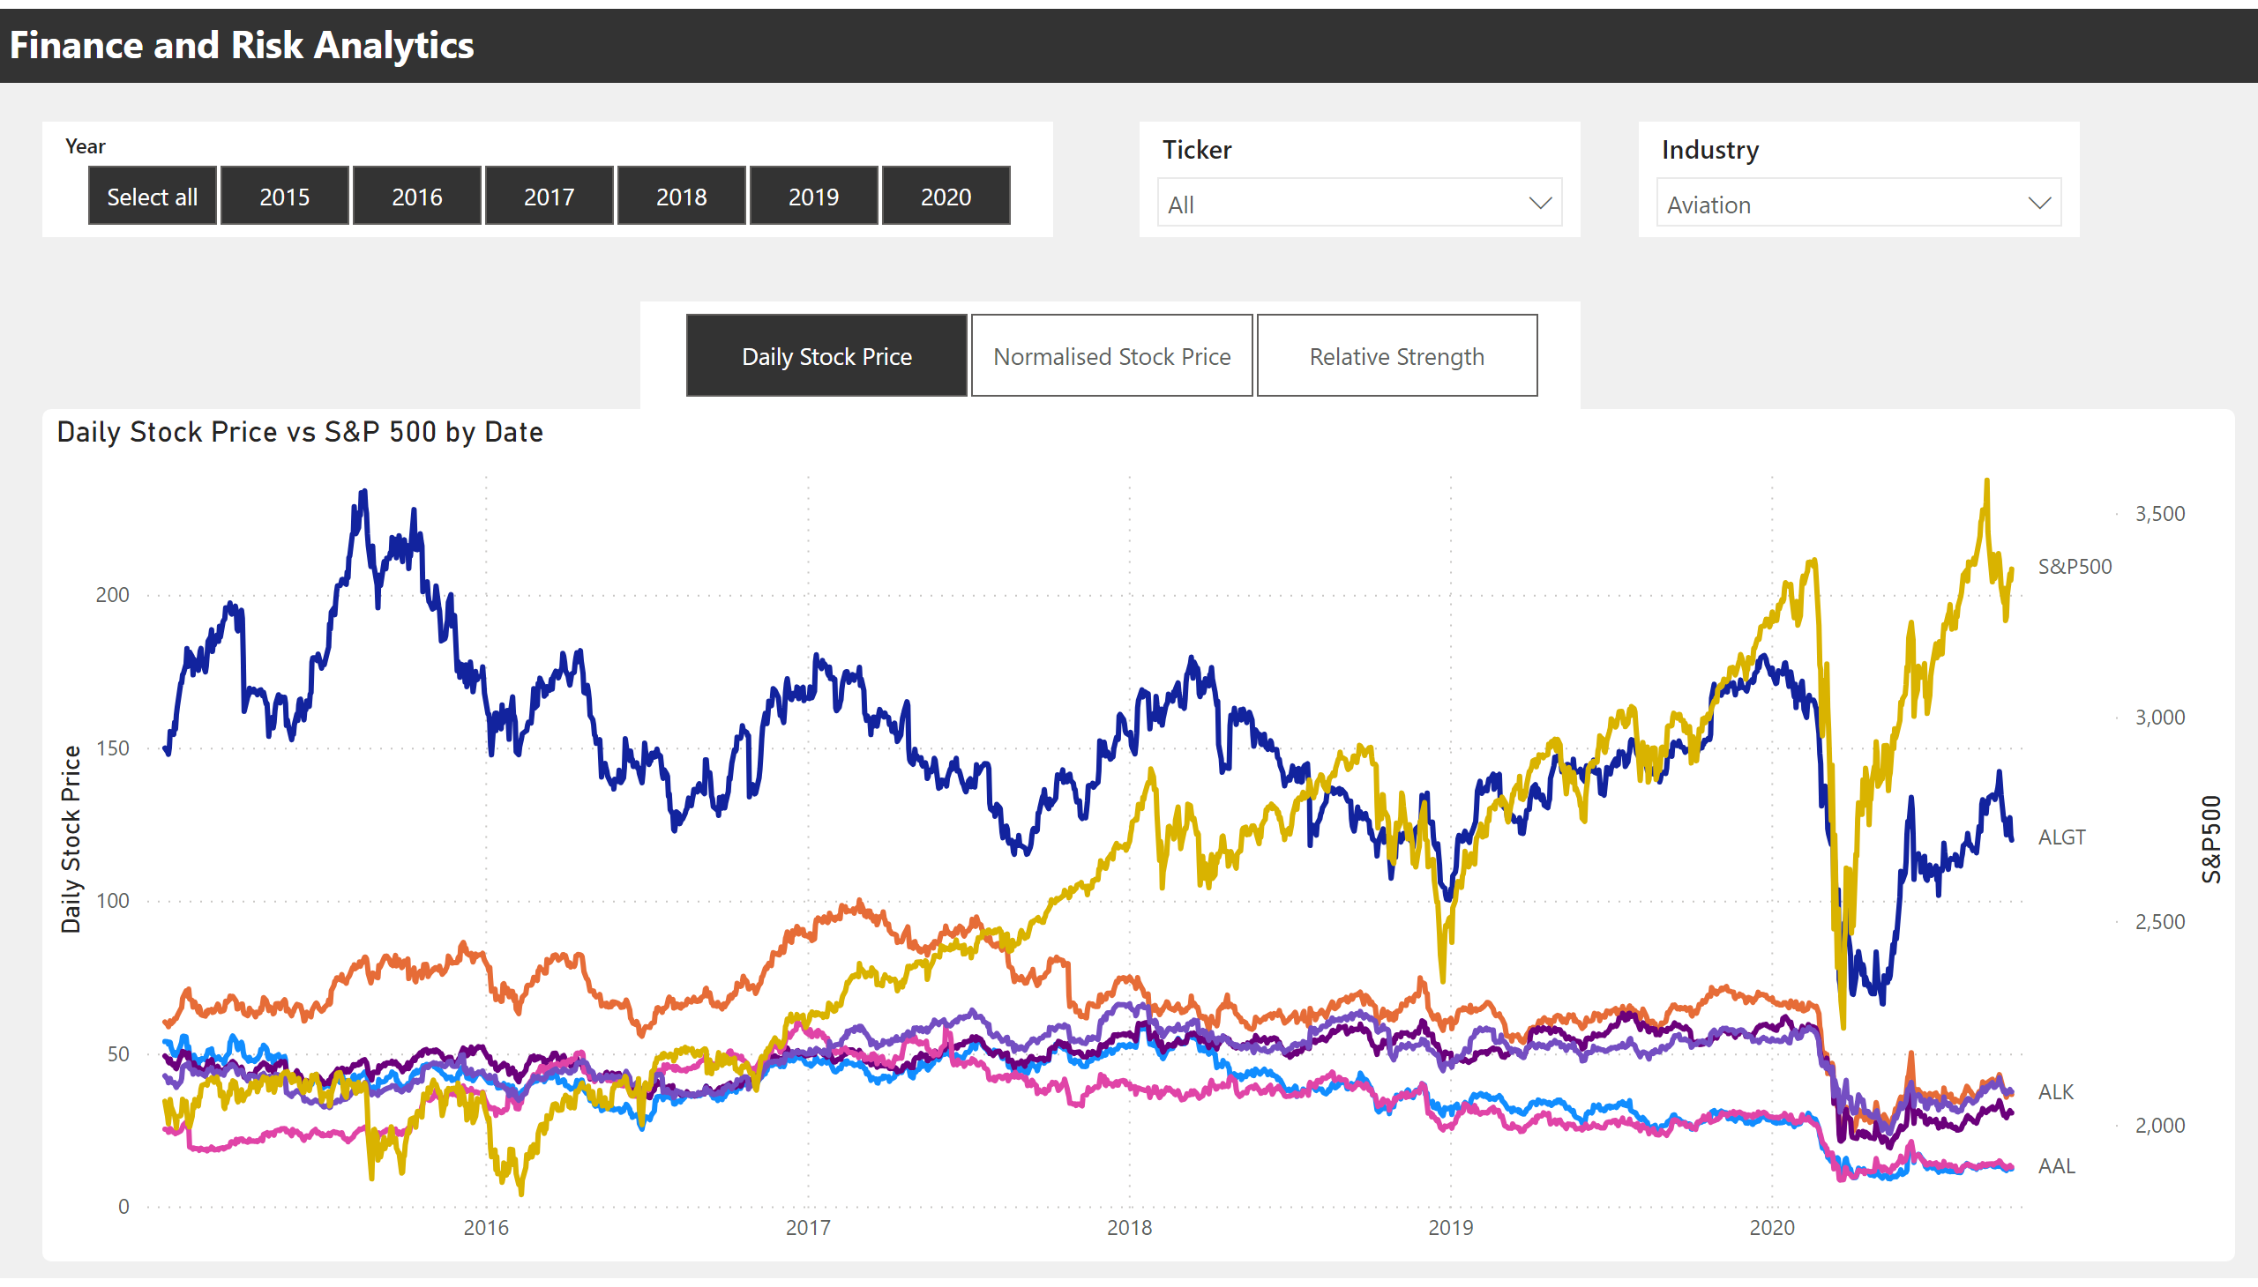
5 Years Analysis
Data Analysis and Visualization
Notes:
Daily Stock Price vs S&P 500 by Date
No alt text provided
slicer
No alt text provided
slicer
No alt text provided
textbox
No alt text provided
slicer
No alt text provided
slicer
No alt text provided

Slide 8
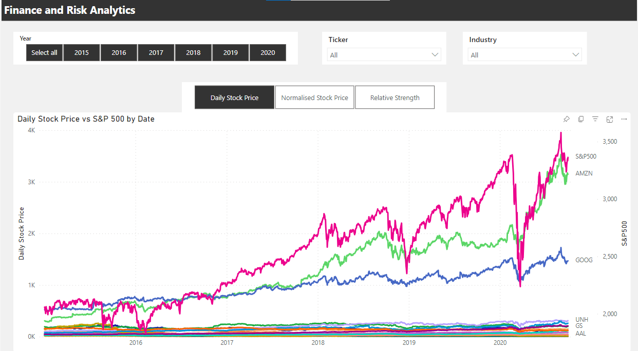
S&P 500
Industry
The graph below illustrates how each stock has fared in relation to the S&P 500 index.
Here, we've compared the 5 years' worth of stock values for every stock.
Industry
Aviation
Finance
Healthcare & Pharmaceuticals
Technology
Data Analysis and Visualization

Slide 9
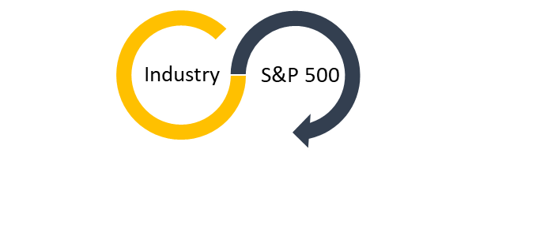
Last 5years Daily Stock vs S&P500
Data Analysis and Visualization

Slide 10
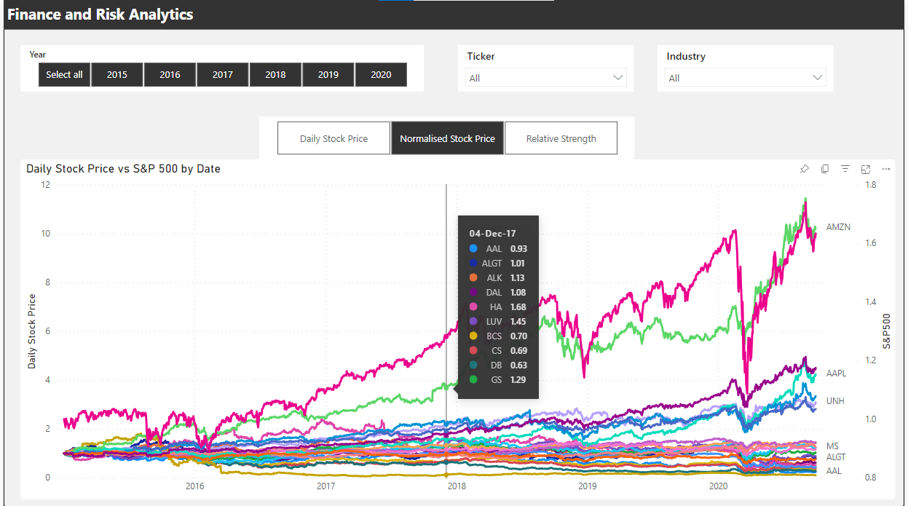
Last 5years Normalised Stock vs S&P500
Data Analysis and Visualization

Slide 11
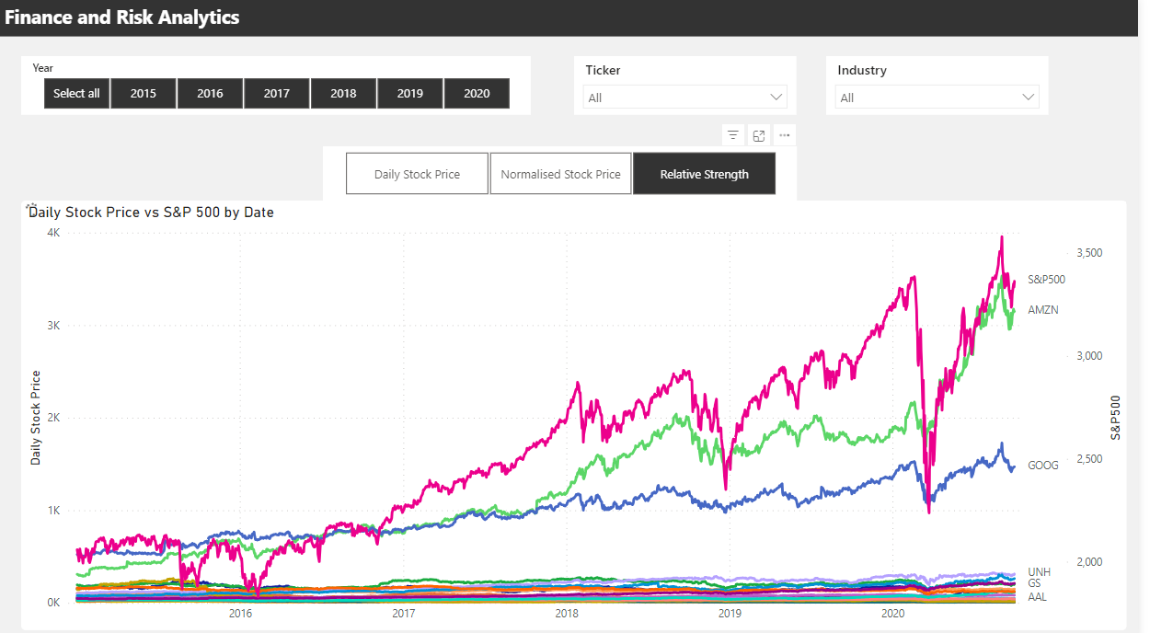
Last 5years Relative Strength
Data Analysis and Visualization

Slide 12
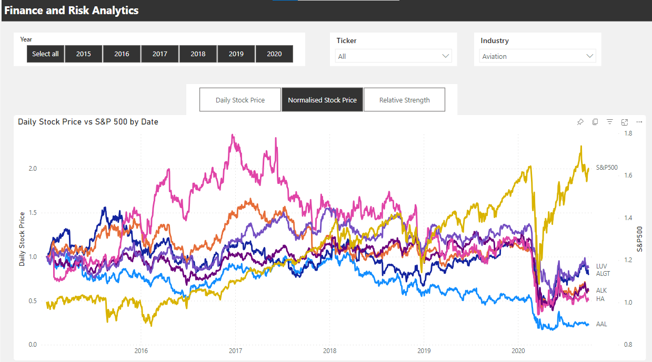
S&P 500
Aviation
Last 5years Normalised Aviation Sector
As we can see ALGT[Allegiant Travel Company] has some positive correlation with Delta Airlines.
Also we can see there is some positive correlation of Delta Airlines with Southwest Airlines Co[LUV]
Data Analysis and Visualization

Slide 13
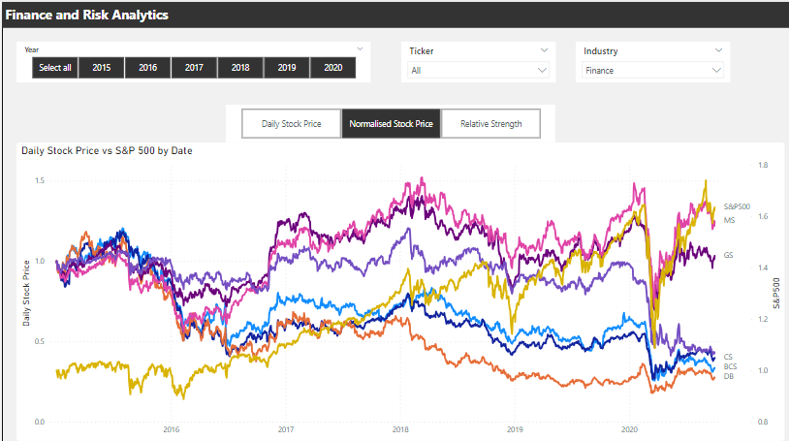
S&P 500
Finance
Last 5years Normalised Finance Sector
After 2020 pandemic , Morgan Stanley[MS] and Goldman Sachs [GS] were able to recover back as well as out performed the sector but still majority of stocks have been hit.
Also, we can see that Goldman Sachs & Morgan Stanley are highly correlated when compared to others stocks
Data Analysis and Visualization

Slide 14
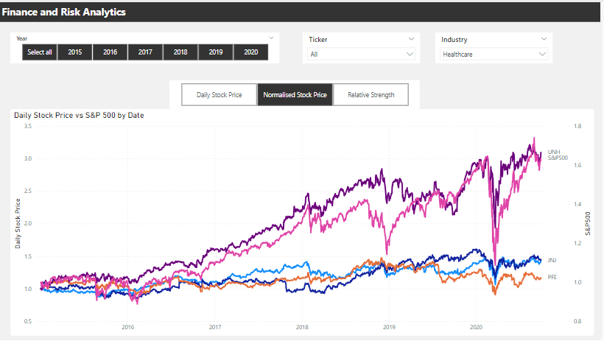
S&P 500
Healthcare
Last 5years Normalised Healthcare Sector
S&P500 is positively co-related with Health and Pharma Sector(JNJ, MARK, UNH).
During the pandemic health and pharma and technology sector showed rapid growth after the market crash in comparison to other industries.
From past 5 years we can see that Bausch Health Companies inc has not seen any growth.
Overall the health and pharma sector is strong compared to S&P500.
Data Analysis and Visualization

Slide 15
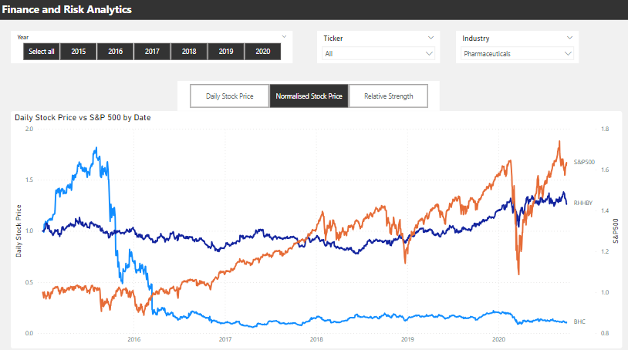
S&P 500
Pharmaceutical
Last 5years Normalised Pharmaceuticals Sector
S&P500 is positively co-related with Pharma Sector(RHHBY)- Roche Holding AG.
Data Analysis and Visualization

Slide 16
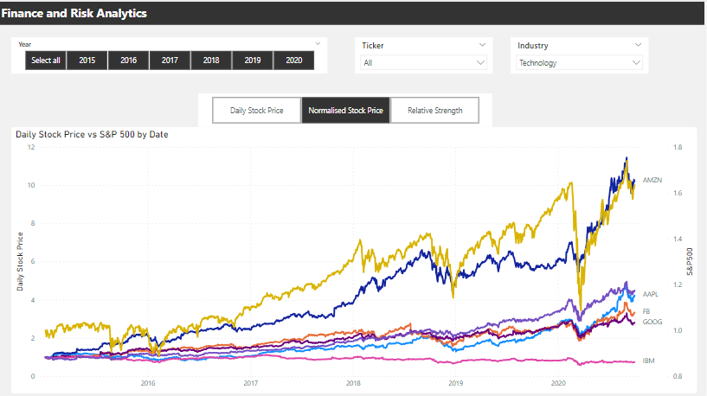
S&P 500
Technology
Last 5years Normalised Technology Sector
S&P500 is positively co-related with Technology Sector(AMZN, FB, MSFT, GOOG, AAPL).
When compared to other sectors during the pandemic Tech sector was one of few sectors to bounce back sharply.
Except for IBM all the other stocks are out performing the market.
Also all the stocks except for IBM are strongly co-related with each other.
Data Analysis and Visualization

Slide 17
S&P 500
Portfolio
Last 5years Portfolio Analysis
Ticker | Mean_Daily_Return | Cumulative_Return | Risk | Beta | Annualized_Return | Sharp_Ratio
AMZN | 0.18% | 980.52% | 1.95% | 0.35 | 46.37% | 1.26
MSFT | 0.12% | 351.35% | 1.76% | 0.54 | 30.26% | 0.82
AAPL | 0.12% | 324.02% | 1.85% | 0.47 | 29.60% | 0.75
FB | 0.11% | 241.37% | 1.99% | 0.37 | 26.50% | 0.60
UNH | 0.09% | 204.02% | 1.75% | 0.47 | 23.33% | 0.57
GOOG | 0.09% | 199.18% | 1.69% | 0.51 | 22.77% | 0.57
S&P500 | 0.04% | 65.81% | 1.18% |  | 10.61% | 0.17
JNJ | 0.03% | 42.36% | 1.22% | 0.63 | 8.07% | 0.03
MRK | 0.03% | 33.15% | 1.40% | 0.53 | 7.47% | 0.00
MS | 0.04% | 32.94% | 2.11% | 0.45 | 10.56% | 0.09
RHHBY | 0.02% | 23.51% | 1.34% | 0.48 | 5.96% | -0.07
PFE | 0.02% | 11.99% | 1.36% | 0.56 | 4.31% | -0.15
GS | 0.02% | 8.59% | 1.92% | 0.49 | 6.08% | -0.05
LUV | 0.02% | -6.83% | 2.25% | 0.29 | 5.19% | -0.06
IBM | -0.01% | -22.23% | 1.57% | 0.56 | -1.26% | -0.35
ALGT | 0.02% | -22.39% | 2.82% | 0.22 | 5.69% | -0.04
DAL | 0.01% | -33.61% | 2.57% | 0.26 | 1.30% | -0.15
ALK | 0.00% | -39.56% | 2.61% | 0.26 | -0.13% | -0.18
HA | 0.01% | -46.78% | 3.31% | 0.16 | 2.95% | -0.09
WFC | -0.04% | -54.83% | 1.95% | 0.45 | -9.07% | -0.53
CS | -0.03% | -56.80% | 2.23% | 0.35 | -8.32% | -0.45
BCS | -0.04% | -64.29% | 2.42% | 0.30 | -10.43% | -0.47
DB | -0.05% | -70.24% | 2.69% | 0.25 | -12.08% | -0.46
AAL | -0.04% | -75.21% | 3.36% | 0.17 | -10.56% | -0.34
BHC | -0.06% | -90.01% | 4.27% | 0.11 | -16.05% | -0.35
At the end of 5 years we can see that top 6 stocks having returns greater than S&P500:
AMZN gives 46.37% annual returns.
MSFT gives 30.26% annual returns.
AAPL gives 29.60% annual returns.
FB gives 26.50% annual returns.
UNH gives 23.33% annual returns.
GOOG gives 22.77% annual returns.
.
Selection of Stocks by Risk and Return

Slide 18
Risk & Return
Portfolio
Last 5years Portfolio Analysis
1. Top Performing Stocks in Annualized Returns:
- AMZN
- MSFT
- AAPL
- FB
- UNH
2. Annualized Returns and Risk Analysis:
Each of the top 5 stocks demonstrates an annualized return exceeding 20%, maintaining a moderate risk level compared to other equities.
3. Risk and Financial Losses:
The probability of financial losses and diminishing the initial investment rises with declining returns.
4. Higher Associated Risks Due to Lack of Disclosure:
BHC, BCS, DB, CS, and WFC face higher associated risks due to the absence of disclosed return on investment at the time of investing.
5. Risk-Return Relationship:
Companies with elevated risk profiles generally offer diminished returns on investment. Nevertheless, certain stocks provide risk-free investment opportunities, even with lower returns.
6. Commendable Returns with Minimal Risk:
JNJ, RHHBY, and MRK stocks deliver commendable returns with minimal associated risk.
Selection of Stocks by Risk and Return

Slide 19
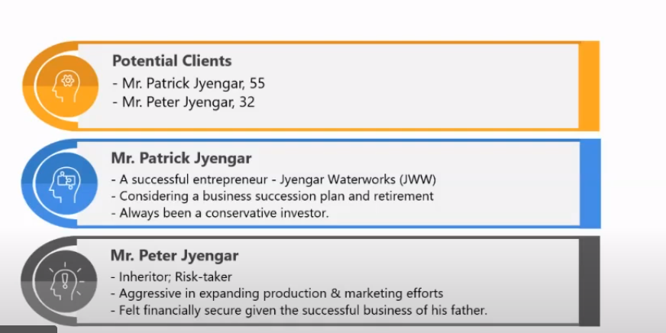
Portfolio Analysis
Risk & Return
Portfolio
The primary goal of this Case Study:
To Suggest a Portfolio of stocks to Mr Patrick Jyenger based on his risk profile to meet his goal on doubling the amount of 500K Dollars in five years of timespan to buy a minoruty stake in Naturo.
To provide a High risk stock to Mr Peter Jyenger based on his risk profile to accomplish his goal on earning greater returns for the invested amount of 1 Million Dollars over a five years of timeframe to use it for the expansion of JWW.

Slide 20
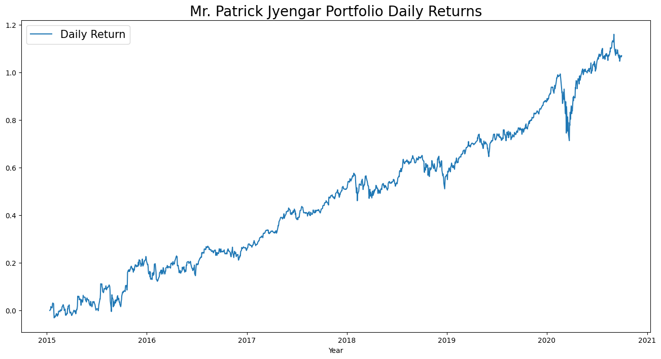
Patrick
Portfolio
Last 5 years Mr. Patrick Jyengar Portfolio Analysis
Portfolio Composition:
Stocks: MSFT, JNJ, RHHBY, GOOG
Weights: MSFT (30%), JNJ (20%), RHHBY (20%), GOOG (30%)
Financial Performance:
- Initial Investment: 500,000
- Total Return: 1,035,072.86
- Earnings: 535,072.86
Return on Investment (ROI):
Impressive ROI: 107.01%
Notable Wealth Accumulation:
Signifies a notable achievement in wealth accumulation over the specified 5-year period.
Portfolio Development

Slide 21
Peter
Portfolio
Last 5 years Mr. Peter Jyengar Portfolio Analysis
Portfolio Composition:
Stocks: AMZN, MSFT, AAPL
Weights: AMZN (75%), MSFT (30%), AAPL (20%)
Financial Performance:
- Initial Investment: 1,000,000
- Total Return: 4,096,424.66
- Earnings: 3,096,424.66
Return on Investment (ROI):
Impressive ROI: 309.64%
Notable Wealth Accumulation:
Signifies a notable achievement in wealth accumulation over the specified 5-year period.
Portfolio Development

Slide 22

Thank You

