Slide 1
Regional Sales Dashboard
Team Members
Sachin S
Seethapathi G

Slide 2
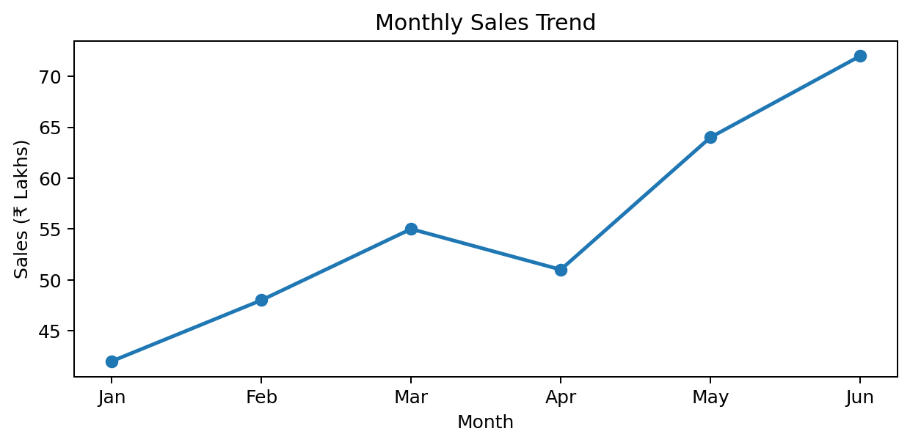
1. Introduction & Objectives
A visual system for monitoring regional sales performance.
Project Objectives
• Combines sales data from multiple regions in one dashboard.
• Tracks revenue, targets, growth and product performance.
• Helps managers identify high- and low-performing regions.
• Supports faster, data-driven business decisions.
₹3.00 Cr
Total Sales
84%
Target Achieved
4
Regions
2

Slide 3
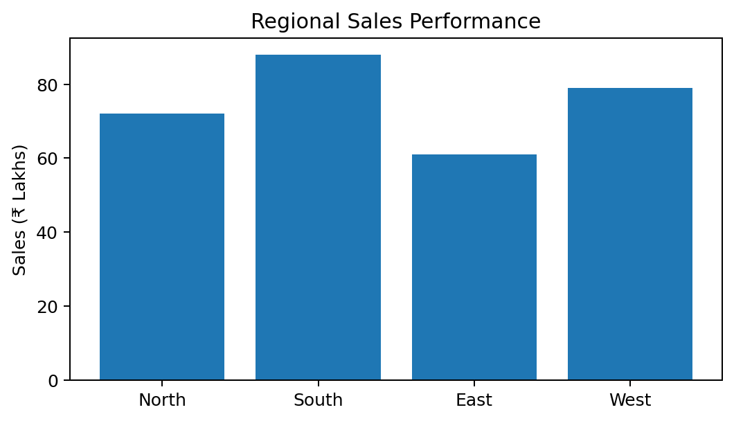
2. Dashboard Components
Key metrics and visuals used to understand regional performance.
1
Sales KPI Cards
Revenue, target, growth and order count.
2
Regional Comparison
Compare sales across North, South, East and West.
3
Trend Analysis
Monthly and quarterly sales movement.
4
Product Insights
Identify products contributing most to revenue.
5
Filters
Region, date, product and sales representative.
3

Slide 4
3. Sample Regional Sales Dashboard
Illustrative dashboard view using sample data.
₹3.00 Cr
Revenue
1,240
Orders
+12.5%
Growth
84%
Target
North
72
Quick Insights
• South region shows the highest sample sales.
• East region needs closer performance review.
• Monthly trend indicates overall upward movement.
South
88
East
61
West
79
4

Slide 5
4. Benefits & Future Scope
How the dashboard can support sales teams and future enhancements.
Benefits
• Faster reporting with a single source of sales information.
• Easy comparison of regions against targets.
• Helps identify trends and performance gaps.
• Improves communication between sales teams and management.
Future Scope
• Real-time data integration from CRM/ERP systems.
• Interactive filters and drill-down reports.
• Forecasting using historical sales trends.
• Mobile-friendly dashboard and automated alerts.
5

Slide 6
THANK YOU
Questions & Discussion
Sachin S
Seethapathi G
6

