Slide 1
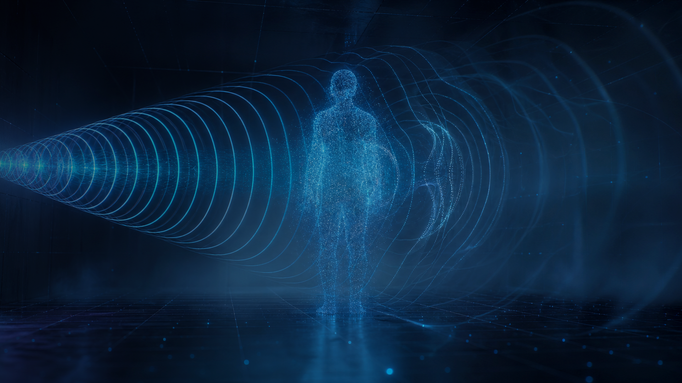
HACKATHON PROJECT · ESP32 · WIFI CSI SENSING
WiFiSense
Privacy-Preserving Human Activity Detection Using WiFi CSI
Sense movement. Not identities.
Two or three ESP32 boards read the WiFi channel instead of a camera.
A lightweight model learns what human motion looks like — and what it does not.
2–3 × ESP32 boards
No camera · No mic · No wearables
On-device ML inference
Team WiFiSense
Live demo · 90 seconds
ESP-IDF · Python · NumPy / Pandas · scikit-learn · FastAPI
Notes:
Open with the line: “We can tell someone is in this room without ever taking a picture of them.”
WiFiSense reads WiFi Channel State Information from two or three ESP32 boards. No camera, no microphone, nothing to wear. Total hardware cost is a couple of dev boards and USB cables.
Say the tagline out loud: Sense movement. Not identities.

Slide 2
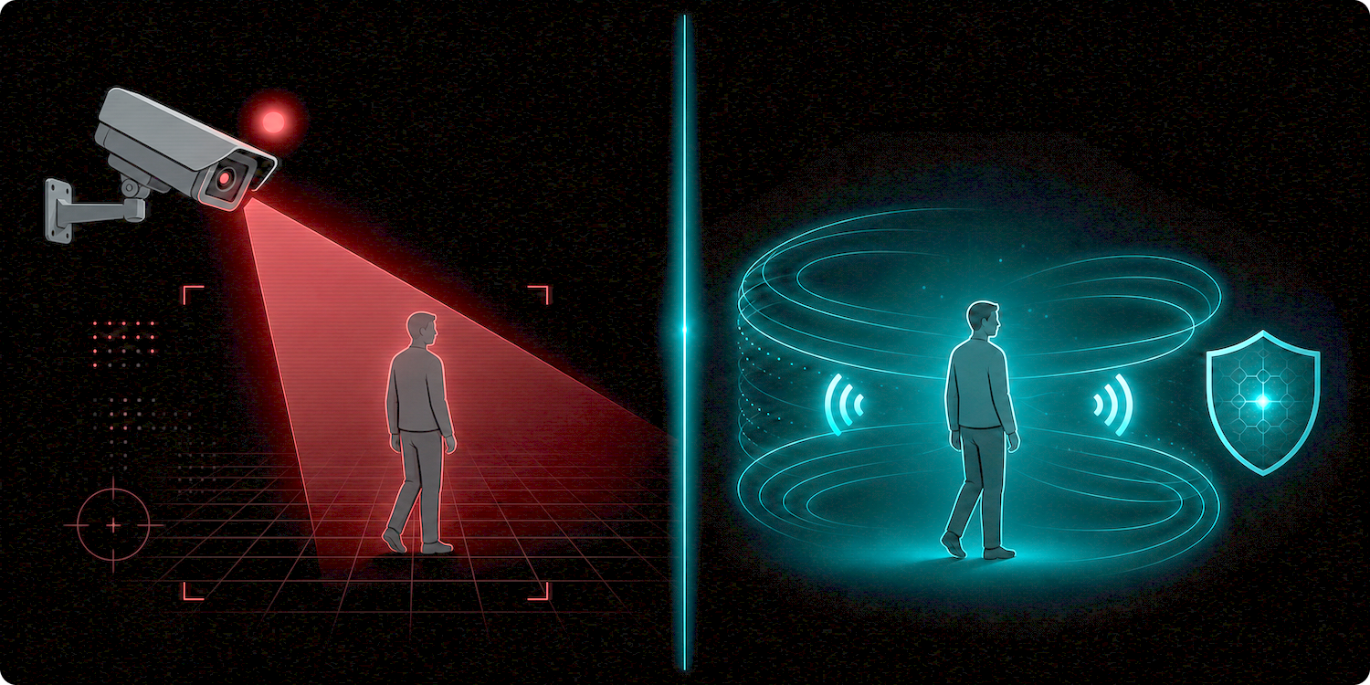
01 — THE PROBLEM
Cameras are not always the answer
Vision-based monitoring breaks down exactly where people care most about privacy.
1
Privacy
Continuous video of people is intrusive — and hard to justify at home.
2
Blind spots
A camera only sees where it points. Corners, shelves and furniture hide movement.
3
Darkness & glare
Night, smoke, backlight and occlusion all degrade vision-based sensing.
Cameras watch people. WiFi sensing watches the air.
4
Wearables don't stick
Bands get forgotten, go uncharged, or are simply refused.
We still need to know whether a space is occupied — without recording who is in it.
WiFiSense · Privacy-Preserving Human Activity Detection Using WiFi CSI
02 / 10
Notes:
Four reasons cameras fall short, in order of how much people care: privacy, blind spots, darkness and glare, and the fact that wearables get forgotten or refused.
Land the strip at the bottom: we still need to know whether a space is occupied — we just should not have to record who is in it.

Slide 3
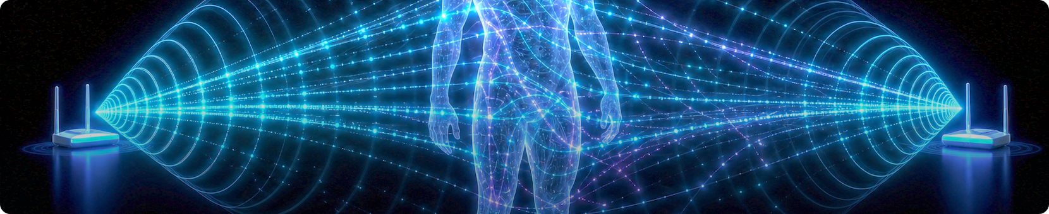
02 — OUR SOLUTION
Don't watch the room. Read the WiFi.
Instead of watching people with cameras, we observe how human movement changes WiFi signals.
ESP32 TX
WiFi Signal
Human Body
ESP32 RX
CSI Stream
ML Model
Activity State
THE ROOM IS THE SENSOR
A body moving through the link absorbs and scatters
radio energy — the receiver sees it as CSI.
Low cost
Privacy by design
Beyond line of sight
Two ESP32 boards, USB cables and a laptop.
No images, no audio, no identity — only numbers.
Radio waves bend around furniture and work in the dark.
WiFiSense · Privacy-Preserving Human Activity Detection Using WiFi CSI
03 / 10
Notes:
Walk the chain left to right: an ESP32 transmits, the signal crosses the room, a body disturbs it, a second ESP32 records the change as CSI, and the model reads the pattern.
Emphasise “ordinary WiFi frames” — we are not adding any new transmitting hardware to the room.

Slide 4
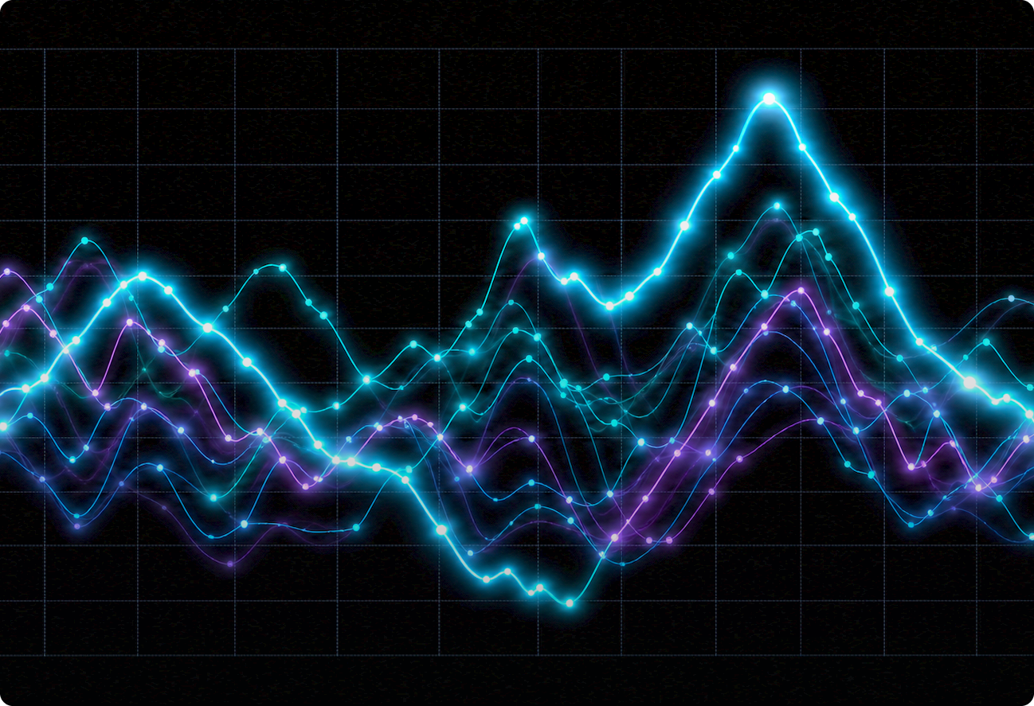
03 — HOW IT WORKS
WiFi CSI, step by step
CSI = Channel State Information — how the signal arrives, not the data it carries.
1
Packets on air
An ESP32 transmits ordinary WiFi frames across the room.
2
Signal travels
Energy reaches the receiver directly and via reflections off walls and objects.
3
A body disturbs it
A moving person absorbs, reflects and scatters part of that energy.
4
Receiver logs CSI
Per packet: amplitude and phase for each OFDM subcarrier — ~50 numbers.
5
ML reads the pattern
Each line is one subcarrier. Human motion leaves a time-structured
fingerprint; a quiet room leaves a flat one.
Models look at how those numbers evolve over seconds, not at one reading.
WiFiSense · Privacy-Preserving Human Activity Detection Using WiFi CSI
04 / 10
Notes:
CSI in one sentence: it is how the signal arrives, not the data it carries — amplitude and phase per subcarrier, per packet.
The key idea is step 5: the model reads how those numbers evolve over seconds, never a single reading.

Slide 5





04 — THE HARD PROBLEM
A changed signal is not always a human
Bags, chairs, doors and fans also disturb the channel. Treating 'signal moved' as 'person' is the classic mistake.
Person walking
Bag placed
Chair moved
Fan spinning
Door opened
=
=
=
=
=
CSI changes
CSI changes
CSI changes
CSI changes
CSI changes
CSI detects changes in the radio environment — not humans directly.
Temporal patterns
Balanced training data
Multiple links
Seconds of behaviour, never a single reading.
Human events AND non-human events in the same dataset.
2–3 ESP32 links cross-check a change from different angles.
WiFiSense · Privacy-Preserving Human Activity Detection Using WiFi CSI
05 / 10
Notes:
This is the slide that separates us from a naive demo. A bag, a chair, a fan and a door all change the channel too.
Call out the line: CSI detects changes in the radio environment, not humans directly.
Our three defences: temporal patterns, balanced training data that includes non-human events, and cross-checking across 2–3 links.

Slide 6
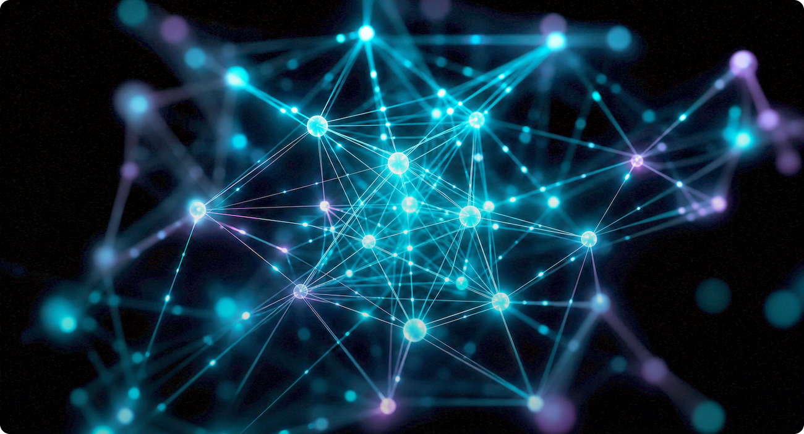
05 — AI / ML PIPELINE
From raw signal to a confidence score
A small, explainable pipeline that runs on a laptop today and on the board tomorrow.
Raw CSI data
Amplitude + phase, per subcarrier, per packet
PATTERN, NOT PIXELS
Noise filtering
Drop empty packets, spikes and idle bursts
Preprocessing
Phase sanitised, normalised, windowed into segments
Feature extraction
Variance, Doppler energy, cross-link correlation
ML classification
Random Forest / SVM / tiny CNN — lightweight on purpose
Human · Object · Stable
A three-way decision, never a hard yes / no
Output is a probability, not a verdict
Human
0.87
Live dashboard + alert
Status, activity and a confidence score
Object
0.11
Stable
0.02
Below threshold the system says “uncertain” — it never guesses.
WiFiSense · Privacy-Preserving Human Activity Detection Using WiFi CSI
06 / 10
Notes:
Seven small stages — nothing exotic. Keep the vocabulary light: filter, normalise, window, extract a handful of features, classify.
Point at the probability bars: the output is a distribution, not a verdict. Below threshold we say “uncertain”.

Slide 7

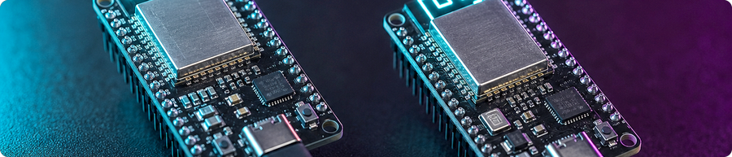
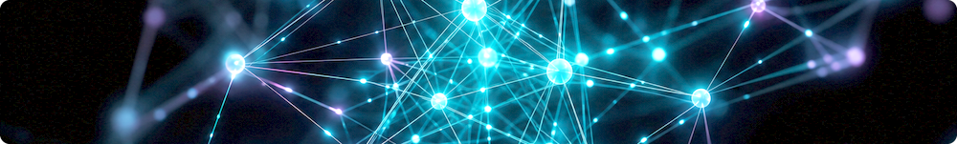
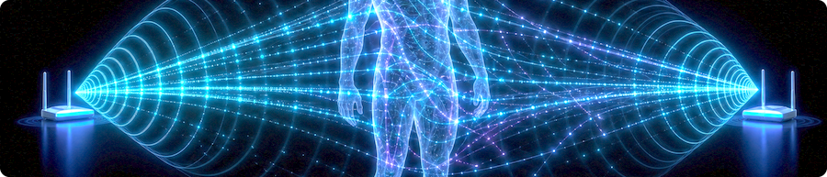
06 — SYSTEM ARCHITECTURE
From radio hardware to a live dashboard
Two to three ESP32 links feed one laptop; raw CSI never leaves the room.
ESP32 Transmitter
Laptop · Edge Processing
Broadcasts standard WiFi frames
Parses, filters and windows the CSI stream
WiFi Signal · 2.4 GHz
ML Model
Travels through walls, air and people
Random Forest / SVM / TinyML — scores each window
Human / Environment
CSI stream → laptop: USB / UART / Wi-Fi. Numbers only, never images.
Web Dashboard
Absorbs, reflects, scatters the energy
FastAPI backend + lightweight web UI
ESP32 Receiver(s) × 2–3
Alerts · Status · Logs
Reports CSI per packet, per subcarrier
Room state, activity and confidence, live
No camera · No microphone · No video or audio is ever captured, stored or transmitted — only numbers.
WiFiSense · Privacy-Preserving Human Activity Detection Using WiFi CSI
07 / 10
Notes:
Left column is radio hardware, right column is software, the arrow is just numbers moving over a cable.
Do not skip the green badge: no camera, no microphone, no video or audio is ever captured or stored. Raw CSI is processed locally.

Slide 8
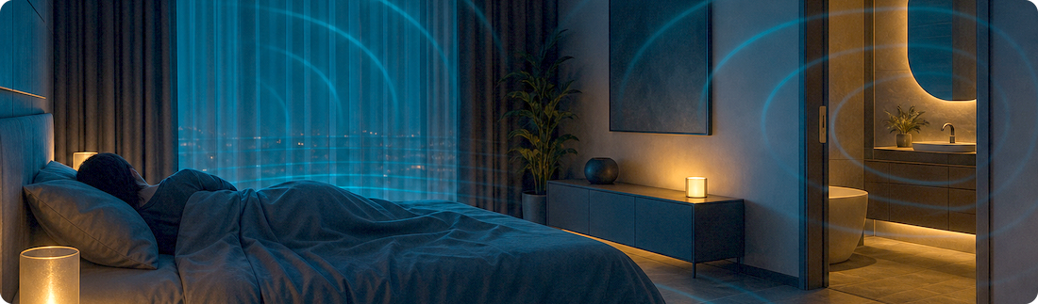
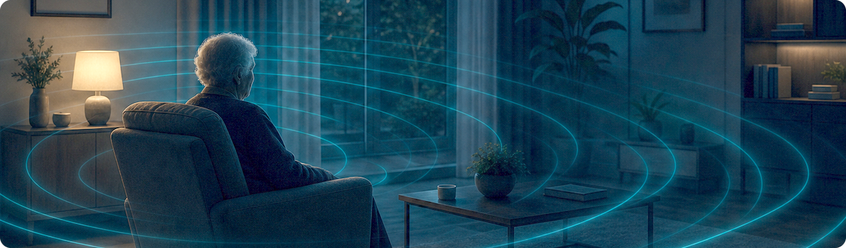
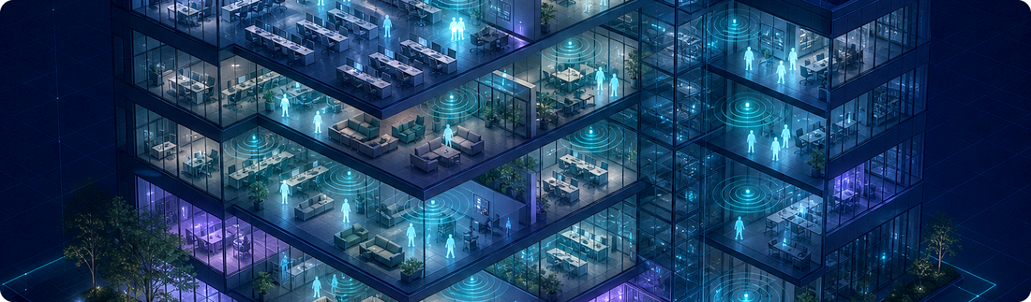
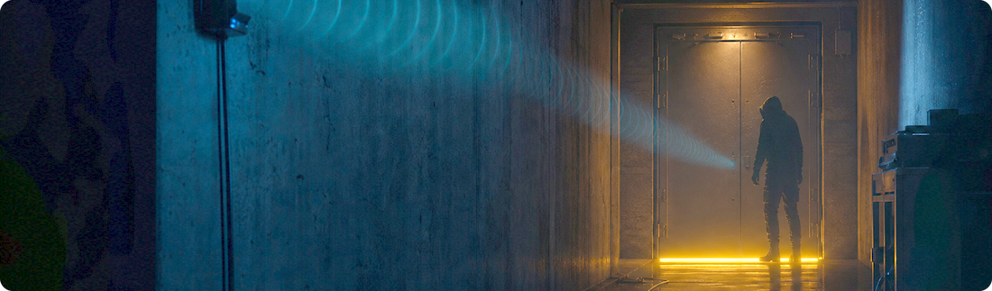
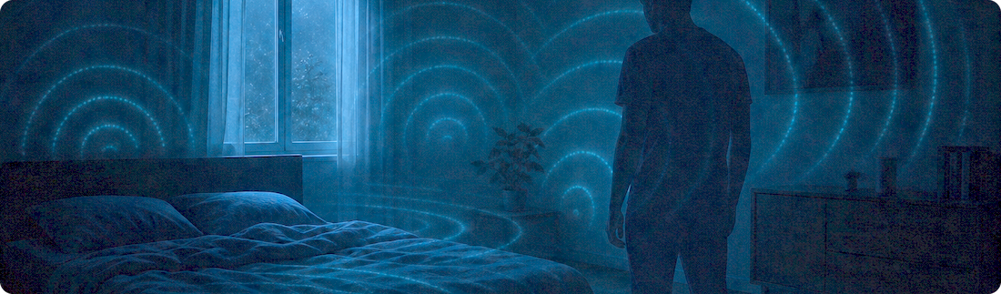
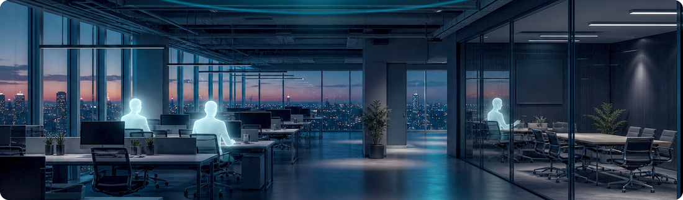
07 — WHERE IT FITS
Real-world use cases
Places where a camera is unwanted, inappropriate, or simply not enough.
Privacy-sensitive rooms
Elderly & fall-risk care
Smart buildings
Bedrooms, bathrooms, clinics — presence without pictures.
Flag long stillness or a sudden drop. No cameras in the home.
Occupancy-aware lighting, HVAC and real energy savings.
Restricted areas
Night-time detection
Occupancy monitoring
After-hours movement in labs, stores or stock rooms.
Works in complete darkness — no light, no infrared.
Desks and meeting rooms, counted in real time.
Honest scope: results depend on walls, layout and furniture — we do not claim reliable sensing in every environment.
WiFiSense · Privacy-Preserving Human Activity Detection Using WiFi CSI
08 / 10
Notes:
Six places this fits. Keep it to one sentence each — the pictures carry the slide.
Read the amber strip honestly. Judges reward teams that know their limits: results depend on walls, layout and furniture.

Slide 9
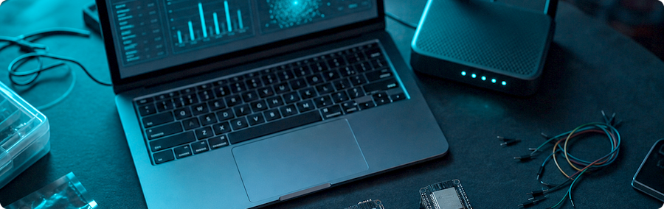
08 — LIVE DEMO
Five steps, ninety seconds
Two ESP32 boards on a table, a laptop, and one honest failure test.
1
Empty room, boards running
No human activity
WiFiSense · Live Monitor
● LIVE
expected output
HUMAN DETECTED
2
A person walks in and stands
Human detected
expected output
Room status
OCCUPIED
The person walks across the link
Activity
WALKING
3
Walking detected
expected output
Alert status
NORMAL
Confidence
0.87
4
The person leaves the room
Room stable
expected output
CSI · last 6 s
5
A bag / chair is moved instead
Not classified as human
expected output
human event
Step 5 is the one that matters: the bag changes the signal, and the system must still say “not human”.
LINKS
A
B
C
No camera feed
WiFiSense · Privacy-Preserving Human Activity Detection Using WiFi CSI
09 / 10
Notes:
Ninety seconds, five steps. Steps 1–4 are the happy path; step 5 is the one to watch: move a bag or chair and the signal still changes, but the system must not call it a human.
Dashboard shows room status, activity, confidence score and alert state — plus per-link signal strength.

Slide 10
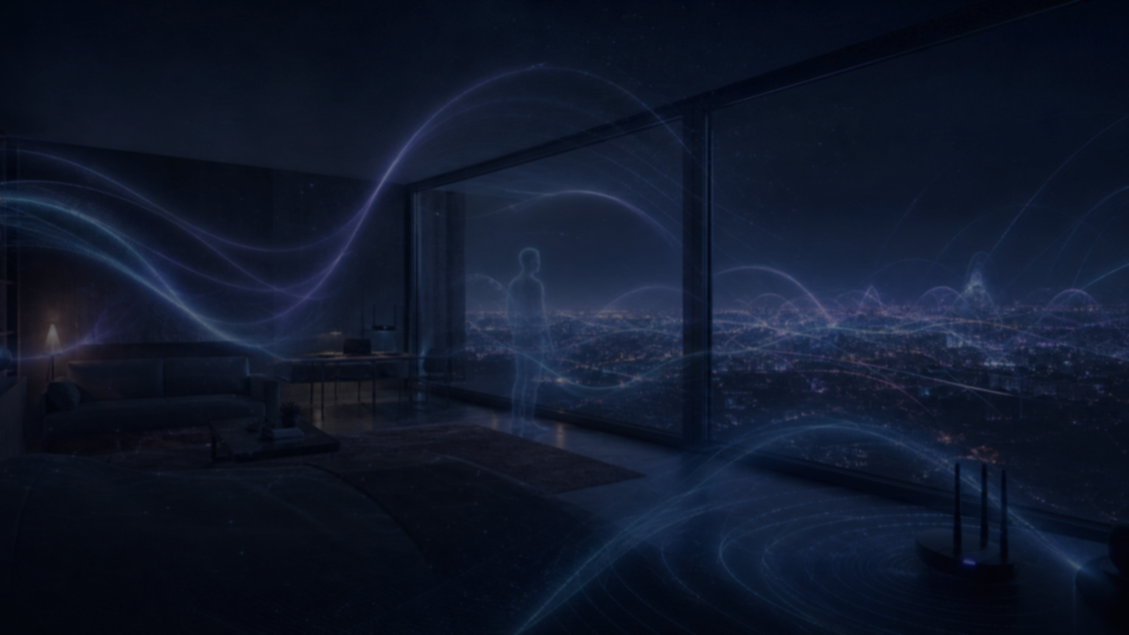
09 — IMPACT & FUTURE
Why this matters — and what comes next
IMPACT
FUTURE
Camera-free sensing
Reliable fall detection
Works where cameras are unwanted
Sudden-drop + long-stillness events
Privacy by design
Multi-room sensing
No images, no audio, no identity
Several links, one coordinated model
Low-cost hardware
Stronger rejection
ESP32 boards — no specialist RF gear
Fans, doors, pets, moving furniture
No wearables
TinyML on the ESP32
Nothing to wear, charge or remember
Inference on the board, not the laptop
Edge / near-device processing
Adaptive calibration
Raw CSI is processed locally
Self-tuning to each new environment
Scales room by room
CSI sensing is established research. Our contribution is a practical, low-cost implementation with explicit non-human rejection.
Add links, reuse the same pipeline
WiFi is everywhere. Why not use it to sense the environment — without seeing it?
WiFiSense · Sense movement. Not identities.
WiFiSense · Privacy-Preserving Human Activity Detection Using WiFi CSI
10 / 10
Notes:
Impact on the left, roadmap on the right. Say plainly that WiFi sensing itself is established research — our contribution is a low-cost implementation with explicit non-human rejection.
Close on the quote: WiFi is everywhere. Why not use it to sense the environment — without seeing it?

