Slide 1
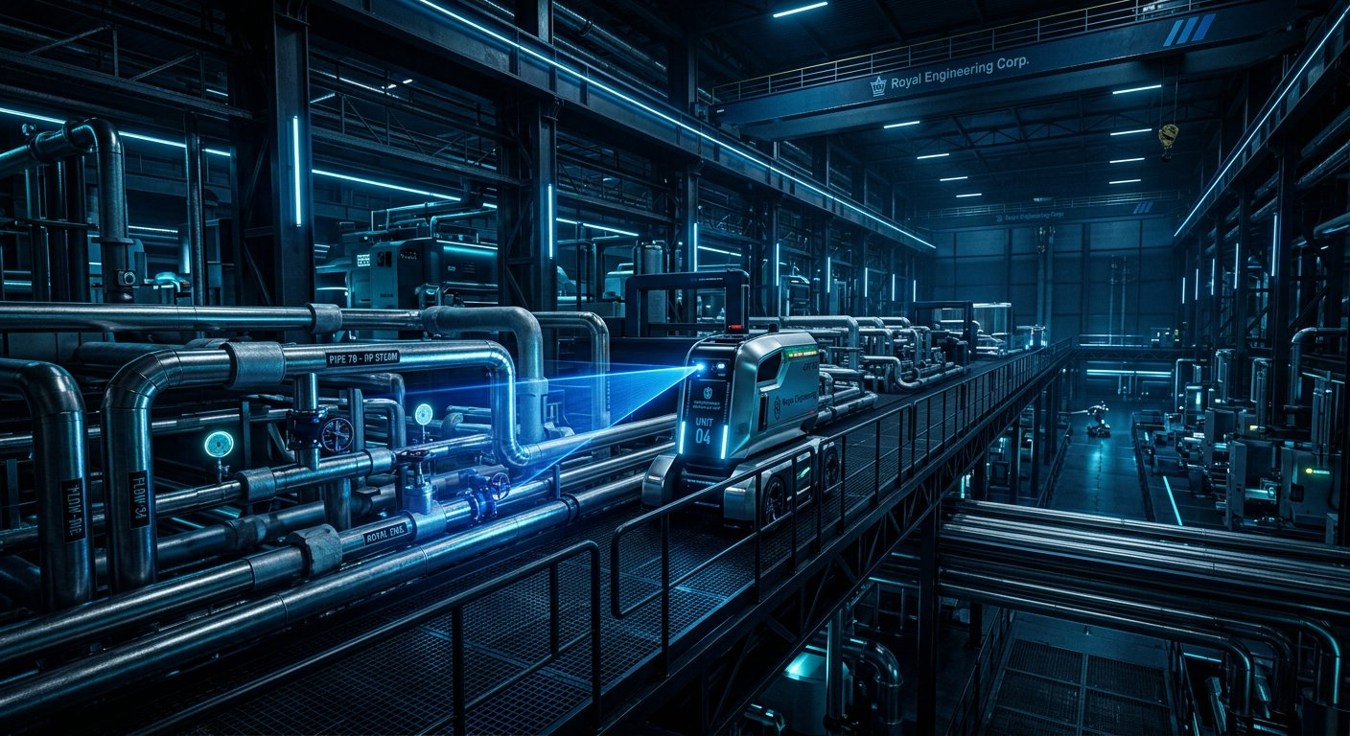
INDUSTRIAL PROJECT • 2026 • LEAKGUARD • EDGE AI
● LEAKGUARD • EDGE AI • LoRa
LeakGuard
Autonomous Edge-AI Robot
for Compressed-Air Leak Detection
★ PREMIUM
Smart Industrial Energy Monitoring System
🤖 AUTONOMOUS
🧠 EDGE AI
⚡ 30% SAVING
Self Navigation
Local Processing
Energy Efficient
PROJECT TEAM • CCE & MECH
Team Lead: Sachin.N — CCE Dept
Member 1: Rithish.P — CCE Dept
Member 2: Dharun.V — MECH Dept
01

Slide 2
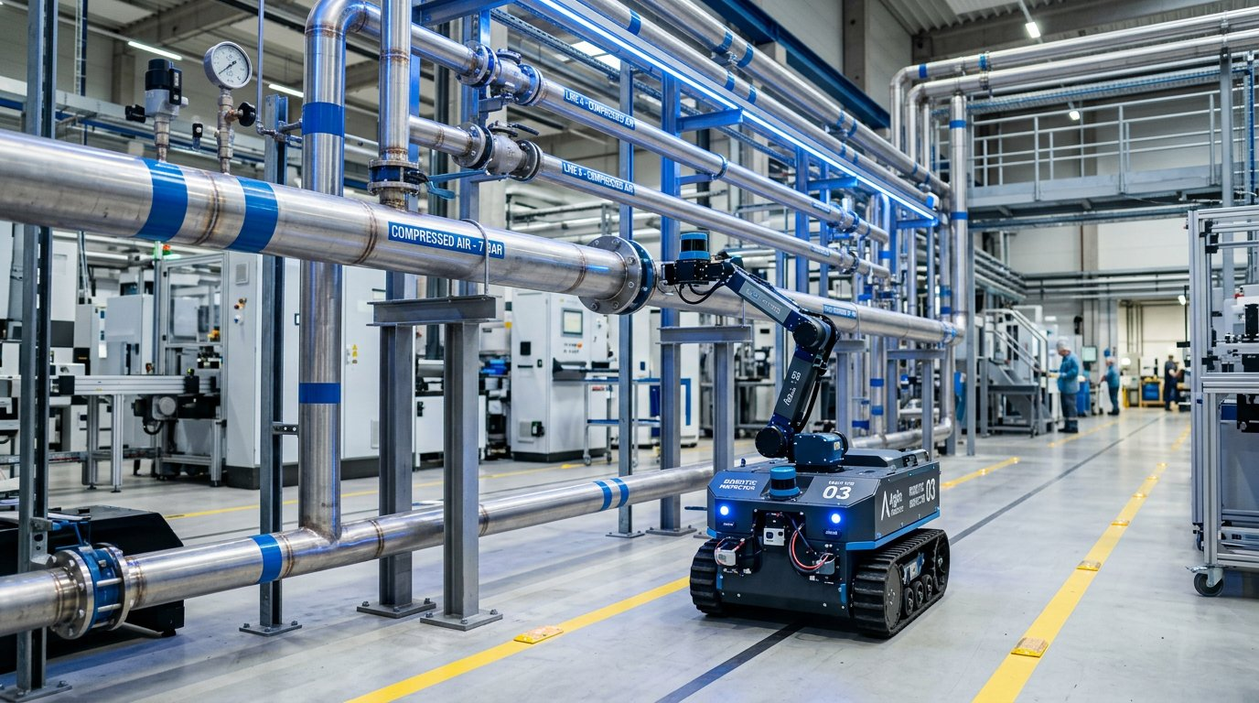
02 • INTRODUCTION • LEAKGUARD
Introduction
✦ Why This Project Matters
● Compressed air is widely used in industries.
● Small pipeline leaks waste huge energy.
● Leaks increase operating costs by 30%.
● Our LeakGuard robot scans automatically.
● It detects leaks in real time.
● Edge AI processes data locally & fast.
● Saves energy, cost and manpower.
💡 DID YOU KNOW?
A 3mm leak can waste ₹2.5 Lakhs / year in energy cost!
📷 LeakGuard Robot Scanning Industrial Pipeline
02

Slide 3
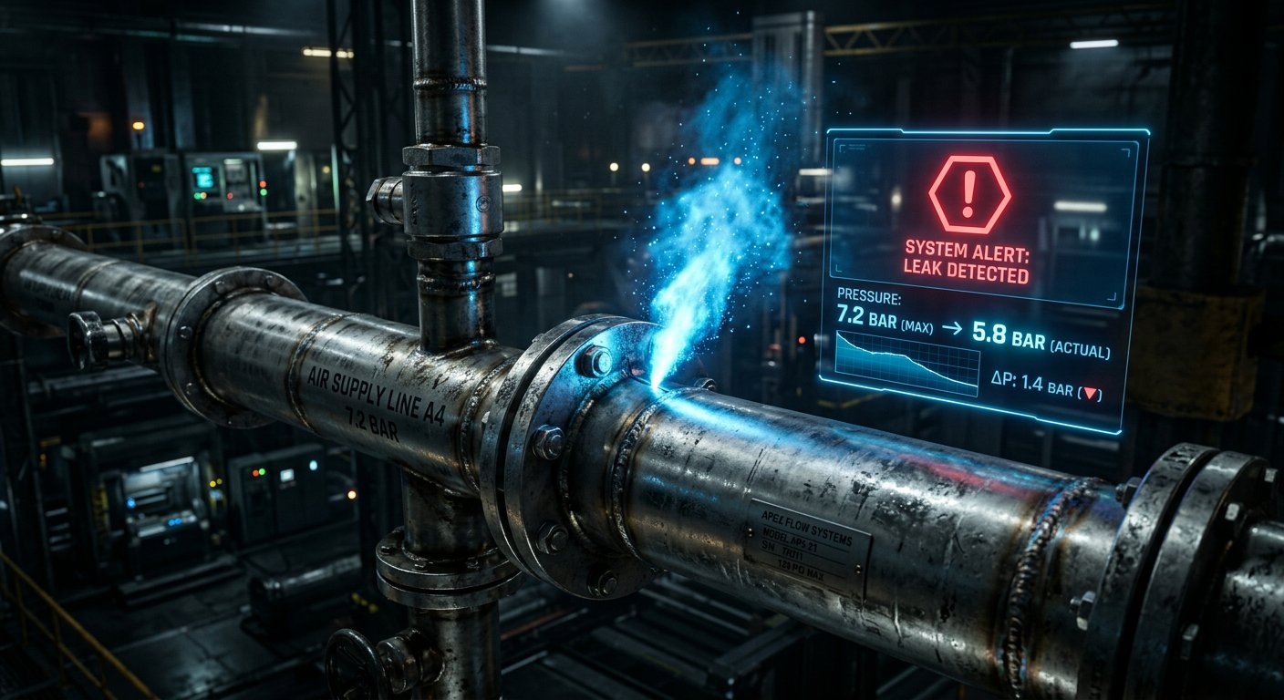
03 • PROBLEM STATEMENT • CRITICAL ISSUES
Problem Statement
High
Critical
⚠ LEAK DETECTED
⏱ TIME CONSUMING
👁 HIDDEN LEAKS
Manual inspection
is slow & inefficient.
Small leaks stay
unnoticed for months.
→ Impact: High
→ Impact: High
Major
₹₹₹
📡 NO 24/7 MONITORING
⚡ 30% ENERGY LOSS
Continuous manual
monitoring is impossible.
Leaks increase power
& maintenance cost.
→ Cost: Very High
→ Cost: Very High
03

Slide 4
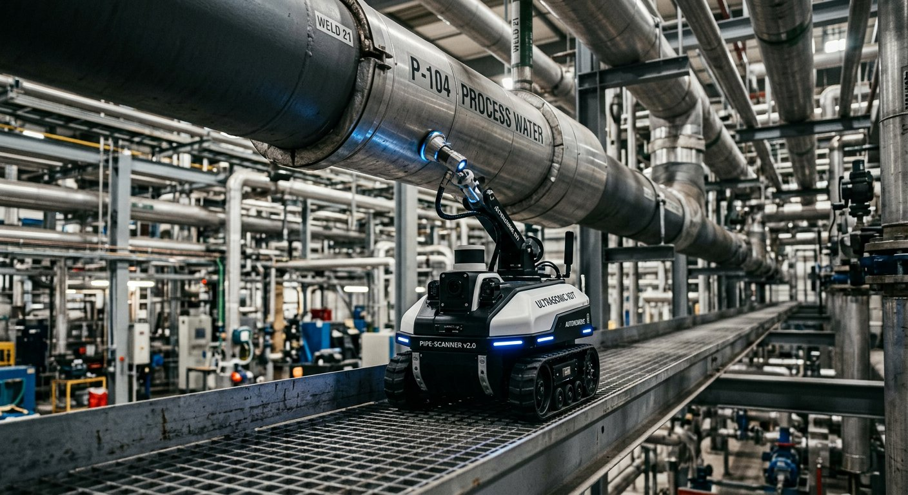
04 • OBJECTIVE • LEAKGUARD GOALS
Objective / Aim
✦ Our Main Goals with LeakGuard
🤖 Detect leaks automatically
📍 Locate exact leak position
👷 Reduce manual inspection
🚨 Faster maintenance alerts
⚡ Reduce energy wastage
🏭 Smart industrial maintenance
100% Auto
± 10cm Accuracy
90% Less Effort
< 2 Sec Alert
30% Cost Saving
Industry 4.0
🤖 LeakGuard Autonomous Inspection in Action
✓ Expected Result: 95% Leak Detection Accuracy with Edge AI
04

Slide 5

05 • SYSTEM ARCHITECTURE • LEAKGUARD FLOW
Flow Chart / Block Diagram
🤖 ROBOT BRAIN
🏭 Compressed-Air Pipeline
📡 LoRa LINK
Autonomous
Line Follow
🤖 Line-Following Robot
Long Range
5km Wireless
STM32 + IR
🎙 Ultrasonic / Acoustic Sensor
433MHz
🎙 SENSOR EAR
🧠 Edge AI Processing
💻 DASHBOARD
Ultrasonic
40kHz Detection
Live Monitoring
Web + Mobile
❓ Leak Detected?
High Sensitivity
📍 Location Recorded
Real-time
🧠 EDGE AI
📡 LoRa / Wireless Comm
🚨 ALERT SYSTEM
TinyML Model
Local Inference
Fast Action
Buzzer + SMS
💻 Gateway / Dashboard
< 100ms
🚨 Maintenance Alert
Instant
05

Slide 6
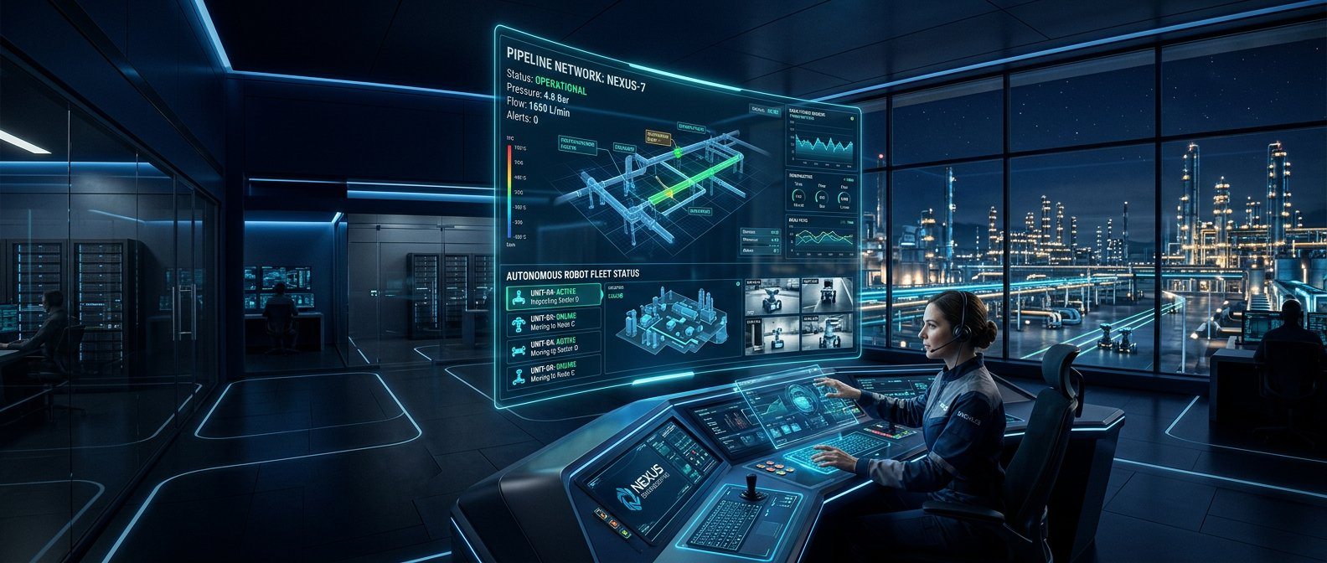
06 • CONCLUSION • LEAKGUARD IMPACT
Conclusion
✦ Key Achievements
✦ LEAKGUARD PROJECT
✓ Autonomous detection reduces manual effort by 90%.
✓ Edge AI enables fast local decisions in <100ms.
✓ Early leak detection saves 30% energy and cost.
✓ LeakGuard can expand for smart Industry 4.0 maintenance.
LeakGuard
THANK YOU
Questions & Discussion
Team Lead: Sachin.N (CCE)
Rithish.P (CCE) • Dharun.V (MECH)
95%
Accuracy
<2s
Alert Time
30%
Energy Save
QR
CODE
LeakGuard | Autonomous Edge-AI Robot for Compressed-Air Leak Detection | Team Lead: Sachin.N (CCE) | Rithish.P (CCE) | Dharun.V (MECH)
Smart Industrial Energy Monitoring System • Industry 4.0 • Edge AI • LoRa Communication
06

