Slide 1
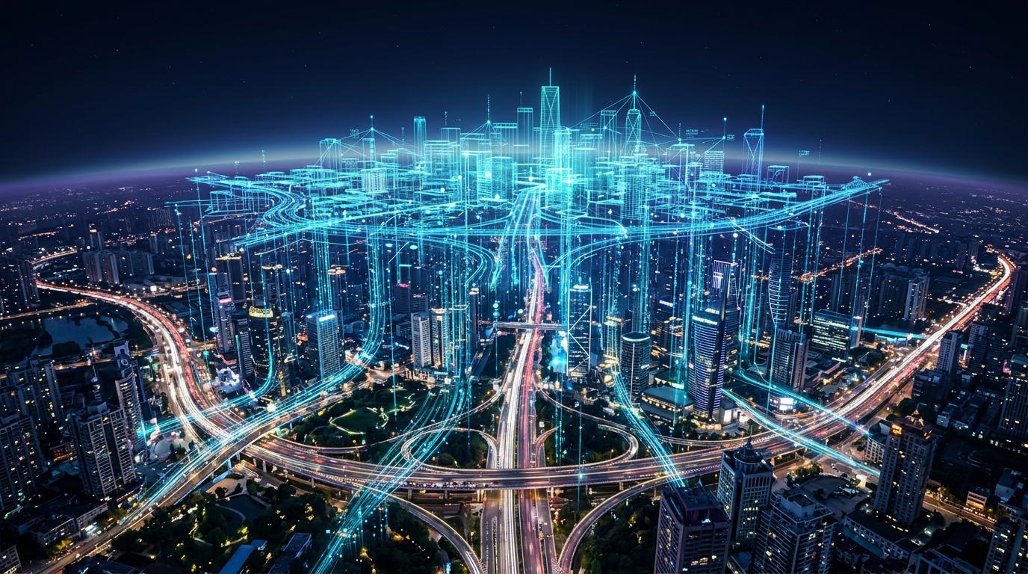
NATIONAL HACKATHON · SMART CITIES TRACK
CityVerse AI
A Living Digital Twin for Smarter, Safer & Sustainable Cities
SEE THE CITY · PREDICT THE FUTURE · ACT BEFORE IT HAPPENS
Notes:
Good morning judges. Every minute, our cities generate millions of data points — yet the people running them still can't see the whole picture. This is CityVerse AI — a living digital twin of an entire city. It watches every signal in real time, predicts what happens next, and helps authorities act before problems occur. Over the next six minutes, I'll show you how a city learns to see itself. (Click once to build the scene.)

Slide 2
THE PROBLEM
Cities Have Data. But Not a Unified View.
WHAT CITIES FACE EVERY DAY
WHAT PLANNERS ACTUALLY HAVE
Traffic Congestion
gridlock decides the morning
Traffic Control
Pollution Board
own portal
PDF reports
Air Pollution
AQI spikes go unnoticed
Energy Waste
Power Utility
Disaster Mgmt
consumption blind spots
monthly CSV
phone lines
Aging Infrastructure
failures found too late
⚠ SIX SYSTEMS. ZERO CONVERSATION.
Emergency Delays
when minutes decide lives
“City data exists in silos — making proactive planning nearly impossible.”
CITYVERSE AI · SMART DIGITAL TWIN PLATFORM
02 / 12
Notes:
Here's the problem. A city's traffic, pollution, energy, infrastructure and emergency data all live in different departments, different dashboards, different formats. Traffic control doesn't talk to the pollution board; the power utility doesn't talk to disaster management. So decisions are slow, reactive, and too late. City data exists in silos — and in a siloed city, proactive planning is nearly impossible. That's exactly the gap CityVerse attacks.

Slide 3
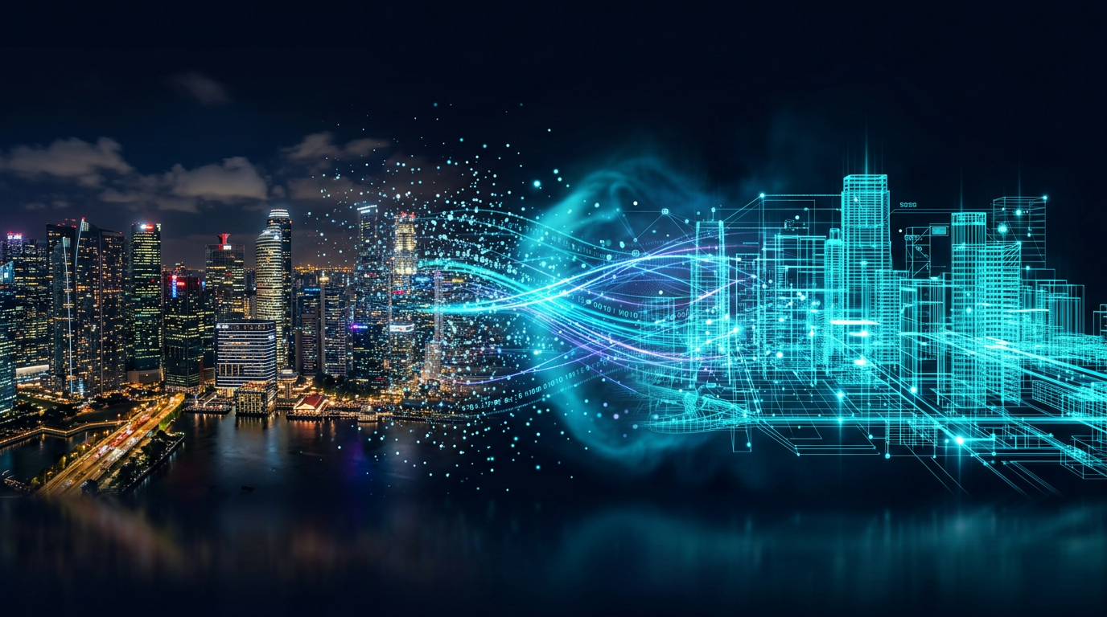
OUR VISION
What If a City Could See Itself?
Physical City
Live Digital Twin
AI Predictions
Better Decisions
streets · signals · sensors
a real-time virtual replica
see the next 30 minutes
act before it happens
One living model. Every signal. Zero guesswork.
Notes:
So we asked a simple question — what if a city could see itself? CityVerse AI mirrors the physical city into a live digital twin, layer by layer. IoT signals stream in, the twin updates continuously, AI looks ahead, and planners finally get decisions instead of just data. Physical city, to live twin, to predictions, to action — one continuous learning loop. That's our vision.

Slide 4
THE SOLUTION
Meet CityVerse AI
Live Digital City
01
the city, mirrored in real time
Emergency Simulation
Infrastructure Health
05
02
rehearse any scenario
roads & bridges, self-reporting
Energy & Pollution
Traffic Intelligence
04
03
consumption & AQI analytics
flow simulated and eased
CITYVERSE AI · SMART DIGITAL TWIN PLATFORM
04 / 12
Notes:
Meet CityVerse AI — five modules around one living model. At the core, the Live Digital City: a real-time replica of every road, building and signal. Around it, Infrastructure Health monitoring, Traffic Intelligence, Energy and Pollution analytics, and Emergency Simulation. Every module reads from the same twin — so a change anywhere is visible everywhere. One city, one model, five superpowers. Now let me show you the engine underneath.

Slide 5
SYSTEM ARCHITECTURE
From Sensors to Smart Decisions
Traffic cameras
01
IoT Sensor Network
DESIGNED FOR THE REAL WORLD
10k+ live data points, every second
Air quality sensors
≈ 1 s
Smart meters
02
GIS + Real-Time Data
every signal pinned to the map
sensor → decision latency
Road vibration sensors
03
AI Analytics Engine
Modular microservices
Weather feeds
swap any layer without downtime
patterns · predictions · anomalies
Open standards
GeoJSON · REST · WebSockets everywhere
04
Digital Twin Engine
Ward → megacity
a live, queryable simulation
same codebase, linear scale-out
05
Governance Dashboard
insight → one-click action
CITYVERSE AI · SMART DIGITAL TWIN PLATFORM
05 / 12
Notes:
The architecture is a five-stage pipeline. IoT sensors — traffic cameras, air-quality monitors, smart meters, road-vibration sensors and weather feeds — stream into a GIS layer that geotags everything in real time. The AI engine finds patterns and makes predictions. The digital twin engine turns those into a living simulation. And the governance dashboard turns insight into one-click decisions. It's fully modular — every layer is swappable and scalable.

Slide 6
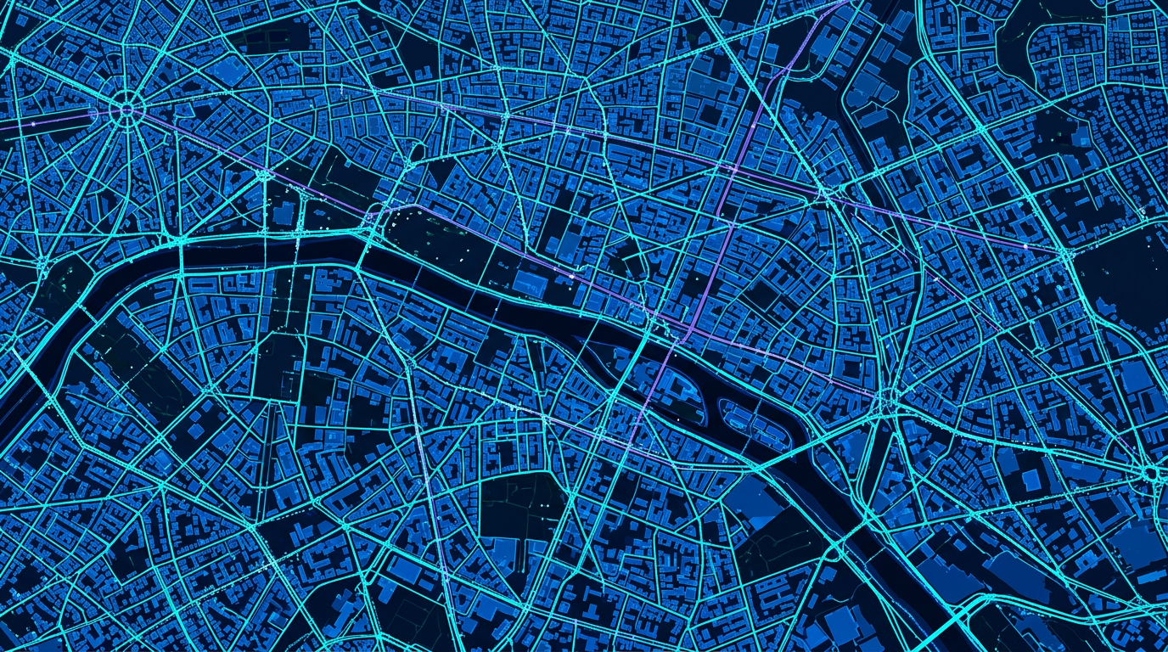
MODULE 01 — LIVE DIGITAL CITY
A City That Updates in Real Time
TRAFFIC
Moderate
avg 24 km/h downtown
AIR QUALITY
AQI 82
moderate · trending down
ENERGY LOAD
74%
peak expected 19:00
ROAD HEALTH
Good
3 minor flags open
● SECTOR GRID 7 · ALL SYSTEMS NOMINAL
CITYVERSE AI · SMART DIGITAL TWIN PLATFORM
06 / 12
Notes:
This is the live digital city — the command-center view. Every road, building, hospital, school and signal, mapped on a real GIS canvas, with sensors streaming in real time. Check the vitals on the right: traffic is moderate, AQI at 82, energy load at 74 percent, road health good. The moment anything changes in the real city, the twin updates — sub-second. Nobody waits for a monthly PDF ever again.

Slide 7

MODULE 03 — AI ENGINE
Don't Just Monitor. Predict.
TF
Traffic Foresight
94%
Congestion predicted 30 minutes before it forms
CONFIDENCE
IN
Infrastructure Watch
89%
Road & bridge fatigue flagged before failure
CONFIDENCE
EN
Environment Outlook
91%
Tomorrow's pollution hotspots, mapped today
CONFIDENCE
Forecasting ML
Anomaly AI
Vision AI
Models retrain nightly on live city data — the twin gets smarter every day.
CITYVERSE AI · SMART DIGITAL TWIN PLATFORM
07 / 12
Notes:
But monitoring isn't enough. CityVerse doesn't just watch — it predicts. Traffic models forecast congestion thirty minutes before it forms. Infrastructure models detect stress signatures on roads and bridges before they fail. Environmental models flag tomorrow's pollution hotspots today. Every prediction carries a confidence score, so planners know what to trust. You fix the problem on Tuesday — instead of apologizing for it on Friday.

Slide 8
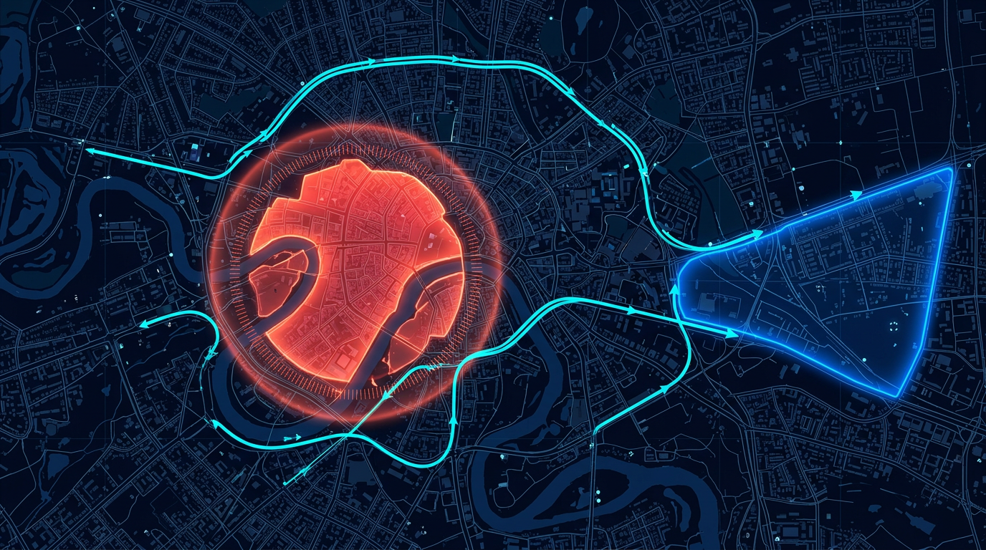
MODULE 05 — SIMULATION
Test Emergencies Before They Happen
Incident
● LIVE SIM · FLOOD, SECTOR 4
simulated flood hits Sector 4
AI Analyzes
exposure, risk & impact in seconds
Traffic Reroutes
signals adapt, roads reopen
Fastest Route
units dispatched on optimal path
Full Impact View
authorities see the outcome
“Plan the response before the real event occurs.” — that's the point of a twin.
CITYVERSE AI · SMART DIGITAL TWIN PLATFORM
08 / 12
Notes:
Here's where it gets powerful: cities can test emergencies before they happen. We simulate a flood in Sector 4 — the AI instantly analyzes exposure, reroutes traffic around the danger zone, computes the fastest path for every emergency vehicle, and shows authorities the complete impact — before a single drop of rain falls. You don't rehearse disaster response during the disaster. You plan it in the twin, safely, as many times as you need.

Slide 9
MODULE 05+ · COMMAND CENTER
One Screen. The Entire City.
CITYVERSE COMMAND CENTER — LIVE FEED
TRAFFIC HEATMAP
ENERGY · TODAY
74%
AIR QUALITY TREND
AQI 82
AI RECOMMENDATION
82
ALERTS
Reroute traffic from Sector 4 — reduce congestion by 18%.
APPLY
INFRA
HEALTH
B+
Flood sim · S4
AQI spike · East
CITYVERSE AI · SMART DIGITAL TWIN PLATFORM
09 / 12
Notes:
Everything converges on one screen. Live traffic heatmap, energy consumption, air-quality trends, infrastructure health, and active alerts. But the star feature is the AI recommendation engine — it doesn't just show problems, it suggests actions: 'reroute traffic from Sector 4, reduce congestion by eighteen percent.' One click on Apply, and the city adapts. That is what data-driven governance actually looks like.

Slide 10
UNDER THE HOOD
Built for Scale
LAYER 01
LAYER 02
LAYER 03
LAYER 04
LAYER 05
Frontend
Backend
AI Engine
Data
Cloud
React + glassmorphic UI
Node.js · Python services
Forecasting ML (LSTM)
PostgreSQL + PostGIS
Containerized deploy
Mapbox GL / GIS canvas
REST + WebSocket APIs
Anomaly detection
Time-series sensor store
Autoscaling compute
WebGL 3D twin view
Stream ingestion
Traffic vision models
GeoJSON pipelines
Edge-ready nodes
Sub-second sync
Modular by design
Hackathon-proven
twin never lags reality
every layer swappable
prototype → city scale
CITYVERSE AI · SMART DIGITAL TWIN PLATFORM
10 / 12
Notes:
Under the hood — a stack realistic for a student team, yet genuinely scalable. React with Mapbox GL renders the twin in the browser. Node and Python services ingest streams over REST and WebSockets. The AI layer runs LSTM forecasting and anomaly detection. PostGIS stores the geography; a time-series store handles the sensor firehose. It all ships containerized to the cloud — and every layer is modular and swappable.

Slide 11
WHY IT MATTERS
Better Cities. Better Lives.
20–30%
15–25%
10–20%
EARLY
Faster incident response
Smoother traffic flow
Energy optimization
Infra risk detection
when seconds decide outcomes
modeled congestion relief
less waste · lower bills
fix it before it fails
WHO BENEFITS
Citizens
Urban Planners
Emergency Services
City Government
safer, cleaner commutes
simulate before building
minutes that save lives
budgets spent wisely
CITYVERSE AI · SMART DIGITAL TWIN PLATFORM
11 / 12
Notes:
What does this mean in numbers? Published smart-city studies show platforms like this deliver 20 to 30 percent faster incident response, 15 to 25 percent better traffic flow, and 10 to 20 percent energy savings — plus early detection of infrastructure risks before they become failures. Citizens get safer, cleaner commutes. Planners simulate before they build. Emergency services save the minutes that save lives. And governments spend every rupee smarter.

Slide 12
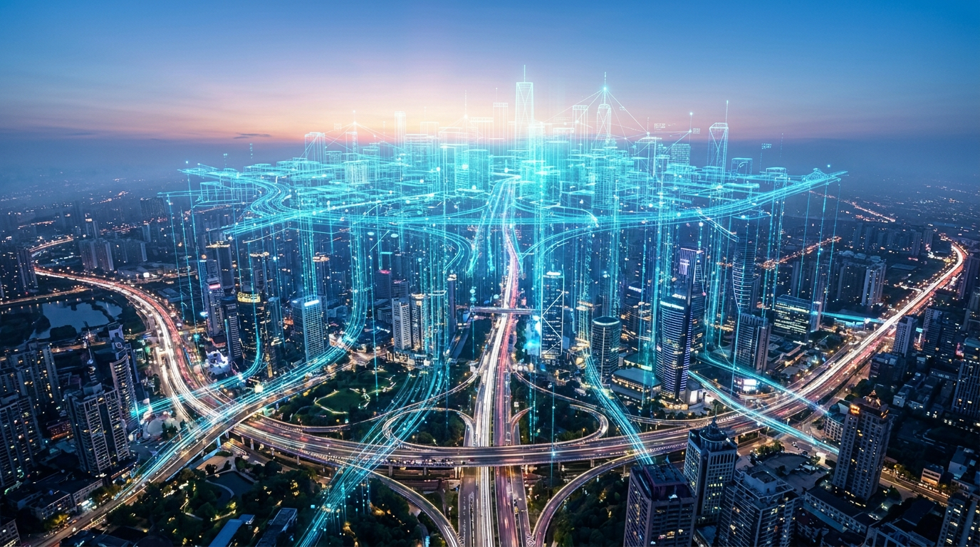
“
The smartest city isn't the one with the most sensors.
It's the one that understands what they're saying.
CityVerse AI
SEE THE CITY · PREDICT THE FUTURE · ACT BEFORE IT HAPPENS
THANK YOU
Notes:
We'll leave you with this. The smartest city isn't the one with the most sensors — it's the one that understands what they're saying. CityVerse AI gives cities that understanding: see the city, predict the future, act before it happens. We're a student team with a working blueprint and a scalable prototype — and we'd love to build this for real. Thank you. We welcome your questions.

