Slide 1
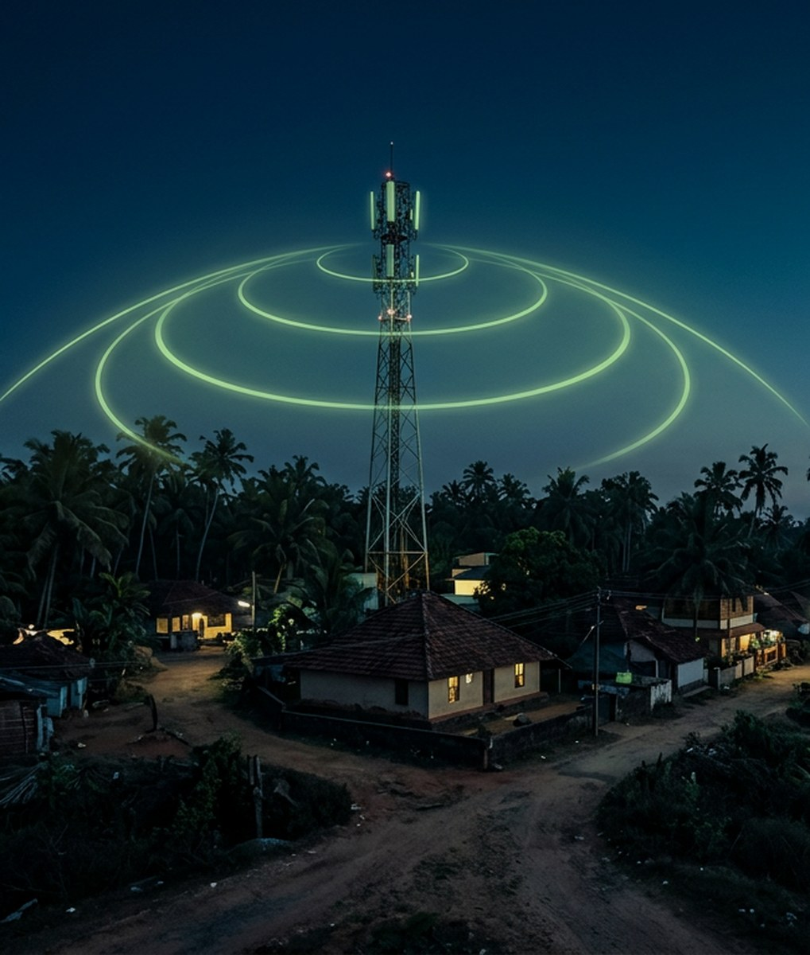
IEEE AP-S IDEATHON 2026
TRACK 2 · UN SDGs
SignalShield
Predict network blackouts
before disasters strike.
FREE SOFTWARE
DATAPULSE
SRI SAIRAM ENGINEERING COLLEGE
TEAM LEAD
TEAM MEMBERS
N.Sachin
N.Sachin · NithyaSri S · Preethika S
Notes:
We are team DATAPULSE. SignalShield helps us see which villages may lose mobile service in a disaster.

Slide 2
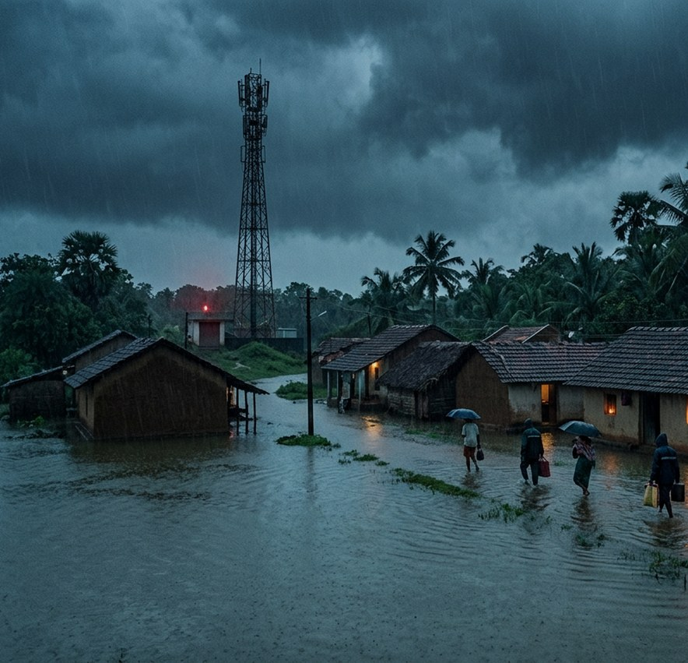
The Problem
Storms and floods can
knock out mobile towers.
Families may lose calls, help,
and warning messages.
We need to know which villages
may go offline before danger arrives.
WHY IT MATTERS
A late warning gives families less time to act.
Notes:
Storms can knock out towers. Families may lose calls, help, and warnings. A late warning gives people less time to act. We need to predict weak areas before danger arrives.

Slide 3
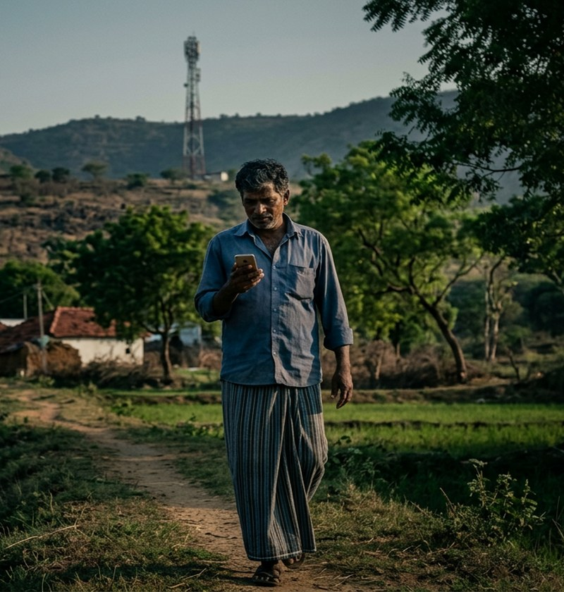
Why Current Apps Fall Short
Existing apps
SignalShield
OpenSignal · Speedtest
Measure after people
walk
Predict outage risk early
Need users in
dead zones
Use free public data
No suggested fix
Suggest one relay site
Signal today is not a forecast for tomorrow.
Notes:
Existing apps measure signal after people walk around. They need users in weak areas. SignalShield uses public data to predict which villages may lose service before a storm.

Slide 4
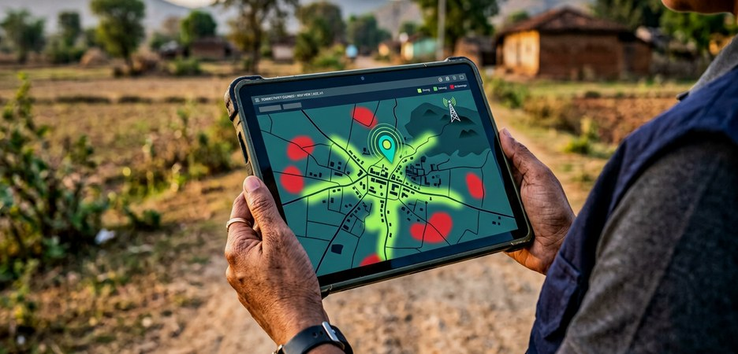
Our Solution
01
02
03
Choose a village
Switch off one tower
Tool picks one relay spot
on the map
See red zones
Weak areas turn green
WHAT YOU SEE
Villages that lose signal
People affected by each outage
Best place for one relay
Compare normal and disaster coverage.
Notes:
Choose a village, then switch off a tower in the model. The map shows villages that lose signal, people affected, and one good relay location. Compare normal and disaster coverage.

Slide 5
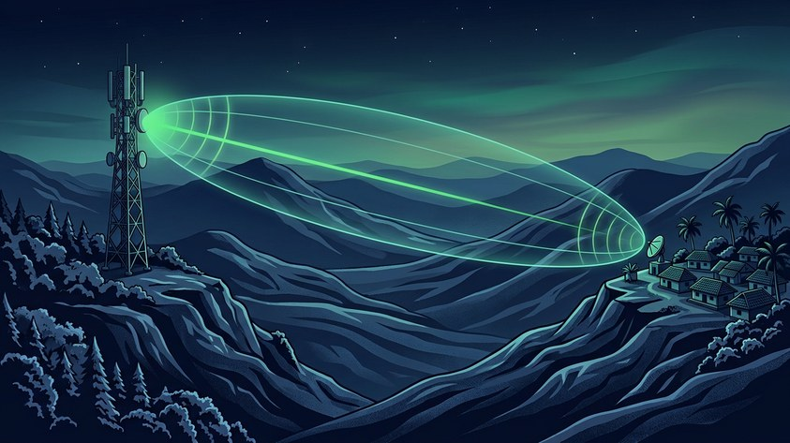
RF + Tech: How It Works
Free terrain + tower data
RF calculation
Coverage map
Disaster Mode
Relay suggestion
Hills and distance can weaken radio signals.
Path loss
Line of sight
Fresnel zone
Antenna height
Gain
Signal weakens
over distance
Clear path between
antennas
Keep space clear
around the path
Higher antennas clear
more obstacles
Focus signal
toward the village
Python
Leaflet map
SRTM elevation
OpenCellID
WorldPop
Notes:
Hills and distance can weaken radio signals. Path loss is signal drop over distance. Line of sight is a clear path. The Fresnel zone is space around that path. Height and gain help the signal reach further.

Slide 6
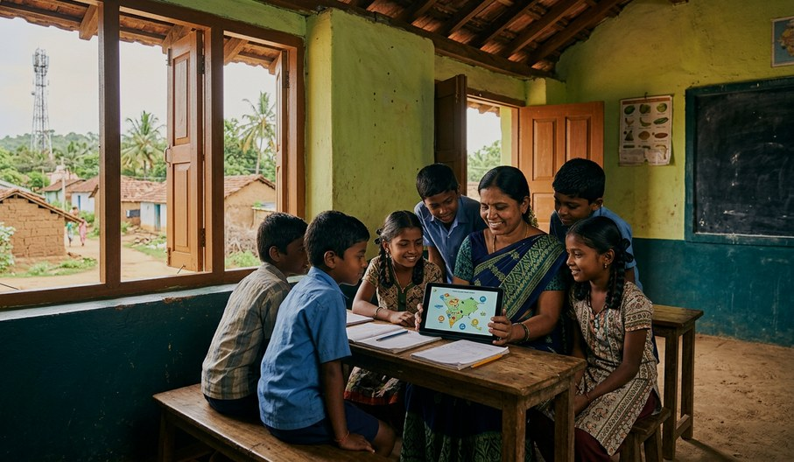
Impact for People and Places
SDG 9
SDG 11
Strong network
links
Safer villages
SDG 13
SDG 4
Ready for extreme
weather
Learning stays
connected
Better coverage planning supports warnings and learning.
PILOT VILLAGE
PEOPLE COVERED
RELAY COST
[name]
[number]
Rs [amount]
Notes:
SignalShield supports strong networks, safer villages, climate readiness, and learning. Better coverage planning helps warnings reach people. A pilot will report the village, people reached, and relay cost.

Slide 7
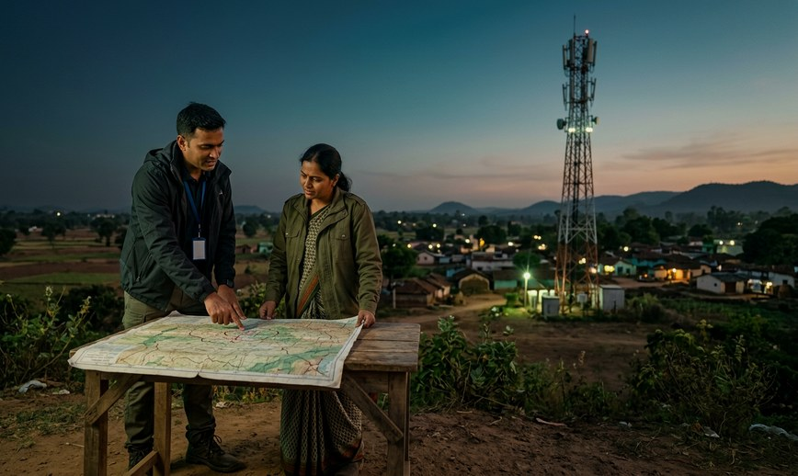
Roadmap and Ask
PHASE 1
Prototype in one village
PHASE 2
Pilot with a district disaster
management authority
PHASE 3
Scale to flood-prone districts
across India
Start small. Measure results. Then expand.
Thank you
ASK
Pilot partner + data access
EMAIL
itxsachin6729@gmail.com
Notes:
We will test one village, work with a district disaster management authority, and then scale to flood-prone districts. Start small, measure results, then expand. We seek a pilot partner and data access.

