Slide 1

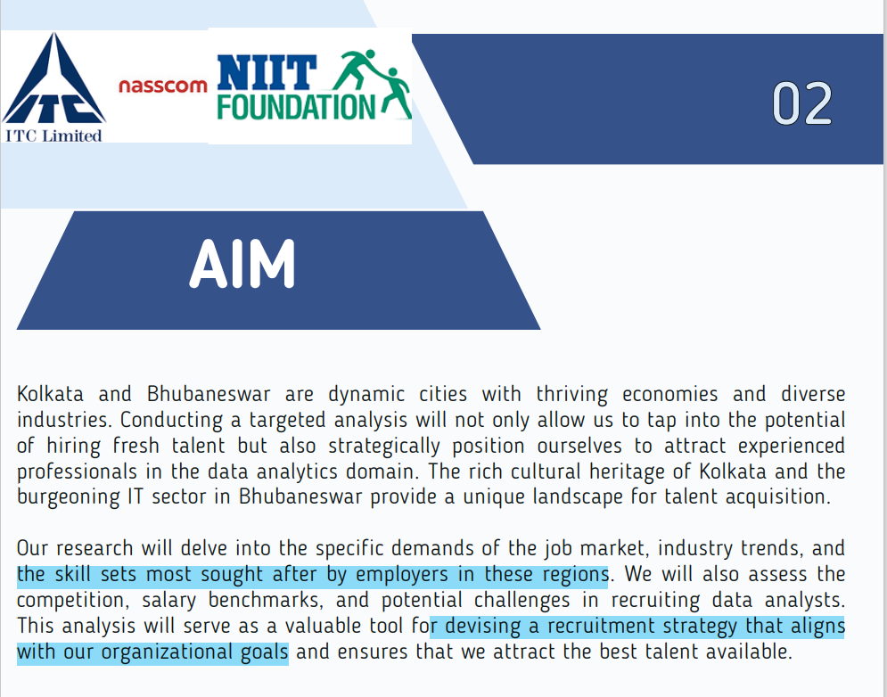



Slide 2
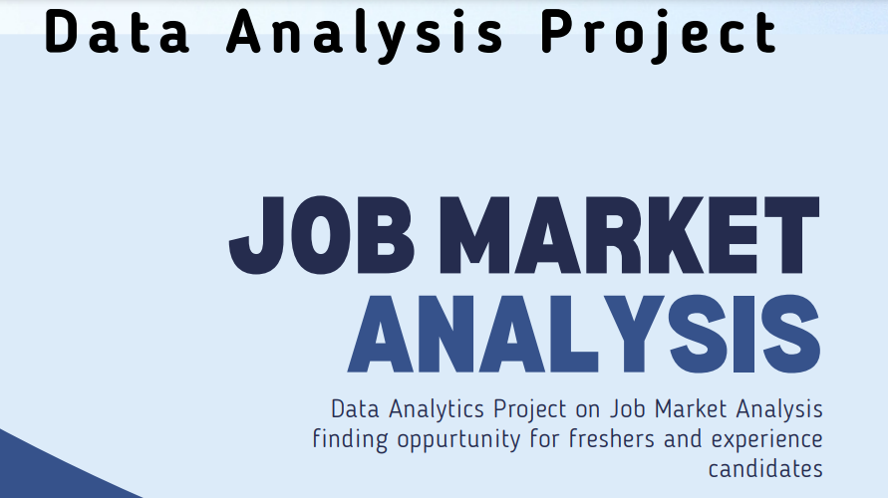

Slide 3
Data Collection : For this project, our scope includes exploring job listings
on prominent platform such as Naukri.com
Our focus extends to a comprehensive collection of data pertaining to various job categories.
Additionally, we will gather information related to the industrial landscape in the Kolkata

Slide 4





TECHNOLOGY USED IN THIS PROJECT
Web scrapping
excel
SQL
DATE &TIME
MS POWER POINT
WEB SCRAPPING.
EXCEL was used for preprocessing, filtering and cleaning the data
Group by function is used for the project
This data was collected on 13th jan 2024.
FOR VISUALISATION
\
This Photo by Unknown Author is licensed under CC BY-NC

Slide 5

DIFFERENT DATA RELATED JOBS

Slide 6

DATA DOMAIN JOBS IN KOLKATA
Data analyst/business/financial/market analyst,business analyst
Data scientist/sr/lead scientist/ml scientist
Data engineer/Hadoop engineer
/big data engineer

Slide 9


Slide 10

MARKET SHARE
OF EACH DOMAIN IN DATASCIENCE

Slide 12

OPPORTUNITIES
FOR
FRESHERS

Slide 15

MAX
MINIMUM SALARIES OFFERED

Slide 16
Job Title | MAX SALARY | MIN SALARY | COMPANY NAME(Max Salary)
Data analyst | 20 L P.A | 80,000 PA | Purview India Consulting And Services Llp( 20 L.P.A)
data scientist | 37.5 L P.A | 6 L P.A | Staffing Resources (REMOTE JOB)(37.5 L.P.A)
data engineer | 1 CR P.A | 2 L P.A | Data Science Director For Big 4 (Female Candidates only position)(1 CR P.A)

Slide 17

DATA DOMAIN JOB IN BHUBHANESWAR

Slide 22
consumer data
excel
Making pivot tables
LEADING THE WAY
Filtering over 2700row of data in excel and using various tools
100
Our research will delve into the specific demands of the job market, industry trends, and the skill sets most sought after by employers in these regions. We will also assess the competition, salary benchmarks, and potential challenges in recruiting data analysts. This analysis will serve as a valuable tool for devising a recruitment strategy
90
80
Naukri.com
70
60
Over 950 row of data have been collected for the market analysis
50
40
Taking out max and min salaries for various data domain jobs
30
20
10
presentation for visualisation
sql
Add text here.
excel
Add text here.

Slide 23
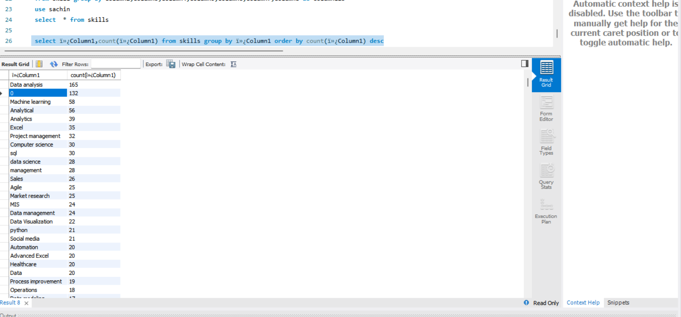

Slide 24
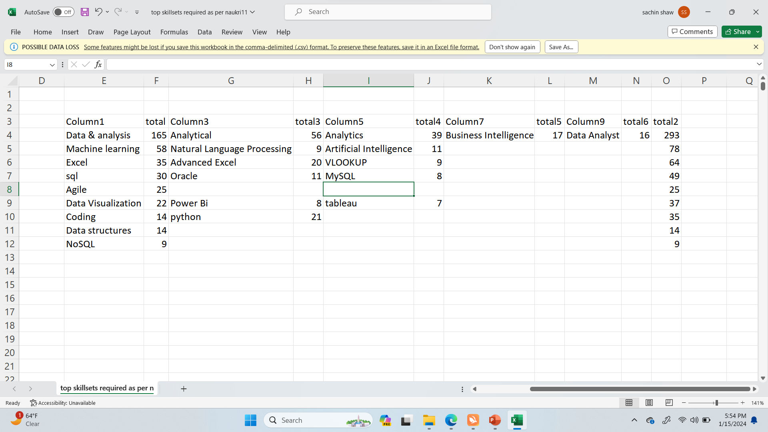

Slide 26
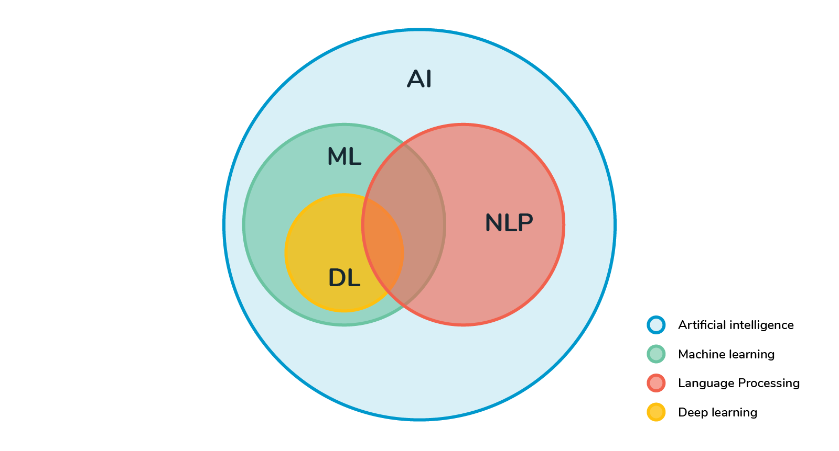
Tools required as per Recruiters
MOVING UP
ANALYTICAL SKILLS
Business growth is essential for any company that wants to remain competitive and successful in the long term.
With the right strategy, resources, and team in place, businesses can achieve the growth they need to reach their full potential and thrive in today's competitive marketplace.
EXCEL
.
SQL
AI ML
.

Slide 27
Conclusion/Way Forward
Prescriptive analysis
Market reversal
Less opportunity
There are more opportunity in data engineering job (hdfs haddop clustering big data spark.and decline in data analytical jobs earlier there was more job in this field
For fresher we have confined to few jobs data science domain.
Acquiring skillset
Adding this skillset in our resume
Add text here.
Internal trans
Add text here.
Add text here.

Slide 28
THANK YOU

