Slide 1

INTERNSHIP PRESENTATION · 2026
WEB DEVELOPMENT INTERNSHIP
ShopEase
IILM UNIVERSITY
GREATER NOIDA · U.P.
A Responsive E-Commerce Website
School of Computer Science
& Engineering
A one-month front-end development internship — building a multi-page e-commerce front-end with category filters, keyword search, a persistent cart, and a working contact form.
STUDENT
PROGRAM
ORGANIZATION
Sachin Kumar Gupta
B.Tech CSE
Codec Technologies Pvt. Ltd.
Roll No: 25SCS1003003494
3rd Semester · Batch 2025–2029
Web Developer Intern · 01 Aug – 05 Sep 2026

Slide 2
SLIDE 02 · ABOUT THE INTERNSHIP
Where I spent the summer.
A one-month, AICTE & ICAC approved Web Developer Internship run through the National Internship Portal — hosted by an ed-tech and skill-development organization that partners with Google for Education.
01 · ORGANIZATION
02 · THE PROGRAM
Codec Technologies Pvt. Ltd.
Web Developer
Internship
An ed-tech and skill-development organization that partners with the National Internship Portal (an initiative under the Ministry of Education) to deliver AICTE & ICAC approved internship programs to engineering and technology students across India.
ROLE
Web Developer Intern
In association with Google for Education, Codec conducts structured, mentor-guided internship programs in Web Development, Data Science, Machine Learning and Cybersecurity.
DURATION
1 Month · 01 Aug – 05 Sep 2026
FOCUS
Move from theoretical classroom knowledge to practical, project-based learning through real development workflows, coding best practices, and modern front-end frameworks.
4 domains
AICTE
Google
Web · Data · ML · Cyber
& ICAC approved program
For Education Partner
02 / 05

Slide 3
SLIDE 03 · PROJECT DESCRIPTION
What I built — and why.
PROBLEM STATEMENT
Small and first-time online sellers struggle to showcase products without investing in a heavy, expensive e-commerce platform. Beginner templates are often not responsive, lack a working cart, or do not let users search and filter efficiently.
The need: a lightweight, responsive e-commerce front-end that lets visitors browse, search, filter, and add items to a cart — with cart data persisting across reloads, without a heavy back-end.
01 · PROJECT OBJECTIVES
02 · SCOPE
Six concrete goals.
Front-end, intentionally.
01
Design a clean, responsive, multi-page website across desktop, tablet, mobile.
Scope is limited to the front-end of an e-commerce website — covering a home page, product listing with filter & search, product detail view, cart page, and contact page.
02
Dynamic product listing with category-based filtering & keyword search.
03
Functional cart: add, update quantity, remove items.
04
Persist cart data across page reloads using browser localStorage.
Static/local JSON simulates the catalogue rather than connecting to a live back-end or payment gateway, since the focus was front-end development, responsive design, and client-side logic.
05
Client-side validation of a working contact / enquiry form.
06
Semantic HTML, good coding practices, Git/GitHub version control.
A real back-end, database & payment gateway are flagged as natural extensions beyond the internship.
03 / 05

Slide 4
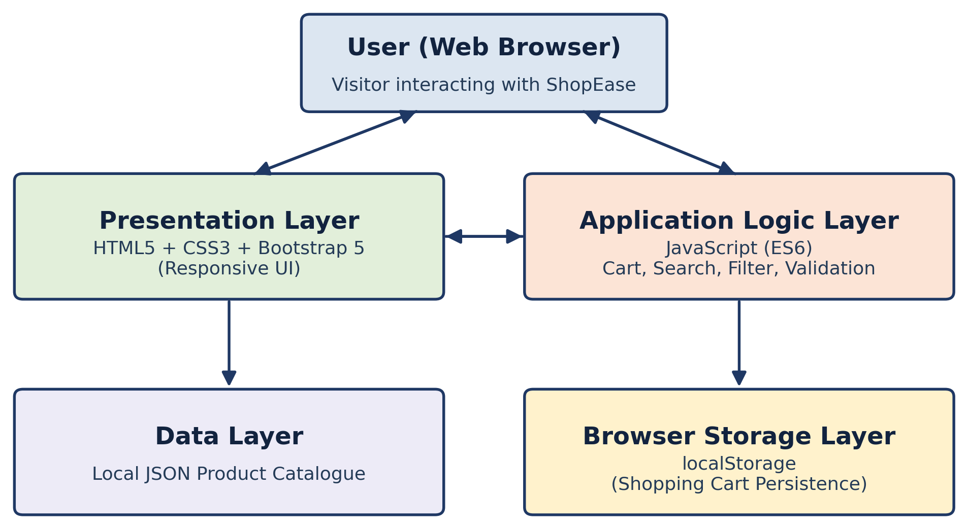
SLIDE 04 · TECHNOLOGIES & ARCHITECTURE
Stack & system architecture.
A simple client-side, layered architecture — built entirely on industry-standard front-end tools, versioned through Git/GitHub.
01 · TECH STACK
02 · SYSTEM ARCHITECTURE
Major technologies & tools.
Four layers, client-side.
Category | Technology | Purpose
Markup & Styling | HTML5, CSS3, Bootstrap 5 | Page structure & responsive UI
Scripting | JavaScript (ES6) | Cart, search, form validation
Data | JSON | Local product catalogue
Storage | localStorage | Persist cart across sessions
Version Control | Git & GitHub | Source-code management
Tools | VS Code, Chrome DevTools | Development & testing
Figure 4.1 — System Architecture of ShopEase
METHODOLOGY Requirement Analysis → Design → Development → Testing → Refinement & Deployment
04 / 05

Slide 5
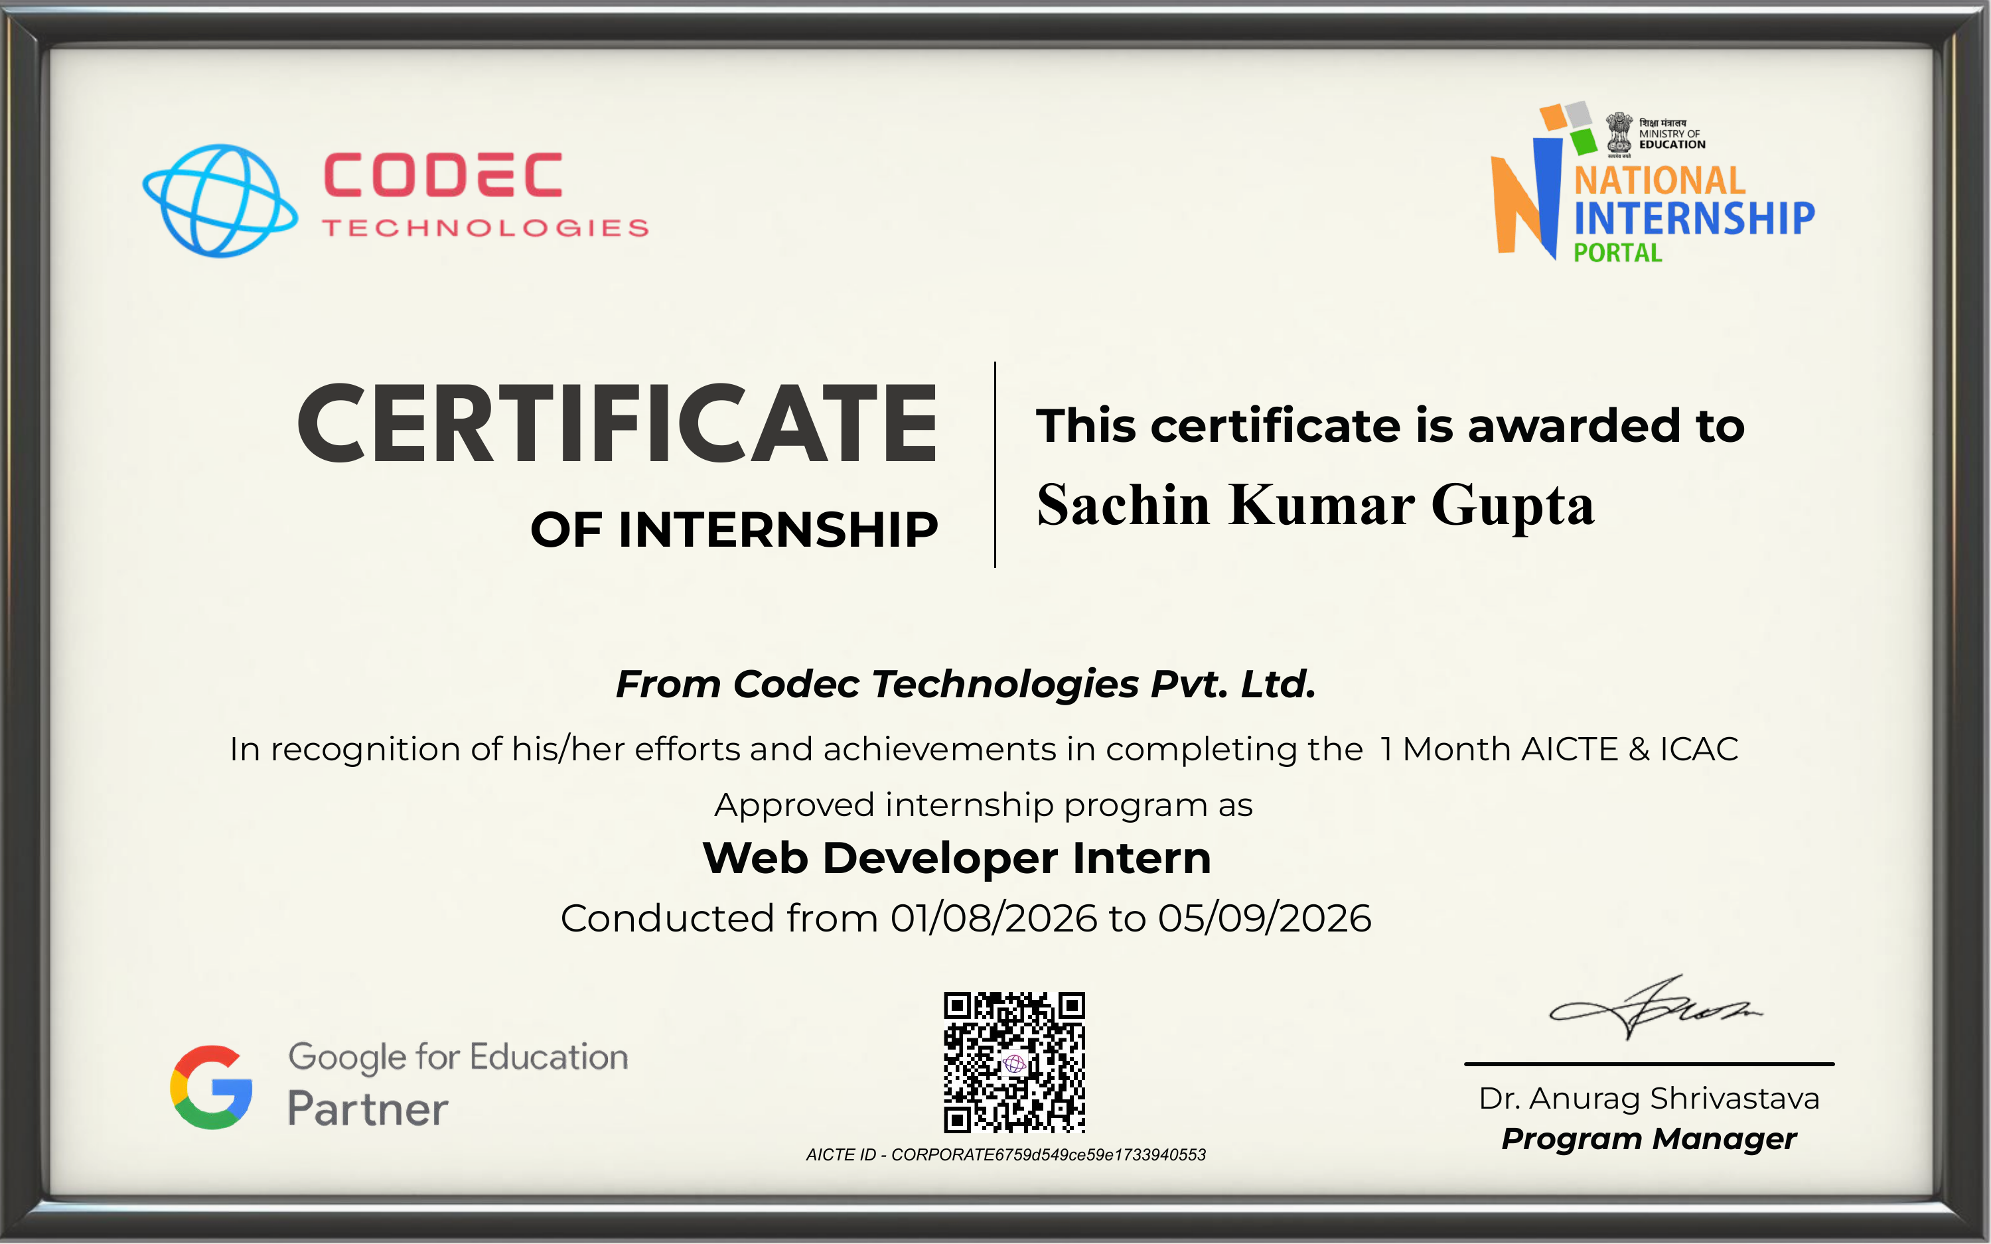
SLIDE 05 · OUTCOMES & CONCLUSION
What I take away.
Five concrete deliverables, hands-on proficiency in industry-standard tools, and a structured workflow that carries into the next project.
01
02
A fully responsive, multi-page e-commerce front-end that works across devices.
A working shopping cart with add / update / remove, persisted via localStorage.
03
04
A searchable and filterable product listing page.
Improved proficiency in HTML5, CSS3, Bootstrap, and JavaScript (ES6).
05
Thank you.
Hands-on Git/GitHub version control and a structured development workflow.
Open to questions, feedback & discussion.
05 / 05

