Slide 1

Date and Time in Python

Slide 2
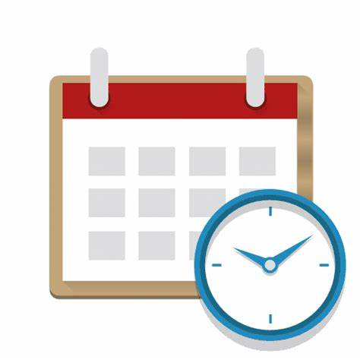
Date and time modules in Python!

Slide 3
Goals for next meeting

