Slide 1

Data Science & Machine Learning Logistic Regression
Senior Mentor- Sachin Saxena

Slide 2
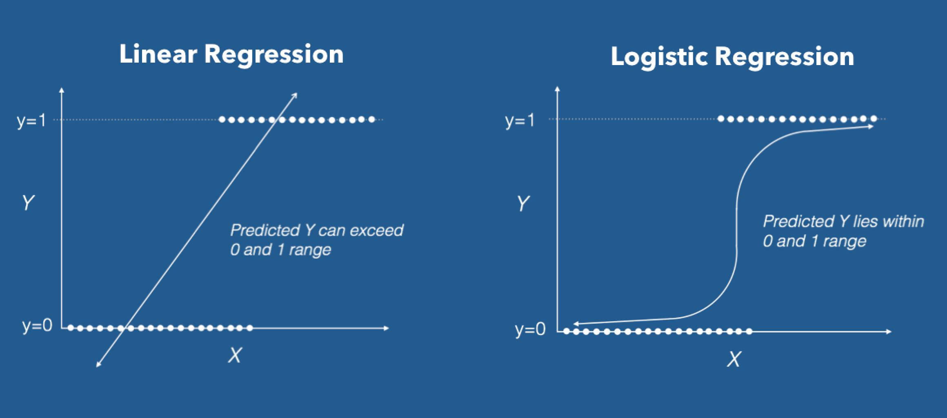

Slide 3
Categorical Response Variables
Examples:
Whether or not a person smokes
Binary Response
Success of a medical treatment
Opinion poll responses
Ordinal Response

Slide 4
Notes:
> plot(Pulse$Gender~Pulse$Hgt)
> abline(regmodel)

Slide 5
Logistic regression
Table 2 Age and signs of coronary heart disease (CD)

Slide 6
How can we analyse these data?
Compare mean age of diseased and non-diseased
Non-diseased: 38.6 years
Diseased: 58.7 years (p<0.0001)
Linear regression?

Slide 7
Dot-plot: Data from Table

Slide 8
Logistic regression
Table 3 Prevalence (%) of signs of CD according to age group

Slide 9
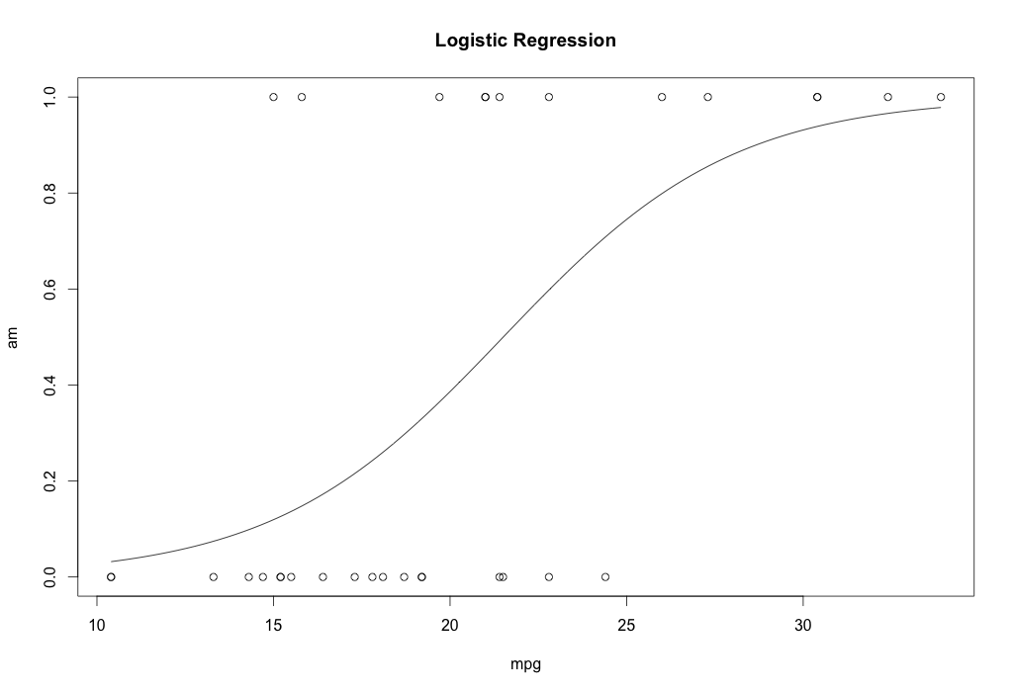
Logistic regression

Slide 10


1 (Yes)
Malignant?
Threshold classifier output $h_{θ}\left(x\right)$ at 0.5
If $h_{θ}\left(x\right)≥0.5,$ predict “$y=1$”
If $h_{θ}\left(x\right)<0.5$, predict “$y=0$”
0 (No)
Tumor Size
$$h_{θ}\left(x\right)=θ^{⊤}x$$

Slide 11
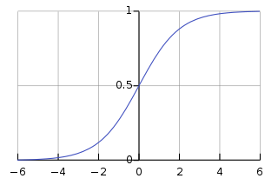




Hypothesis representation
Want ${0≤h}_{θ}\left(x\right)≤1$
$h_{θ}\left(x\right)=g\left(θ^{⊤}x\right),$ where $g\left(z\right)=\frac{1}{1+e^{−z}}$
Sigmoid function
Logistic function
$$h_{θ}\left(x\right)=\frac{1}{1+e^{−θ^{⊤}x}}$$
$$g(z)$$
$$z$$

Slide 12
Goals for next meeting
L2 and L1 Regularization

