Slide 1

TensorFlow and Keras in Deep Learning

Slide 2
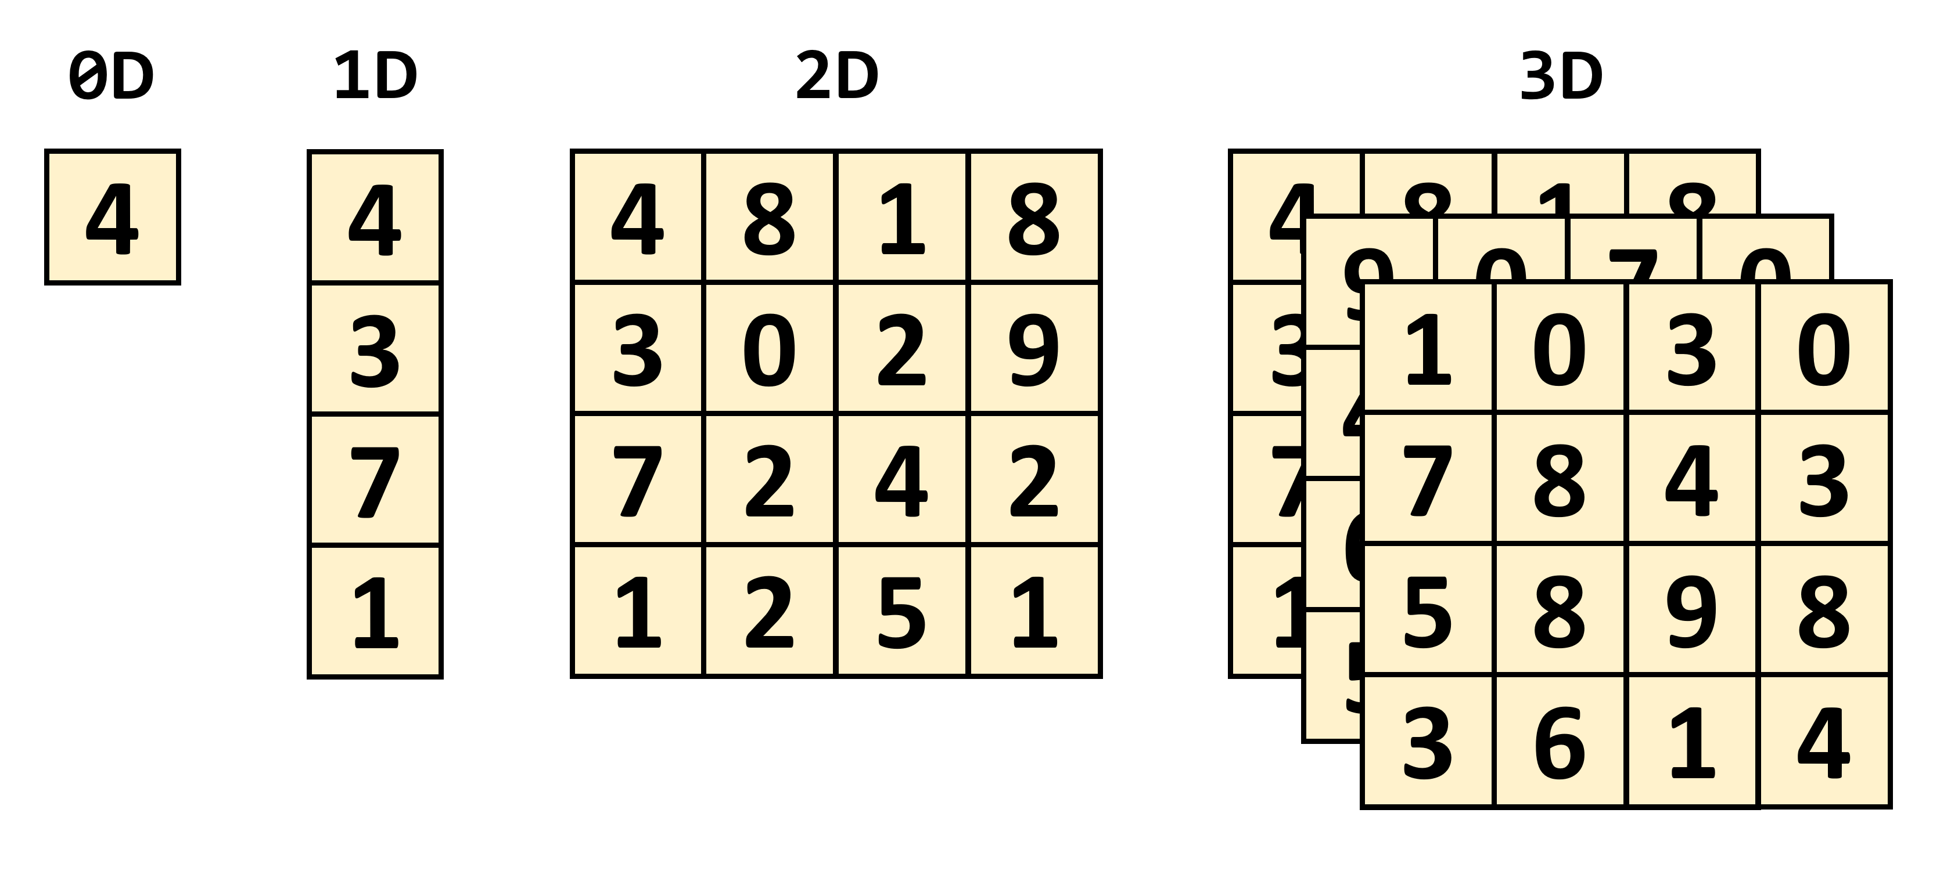
What is Tensor ?

Slide 3
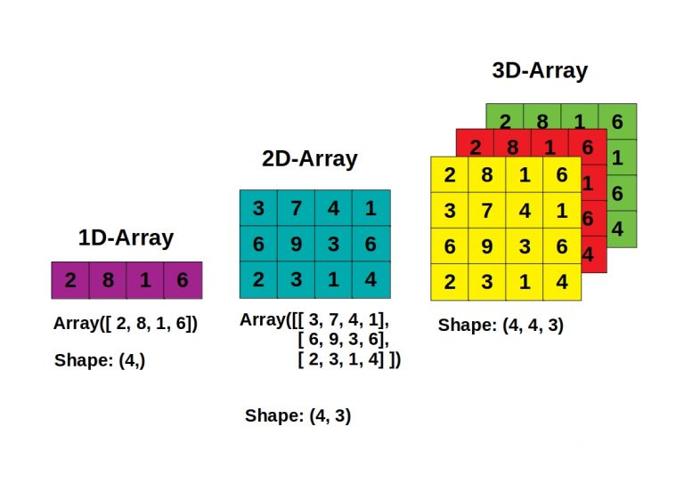
What is Tensor ?

Slide 4
TensorFlow in Python!
TensorFlow makes it easy for beginners and experts to create machine learning
models for desktop, mobile, web, and cloud.
TensorFlow provides a collection of workflows to develop and train models
using Python or JavaScript, and to easily deploy in the cloud, on-prem, in the
browser, or on-device no matter what language you use.

Slide 5
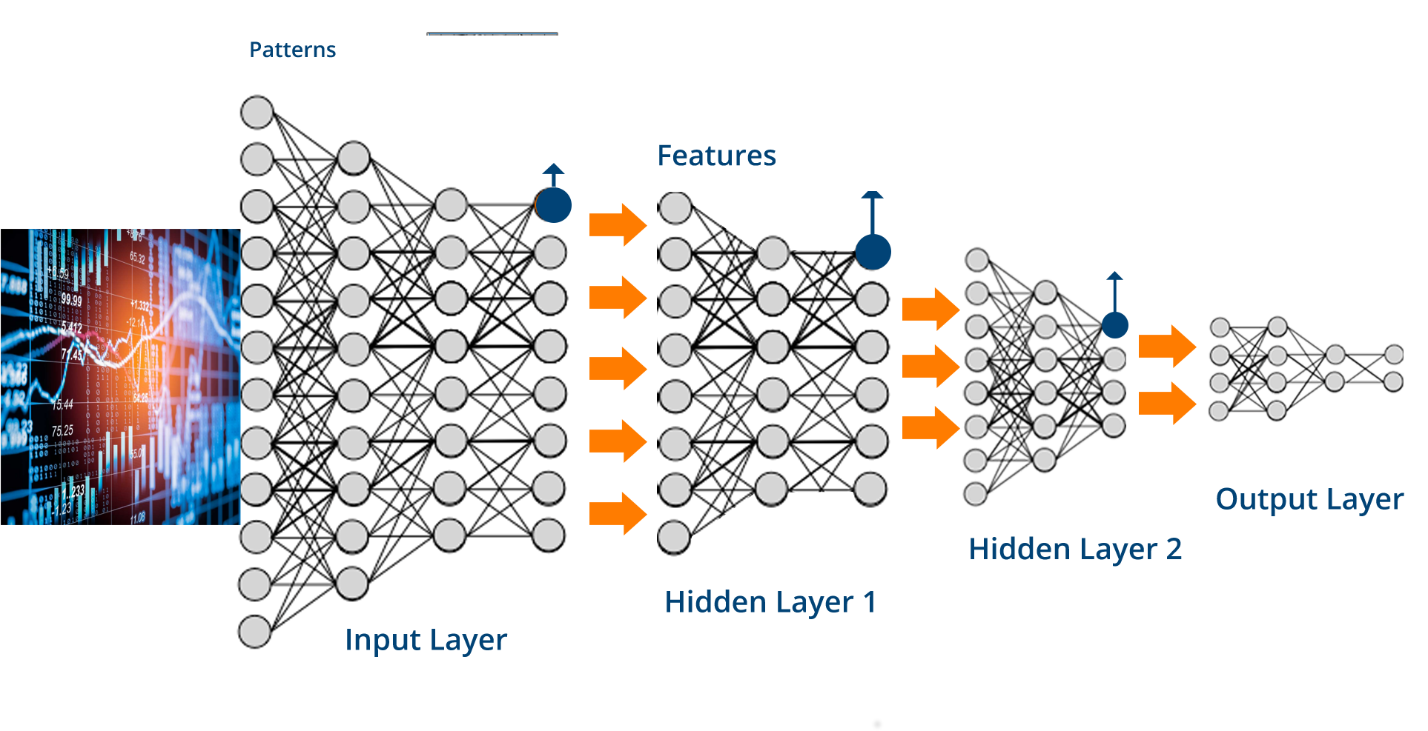
TensorFlow in Python!

Slide 6
Code for Tensorflow

