Slide 1

Data Science & Machine Learning
Senior Mentor- Sachin Saxena

Slide 2
Fundamental of Programming Python, Anaconda Installation

Slide 3
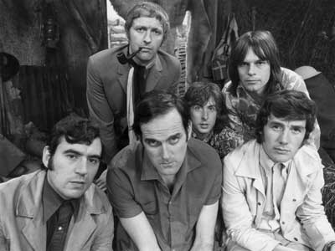
Python! Introduction..
Created in 1991 by Guido van Rossum (now at Google)
Named for Monty Python
Useful as a scripting language
script: A small program meant for one-time use
Targeted towards small to medium sized projects
Used by:
Google, Yahoo!, Youtube
Many Linux distributions
Games and apps (e.g. Eve Online)

Slide 4





Python is used everywhere!

Slide 5
Installing Python
Windows:
Download Python from http://www.python.org
Install Python.
Run Idle from the Start Menu.
Mac OS X:
Python is already installed.
Open a terminal and run python or run Idle from Finder.
Linux:
Chances are you already have Python installed. To check, run python from the terminal.
If not, install from your distribution's package system.
Note: For step by step installation instructions, see the course web site.

Slide 6
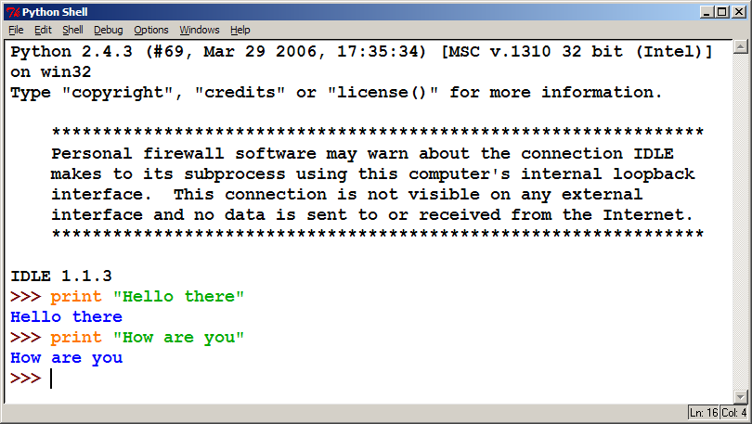
The Python Interpreter
Allows you to type commands one-at-a-time and see results A great way to explore Python's syntax
Repeat previous command: Alt+P

Slide 7
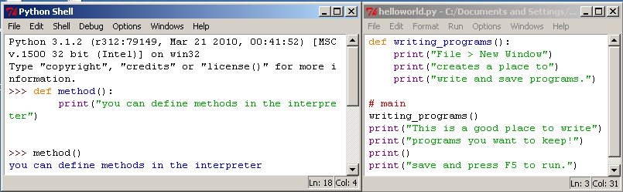
How to run Python Windows
Run IDLE to use the interpret
Open a new window in IDLE to write and save programs

Slide 8
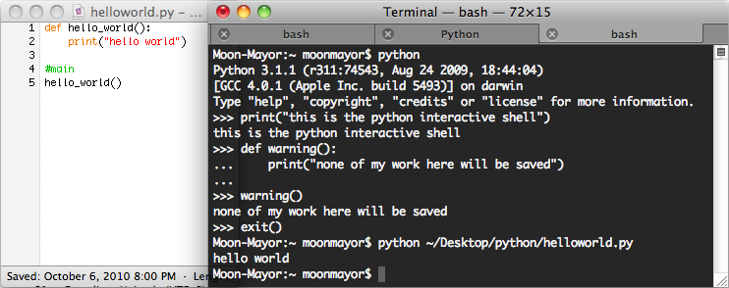
How to run Python Unix
Start the interactive shell with python
Run a program with python /path/to/program.py

Slide 9
Previous code
Console output: System.out.println();
Methods: public static void name() { ... }
Hello2.java
1 2 3 4 5 6 7 8 9 | public class Hello2 { public static void main(String[] args) { hello(); } public static void hello() { System.out.println("Hello, world!"); } }

Slide 10
Python 2.x vs Python 3.x
We will be using Python 3 for this course
Sometimes we may refer to Python 2
The differences are minimal
How to | Python 2.x | Python 3.x
print text | print “text” | print(“text”)
print a blank line | print | print()

Slide 11
Other platforms to Run Python Code:
Google Colab
Kaggle Online complier
Pycharm
Spyder
https://www.anaconda.com/
https://www.programiz.com/python-programming/online-compiler/
https://www.onlinegdb.com/online_python_compiler
https://www.w3schools.com/python/python_compiler.asp
https://www.online-python.com/
https://www.tutorialspoint.com/execute_python_online.php

Slide 12
Goals for next meeting
Why Learn Python

