Slide 1

Data Science & Machine Learning
Senior Mentor- Sachin Saxena

Slide 2
Fundamental of Programming Why learn Python? Variables and Data Types

Slide 3
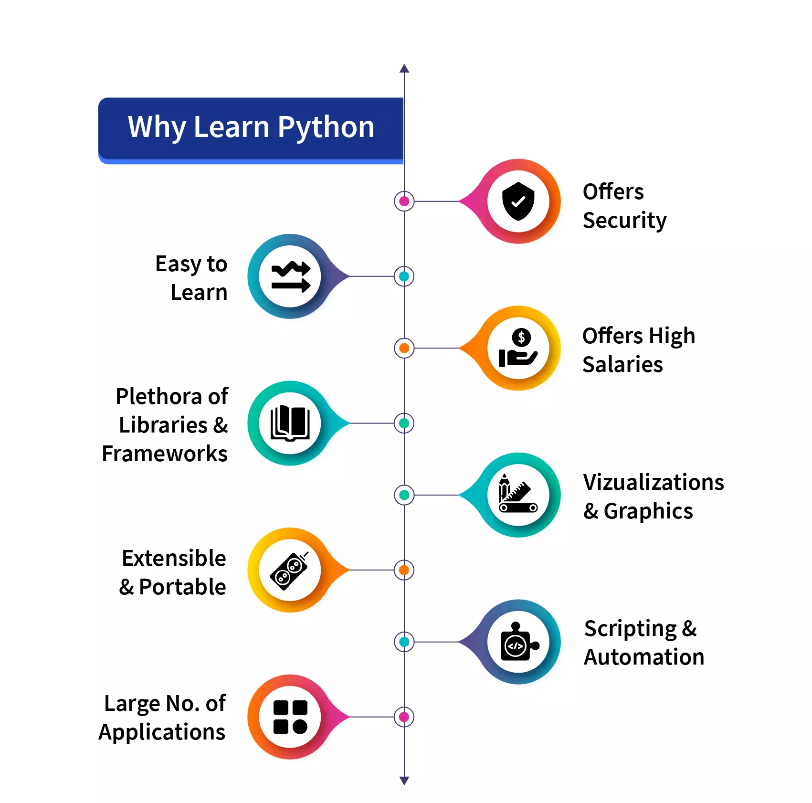
Why Learn Python
Image courtesy: https://scaler.com/topics/images/why-learn-python.webp

Slide 4
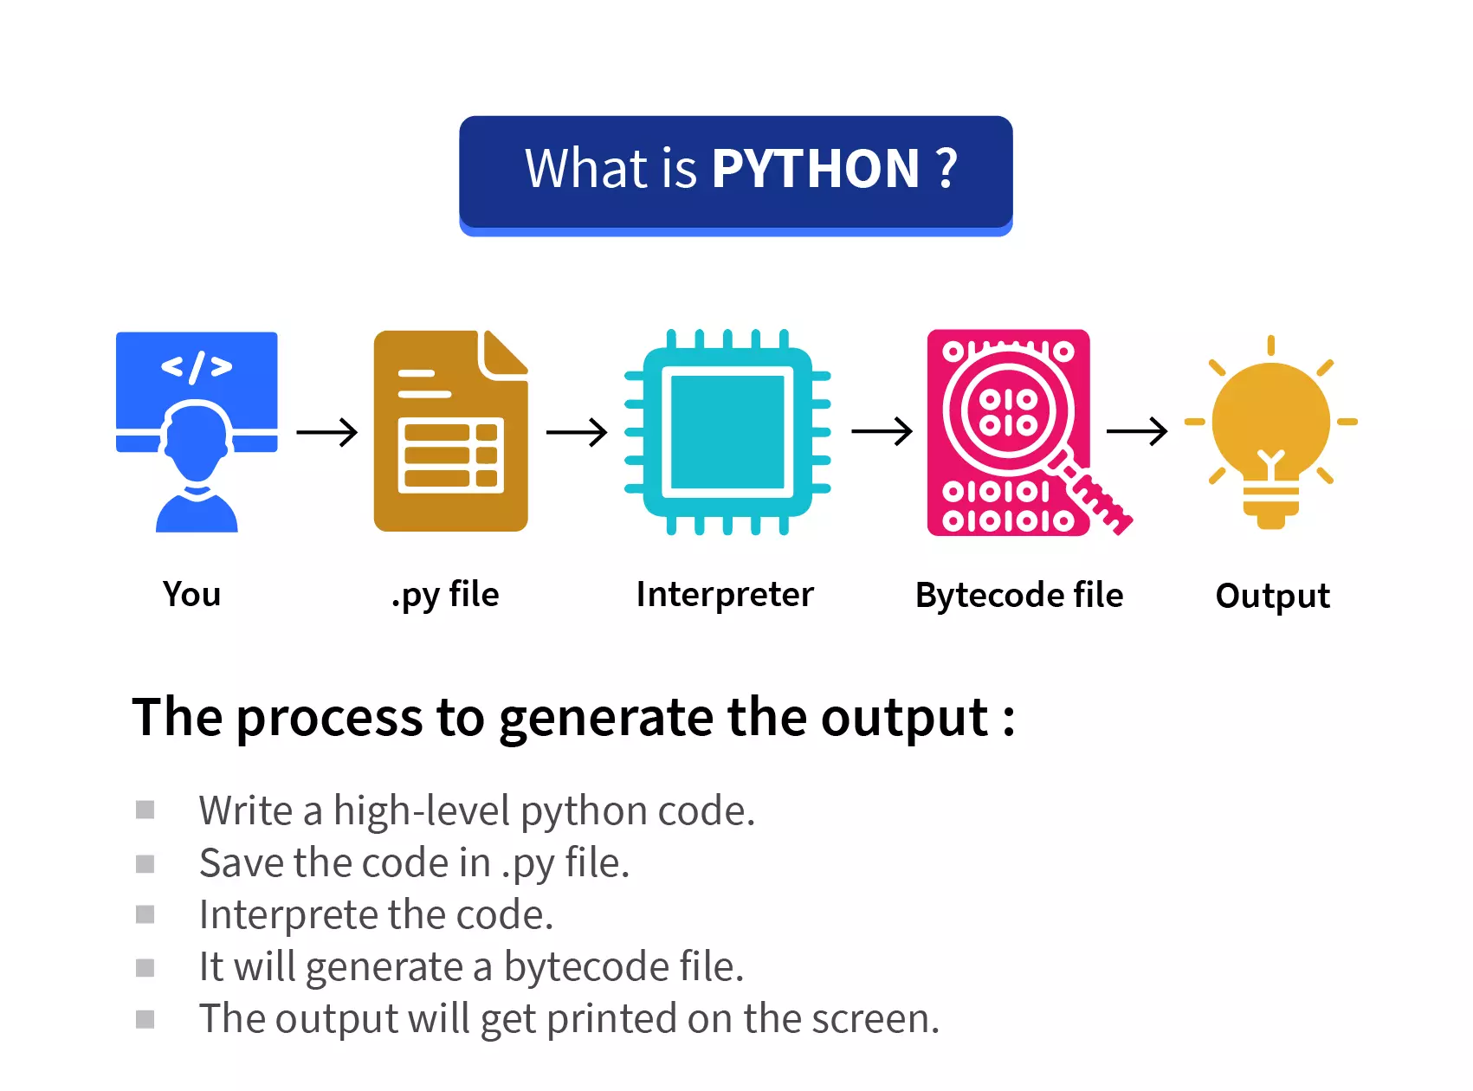
How Python works?
Image courtesy: https://scaler.com/topics/images/what-is-python.webp

Slide 5
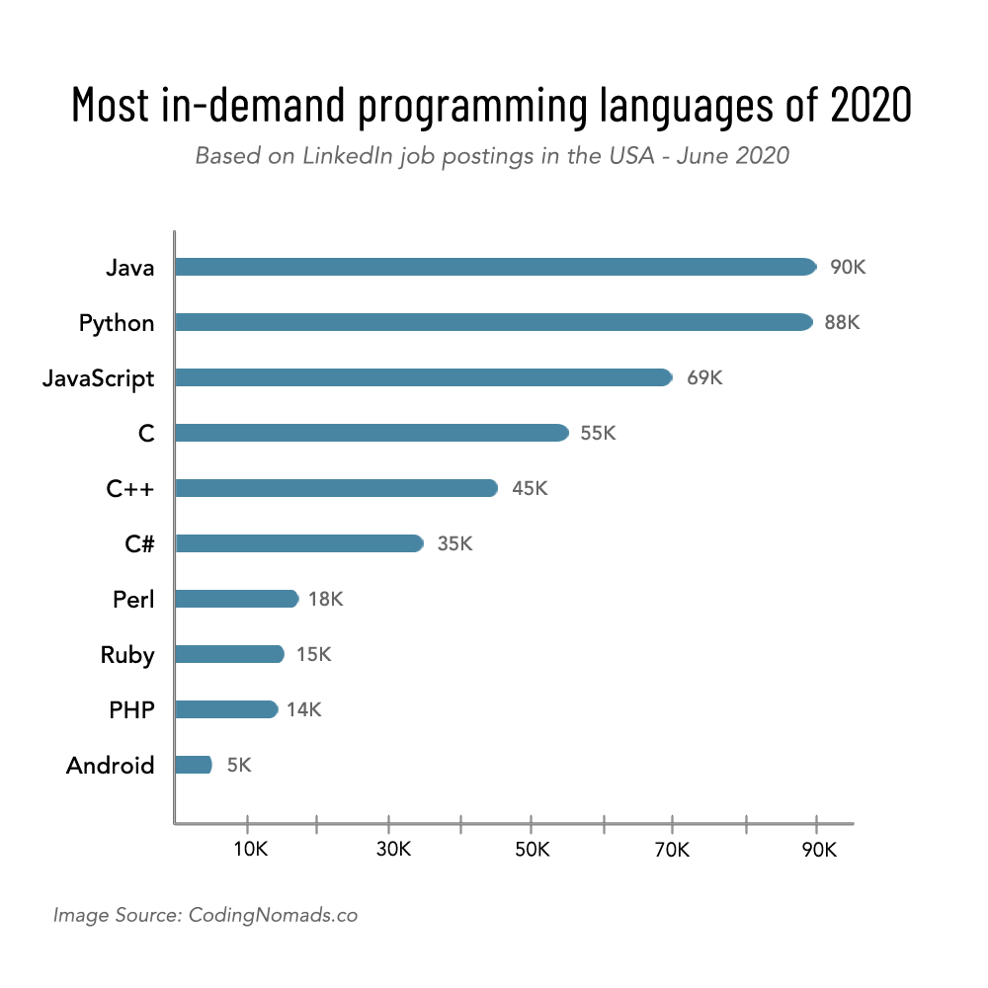
Why Python?

Slide 6
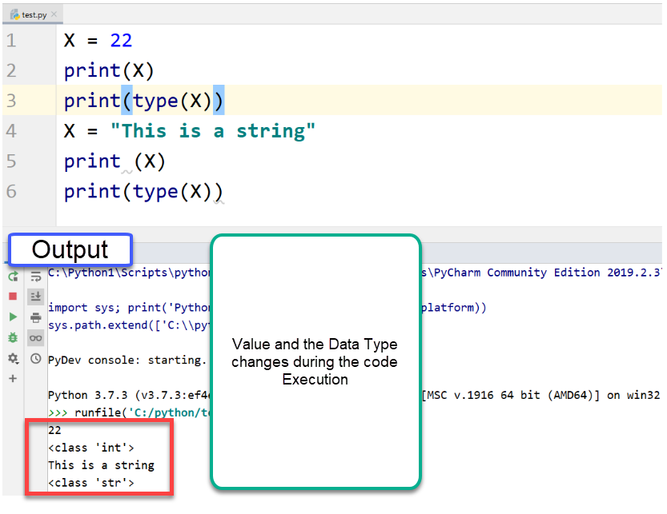
Variables in Python

Slide 7
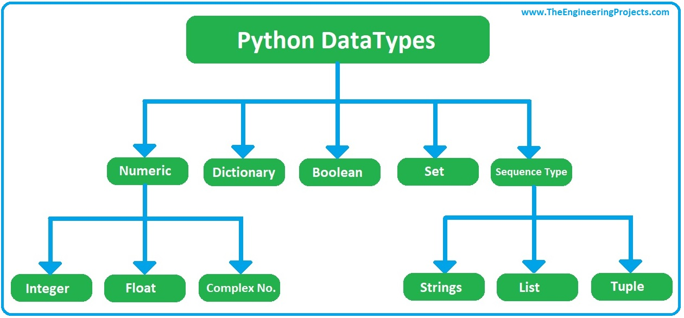
Variables in Python

Slide 8
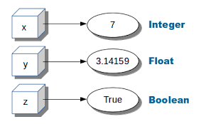
Variables in Python

Slide 9
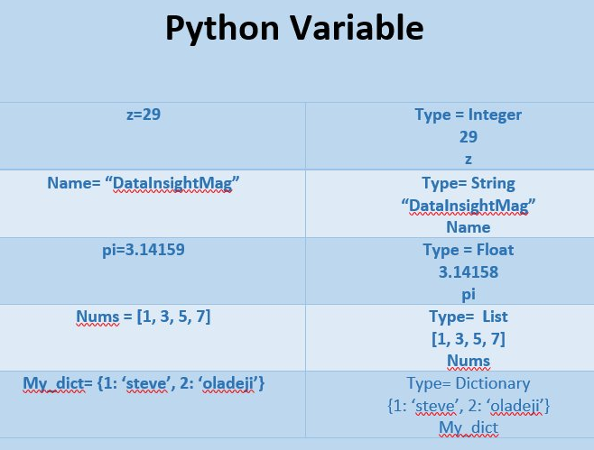
Variables in Python

Slide 10
Python Strings:
Strings in Python are identified as a contiguous set of characters in between quotation marks.
Python allows for either pairs of single or double quotes. Subsets of strings can be taken using the slice operator ( [ ] and [ : ] ) with indexes starting at 0 in the beginning of the string and working their way from -1 at the end.
The plus ( + ) sign is the string concatenation operator, and the asterisk ( * ) is the repetition operator.

Slide 11
Example:
str = 'Hello World!'
print str # Prints complete string
print str[0] # Prints first character of the string
print str[2:5] # Prints characters starting from 3rd to 6th
print str[2:] # Prints string starting from 3rd character
print str * 2 # Prints string two times
print str + "TEST" # Prints concatenated string
Output:
Hello World!
H
llo
llo World!
Hello World!Hello World!
Hello World!TEST

Slide 12
Python Lists:
Lists are the most versatile of Python's compound data types. A list contains items separated by commas and enclosed within square brackets ([]).
To some extent, lists are similar to arrays in C. One difference between them is that all the items belonging to a list can be of different data type.
The values stored in a list can be accessed using the slice operator ( [ ] and [ : ] ) with indexes starting at 0 in the beginning of the list and working their way to end-1.
The plus ( + ) sign is the list concatenation operator, and the asterisk ( * ) is the repetition operator.

Slide 13
list = [ 'abcd', 786 , 2.23, 'john', 70.2 ]
tinylist = [123, 'john']
print list # Prints complete list
print list[0] # Prints first element of the list
print list[1:3] # Prints elements starting from 2nd till 3rd
print list[2:] # Prints elements starting from 3rd element
print tinylist * 2 # Prints list two times
print list + tinylist # Prints concatenated lists
Output:
['abcd', 786, 2.23, 'john', 70.2]
abcd
[786, 2.23]
[2.23, 'john', 70.2]
[123, 'john', 123, 'john']
['abcd', 786, 2.23, 'john', 70.2, 123, 'john']

Slide 14
Python Tuples:
A tuple is another sequence data type that is similar to the list. A tuple consists of a number of values separated by commas. Unlike lists, however, tuples are enclosed within parentheses.
The main differences between lists and tuples are: Lists are enclosed in brackets ( [ ] ), and their elements and size can be changed, while tuples are enclosed in parentheses ( ( ) ) and cannot be updated. Tuples can be thought of as read-only lists.

Slide 15
tuple = ( 'abcd', 786 , 2.23, 'john', 70.2 )
tinytuple = (123, 'john')
print tuple # Prints complete list
print tuple[0] # Prints first element of the list
print tuple[1:3] # Prints elements starting from 2nd till 3rd
print tuple[2:] # Prints elements starting from 3rd element
print tinytuple * 2 # Prints list two times
print tuple + tinytuple # Prints concatenated lists
OUTPUT:
('abcd', 786, 2.23, 'john', 70.2)
abcd
(786, 2.23)
(2.23, 'john', 70.2)
(123, 'john', 123, 'john')
('abcd', 786, 2.23, 'john', 70.2, 123, 'john')

Slide 16
Python Dictionary:
Python 's dictionaries are hash table type. They work like associative arrays or hashes found in Perl and consist of key-value pairs.
Keys can be almost any Python type, but are usually numbers or strings. Values, on the other hand, can be any arbitrary Python object.
Dictionaries are enclosed by curly braces ( { } ) and values can be assigned and accessed using square braces ( [] ).

Slide 17
dict = {}
dict['one'] = "This is one"
dict[2] = "This is two“
tinydict = {'name': 'john','code':6734, 'dept': 'sales'}
print dict['one'] # Prints value for 'one' key
print dict[2] # Prints value for 2 key
print tinydict # Prints complete dictionary
print tinydict.keys() # Prints all the keys
print tinydict.values() # Prints all the values
OUTPUT:
This is one
This is two
{'dept': 'sales', 'code': 6734, 'name': 'john'}
['dept', 'code', 'name']
['sales', 6734, 'john']

Slide 18
Comments in Python:
A hash sign (#) that is not inside a string literal begins a comment. All characters after the # and up to the physical line end are part of the comment, and the Python interpreter ignores them.

Slide 19
Goals for next meeting
Standard I/O operators

