Slide 1

Data Science & Machine Learning Standard Input/Output
Senior Mentor- Sachin Saxena

Slide 2
Python Input, Output
This tutorial focuses on two built-in functions print() and input() to perform I/O task in Python .
Some of the functions like input() and print() are widely used for standard input and output operations respectively.
-------------------------------------------------------------------------
An example of its use is given below.
print('This sentence is output to the screen')
Output
This sentence is output to the screen

Slide 3
Python Output
a = 5
print('The value of a is', a)
Output
The value of a is 5

Slide 4
Python Output
>>> x = 5; y = 10
>>> print('The value of x is {} and y is {}'.format(x, y))
The value of x is 5 and y is 10

Slide 5
Python Input
>>> num = input('Enter a number: ')
Enter a number: 10
>>> num '10'

Slide 6
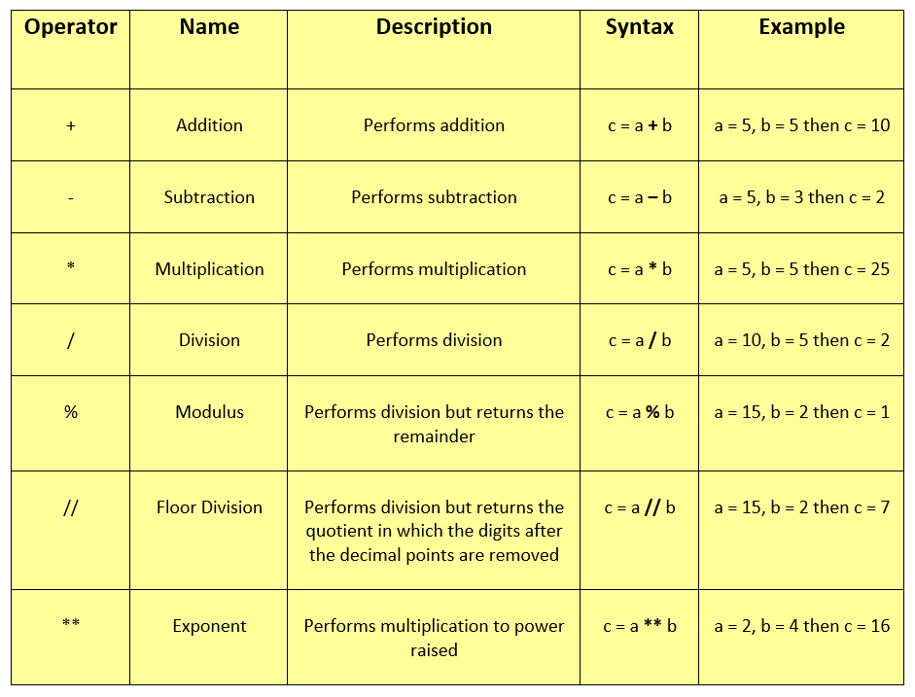
Python Operators

Slide 7
Goals for next meeting
While loop For loop Break
Continue

