Slide 1

Data Science & Machine Learning If else condition While loop, break, continue
Senior Mentor- Sachin Saxena

Slide 2
If condition in Python
Python Conditions and If statements
Python supports the usual logical conditions from mathematics:
------------------------------------------------------------------------------
Equals: a == b
Not Equals: a != b
Less than: a < b
Less than or equal to: a <= b
Greater than: a > b
Greater than or equal to: a >= b

Slide 3
If condition in Python
a = 33
b = 200
if b > a:
print("b is greater than a")

Slide 4
If else condition in Python
# Program checks if the number is positive or negative
# And displays an appropriate message
num = 3
if num >= 0:
print("Positive or Zero")
else:
print("Negative number")

Slide 5
Indentation
Python relies on indentation (whitespace at the beginning of a line) to define scope in the code. Other programming languages often use curly-brackets for this purpose.

Slide 6
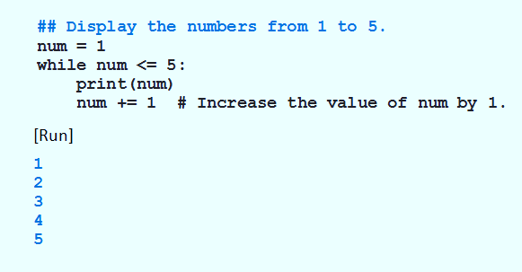
The while Loop
Example : Program displays 1 – 5, after loop terminates, num will be 6

Slide 7
The while Loop
Example : Program displays 1 – 5, after loop terminates, num will be 6

Slide 8
The for Loop
A Simple Definite Loop
5
4
3
2
1
Blastoff!
for i in [5, 4, 3, 2, 1] :
print(i)
print('Blastoff!')

Slide 9
A Simple Definite Loop
Yes
Done?
No
Move i ahead
5
4
3
2
1
Blastoff!
for i in [5, 4, 3, 2, 1] :
print(i)
print('Blastoff!')
print(i)
Definite loops (for loops) have explicit iteration variables that change each time through a loop. These iteration variables move through the sequence or set.
print('Blast off!')

Slide 10
Looking at in...
The iteration variable “iterates” through the sequence (ordered set)
The block (body) of code is executed once for each value in the sequence
The iteration variable moves through all of the values in the sequence
Five-element sequence
Iteration variable
for i in [5, 4, 3, 2, 1] :
print(i)

Slide 11
No
Yes
Done?
The iteration variable “iterates” through the sequence (ordered set)
The block (body) of code is executed once for each value in the sequence
The iteration variable moves through all of the values in the sequence
Move i ahead
print(i)
for i in [5, 4, 3, 2, 1] :
print(i)

Slide 12
i = 5
No
Yes
Done?
print(i)
Move i ahead
i = 4
print(i)
print(i)
i = 3
print(i)
i = 2
for i in [5, 4, 3, 2, 1] :
print(i)
print(i)
i = 1
print(i)

Slide 13
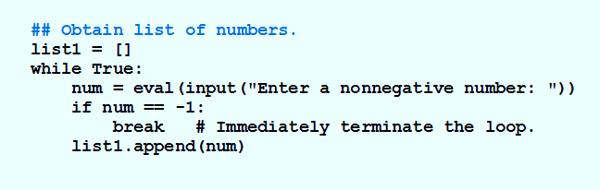
The break Statement
Causes an exit from anywhere in the body of a loop
When break is executed
Loop immediately terminates
Break statements usually occur in if statements

Slide 14
Breaking Out of a Loop
The break statement ends the current loop and jumps to the statement immediately following the loop
It is like a loop test that can happen anywhere in the body of the loop
while True:
line = input('> ')
if line == 'done' :
break
print(line)
print('Done!')
> hello there
hello there
> finished
finished
> done
Done!

Slide 15
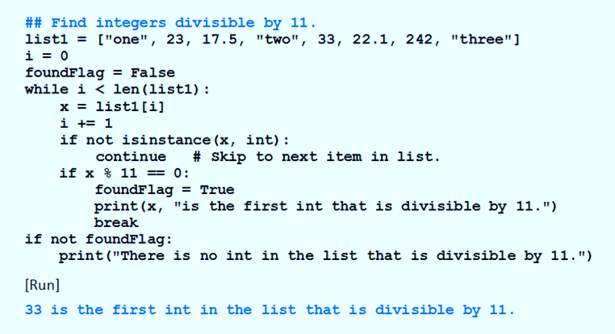
The continue statement
When continue executed in a while loop
Current iteration of the loop terminates
Execution returns to the loop’s header
Usually appear inside if statements.

Slide 16
Goals for next meeting
Types of Function

