Slide 1

Data Science & Machine Learning Function, Packages, File Handling
Senior Mentor- Sachin Saxena

Slide 2
Functions in Python

Slide 3
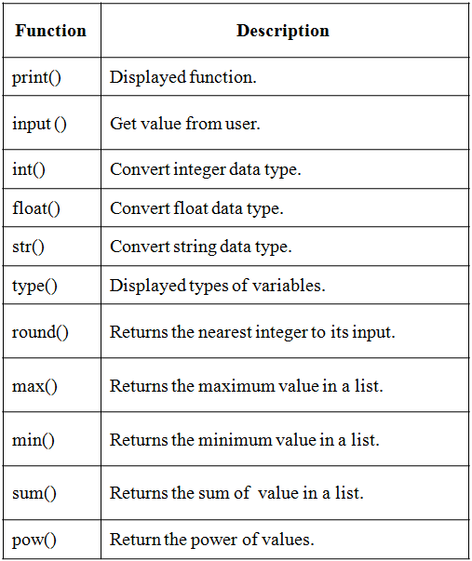
Python Built in Functions

Slide 4
Defining Functions
Function definition begins with “def.”
Function name and its arguments.
def get_final_answer(filename):
“““Documentation String””” line1
line2
return total_counter
Colon.
The indentation matters…
First line with less indentation is considered to be outside of the function definition.
The keyword ‘return’ indicates the value to be sent back to the caller.
No header file or declaration of types of function or arguments

Slide 5
Python and Types
Dynamic typing: Python determines the data types of variable bindings in a program automatically
Strong typing: But Python’s not casual about types, it enforces the types of objects
For example, you can’t just append an integer to a string, but must first convert it to a string
x = “the answer is ” # x bound to a string
y = 23 # y bound to an integer.
print x + y # Python will complain!

Slide 6
Calling a Function
The syntax for a function call is:
>>> def myfun(x, y):
return x * y
>>> myfun(3, 4)
12
Parameters in Python are Call by Assignment
Old values for the variables that are parameter names are hidden, and these variables are simply made to refer to the new values
All assignment in Python, including binding function parameters, uses reference semantics.

Slide 7
Functions without returns
All functions in Python have a return value, even if no return line inside the code
Functions without a return return the special value None
None is a special constant in the language
None is used like NULL, void, or nil in other languages
None is also logically equivalent to False
The interpreter’s REPL doesn’t print None

Slide 8
Default Values for Arguments
You can provide default values for a function’s arguments
These arguments are optional when the function is called
>>> def myfun(b, c=3, d=“hello”): return b + c
>>> myfun(5,3,”hello”)
>>> myfun(5,3)
>>> myfun(5)
All of the above function calls return 8

Slide 9
Keyword Arguments
Can call a function with some/all of its arguments out of order as long as you specify their names
>>> def foo(x,y,z): return(2*x,4*y,8*z)
>>> foo(2,3,4)
(4, 12, 32)
>>> foo(z=4, y=2, x=3)
(6, 8, 32)
>>> foo(-2, z=-4, y=-3)
(-4, -12, -32)
Can be combined with defaults, too
>>> def foo(x=1,y=2,z=3): return(2*x,4*y,8*z)
>>> foo()
(2, 8, 24)
>>> foo(z=100)
(2, 8, 800)

Slide 10
Lambda Notation
Be careful with the syntax
>>> f = lambda x,y : 2 * x + y
>>> f
<function <lambda> at 0x87d30>
>>> f(3, 4)
10
>>> v = lambda x: x*x(100)
>>> v
<function <lambda> at 0x87df0>
>>> v = (lambda x: x*x)(100)
>>> v
10000

Slide 11
Lambda Notation
Python’s lambda creates anonymous functions
>>> lambda x: x + 1
<function <lambda> at 0x1004e6ed8>
>>> f = lambda x: x + 1
>>> f
<function <lambda> at 0x1004e6f50>
>>> f(100)
101

Slide 12
Example: composition
>>> def square(x):
return x*x
>>> def twice(f):
return lambda x: f(f(x))
>>> twice
<function twice at 0x87db0>
>>> quad = twice(square)
>>> quad
<function <lambda> at 0x87d30>
>>> quad(5)
625

Slide 13
map
>>> def add1(x): return x+1
>>> map(add1, [1,2,3,4])
[2, 3, 4, 5]
>>> map(lambda x: x+1, [1,2,3,4])
[2, 3, 4, 5]
>>> map(+, [1,2,3,4], [100,200,300,400])
map(+,[1,2,3,4],[100,200,300,400])
^
SyntaxError: invalid syntax

Slide 14
Packages in Python

Slide 15
Packages in Python

Slide 16
Packages in Python
“dotted module names” (ex. a.b)
Submodule b in package a
Saves authors of multi-module packages from worrying about each other’s module names
Python searches through sys.path directories for the package subdirectory
Users of the package can import individual modules from the package
Ways to import submodules
import sound.effects.echo
from sound.effects import echo
Submodules must be referenced by full name
An ImportError exception is raised when the package cannot be found

Slide 17
Importing * From a Package
Packages in Python
* does not import all submodules from a package
Ensures that the package has been imported, only importing the names of the submodules defined in the package
import sound.effects.echo
import sound.effects.surround
from sound.effects import *

Slide 18
Intra-package References
Submodules can refer to each other
Surround might use echo module
import echo also loads surround module
import statement first looks in the containing package before looking in the standard module search path
Absolute imports refer to submodules of sibling packages
sound.filters.vocoder uses echo module
from sound.effects import echo
Can write explicit relative imports
from . import echo
from .. import formats
from ..filters import equalizer

Slide 19
Packages in Multiple Directories
_path_ is a list containing the name of the directory holding the package’s _init_.py
Changing this variable can affect futute searches for modules and subpackages in the package
Can be used to extend the set of modules in a package
Not often needed

Slide 20
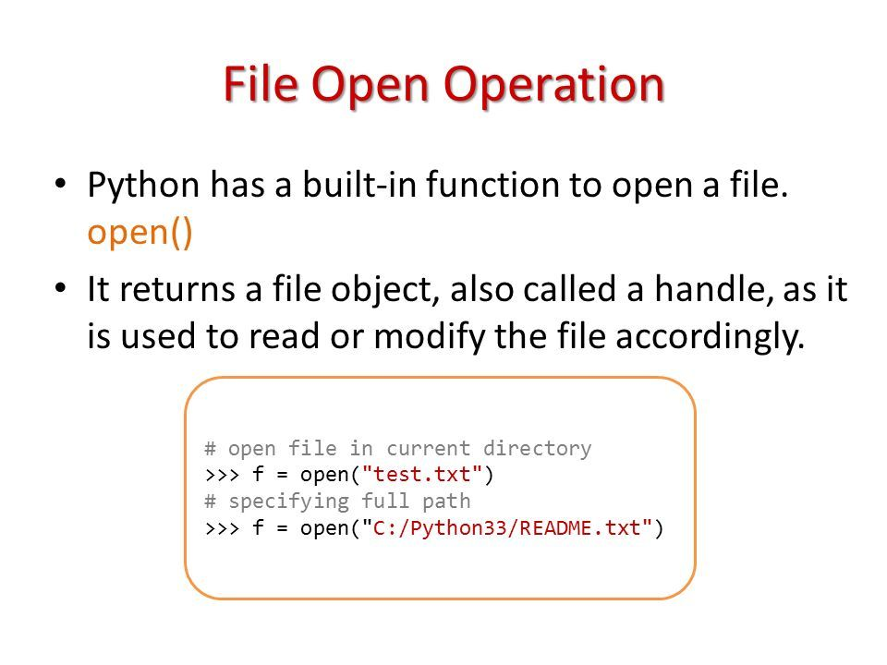
File Handling

Slide 21
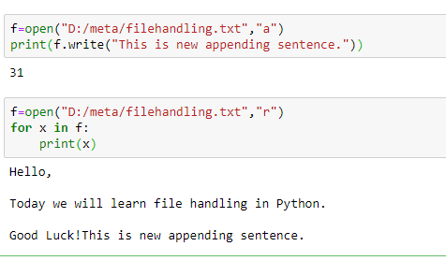
File Handling

Slide 22
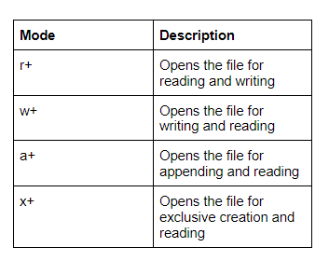
File Handling

Slide 23
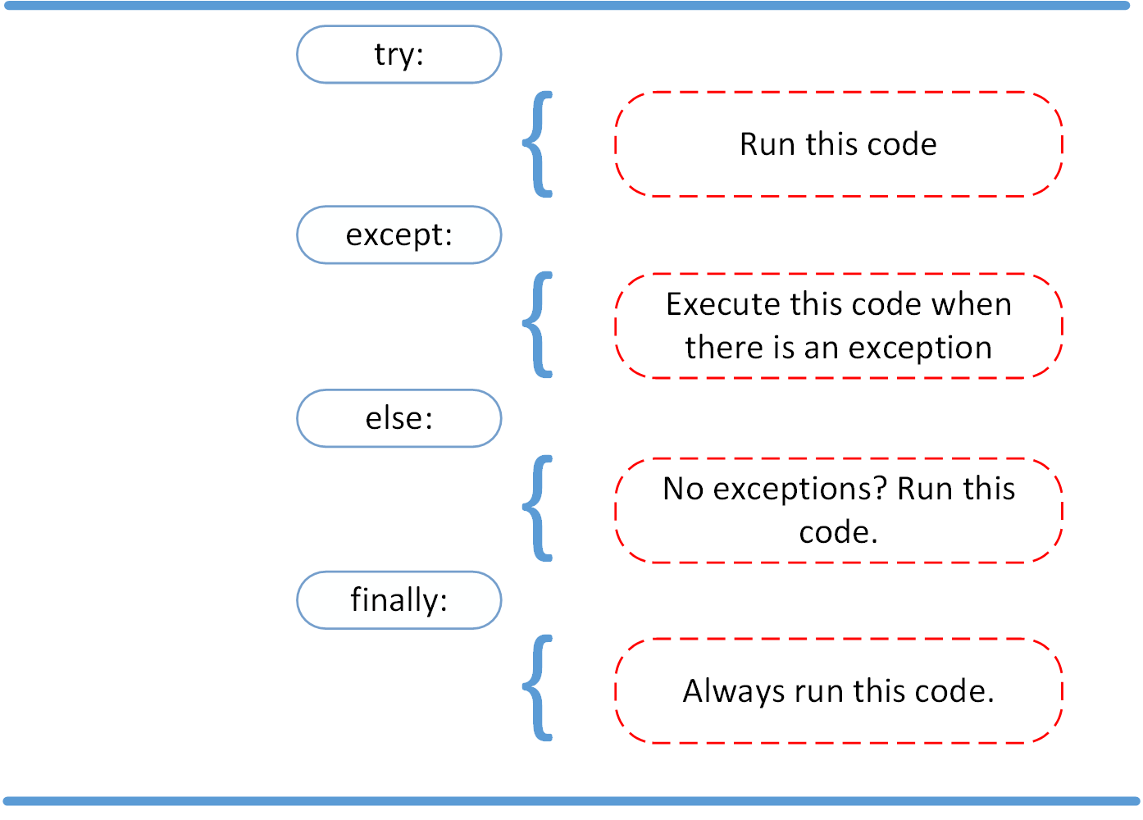
Exception Handling

Slide 24
Goals for next meeting
Numpy in Python

