Slide 1

Functions in Python

Slide 2
Python! Introduction..
Python is a high-level, interpreted, general-purpose programming language.
Its design philosophy emphasizes code readability with the use of significant indentation.
Python is dynamically-typed and garbage-collected.

Slide 3
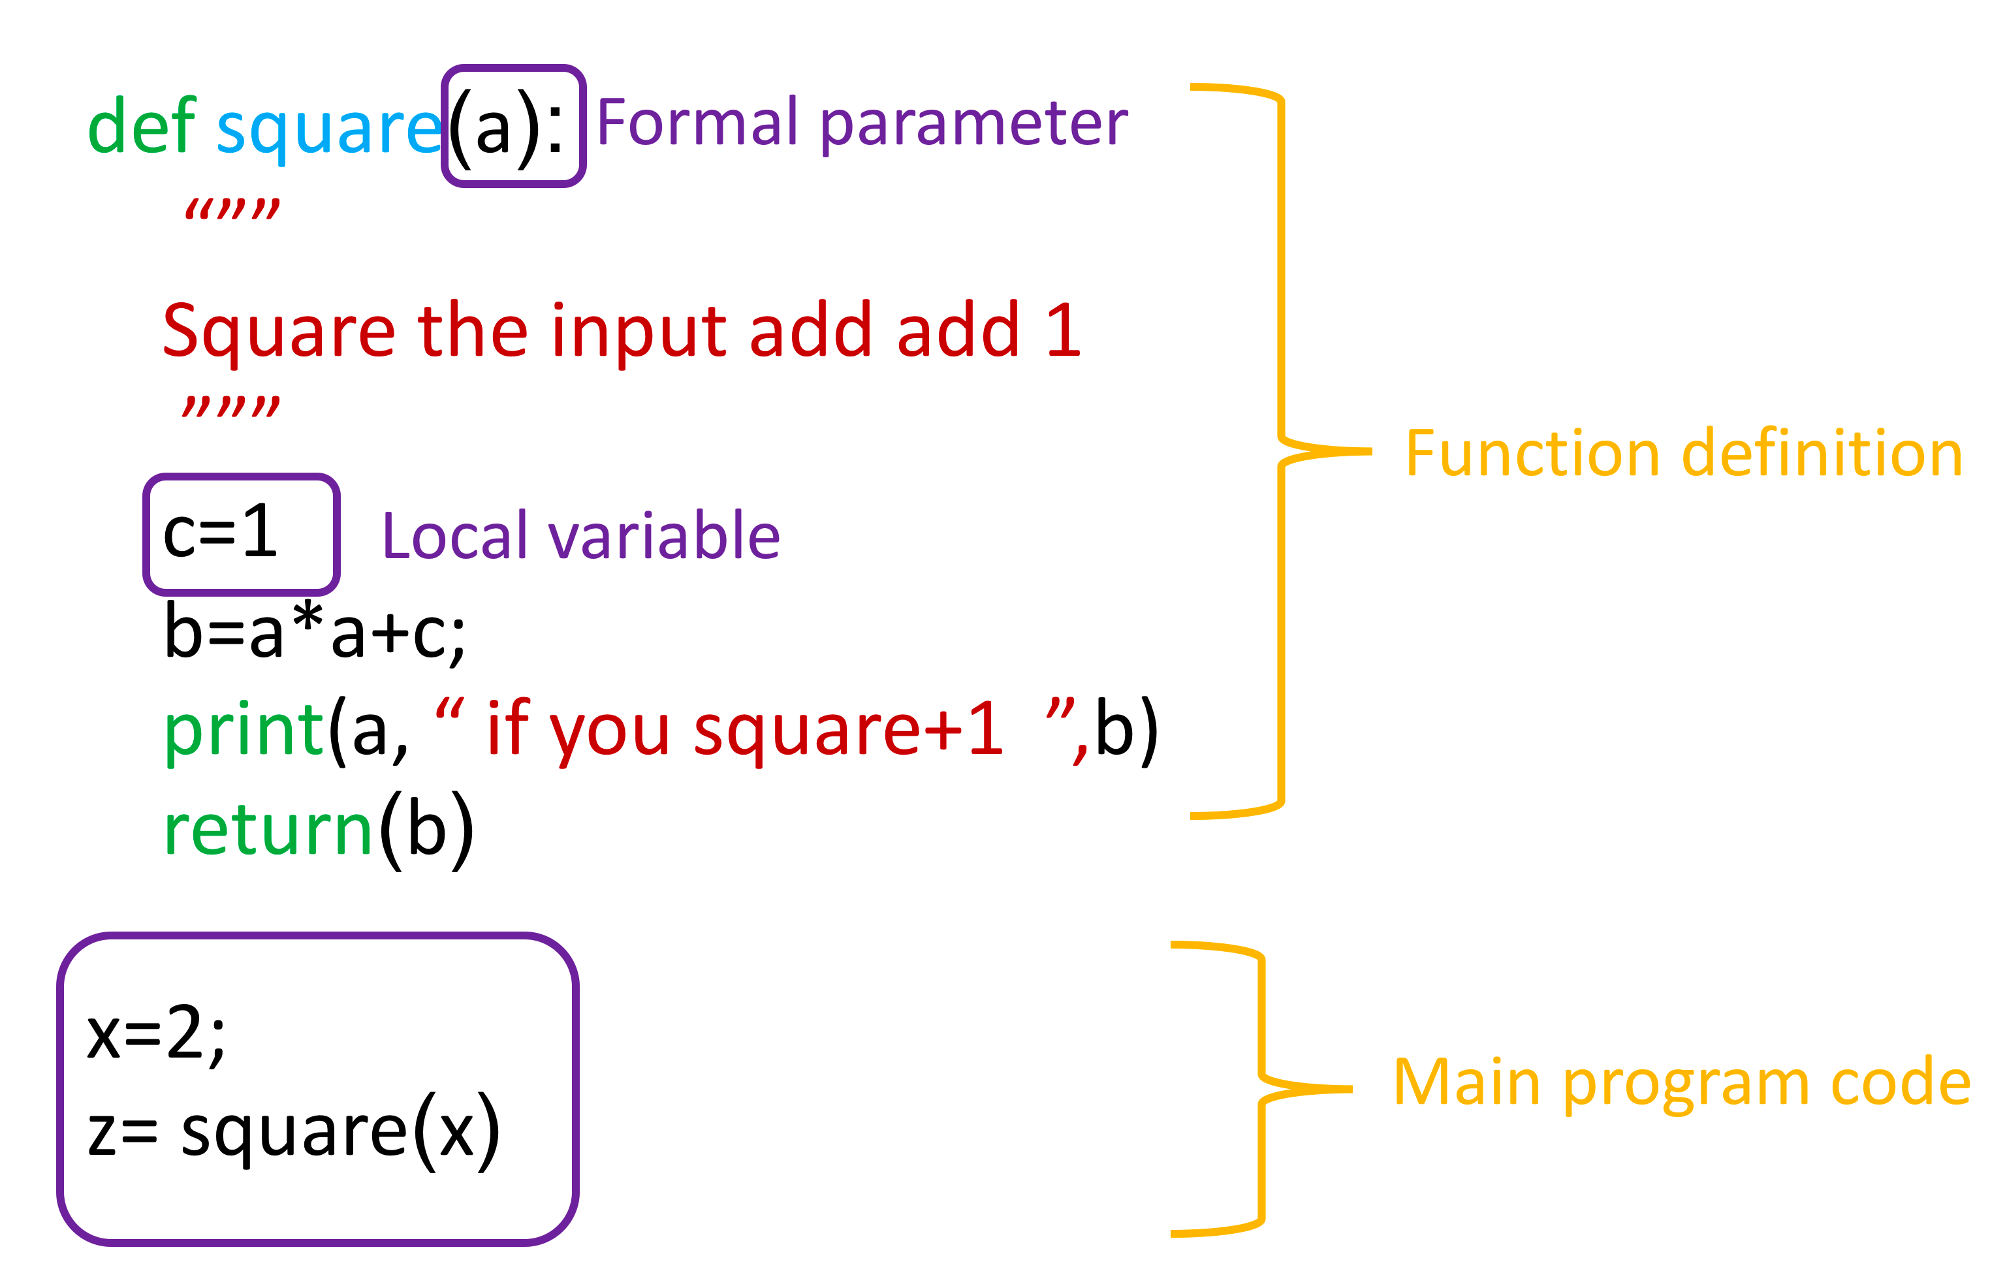
Function structure in Python !

Slide 4
Goals for next meeting
Class in Python

