Slide 1

Class and Objects in Python

Slide 2
Class in Python! Introduction..
Defining a Class.
A class in Python can be defined using the class keyword. As per the syntax above, a class is defined.
It supports multiple programming paradigms, including structured, object-oriented and functional programming.

Slide 3
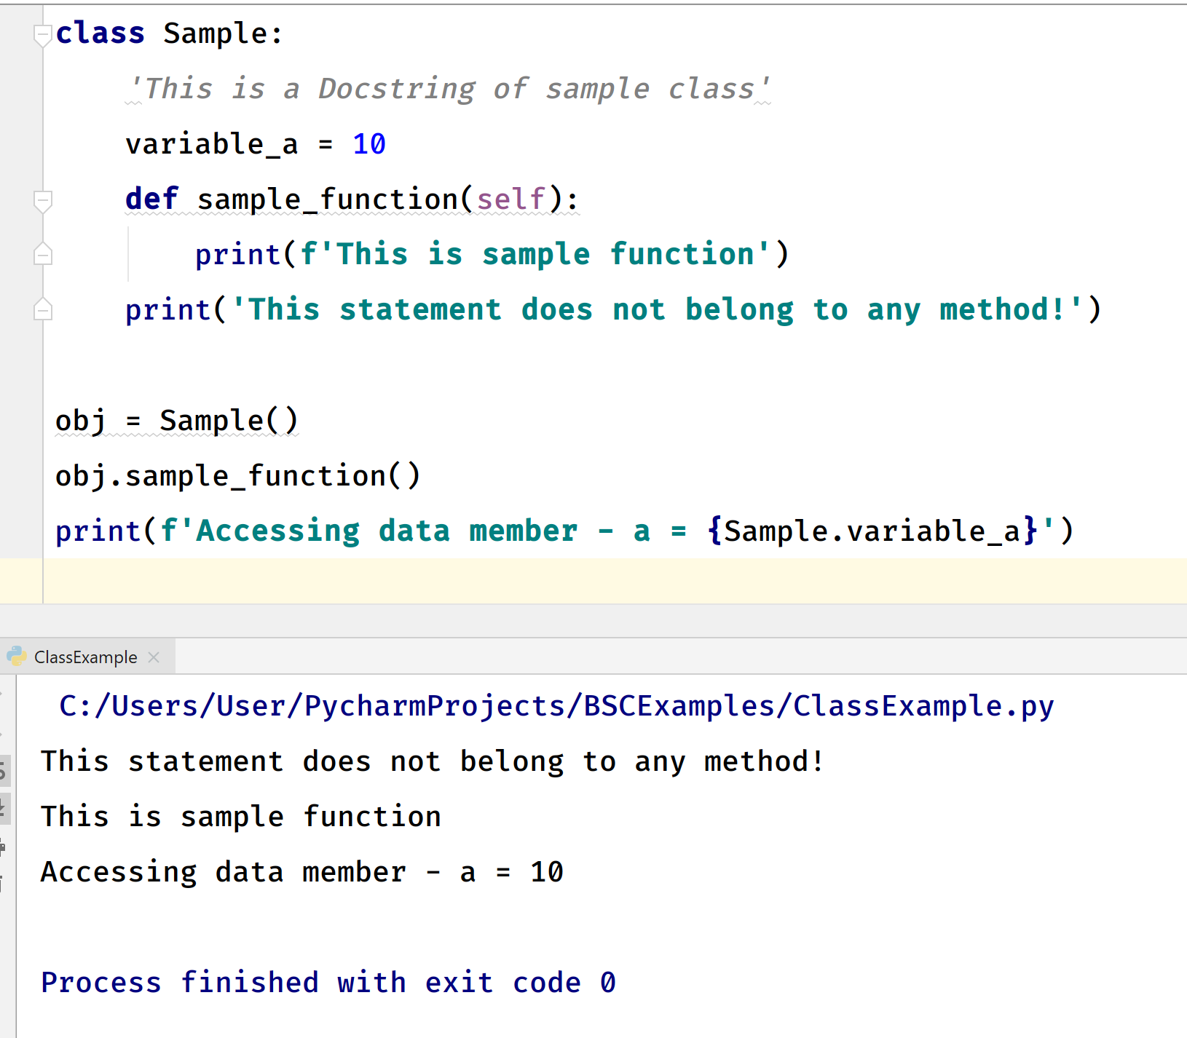
Class structure in Python !

Slide 4
See you in next meeting

