Slide 1

Data Science & Machine Learning Numpy in Python
Senior Mentor- Sachin Saxena

Slide 2
Numpy in Python

Slide 3
What is Numpy?
Numpy, Scipy, and Matplotlib provide MATLAB-like functionality in python.
Numpy Features:
Typed multidimentional arrays (matrices)
Fast numerical computations (matrix math)
High-level math functions

Slide 4
Why do we need NumPy
Python does numerical computations slowly.
1000 x 1000 matrix multiply
Python triple loop takes > 10 min.
Numpy takes ~0.03 seconds

Slide 5
Logistics: Versioning
In this class, your code will be tested with:
Python 2.7.6
Numpy version: 1.8.2
Scipy version: 0.13.3
OpenCV version: 2.4.8
Two easy options:
Class virtual machine (always test on the VM)
Anaconda 2 (some assembly required)

Slide 6
NumPy Overview
Arrays
Shaping and transposition
Mathematical Operations
Indexing and slicing
Broadcasting

Slide 7
Arrays
Structured lists of numbers.
Vectors
Matrices
Images
Tensors
ConvNets

Slide 8

Arrays
Structured lists of numbers.
Vectors
Matrices
Images
Tensors
ConvNets
$$\left[\begin{matrix}p_{x} \\ p_{y} \\ p_{z}\end{matrix}\right]$$
$$\left[\begin{matrix}a_{11} & ⋯ & a_{1n} \\ ⋮ & ⋱ & ⋮ \\ a_{m1} & ⋯ & a_{mn}\end{matrix}\right]$$

Slide 9

Arrays
Structured lists of numbers.
Vectors
Matrices
Images
Tensors
ConvNets

Slide 10
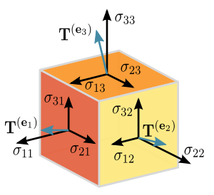
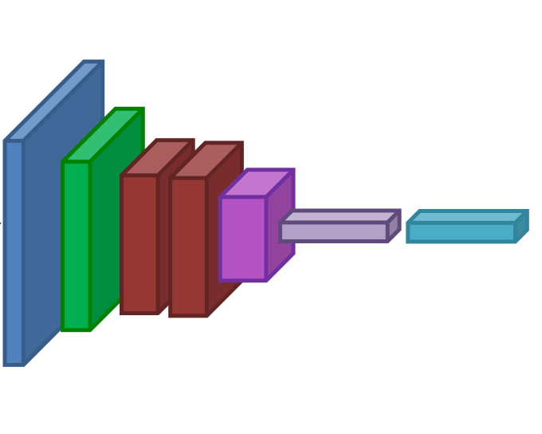
Arrays
Structured lists of numbers.
Vectors
Matrices
Images
Tensors
ConvNets

Slide 11
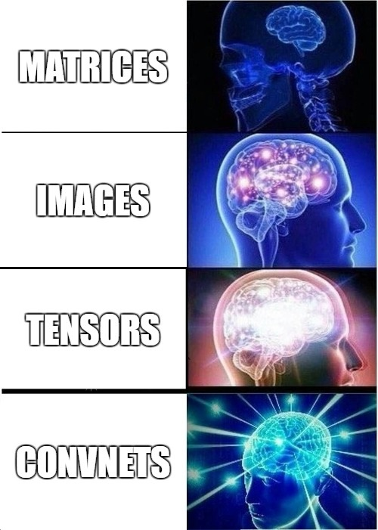
Arrays
Structured lists of numbers.
Vectors
Matrices
Images
Tensors
ConvNets

Slide 12
Arrays, Basic Properties
import numpy as np
a = np.array([[1,2,3],[4,5,6]],dtype=np.float32)
print a.ndim, a.shape, a.dtype
Arrays can have any number of dimensions, including zero (a scalar).
Arrays are typed: np.uint8, np.int64, np.float32, np.float64
Arrays are dense. Each element of the array exists and has the same type.

Slide 13
Arrays, creation
np.ones, np.zeros
np.arange
np.concatenate
np.astype
np.zeros_like, np.ones_like
np.random.random

Slide 14
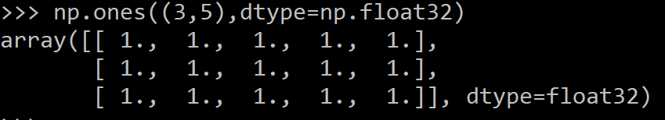
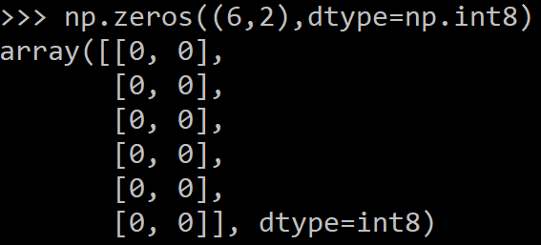
Arrays, creation
np.ones, np.zeros
np.arange
np.concatenate
np.astype
np.zeros_like, np.ones_like
np.random.random

Slide 15

Arrays, creation
np.ones, np.zeros
np.arange
np.concatenate
np.astype
np.zeros_like, np.ones_like
np.random.random

Slide 16
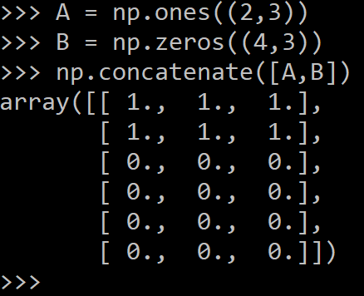
Arrays, creation
np.ones, np.zeros
np.arange
np.concatenate
np.astype
np.zeros_like, np.ones_like
np.random.random

Slide 17
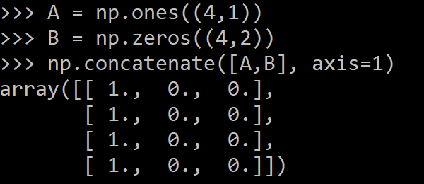
Arrays, creation
np.ones, np.zeros
np.arange
np.concatenate
np.astype
np.zeros_like, np.ones_like
np.random.random

Slide 18
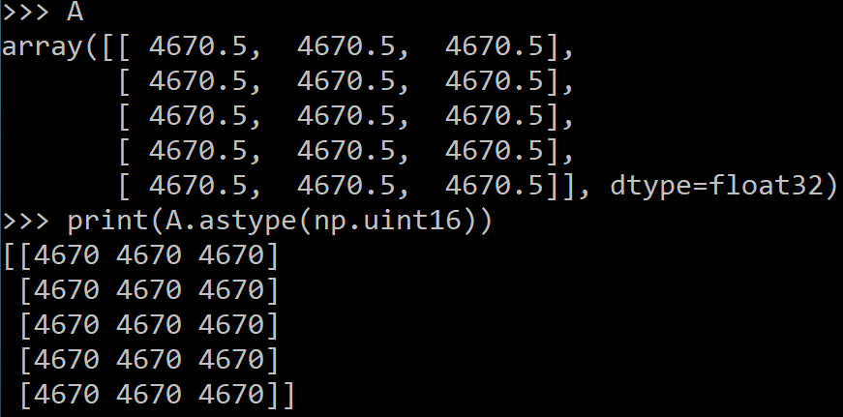
Arrays, creation
np.ones, np.zeros
np.arange
np.concatenate
np.astype
np.zeros_like, np.ones_like
np.random.random

Slide 19
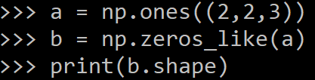
Arrays, creation
np.ones, np.zeros
np.arange
np.concatenate
np.astype
np.zeros_like, np.ones_like
np.random.random

Slide 20
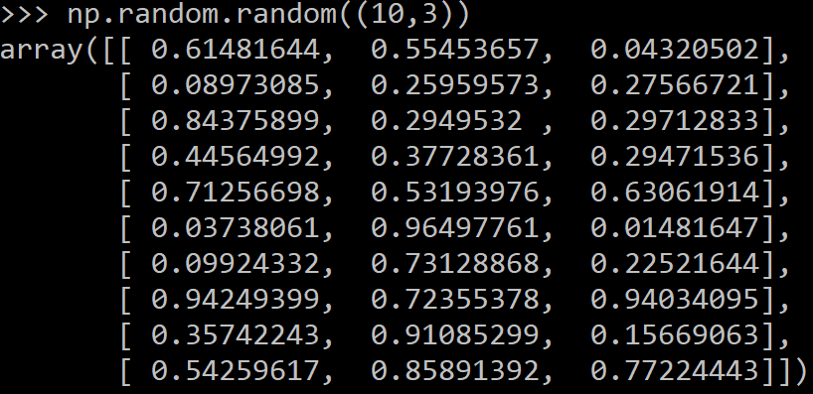
Arrays, creation
np.ones, np.zeros
np.arange
np.concatenate
np.astype
np.zeros_like, np.ones_like
np.random.random

Slide 21
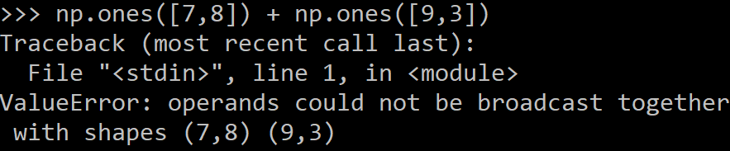
Arrays, danger zone
Must be dense, no holes.
Must be one type
Cannot combine arrays of different shape

Slide 22
Shaping
a = np.array([1,2,3,4,5,6])
a = a.reshape(3,2)
a = a.reshape(2,-1)
a = a.ravel()
Total number of elements cannot change.
Use -1 to infer axis shape
Row-major by default (MATLAB is column-major)

Slide 23
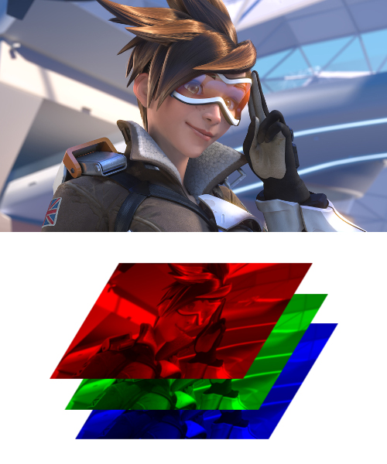
Image arrays
Images are 3D arrays: width, height, and channels
Common image formats:
height x width x RGB (band-interleaved)
height x width (band-sequential)
Gotchas:
Channels may also be BGR (OpenCV does this)
May be [width x height], not [height x width]

Slide 24
Math, universal functions
Also called ufuncs
Element-wise
Examples:
np.exp
np.sqrt
np.sin
np.cos
np.isnan

Slide 25

Math, universal functions
Also called ufuncs
Element-wise
Examples:
np.exp
np.sqrt
np.sin
np.cos
np.isnan

Slide 26
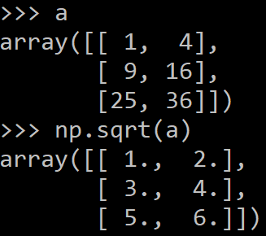
Math, universal functions
Also called ufuncs
Element-wise
Examples:
np.exp
np.sqrt
np.sin
np.cos
np.isnan

Slide 27
Goals for next meeting
Matplotlib in Python

