Slide 1

Data Science & Machine Learning Matplotlib In Python
Senior Mentor- Sachin Saxena

Slide 2
Matplotlib is a cross-platform, data visualization and graphical plotting library for Python.
It is numerical extension of NumPy.
Most of the matplotlib utilities lie under the pyplot submodule.
Pyplot is an API (Application Programming Interface) for Python’s matplotlib that effectively makes matplotlib a viable open source alternative to MATLAB.
The pyplot API consists of a hierarchy of Python code objects, and includes numerous functions topped by matplotlib.pyplot.

Slide 3
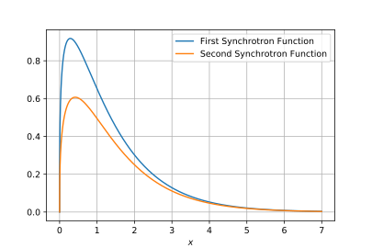
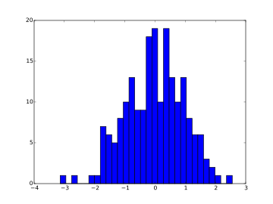
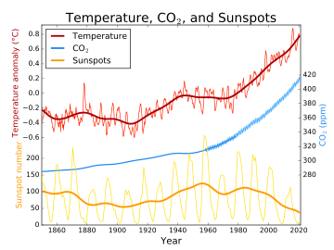
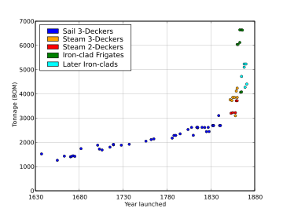
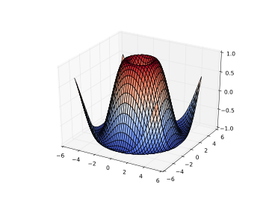
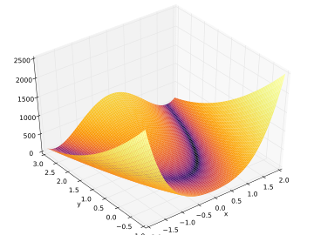
EXAMPLES OF MATPLOTLIB VISUALISATIONS
Line Plot
Histogram
Line Plot
Scatter Plot
3D Plot
3D Plot

Slide 4
We can create a Pyplot package via matplotlib by using alias.
Eg:
from matplotlib import pyplot as plt
Or
import matplotlib.pyplot as plt
Now the Pyplot package can be referred as plt.
plt.title(‘Title of the chart’) : Displays Title of the figure
plt.show() : Visualise the figure
plt.legends() : Displays specifications of the axis

Slide 5
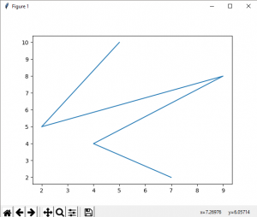
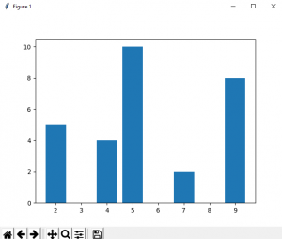
Basic plots in Matplotlib:
Line Plot
from matplotlib import pyplot as plt
# x-axis values
x = [5, 2, 9, 4, 7]
# Y-axis values
y = [10, 5, 8, 4, 2]
# Function to plot
plt.plot(x,y)
# function to show the plot
plt.show()
Bar Plot
# importing matplotlib module
from matplotlib import pyplot as plt
# x-axis values
x = [5, 2, 9, 4, 7]
# Y-axis values
y = [10, 5, 8, 4, 2]
# Function to plot the bar
plt.bar(x,y)
# function to show the plot
plt.show()

Slide 6
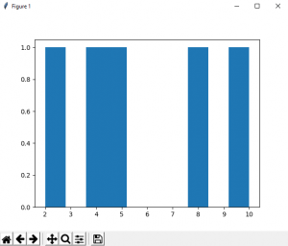
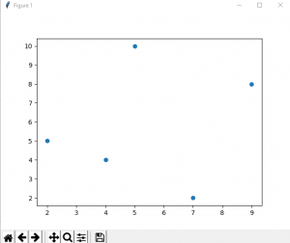
Histogram
# importing matplotlib module
from matplotlib import pyplot as plt
# Y-axis values
y = [10, 5, 8, 4, 2]
# Function to plot histogram
plt.hist(y)
# Function to show the plot
plt.show()
Scatter Plot
# importing matplotlib module
from matplotlib import pyplot as plt
# x-axis values
x = [5, 2, 9, 4, 7]
# Y-axis values
y = [10, 5, 8, 4, 2]
# Function to plot scatter
plt.scatter(x, y)
# function to show the plot
plt.show()

Slide 7
Parameters: This function accepts parameters that enables us to set axes scales and format the graphs.
These parameters are mentioned below :-
plot(x, y) : plot x and y using default line style and color.
plot.axis([xmin, xmax, ymin, ymax]) : scales the x-axis and y-axis from minimum to maximum values
plot.(x, y, color=’green’, marker=’o’, linestyle=’dashed’, linewidth=2, markersize=12) :
x and y co-ordinates are marked using circular markers of size 12 and green color line with — style of width 2
plot.xlabel(‘X-axis’) : names x-axis
plot.ylabel(‘Y-axis’) : names y-axis
plot(x, y, label = ‘Sample line ‘) : plotted Sample Line will be displayed as a legend

Slide 8
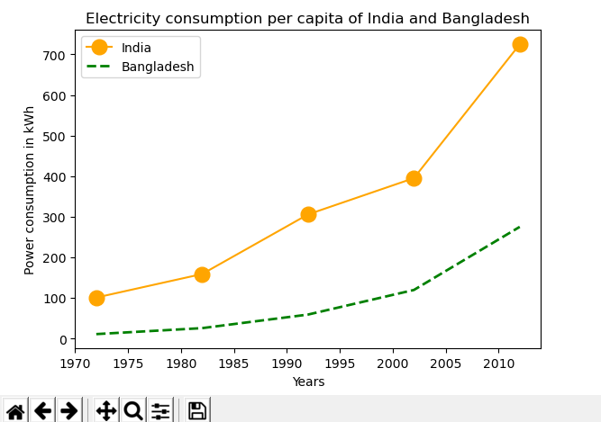
# Python Program to illustrate Linear Plotting
import matplotlib.pyplot as plt
year = [1972, 1982, 1992, 2002, 2012]
e_india = [100.6, 158.61, 305.54, 394.96, 724.79]
e_bangladesh = [10.5, 25.21, 58.65, 119.27, 274.87]
# formatting of line style and
# plotting of co-ordinates
plt.plot(year, e_india, color ='orange’, marker ='o', markersize=12, label ='India')
plt.plot(year, e_bangladesh, color ='g’, linestyle ='dashed', linewidth = 2,
label ='Bangladesh')
plt.xlabel('Years')
plt.ylabel('Power consumption in kWh')
plt.title('Electricity consumption per \capita of India and Bangladesh')
plt.legend()
plt.show()

Slide 9
Axes Class
Axes allow placement of plots at any location in the figure.
axes() or add_axes() function creates axes object with argument, where argument is a list of 4 elements [left, bottom, width, height] .
add_axes([left, bottom, width, height])
axes([left, bottom, width, height])
Adding legend to the plot figure can be done by calling the legend() function of the axes class. It consists of three arguments.
ax.legend(handles, labels, loc)
plot() function of the axes class plots the values of one array versus another as line or marker.
plt.plot(X, Y, ‘CLM’)

Slide 10
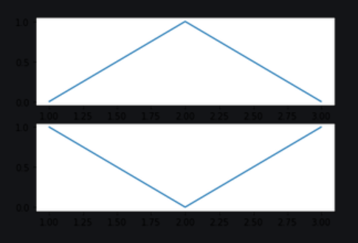
SUBPLOTS
matplotlib.pyplot.subplots method returns the figure along with Axes object or array of Axes object. nrows, ncols.
# importing library
import matplotlib.pyplot as plt
# Some data to display
x = [1, 2, 3]
y = [0, 1, 0]
z = [1, 0, 1]
# Creating 2 subplots
fig, ax = plt.subplots(2)
# Accessing each axes object to plot the data through returned array
ax[0].plot(x, y)
ax[1].plot(x, z)

Slide 11
We use matplotlib.axes._axes.Axes.set_title(label) method to set title (string label) for the current subplot Axes.
To set a single main title for all subplots, suptitle() method is used.
suptitle(self, t, **kwargs)
We use matplotlib.axes.Axes.set_axis_off() to turn the x-and y-pivot off influencing the axis lines, ticks, ticklabels, network and axis marks as well.
We can use different parameters to adjust the grid and each plot size.
ncols : pass number of columns you want in Grid.
nrows : pass number of rows we want in Grid to make subplots.
width_ratios : set width ratio of subplot(adjust the width of plot).
height_ratios : set height ratio of subplot(adjust the height of plot).
wspace : give “wspace” amount of space vertically to separate the subplots.
hspace : give “hspace” amount of space horizontally to separate the subplots.

Slide 12
LEGENDS
The Following are some more attributes of function legend() :
shadow: [None or bool] Whether to draw a shadow behind the legend.It’s Default value is None.
markerscale: [None or int or float] The relative size of legend markers compared with the originally drawn ones.The Default is None.
numpoints: [None or int] The number of marker points in the legend when creating a legend entry for a Line2D (line).The Default is None.
fontsize: The font size of the legend.If the value is numeric the size will be the absolute font size in points.
facecolor: [None or “inherit” or color] The legend’s background color.
edgecolor: [None or “inherit” or color] The legend’s background patch edge color.
The attribute Loc in legend() is used to specify the location of the legend.Default value of loc is loc=”best” (upper left). The strings best upper right, upper left, lower left, lower right, right, center left, center right, lower center, upper center, and center place the legend at the corresponding corner of the axes/figure.
plt.legend(['Legend'], loc='upper left')

