Slide 1

Data Science & Machine Learning Pandas In Python
Senior Mentor- Sachin Saxena

Slide 2
Pandas In Python

Slide 3
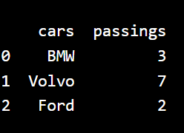
PANDAS
Pandas is a Python library used for working with data sets.
It offers data structures and operations for manipulating numerical tables and time series
We import Pandas Python Library in our application as:
import pandas OR import pandas as pd (using alias)
import pandas mydataset = { 'cars': ["BMW", "Volvo", "Ford"], 'passings': [3, 7, 2]} myvar = pandas.DataFrame(mydataset) print(myvar)

Slide 4
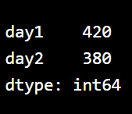
A Pandas Series is like a column in a table. It is a one-dimensional array holding data of any type.
pd.Series(array of elements)
Pd.Series(array of elements)[index] : access elements from index
With the index argument, you can name your own labels.
pd.Series((array of elements), index = ["x", "y", "z"])
You can access an item by referring to the label.
print(myvar["y"]) (return value of y)
We can also use dictionaries to create series:
import pandas as pd
calories = {"day1": 420, "day2": 380, "day3": 390}
myvar = pd.Series(calories, index = ["day1", "day2"])
print(myvar)

Slide 5
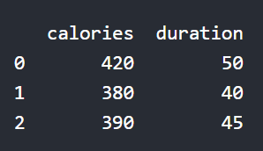
A Pandas DataFrame is a 2 dimensional data structure, like a 2 dimensional array, or a table with rows and columns.
import pandas as pd data = {"calories": [420, 380, 390],"duration": [50, 40, 45]} #load data into a DataFrame object: df = pd.DataFrame(data) print(df)
Pandas use the loc attribute to return one or more specified row(s
#refer to the row index: print(df.loc[0]))
#use a list of indexes: print(df.loc[[0, 1]])
#refer to the named index: print(df.loc["day2"])

Slide 6
.
If your data sets are stored in a file, Pandas can load them into a DataFrame using comma separated file (CSV file) as:
import pandas as pd
df = pd.read_csv('data.csv’)
print(df)
You can check your system's maximum rows with pd.options.display.max_rows statement.
Increase the maximum number of rows to display the entire DataFrame:
pd.options.display.max_rows = 9999

Slide 7
.
Pandas Read JSON
JSON is plain text, but has the format of an object, and is well known in the world of programming, including Pandas.
Imported as:
import pandas as pd
df = pd.read_json('data.json')
print(df.to_string())
JSON = Python Dictionary
JSON objects have the same format as Python dictionaries.
The head() method returns the headers and a specified number of rows, starting from the top.
The tail() method returns the headers and a specified number of rows, starting from the bottom

Slide 8
Pandas - Cleaning Data
Data cleaning means fixing bad data in your data set.
Bad data could be:
Empty cells
Data in wrong format
Wrong data
Duplicates
Return a new Data Frame with no empty cells:
import pandas as pd df = pd.read_csv('data.csv') new_df = df.dropna() print(new_df.to_string())
Remove all rows with NULL values:
df.dropna(inplace = True)

Slide 9
Replace NULL values with the number 130:
df.fillna(130, inplace = True)
Replace NULL values in the "Calories" columns with the number 130:
df["Calories"].fillna(130, inplace = True)
Calculate the MEAN, and replace any empty values with it:
x = df["Calories"].mean()
Calculate the MEDIAN, and replace any empty values with it:
x = df["Calories"].median()
Calculate the MODE, and replace any empty values with it:
x = df["Calories"].mode()[0]
Convert to date:
df['Date'] = pd.to_datetime(df['Date’])
Remove rows with a NULL value in the "Date" column:
df.dropna(subset=['Date'], inplace = True)

Slide 10
Replacing Values
Set "Duration" = 45 in row 7:
df.loc[7, 'Duration'] = 45
Removing Rows
Delete rows where "Duration" is higher than 120:
if df.loc[x, "Duration"] > 120: df.drop(x, inplace = True)
Returns True for every row that is a duplicate, othwerwise False:
print(df.duplicated())
Remove all duplicates:
df.drop_duplicates(inplace = True)

Slide 11
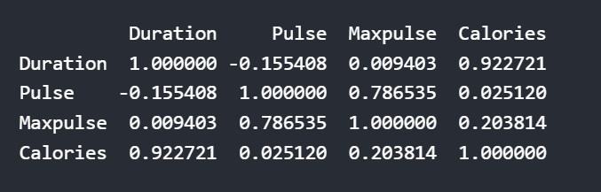
Pandas - Data Correlations
The corr() method calculates the relationship between each column in your data set.
df.corr()
The number varies from -1 to 1.
1 means that there is a 1 to 1 relationship (a perfect correlation), and for this data set, each time a value went up in the first column, the other one went up as well.
0.9 is also a good relationship, and if you increase one value, the other will probably increase as well.
-0.9 would be just as good relationship as 0.9, but if you increase one value, the other will probably go down.
0.2 means NOT a good relationship, meaning that if one value goes up does not mean that the other will.

Slide 12
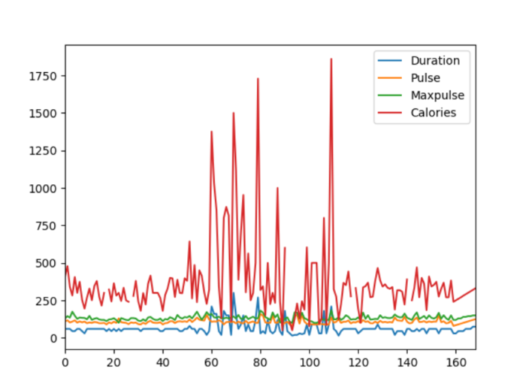
Pandas - Plotting
Pandas uses the plot() method to create diagrams.
import sys
import matplotlib
matplotlib.use('Agg')
import pandas as pd
import matplotlib.pyplot as plt
df = pd.read_csv('data.csv')
df.plot()
plt.show()
Scatter Plot
df.plot(kind = 'scatter', x = 'Duration', y = 'Calories’)
Histogram
df["Duration"].plot(kind = 'hist’)

