Slide 1

Computational Complexity In Python
Senior Mentor – Sachin Saxena

Slide 2
Computational Complexity
Computational complexity is a field from computer science which analyzes algorithms based on the amount resources required for running it.
The amount of required resources varies based on the input size, so the complexity is generally expressed as a function of n, where n is the size of the input.
It is important to note that when analyzing an algorithm we can consider the time complexity and space complexity.

Slide 3
Time Complexity
The time complexity is the computational complexity that describes the amount of time it takes to run an algorithm.
Time complexity is commonly estimated by counting the number of elementary operations performed by the algorithm, supposing that each elementary operation takes a fixed amount of time to perform.
When analyzing the time complexity of an algorithm we may find three cases:
best-case: this is the complexity of solving the problem for the best input. In our example, the best case would be to search for the value 1.
average-case: this is the average complexity of solving the problem. Average-case would be when we’re searching for some value in the “middle” of the list.
worst-case: this is the complexity of solving the problem for the worst input of size n. In our example, the worst-case would be to search for the value 8, which is the last element from the list.

Slide 4
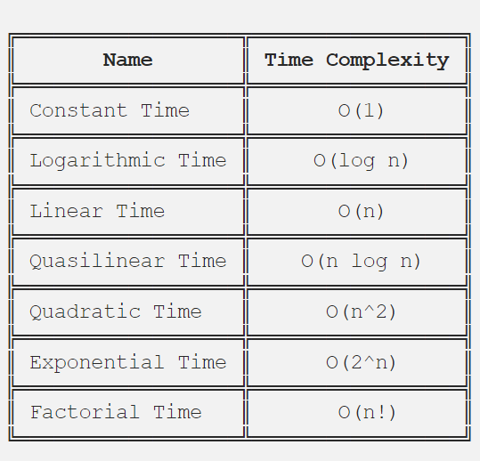
How we describe the time complexity of an algorithm?
Big-O notation, sometimes called “asymptotic notation”, is a mathematical notation that describes the limiting behavior of a function when the argument tends towards a particular value or infinity.
In computer science, Big-O notation is used to classify algorithms according to how their running time or space requirements grow as the input size (n) grows.

Slide 5
Constant Time — O(1)
An algorithm is said to have a constant time when it is not dependent on the input data (n). No matter the size of the input data, the running time will always be the same.
example:
if a > b: return True else: return False
Logarithmic Time — O(log n)
An algorithm is said to have a logarithmic time complexity when it reduces the size of the input data in each step.
example:
for index in range(0, len(data), 3): print(data[index])
Linear Time — O(n)
An algorithm is said to have a linear time complexity when the running time increases at most linearly with the size of the input data. This is the best possible time complexity when the algorithm must examine all values in the input data.
example:
for value in data: print(value)

Slide 6
Quasilinear Time — O(n log n)
An algorithm is said to have a quasilinear time complexity when each operation in the input data have a logarithm time complexity. It is commonly seen in sorting algorithms.
For example: for each value in the data1 (O(n)) use the binary search (O(log n)) to search the same value in data2.
for value in data1: result.append(binary_search(data2, value))
Quadratic Time — O(n²)
An algorithm is said to have a quadratic time complexity when it needs to perform a linear time operation for each value in the input data.
example:
for x in data: for y in data: print(x, y)
Exponential Time — O(2^n)
An algorithm is said to have an exponential time complexity when the growth doubles with each addition to the input data set.
Example: def fibonacci(n): if n <= 1: return n return fibonacci(n-1) + fibonacci(n-2)

Slide 7
Factorial — O(n!)
An algorithm is said to have a factorial time complexity when it grows in a factorial way based on the size of the input data.
example:
2! = 2 x 1 = 2 3! = 3 x 2 x 1 = 6 4! = 4 x 3 x 2 x 1 = 24 5! = 5 x 4 x 3 x 2 x 1 = 120 6! = 6 x 5 x 4 x 3 x 2 x 1 = 720 7! = 7 x 6 x 5 x 4 x 3 x 2 x 1 = 5.040 8! = 8 x 7 x 6 x 5 x 4 x 3 x 2 x 1 = 40.320

