Slide 1

Data Science & Machine Learning Iris dataset introduction and 2d scatter plot

Slide 2
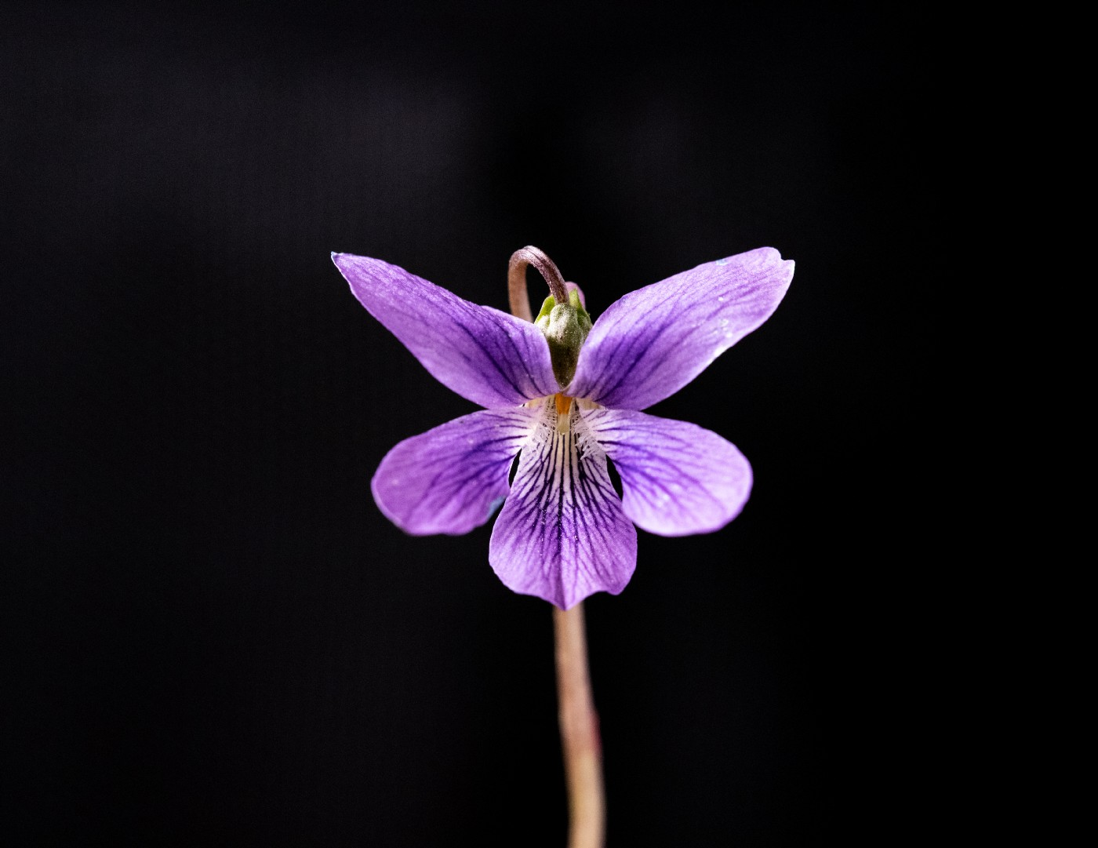
Exploratory Data Analysis : Iris Dataset

Slide 3
Iris Dataset
The Iris flower data set or Fisher’s Iris data set is one of the most famous multivariate data set used for testing various Machine Learning Algorithms.
Source Of Data
Data has been stored inside a csv file namely ‘iris.csv’

Slide 4
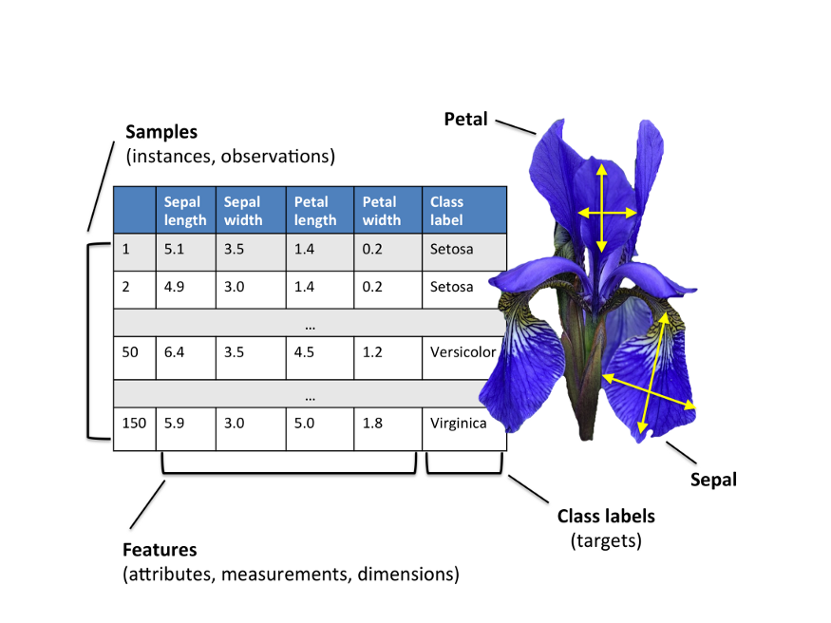
Exploratory Data Analysis : Iris Dataset

Slide 5
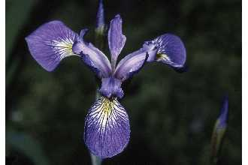
Iris Sample Data Set
Many of the exploratory data techniques are illustrated with the Iris Plant data set.
Can be obtained from the UCI Machine Learning Repository http://www.ics.uci.edu/~mlearn/MLRepository.html
From the statistician Douglas Fisher
Three flower types (classes):
Setosa
Virginica
Versicolour
Four (non-class) attributes
Sepal width and length
Petal width and length
Virginica. Robert H. Mohlenbrock. USDA NRCS. 1995. Northeast wetland flora: Field office guide to plant species. Northeast National Technical Center, Chester, PA. Courtesy of USDA NRCS Wetland Science Institute.

Slide 6
Iris Dataset
Loading data
iris_data = pd.read_csv(‘iris.csv’)
iris_data

Slide 7
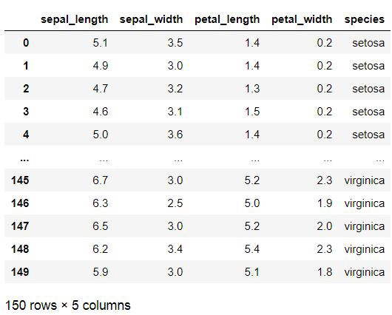
Iris Dataset

Slide 8
Goals for next meeting
3D Scatter Plot

