Slide 1

Data Science & Machine Learning 3D scatter plot and Pair plots

Slide 2
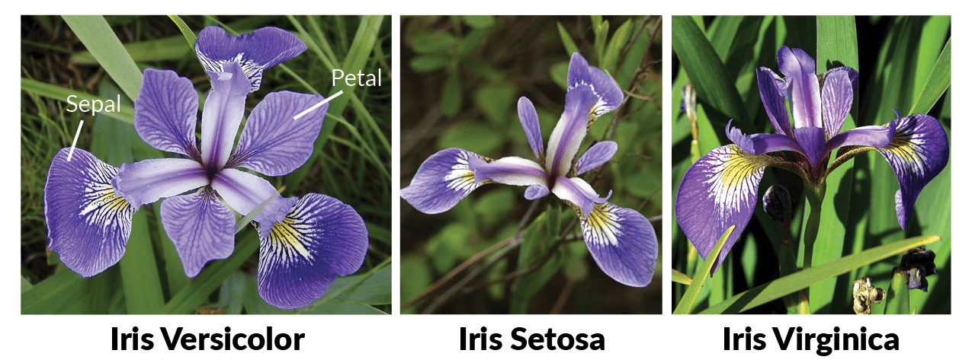
Iris Flower

Slide 3
Iris Dataset
px.scatter_3d(df, x="PetalLengthCm", y="PetalWidthCm", z="SepalLengthCm", size="SepalWidthCm",
color="Species", color_discrete_map = {"Joly": "blue", "Bergeron": "violet", "Coderre":"pink"})

Slide 4
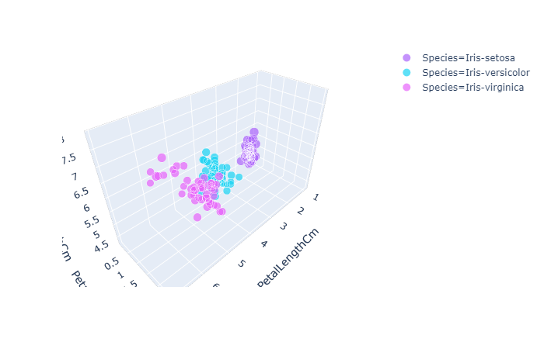
Iris Dataset

Slide 5
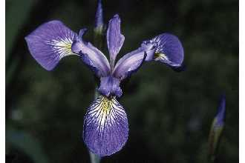
Iris Sample Data Set
Many of the exploratory data techniques are illustrated with the Iris Plant data set.
Can be obtained from the UCI Machine Learning Repository http://www.ics.uci.edu/~mlearn/MLRepository.html
From the statistician Douglas Fisher
Three flower types (classes):
Setosa
Virginica
Versicolour
Four (non-class) attributes
Sepal width and length
Petal width and length
Virginica. Robert H. Mohlenbrock. USDA NRCS. 1995. Northeast wetland flora: Field office guide to plant species. Northeast National Technical Center, Chester, PA. Courtesy of USDA NRCS Wetland Science Institute.

Slide 6
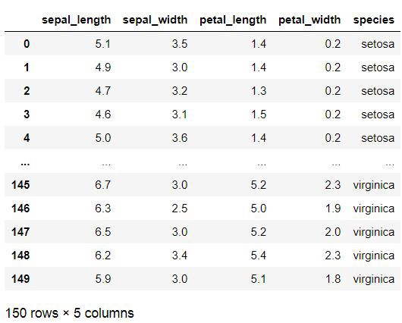
Iris Dataset

Slide 7
Goals for next meeting
What is dimensionality reduction?

