Slide 1

Data Science and Machine Learning
PCA algorithms
Senior Mentor – Sachin Saxena

Slide 2
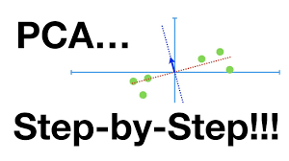
PCA
Principal Component
Analysis

Slide 3
What is PCA?
It is a statistical procedure that allows you to summarize the information content in large data tables by means of a smaller set of “summary indices” that can be more easily visualized and analyzed.

Slide 4
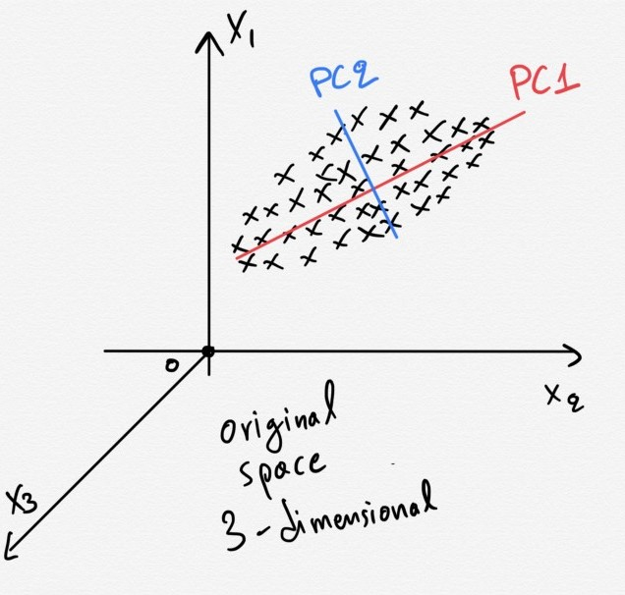
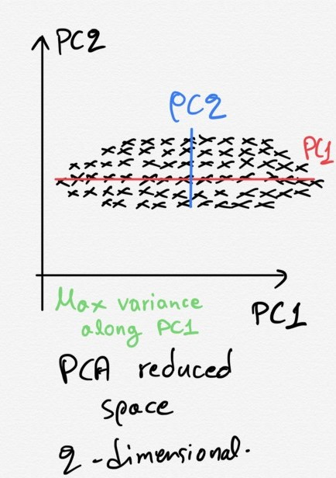
When/Why to use PCA?
Processing data where multi-colinearity
exists between the variables.
Used when the dimensions of the input
features are high .
For denoising and data compression.

Slide 5
Consider n x p data matrix with column-wise zero empirical mean
n- different repetition
p-particular feature
Mathematically,
the transformation is defined by a set of size l of p-dimensional vectors of weights or coefficients
w(k)= (w1,….,w p)(k) that map each row vector x(i)of X to a new vector of principal component scores
t(i)=(t1,…t l)(i) , given by
t k(i)= x (i) . w (k) for i=1,…,n l=1,…,l

Slide 6



First component
In order to maximize variance, the first weight vector w₍₁₎ thus has to satisfy
Equivalently, writing this in matrix form gives
Since w₍₁₎ has been defined to be a unit vector, it equivalently also satisfies
The quantity to be maximised can be recognised as a Rayleigh quotient.

Slide 7
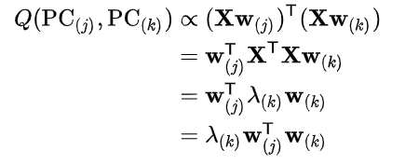


Covariances
The sample covariance Q between two of the different principal components over the dataset is given by:
In matrix form, the empirical covariance matrix for the original variables can be written
The empirical covariance matrix between the principal components becomes

Slide 8



Dimensionality Reduction
The transformation T = X W maps a data vector x_{(i)}
truncated transformation,
PCA learns a linear transformation where the columns of p × L matrix WL form an orthogonal basis .
minimising the total squared reconstruction error ,
a method called principal component regression

Slide 9

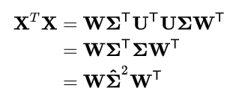
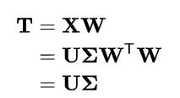

Singular value decomposition
the singular value decomposition (SVD) of X,
In terms of this factorization, the matrix X^{T}X can be written
Using the singular value decomposition the score matrix T can be written
As with the eigen-decomposition,

Slide 10



Properties of PCA
For any integer q, 1 ≤ q ≤ p, consider the orthogonal linear transformation
where y is a q-element vector and B’
Consider again the orthonormal transformation
with x,B,A and (y1+y2+…+yn) defined as before. Then tr(y1+y2+…+yn)is minimized by B=Aq* where Aq* consists of the last q columns of A
Spectral decomposition of Σ

