Slide 1

Data Science and Machine Learning
Senior Mentor – Sachin Saxena

Slide 2
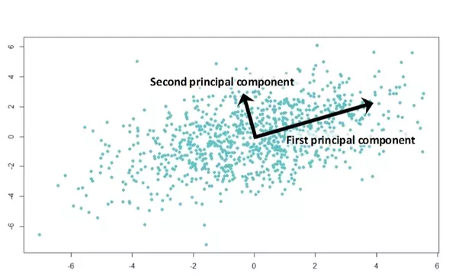
PCA
Principal Component
Analysis

Slide 3
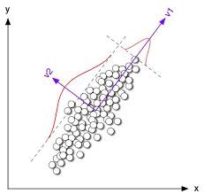
PCA is extensionally used for dimensionality reduction for the visualization of high dimensional data.
2-D TO 1-D
We want to find the direction of v1
variable where the variance is maximum.
So. finally 2-D data set having (x,y) variable
can be converted to 1-D variable in direction of v1.

Slide 4
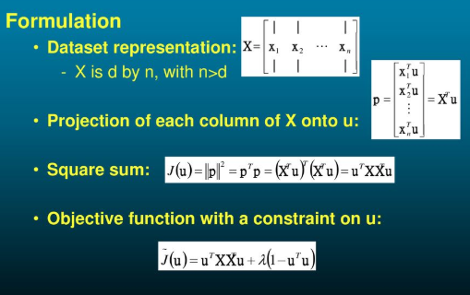
Mathematical Notation
Find u1 such that variance of projected summation of x(i) is maximum.

Slide 5
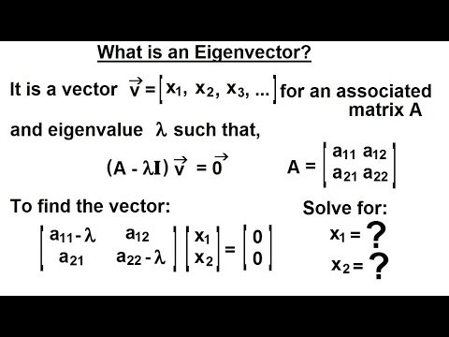
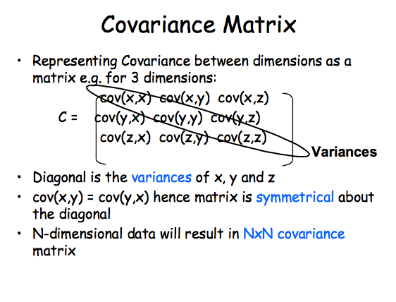
Eigenvalues and Eigenvectors
We will find covariance matrix

Slide 6
PCA on MNIST dataset
1 — Data preprocessing
It is mandatory before applying PCA to convert mean=0 and standard deviation =1 for each variable.
from sklearn.preprocessing import StandardScaler standardized_data = StandardScaler().fit_transform(data) print(standardized_data.shape)
2 — Compute covariance matrix
#find the co-variance matrix which is : A^T * A sample_data = standardized_data # matrix multiplication using numpy covar_matrix = np.matmul(sample_data.T , sample_data) print ( “The shape of variance matrix = “, covar_matrix.shape)

Slide 7
3 — Compute eigen value and eigen vector
# finding the top two eigen-values and corresponding eigen-vectors from scipy.linalg import eigh# the parameter ‘eigvals’ is defined (low value to heigh value) # this code generates only the top 2 (782 and 783)(index) eigenvalues. values, vectors = eigh(covar_matrix, eigvals=(782,783))print(“Shape of eigen vectors = “,vectors.shape) # converting the eigen vectors into (2,d) shape for easyness of further computations vectors = vectors.Tprint(“Updated shape of eigen vectors = “,vectors.shape) # here the vectors[1] represent the eigen vector corresponding 1st principal eigen vector
import matplotlib.pyplot as plt new_coordinates = np.matmul(vectors, sample_data.T)
import pandas as pdnew_coordinates = np.vstack((new_coordinates, labels)).T dataframe = pd.DataFrame(data=new_coordinates, columns=(“1st_principal”, “2nd_principal”, “label”)) print(dataframe.head())

Slide 8
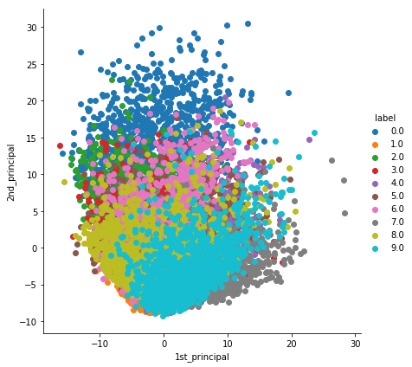
4 — Plotting
# plotting the 2d data points with seaborn import seaborn as sn sn.FacetGrid(dataframe, hue=”label”, size=6).map(plt.scatter, ‘1st_principal’, ‘2nd_principal’).add_legend() plt.show()
PCA is mainly used for dimensionality reduction, not for visualization.
5 — PCA for dimension reduction
# initializing the pca from sklearn import decomposition pca = decomposition.PCA()# PCA for dimensionality redcution (non-visualization) pca.n_components = 784 pca_data = pca.fit_transform(sample_data)percentage_var_explained = pca.explained_variance_ / np.sum(pca.explained_variance_); cum_var_explained = np.cumsum(percentage_var_explained)

Slide 9
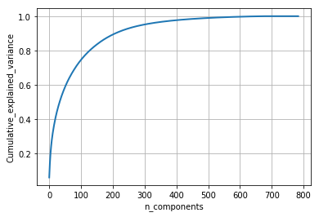
Plotting
# Plot the PCA spectrum plt.figure(1, figsize=(6, 4)) plt.clf() plt.plot(cum_var_explained, linewidth=2) plt.axis(‘tight’) plt.grid() plt.xlabel(‘n_components’) plt.ylabel(‘Cumulative_explained_variance’) plt.show()

Slide 10
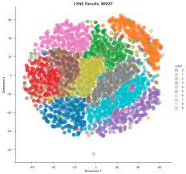
T-SNE
Distributed Stochastic Neighbourhood Embedding
T-distributed Stochastic Neighbor Embedding (t-SNE) is an unsupervised machine learning algorithm for visualization developed by Laurens van der Maaten and Geoffrey Hinton.

