Slide 1

Data Science and Machine Learning
PCA with MINST Dataset
Senior Mentor – Sachin Saxena

Slide 2
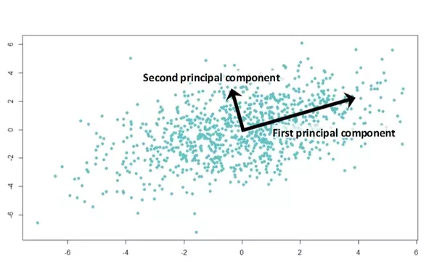
PCA
Principal Component
Analysis

Slide 3
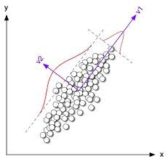
PCA is extensionally used for dimensionality reduction for the visualization of high dimensional data.
2-D TO 1-D
We want to find the direction of v1
variable where the variance is maximum.
So. finally 2-D data set having (x,y) variable
can be converted to 1-D variable in direction of v1.

Slide 4
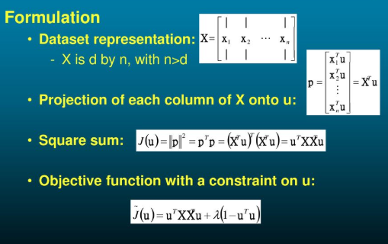
Mathematical Notation
Find u1 such that variance of projected summation of x(i) is maximum.

Slide 5
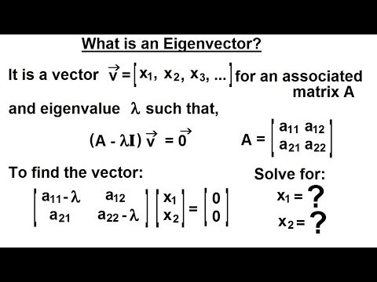
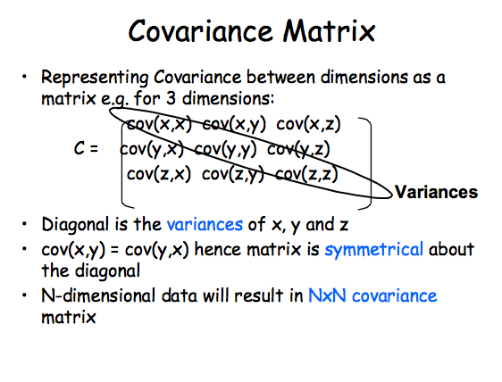
Eigenvalues and Eigenvectors
We will find covariance matrix

Slide 6
PCA on MNIST dataset
1 — Data preprocessing
It is mandatory before applying PCA to convert mean=0 and standard deviation =1 for each variable.
from sklearn.preprocessing import StandardScaler standardized_data = StandardScaler().fit_transform(data) print(standardized_data.shape)
2 — Compute covariance matrix
#find the co-variance matrix which is : A^T * A sample_data = standardized_data # matrix multiplication using numpy covar_matrix = np.matmul(sample_data.T , sample_data) print ( “The shape of variance matrix = “, covar_matrix.shape)

Slide 7
3 — Compute eigen value and eigen vector
# finding the top two eigen-values and corresponding eigen-vectors from scipy.linalg import eigh# the parameter ‘eigvals’ is defined (low value to heigh value) # this code generates only the top 2 (782 and 783)(index) eigenvalues. values, vectors = eigh(covar_matrix, eigvals=(782,783))print(“Shape of eigen vectors = “,vectors.shape) # converting the eigen vectors into (2,d) shape for easyness of further computations vectors = vectors.Tprint(“Updated shape of eigen vectors = “,vectors.shape) # here the vectors[1] represent the eigen vector corresponding 1st principal eigen vector
import matplotlib.pyplot as plt new_coordinates = np.matmul(vectors, sample_data.T)
import pandas as pdnew_coordinates = np.vstack((new_coordinates, labels)).T dataframe = pd.DataFrame(data=new_coordinates, columns=(“1st_principal”, “2nd_principal”, “label”)) print(dataframe.head())

Slide 8
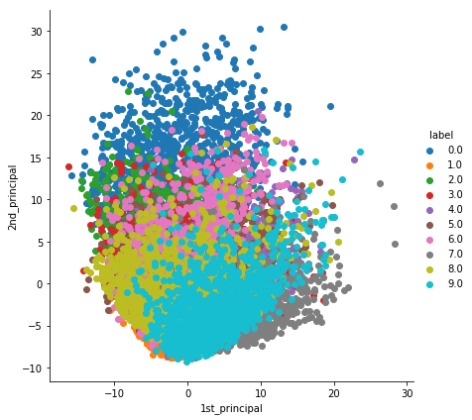
4 — Plotting
# plotting the 2d data points with seaborn import seaborn as sn sn.FacetGrid(dataframe, hue=”label”, size=6).map(plt.scatter, ‘1st_principal’, ‘2nd_principal’).add_legend() plt.show()
PCA is mainly used for dimensionality reduction, not for visualization.
5 — PCA for dimension reduction
# initializing the pca from sklearn import decomposition pca = decomposition.PCA()# PCA for dimensionality redcution (non-visualization) pca.n_components = 784 pca_data = pca.fit_transform(sample_data)percentage_var_explained = pca.explained_variance_ / np.sum(pca.explained_variance_); cum_var_explained = np.cumsum(percentage_var_explained)

Slide 9
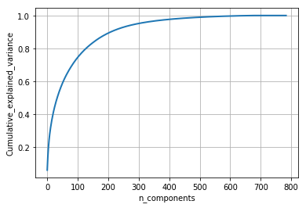
Plotting
# Plot the PCA spectrum plt.figure(1, figsize=(6, 4)) plt.clf() plt.plot(cum_var_explained, linewidth=2) plt.axis(‘tight’) plt.grid() plt.xlabel(‘n_components’) plt.ylabel(‘Cumulative_explained_variance’) plt.show()

Slide 10
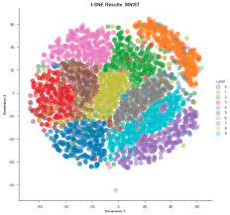
T-SNE
Distributed Stochastic Neighbourhood Embedding
T-distributed Stochastic Neighbor Embedding (t-SNE) is an unsupervised machine learning algorithm for visualization developed by Laurens van der Maaten and Geoffrey Hinton.

Slide 11
Data Science and Machine Learning
T-SNE method
Senior Mentor – Sachin Saxena

Slide 12
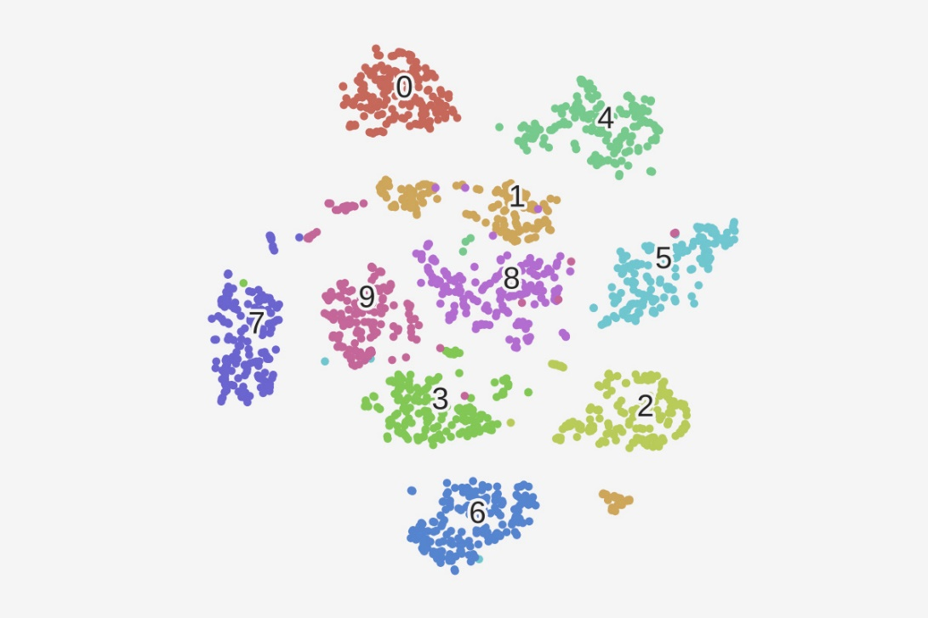
T-SNE
Distributed Stochastic Neighbourhood Embedding

Slide 13
What is t-SNE?
t-distributed stochastic neighbor embedding (t-SNE) is a statistical method for visualizing high-dimensional data by giving each datapoint a location in a two or three-dimensional map.

Slide 14
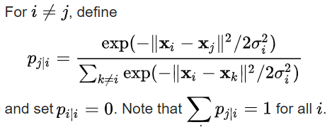
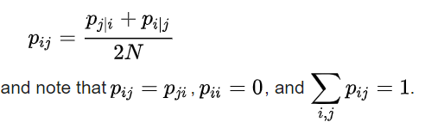
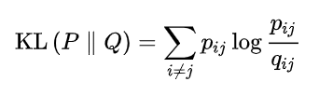
Given a set of N high-dimensional objects X1, X2,…., XN , t-SNE first computes probabilities pij that are proportional to the similarity of objects Xi and Xj, as follows.
Now define,
The locations of the points yi

Slide 15
GEOMETRIC INTUTION
lets take an example,
assume in a D dimension space we have five data points,
x1,x2,x3,x4,x5
T-SNE tries to embbed point from D dimension to
2 dimension such that the distance between the
neigbours remain same as it was in D dimensions.

Slide 16
lets assume T-SNE successfully covert D dimension
data into 2D or 2 dimension so lets take new points
in 2D be x1’(corresponding point to x1),
x2’(corresponding point to x2), x3’, x4’,x5’.
d(x1,x2) would be approximately equal to d(x1’,x2’)

Slide 17
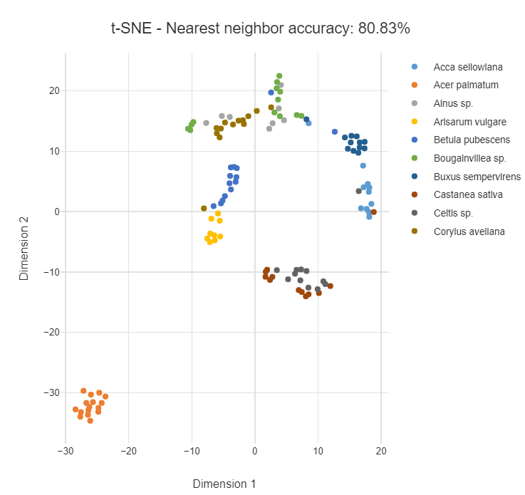
How to use t-SNE?
The t-SNE algorithm models the probability distribution of neighbors around each point.
t- SNE visualizations
These include the elongation and aspect ratio of the leaves.

Slide 18
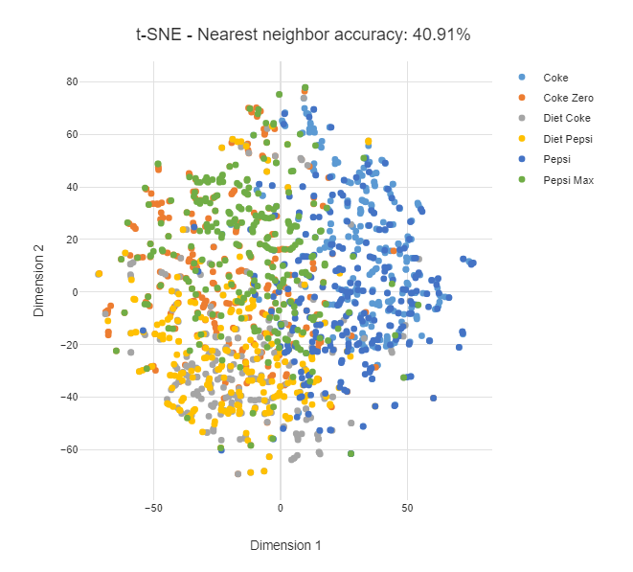
Perplexity
The mapping of each point considers only its very closest neighbors. We tend to see many small groups of a few points.

Slide 19
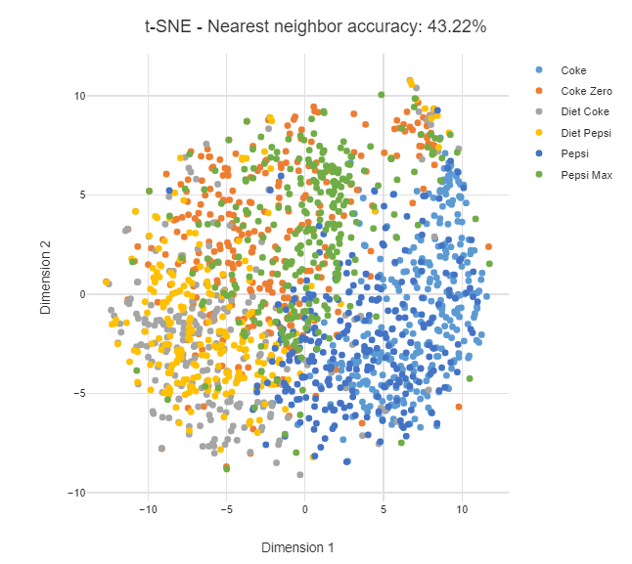
Below we see the points are more evenly spread out, as though they are less-strongly attracted to each other.

Slide 20
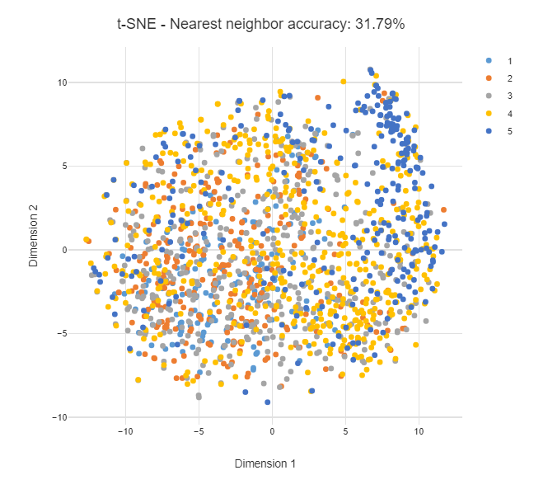
Insights into prediction
expect to achieve high accuracy.

Slide 21
Apply T-SNE on MNIST dataset
MNIST is 784-dimensional data try which is being projected by T-SNE into 2-D data.
# TSNE data_1000 = standardized_data[0:1000,:] labels_1000 = labels[0:1000]model = TSNE(n_components=2, random_state=0) # configuring the parameteres # the number of components = 2 # default perplexity = 30 # default learning rate = 200 # default Maximum number of iterations for the optimization = 1000tsne_data = model.fit_transform(data_1000)
# creating a new data frame which help us in ploting the result data tsne_data = np.vstack((tsne_data.T, labels_1000)).T tsne_df = pd.DataFrame(data=tsne_data, columns=(“Dim_1”, “Dim_2”, “label”))# Ploting the result of tsne sn.FacetGrid(tsne_df, hue=”label”, size=6).map(plt.scatter, ‘Dim_1’, ‘Dim_2’).add_legend() plt.show()

Slide 22
