Slide 1

Data Science & Machine Learning Classification vs Regression
Senior Mentor- Sachin Saxena

Slide 2
Supervised vs. Unsupervised Learning
Supervised Learning:
All the predictors, X_{i}, and the response, Y_{i}, are observed.
Many regression and classification methods
Unsupervised Learning:
Here, only the X_{i}’s are observed (not Y_{i}’s).
We need to use the X_{i}’s to guess what Y would have been, and then build a model form there.
Clustering and principal components analysis

Slide 3
Terminology
Notation
Input X: feature, predictor, or independent variable
Output Y: response, dependent variable
Categorization
Supervised learning vs. unsupervised learning
Key question: Is Y available in the training data?
Regression vs. Classification
Key question: Is Y quantitative or qualitative?

Slide 4
Terminology (cont.)
Quantitative:
Measurements or counts, recorded as numerical values (e.g. height, temperature, etc.)
Qualitative: group or categories
Ordinal: possesses a natural ordering (e.g. shirt sizes)
Nominal: just name the categories (e.g. marital status, gender, etc.)

Slide 5
Terminology (cont.)

Slide 6
Supervised Learning

Slide 7
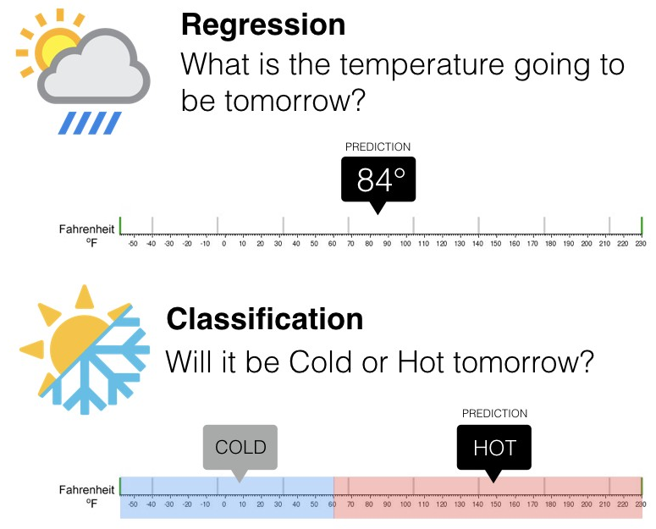
Classification vs Regression

Slide 8
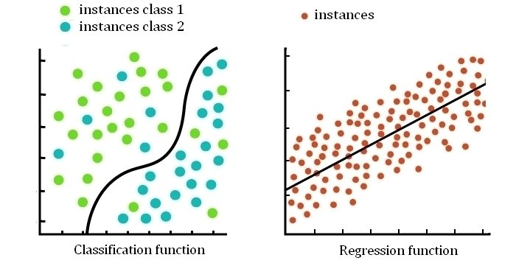
Supervised Learning: Regression vs. Classification

Slide 9
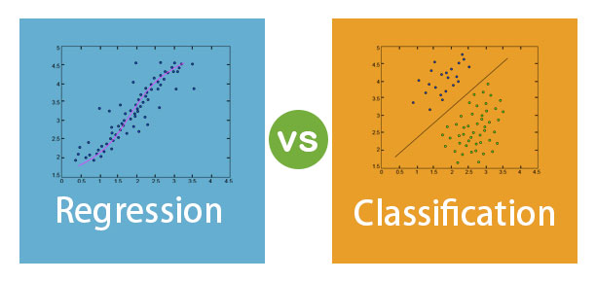
Supervised Learning: Regression vs. Classification

Slide 10
Goals for next meeting
K Nearest Neighbours

