Slide 1

Data Science & Machine Learning K- Nearest Neighbour
Senior Mentor- Sachin Saxena

Slide 2
Nearest Neighbor Search
Given: a set P of n points in R^{d}
Goal: a data structure, which given a query point q, finds the nearest neighbor p of q in P
p
q

Slide 3
K-NN
(K-l)-NN: Reduce complexity by having a threshold on the majority. We could restrict the associations through (K-l)-NN.

Slide 4
K-NN
(K-l)-NN: Reduce complexity by having a threshold on the majority. We could restrict the associations through (K-l)-NN. K=5

Slide 5
K-NN
Select 5 Nearest Neighbors
as Value of K=5 by Taking their
Euclidean Disances

Slide 6
K-NN
Decide if majority of Instances over a given value of K Here, K=5.

Slide 7
Example
Points | X1 (Acid Durability ) | X2(strength) | Y=Classification
P1 | 7 | 7 | BAD
P2 | 7 | 4 | BAD
P3 | 3 | 4 | GOOD
P4 | 1 | 4 | GOOD

Slide 8
KNN Example
Points | X1(Acid Durability) | X2(Strength) | Y(Classification)
P1 | 7 | 7 | BAD
P2 | 7 | 4 | BAD
P3 | 3 | 4 | GOOD
P4 | 1 | 4 | GOOD
P5 | 3 | 7 | ?

Slide 9
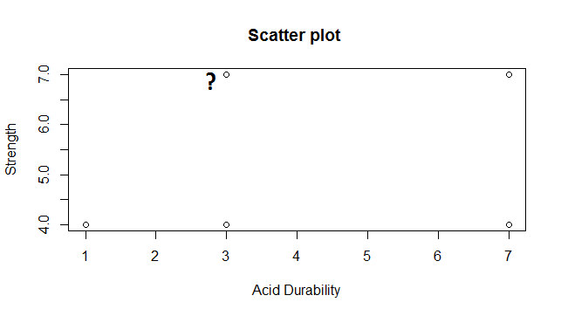
Scatter Plot

Slide 10
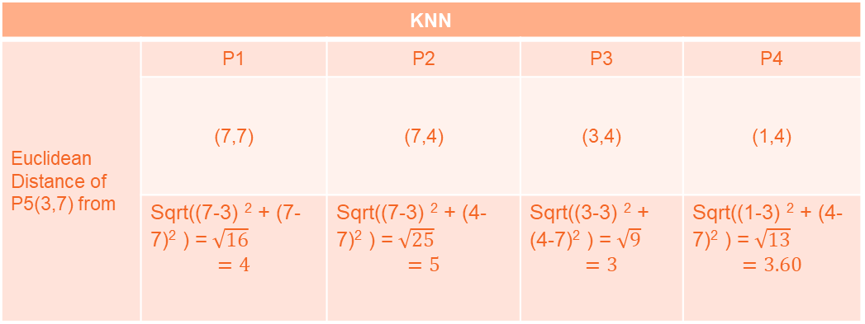
Euclidean Distance From Each Point
KNN
Euclidean Distance of P5(3,7) from | P1 | P2 | P3 | P4
 | (7,7) | (7,4) | (3,4) | (1,4)
 | Sqrt((7-3) ² + (7-7)² ) =$\sqrt{16}$ $$=4$$ | Sqrt((7-3) ² + (4-7)² ) =$\sqrt{25}$ $$=5$$ | Sqrt((3-3) ² + (4-7)² ) =$\sqrt{9}$ $$=3$$ | Sqrt((1-3) ² + (4-7)² ) =$\sqrt{13}$ $$=3.60$$

Slide 11
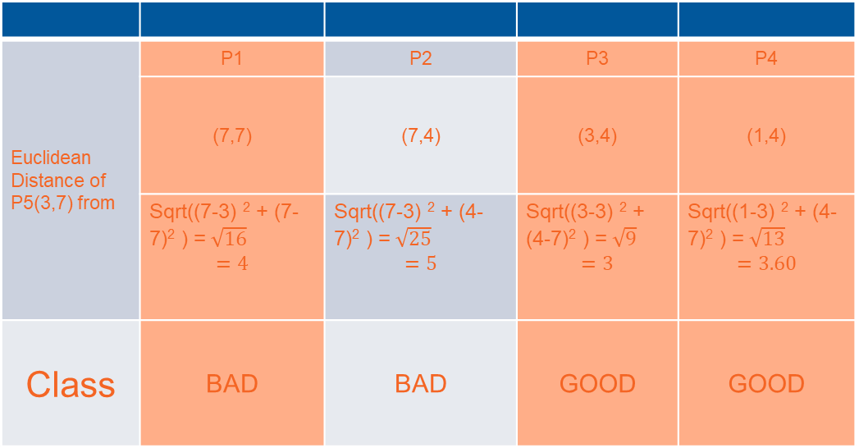
3 Nearest NeighBour
Euclidean Distance of P5(3,7) from | P1 | P2 | P3 | P4
 | (7,7) | (7,4) | (3,4) | (1,4)
 | Sqrt((7-3) ² + (7-7)² ) =$\sqrt{16}$ $$=4$$ | Sqrt((7-3) ² + (4-7)² ) =$\sqrt{25}$ $$=5$$ | Sqrt((3-3) ² + (4-7)² ) =$\sqrt{9}$ $$=3$$ | Sqrt((1-3) ² + (4-7)² ) =$\sqrt{13}$ $$=3.60$$
Class | BAD | BAD | GOOD | GOOD

Slide 12
KNN Classification
Points | X1(Durability) | X2(Strength) | Y(Classification)
P1 | 7 | 7 | BAD
P2 | 7 | 4 | BAD
P3 | 3 | 4 | GOOD
P4 | 1 | 4 | GOOD
P5 | 3 | 7 | GOOD

Slide 13
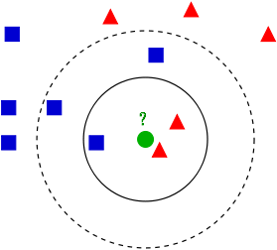
Variation In KNN

Slide 14
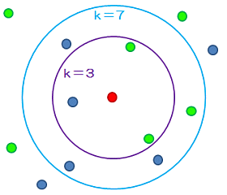
Different Values of K

Slide 15
K-Nearest Neighbor
Features
All instances correspond to points in an n-dimensional Euclidean space
Classification is delayed till a new instance arrives
Classification done by comparing feature vectors of the different points
Target function may be discrete or real-valued

Slide 16
1-Nearest Neighbor

Slide 17
3-Nearest Neighbor

Slide 18
Instance-Based Classifiers
Store the training records
Use training records to predict the class label of unseen cases
Atr1 | ……... | AtrN | Class
 |  |  | A
 |  |  | B
 |  |  | B
 |  |  | C
 |  |  | A
 |  |  | C
 |  |  | B
Unseen Case
Atr1 | ……... | AtrN
Set of Stored Cases

Slide 19
Instance Based Classifiers
Examples:
Rote-learner
Memorizes entire training data and performs classification only if attributes of record match one of the training examples exactly
Nearest neighbor
Uses k “closest” points (nearest neighbors) for performing classification

Slide 20
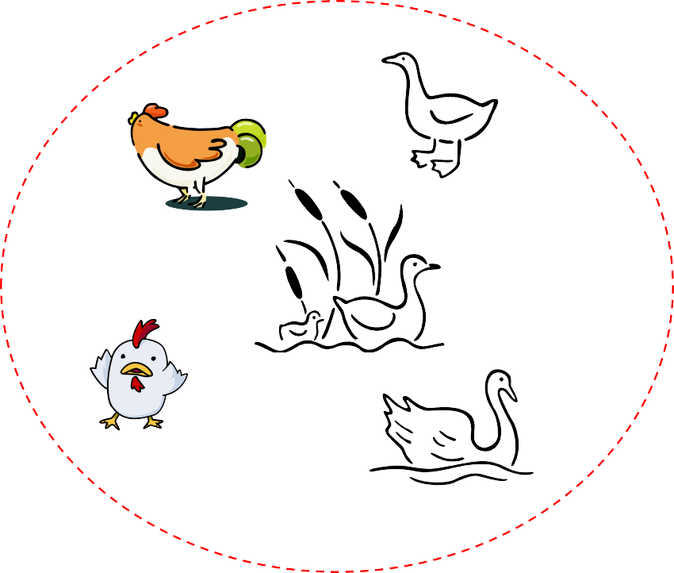
Nearest Neighbor Classifiers
Basic idea:
– If it walks like a duck, quacks like a duck, then it’s probably a duck
Compute Distance
Test Record
Training Records
Choose k of the “nearest” records

Slide 21

Nearest-Neighbor Classifiers
Unknown record
l Requires three things
The set of stored records
Distance Metric to compute distance between records
The value of k, the number of nearest neighbors to retrieve
l To classify an unknown record:
Compute distance to other training records
Identify k nearest neighbors
Use class labels of nearest neighbors to determine the class label of unknown record (e.g., by taking majority vote)

Slide 22

Definition of Nearest Neighbor
X
X
X
(a) 1-nearest neighbor (b) 2-nearest neighbor (c) 3-nearest neighbor
K-nearest neighbors of a record x are data points that have the k smallest distance to x

Slide 23
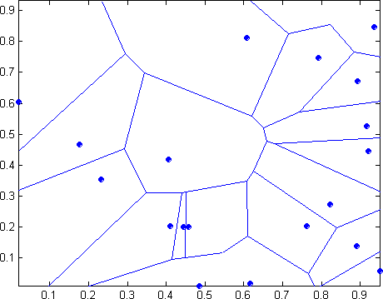
1 nearest-neighbor
Voronoi Diagram

Slide 24
Goals for next meeting
Coding example

