Slide 1

Data Science & Machine Learning Linear Regression

Slide 2
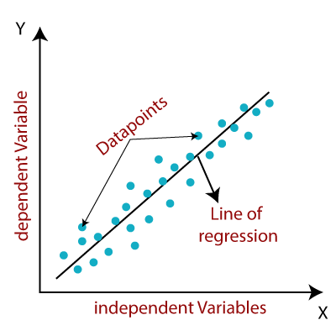
Linear regression
In correlation, the two variables are treated as equals. In regression, one variable is considered independent (=predictor) variable (X) and the other the dependent (=outcome) variable Y.

Slide 3
What is “Linear”?
Remember this:
Y=mX+B?
m
B

Slide 4
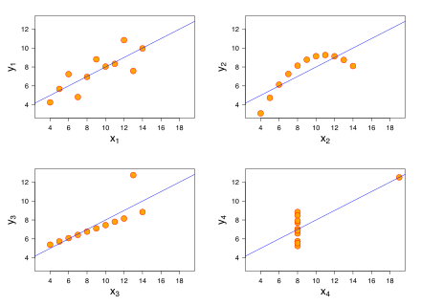
What’s Slope?
A slope of 2 means that every 1-unit change in X yields a 2-unit change in Y.

Slide 5
Prediction
If you know something about X, this knowledge helps you predict something about Y. (Sound familiar?…sound like conditional probabilities?)

Slide 6
Regression equation…
Expected value of y at a given level of x=

Slide 7
Predicted value for an individual…
y_{i}= α + β*x_{i} + random error_{i}
Fixed – exactly on the line
Follows a normal distribution

Slide 8
Assumptions (or the fine print)
Linear regression assumes that…
1. The relationship between X and Y is linear
2. Y is distributed normally at each value of X
3. The variance of Y at every value of X is the same (homogeneity of variances)
4. The observations are independent

Slide 9
The standard error of Y given X is the average variability around the regression line at any given value of X. It is assumed to be equal at all values of X.
Sy/x
Sy/x
Sy/x
Sy/x
Sy/x
Sy/x

Slide 10
Regression Picture
y_{i}
C
A
B
y
B
A
C
y_{i}
*Least squares estimation gave us the line (β) that minimized C²
x
R²=SSreg/SStotal
A² B² C²
SS_{total}
Total squared distance of observations from naïve mean of y
Total variation
SS_{reg}
Distance from regression line to naïve mean of y
Variability due to x (regression)
SS_{residual}
Variance around the regression line
Additional variability not explained by x—what least squares method aims to minimize

Slide 11
Recall example: cognitive function and vitamin D
Hypothetical data loosely based on [1]; cross-sectional study of 100 middle-aged and older European men.
Cognitive function is measured by the Digit Symbol Substitution Test (DSST).

Slide 12
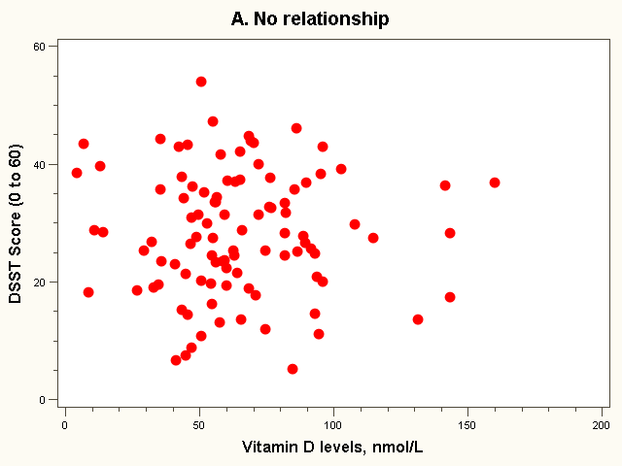
Dataset 1: no relationship

Slide 13
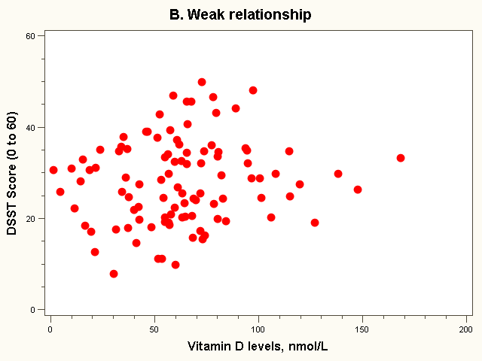
Dataset 2: weak relationship

Slide 14
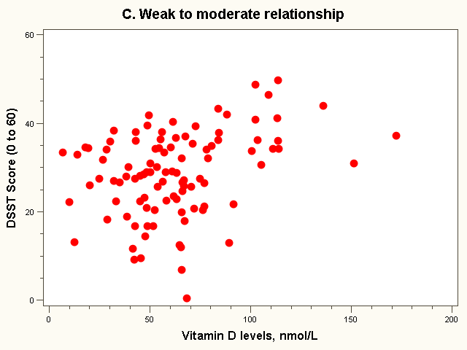
Dataset 3: weak to moderate relationship

Slide 15
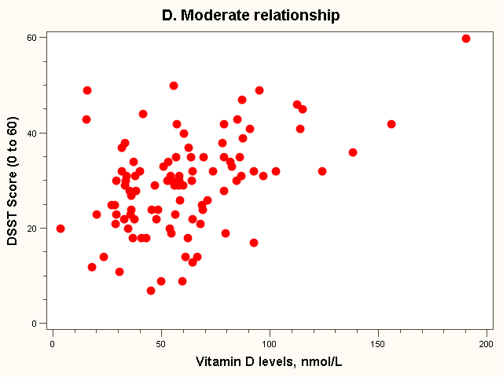
Dataset 4: moderate relationship

Slide 16
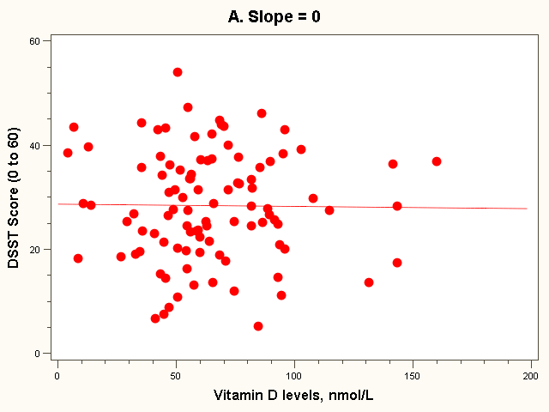
The “Best fit” line
Regression equation:
E(Yi) = 28 + 0*vit Di (in 10 nmol/L)

Slide 17
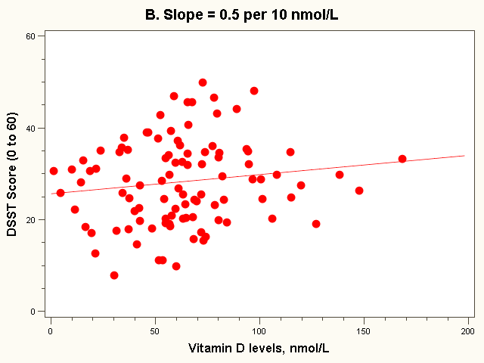
The “Best fit” line
Note how the line is a little deceptive; it draws your eye, making the relationship appear stronger than it really is!
Regression equation:
E(Yi) = 26 + 0.5*vit Di (in 10 nmol/L)

Slide 18
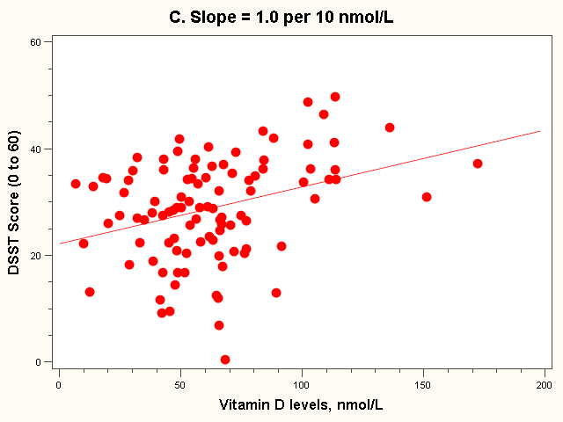
The “Best fit” line
Regression equation:
E(Yi) = 22 + 1.0*vit Di (in 10 nmol/L)

Slide 19
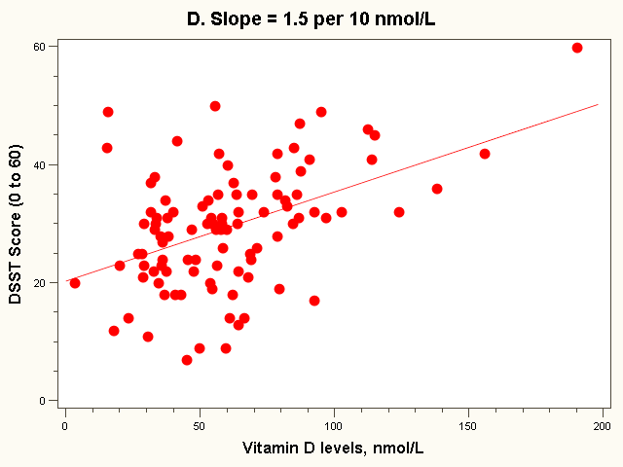
The “Best fit” line
Regression equation:
E(Yi) = 20 + 1.5*vit Di (in 10 nmol/L)
Note: all the lines go through the point (63, 28)!

Slide 20
Resulting formulas…
Slope (beta coefficient) =
Intercept=
Regression line always goes through the point:

Slide 21
Relationship with correlation
In correlation, the two variables are treated as equals. In regression, one variable is considered independent (=predictor) variable (X) and the other the dependent (=outcome) variable Y.

Slide 22
Example: dataset 4
SDx = 33 nmol/L
SDy= 10 points
Cov(X,Y) = 163 points*nmol/L
Beta = 163/33² = 0.15 points per nmol/L
= 1.5 points per 10 nmol/L
r = 163/(10*33) = 0.49
Or
r = 0.15 * (33/10) = 0.49

Slide 23
Residual Analysis: check assumptions
The residual for observation i, e_{i}, is the difference between its observed and predicted value
Check the assumptions of regression by examining the residuals
Examine for linearity assumption
Examine for constant variance for all levels of X (homoscedasticity)
Evaluate normal distribution assumption
Evaluate independence assumption
Graphical Analysis of Residuals
Can plot residuals vs. X

Slide 24
Predicted values…
For Vitamin D = 95 nmol/L (or 9.5 in 10 nmol/L):

Slide 25
Residual Analysis for Linearity
Y
Y
x
x
residuals
x
x
residuals
Not Linear
✓
Linear
Slide from: Statistics for Managers Using Microsoft® Excel 4th Edition, 2004 Prentice-Hall

Slide 26
Residual Analysis for Homoscedasticity
Y
Y
x
x
residuals
x
x
residuals
✓
Non-constant variance
Constant variance
Slide from: Statistics for Managers Using Microsoft® Excel 4th Edition, 2004 Prentice-Hall

Slide 27
Residual Analysis for Independence
Not Independent
✓
Independent
residuals
X
residuals
X
residuals
X
Slide from: Statistics for Managers Using Microsoft® Excel 4th Edition, 2004 Prentice-Hall

Slide 28
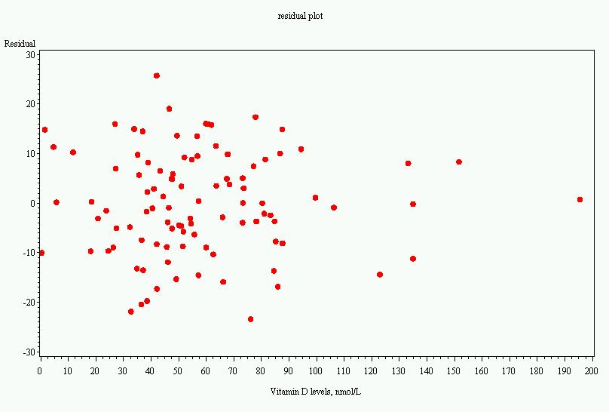
Residual plot, dataset 4

Slide 29
Goals for next meeting
Coding example

