Slide 1

Data Science and
Machine Learning
Senior Mentor – Sachin Saxena

Slide 2
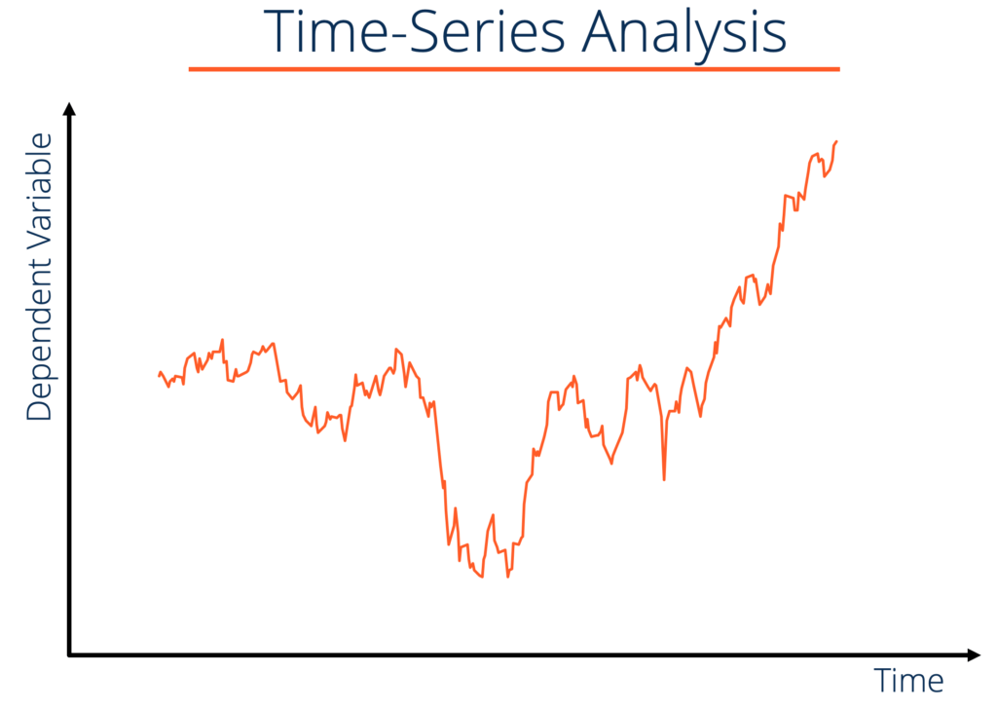
Time Series analysis

Slide 3
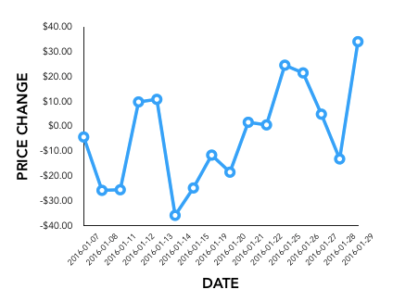
Time series analysis is a specific way of analyzing a sequence of data points collected over an interval of time.

Slide 4
Time series analysis examples
Weather data
Rainfall measurements
Temperature readings
Heart rate monitoring (EKG)
Brain monitoring (EEG)
Quarterly sales
Stock prices
Automated stock trading
Industry forecasts
Interest rates

Slide 5
Time Series Analysis Types
Models of time series analysis include:
Classification
Curve fitting
Descriptive analysis
Explanative analysis
Exploratory analysis
Forecasting
Intervention analysis
Segmentation

Slide 6
Data classification
Further, time series data can be classified into two main categories:
Stock time series data
Flow time series data
Data variations
In time series data, variations can occur sporadically throughout the data:
Functional analysis
Trend analysis
Seasonal variation

