Slide 1

Data Science & Machine Learning Support Vector Machine
Senior Mentor- Sachin Saxena

Slide 2
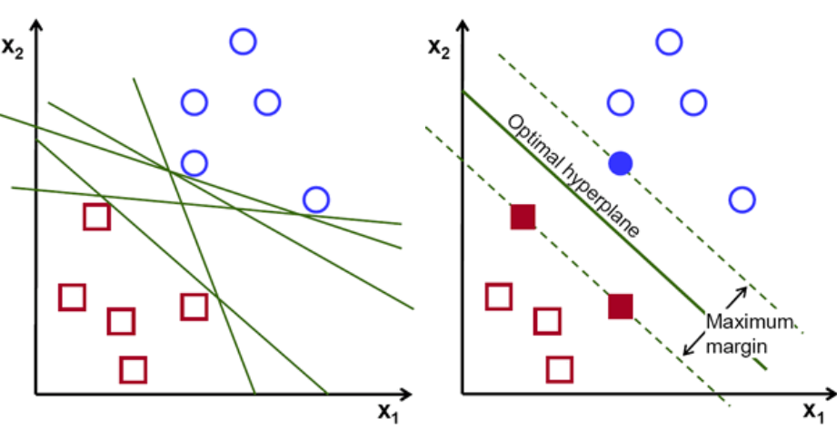

Slide 3
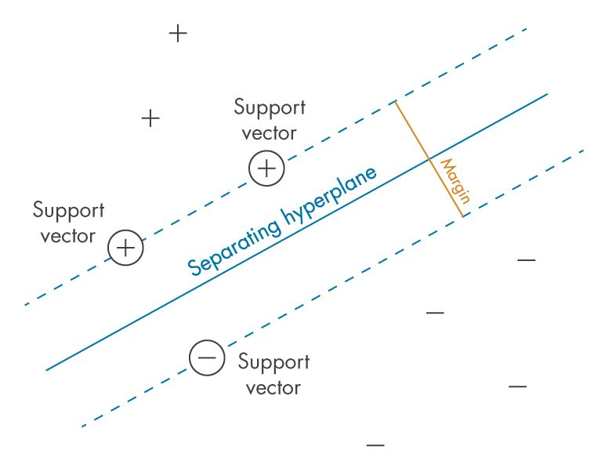

Slide 4
Linear Classifiers
α
x
f
y^{est}
f(x,w,b) = sign(w. x - b)
denotes +1
denotes -1
How would you classify this data?

Slide 5
Linear Classifiers
α
x
f
y^{est}
f(x,w,b) = sign(w. x - b)
denotes +1
denotes -1
How would you classify this data?

Slide 6
Linear Classifiers
α
x
f
y^{est}
f(x,w,b) = sign(w. x - b)
denotes +1
denotes -1
How would you classify this data?

Slide 7
Linear Classifiers
α
x
f
y^{est}
f(x,w,b) = sign(w. x - b)
denotes +1
denotes -1
How would you classify this data?

Slide 8
Linear Classifiers
α
x
f
y^{est}
f(x,w,b) = sign(w. x - b)
denotes +1
denotes -1
Any of these would be fine..
..but which is best?

Slide 9
Classifier Margin
α
x
f
y^{est}
f(x,w,b) = sign(w. x - b)
denotes +1
denotes -1
Define the margin of a linear classifier as the width that the boundary could be increased by before hitting a datapoint.

Slide 10
Maximum Margin
α
x
f
y^{est}
f(x,w,b) = sign(w. x - b)
denotes +1
denotes -1
The maximum margin linear classifier is the linear classifier with the, um, maximum margin.
This is the simplest kind of SVM (Called an LSVM)
Linear SVM

Slide 11
Maximum Margin
α
x
f
y^{est}
f(x,w,b) = sign(w. x - b)
denotes +1
denotes -1
The maximum margin linear classifier is the linear classifier with the, um, maximum margin.
This is the simplest kind of SVM (Called an LSVM)
Support Vectors are those datapoints that the margin pushes up against
Linear SVM

Slide 12
Specifying a line and margin
Plus-Plane
“Predict Class = +1” zone
Classifier Boundary
Minus-Plane
“Predict Class = -1” zone
wx+b=1
wx+b=0
wx+b=-1
Plus-plane = { x : w . x + b = +1 }
Minus-plane = { x : w . x + b = -1 }
Classify as.. | +1 | if | w . x + b >= 1
 | -1 | if | w . x + b <= -1
 | Universe explodes | if | -1 < w . x + b < 1

Slide 13
Computing the margin width
M = Margin Width
“Predict Class = +1” zone
How do we compute M in terms of w and b?
“Predict Class = -1” zone
wx+b=1
wx+b=0
wx+b=-1
Plus-plane = { x : w . x + b = +1 }
Minus-plane = { x : w . x + b = -1 }
Claim: The vector w is perpendicular to the Plus Plane. Why?

Slide 14
Computing the margin width
M = Margin Width
“Predict Class = +1” zone
How do we compute M in terms of w and b?
“Predict Class = -1” zone
wx+b=1
wx+b=0
wx+b=-1
Plus-plane = { x : w . x + b = +1 }
Minus-plane = { x : w . x + b = -1 }
Claim: The vector w is perpendicular to the Plus Plane. Why?
Let u and v be two vectors on the Plus Plane. What is w . ( u – v ) ?
And so of course the vector w is also perpendicular to the Minus Plane

Slide 15
Computing the margin width
x⁺
M = Margin Width
“Predict Class = +1” zone
How do we compute M in terms of w and b?
x⁻
“Predict Class = -1” zone
wx+b=1
wx+b=0
wx+b=-1
Plus-plane = { x : w . x + b = +1 }
Minus-plane = { x : w . x + b = -1 }
The vector w is perpendicular to the Plus Plane
Let x⁻ be any point on the minus plane
Let x⁺ be the closest plus-plane-point to x⁻.
Any location in ^{m}: not necessarily a datapoint
Any location in R^{m}: not necessarily a datapoint

Slide 16
Computing the margin width
x⁺
M = Margin Width
“Predict Class = +1” zone
How do we compute M in terms of w and b?
x⁻
“Predict Class = -1” zone
wx+b=1
wx+b=0
wx+b=-1
Plus-plane = { x : w . x + b = +1 }
Minus-plane = { x : w . x + b = -1 }
The vector w is perpendicular to the Plus Plane
Let x⁻ be any point on the minus plane
Let x⁺ be the closest plus-plane-point to x⁻.
Claim: x⁺ = x⁻ + λ w for some value of λ. Why?

Slide 17
Goals for next meeting
SVM Regression

