Slide 1

Data Science and
Machine Learning
SVM Regression
Support Vector Regression
Senior Mentor – Sachin Saxena

Slide 2
SVM Regression
Support Vector Regression

Slide 3
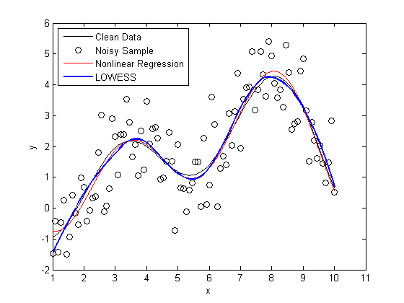
Support Vector Regression is a supervised learning algorithm that is used to predict discrete values.

Slide 4
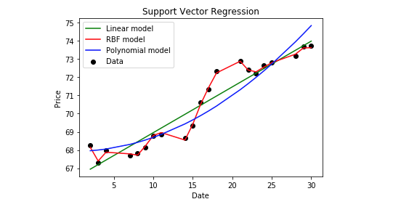
Advantages of Support Vector Regression
robust to outliers.
Decision model can be easily updated.
excellent generalization capability, with high prediction accuracy.
implementation is easy.

Slide 5
Disadvantages of Support Vector Regression
not suitable for large datasets.
In cases where the number of features for each data point exceeds the number of training data samples, the SVM will underperform.
The Decision model does not perform very well when the data set has more noise i.e. target classes are overlapping.

Slide 6
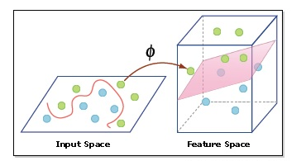
Hyperparameters of the Support Vector Machine (SVM) Algorithm
Kernel
Hyperplane
Decision Boundary

Slide 7
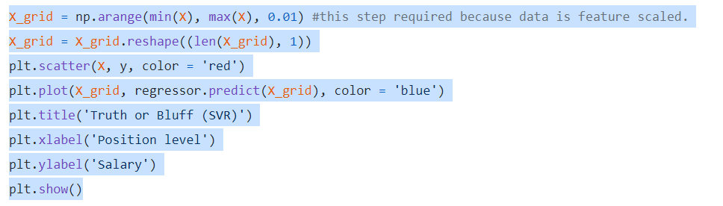
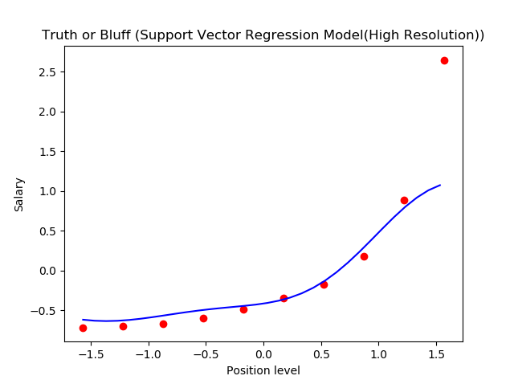
Visualizing the SVR results (for higher resolution and smoother curve)

