Slide 1

Data Science and Machine Learning
Decision Trees
Senior Mentor – Sachin Saxena

Slide 2

Decision Trees

Slide 3
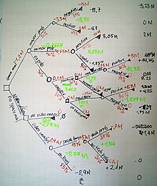
A decision tree is a flowchart-like structure in which each internal node represents a "test" on an attribute, each branch represents the outcome of the test, and each leaf node represents a class label.

Slide 4
Advantages of the Decision Tree
simple to understand.
useful for solving decision-related problems.
helps to think about all the possible outcomes for a problem.
There is less requirement of data cleaning compared to other algorithms.

Slide 5
Disadvantages of the Decision Tree
The decision tree contains lots of layers, which makes it complex.
It may have an overfitting issue, which can be resolved using the Random Forest algorithm.
For more class labels, the computational complexity of the decision tree may increase.

Slide 6
Steps for Decision Tree
Data Pre-processing step
Fitting a Decision-Tree algorithm to the Training set
Predicting the test result
Test accuracy of the result(Creation of Confusion matrix)
Visualizing the test set result.

Slide 7
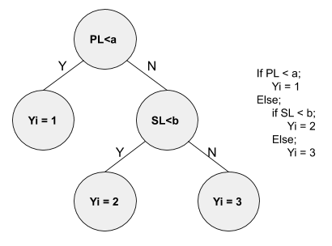
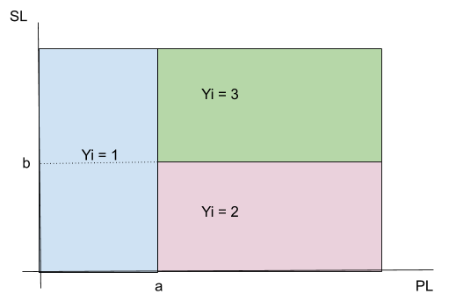
Geometric Intuition
Root Node
Parent Node
Child Node
Leaf Node
Geometrically,

Slide 8
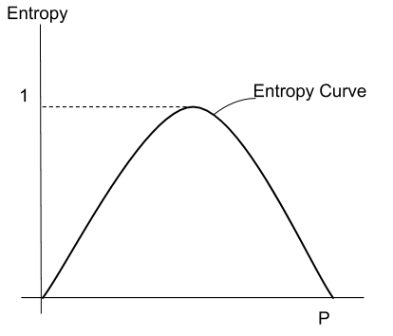


Entropy (ID3)
Information Gain (ID3)

Slide 9
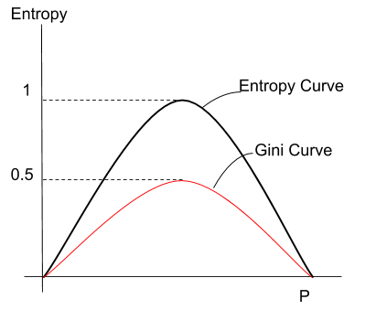

Gini Impurity (CART)

Slide 10
Decision Tree Classifier Building
Load all the basic libraries.
import numpy as np
import matplotlib.pyplot as plt
import pandas as pd
Load the dataset.
data = pd.read_csv('/Users/ML/DecisionTree/Social.csv') data.head()
The next step is to split the dataset into training and test.
Perform feature scaling
Fit the model in the Decision Tree classifier.

Slide 11
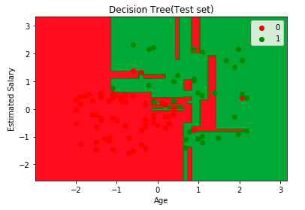
Make predictions and check accuracy.
visualize the model prediction results.
visualize the tree

