Slide 1


Random
Forest

Slide 2
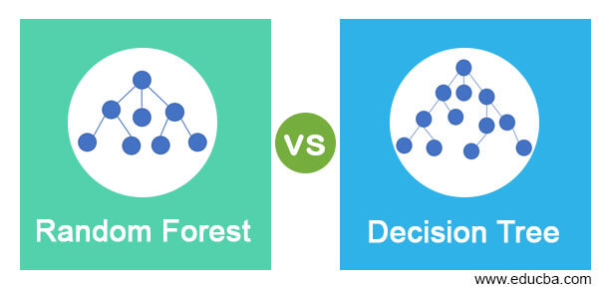
A random forest is a machine learning technique that’s used to solve regression and classification problems.

Slide 3
Features of a Random Forest Algorithm
more accurate than the decision tree.
effective way of handling missing data.
produce a reasonable prediction without hyper- parameter tuning.
solves the issue of overfitting in decision trees.

Slide 4
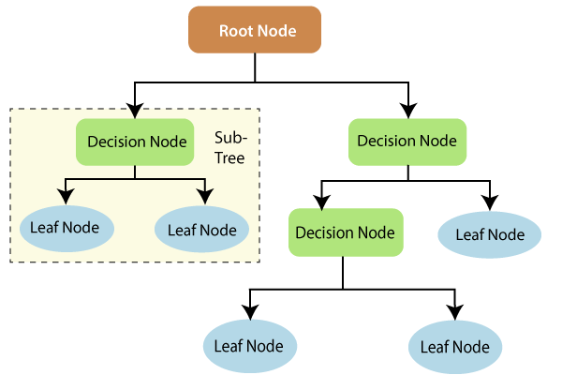
How random forest algorithm works
Decision trees are the building blocks of a random forest algorithm.

Slide 5
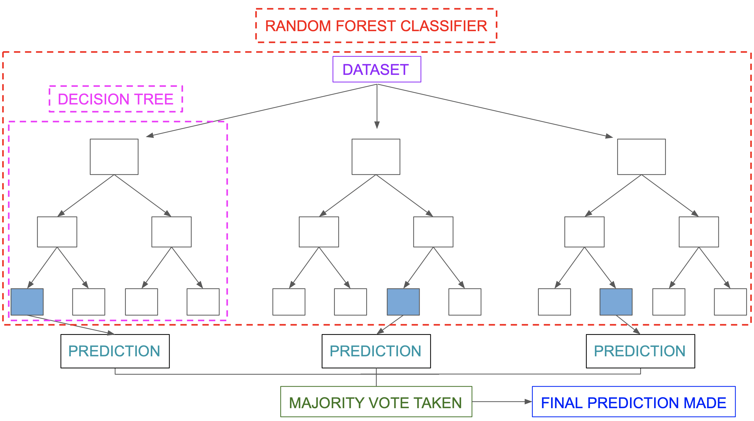
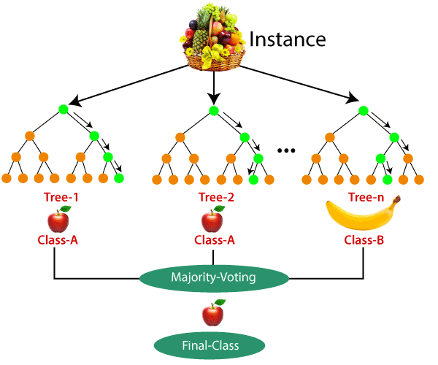
Classification in random forests

Slide 6
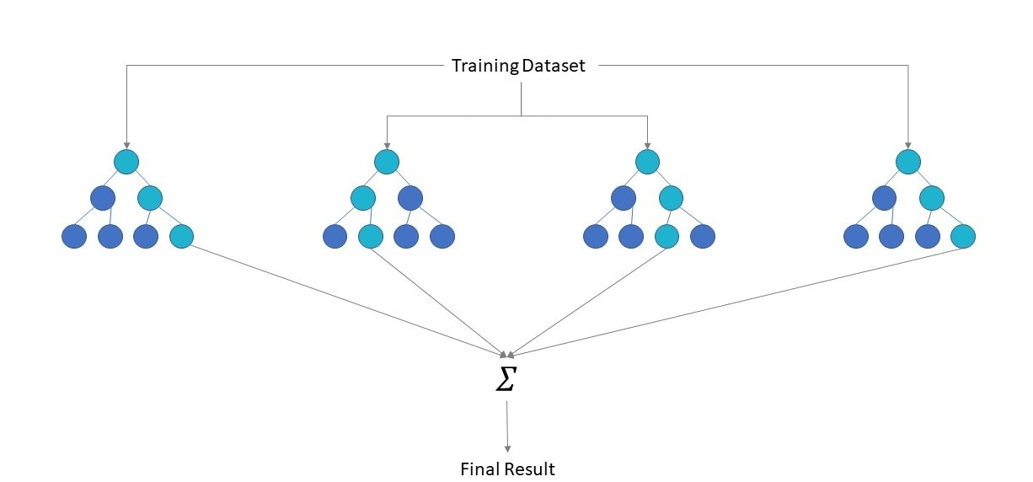
Applications of random forest
Banking
Healthcare
Stock Market
E- commerce

Slide 7
Advantages of random forest
perform both regression and classification tasks.
good predictions that can be understood easily.
handle large datasets efficiently.
provides a higher level of accuracy in predicting outcomes over the decision tree algorithm.

Slide 8
Disadvantages of random forest
more resources are required for computation.
consumes more time compared to a decision tree algorithm.

