Slide 1

Problem Scoping

Slide 2
Problem Scoping
Problem scoping is the process by which student designers “figure out” the problem that they need to solve.
Whenever we start a project, we should know the problem statement with clarity.

Slide 3
Example 1
The world’s largest diamond, is in danger as Mr. X has threatened to steal it.
No one is able to track Mr. X and so the situation is critical.
You have been appointed as the Chief Security Officer and your job is to enhance the security of the diamond to make the area impossible for Mr X to break into and steal the diamond.
Now that you are aware of AI concepts, plan to use them in accomplishing your task.
Start with listing down all the factors which you need to consider while framing a security system.

Slide 4
Aim of system
The aim of this system is to ?
Find Mr X
Track Mr. X
Secure the area.
While finalising the aim of this system, you scope the problem which you wish to solve with the help of your project. This is Problem Scoping.

Slide 5
Example 2
Look around you and select a theme which interests you the most.
Themes can be:
Agriculture
Education
Banking
Health
Security
Infrastructure
Transportation

Slide 6
Example 3
In Agriculture, there are pest issues, yield rates, sowing and harvesting patterns, etc. all being very different from each other but still a part of the Agriculture theme.
Thus, to effectively understand the problem and elaborate it, we need to select one topic under the theme
For example, crop disease detection.

Slide 7
The 4 Ws
What:
What is the problem statement
Evidences to support the problem
Scale of the problem
Where
Where is the problem located
What is the context

Slide 8
Why
Why is the solution required
Why will the solution add value to the stakeholder

Slide 9
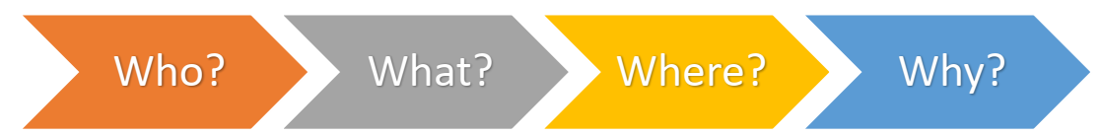
The 4 Ws of problem scoping
Who:
Who are the stakeholders
What do you know about them

Slide 10
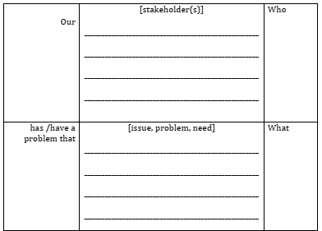
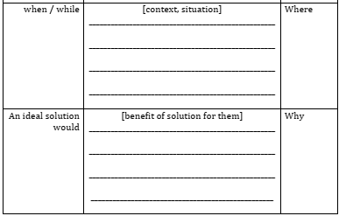
Problem Scoping Template

Slide 11
AI based projects for SDGs
https://ai-for-sdgs.academy/
100s of live projects mentioned for each SDG
Projects are bringing changes to people’s life
Projects sponsored by government and private agencies

Slide 12
Data Acquisition

Slide 13
Mr. X example (Data Acquisition)
Now, as you interact with the authorities, you get to know that some people are allowed to enter the area where the diamond is kept. Some of them being - the maintenance people; officials; VIPs, etc. Now, your challenge is to make sure that no unauthorised person enters the premises. For this, you: (choose one)
a. Get photographs of all the authorised people.
b. Get photographs of all the unauthorised people.
c. Get photographs of the premises in which the diamond has been kept.
d. Get photographs of all the visitors

Slide 14
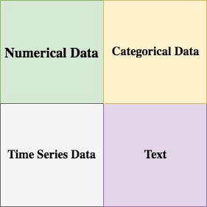
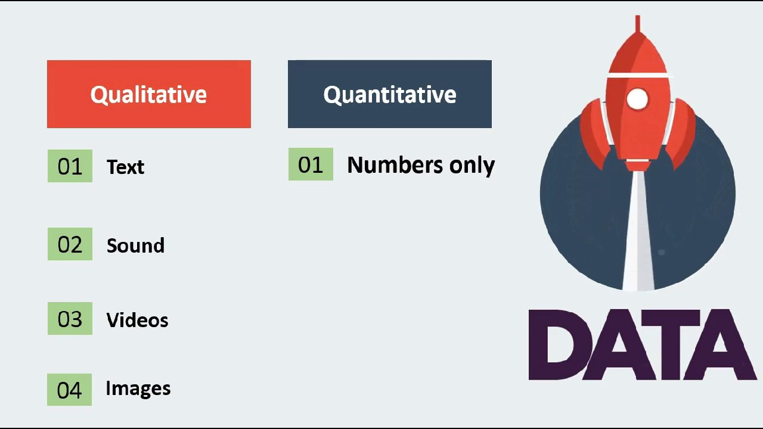
Types of data

Slide 15
Data Features
Data features refer to the type of data you want to collect.
It should be relevant to the problem statement.
For example, while analyzing the weakness of a batsman, you will have data features such as
Speed of ball, type of dismissal, type of bowler, Type of swing, Type of spin, number of balls faced, and many other similar

Slide 16
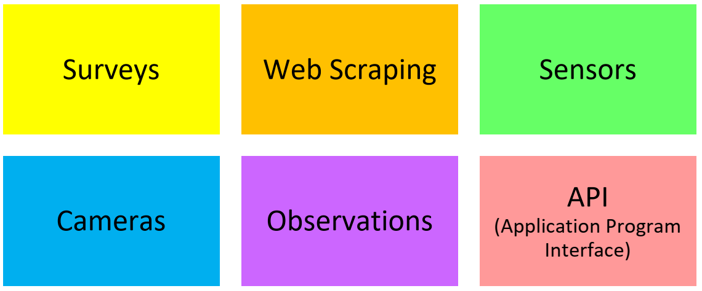
Methods of data acquisition

Slide 17
Open-Source Datasets
Lionbridge AI
Amazon Mechanical Turk
LabelBox
Figure Eight
Kaggle
http://mospi.nic.in/data

Slide 18
Big Data
Big Data is a collection of data that is huge in volume, yet growing exponentially with time.
It is a data with so large size and complexity that none of traditional data management tools can store it or process it efficiently.

Slide 19
Examples of Big Data
The New York Stock Exchange generates about one terabyte of new trade data per day.
The statistic shows that 500+terabytes of new data get ingested into the databases of social media site Facebook, every day.
A single Jet engine can generate 10+terabytes of data in 30 minutes of flight time.

Slide 20
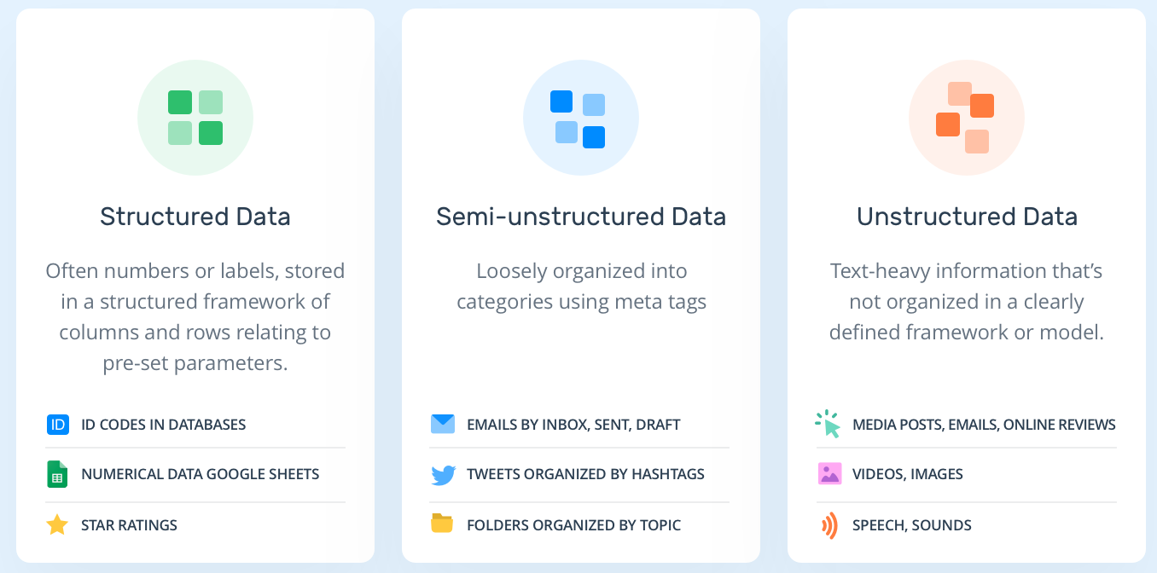
Types of Big Data

Slide 21
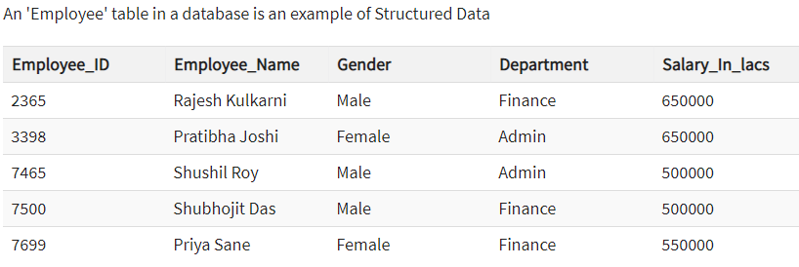
Structured

Slide 22
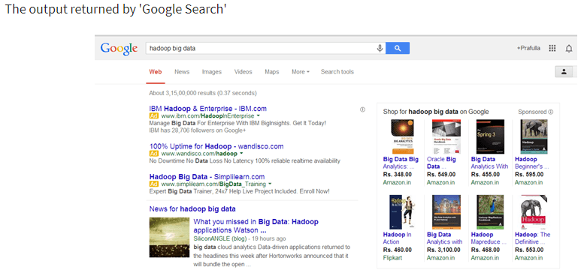
Unstructured

Slide 23
Training Testing and Validation
Training set: The data where the model is trained on
Validation set: Data the model has not been trained on and used to tune hyperparameters
Test set: In principle the same like the validation set.. just used at the final end after the model has been tailored.

Slide 24
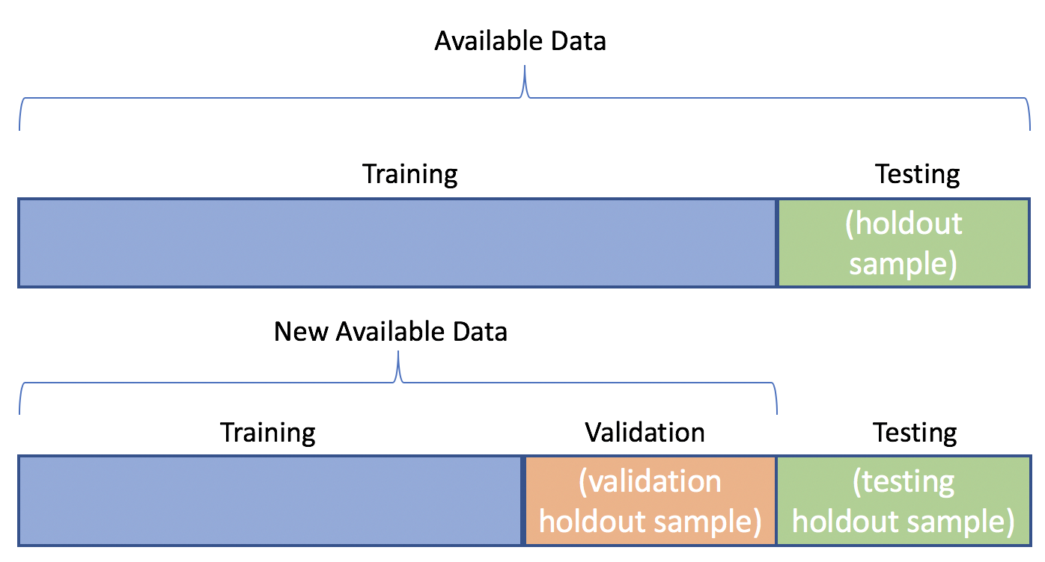

Slide 25
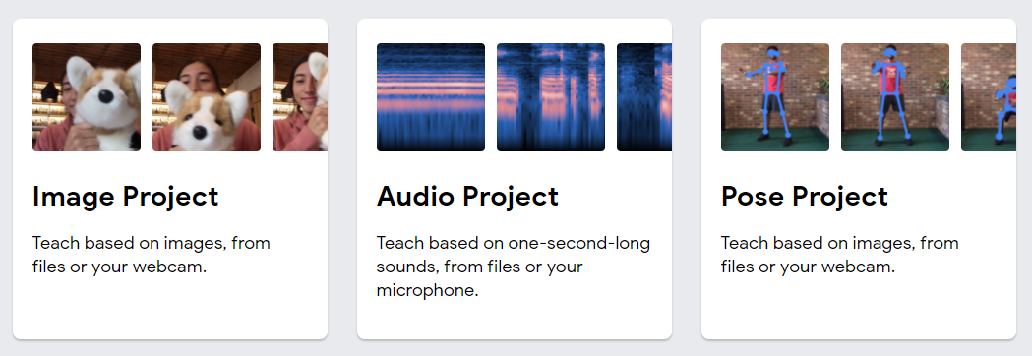
Data acquisition demo
https://teachablemachine.withgoogle.com/
Click on Get started

