Slide 1
Data Exploration

Slide 2
Data visualization tools
Microsoft Excel
Tableau
Qlikview
Datawrapper
Google Data Studio

Slide 3
Why do we need to visualize
Quickly get a sense of the trends, relationships and patterns contained within the data.
Define strategy for which model to use at a later stage.
Communicate the same to others effectively.
To visualise data, we can use various types of visual representations.

Slide 4
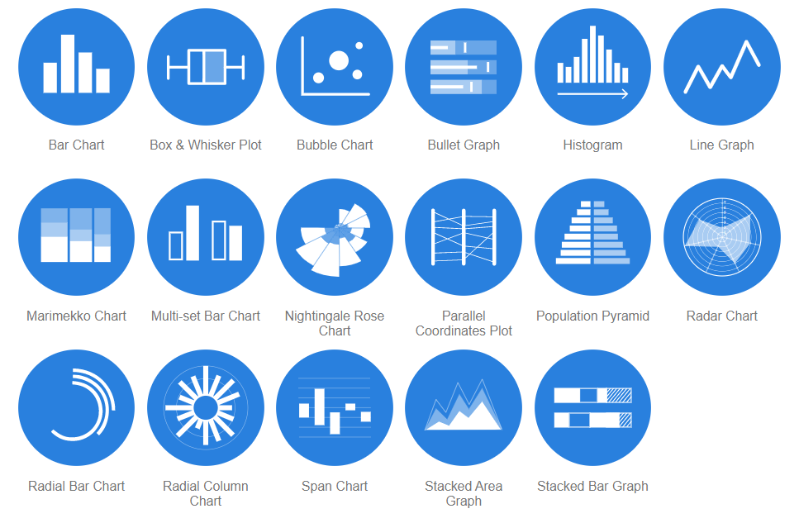
Data Visualization methods
https://datavizcatalogue.com/

Slide 5
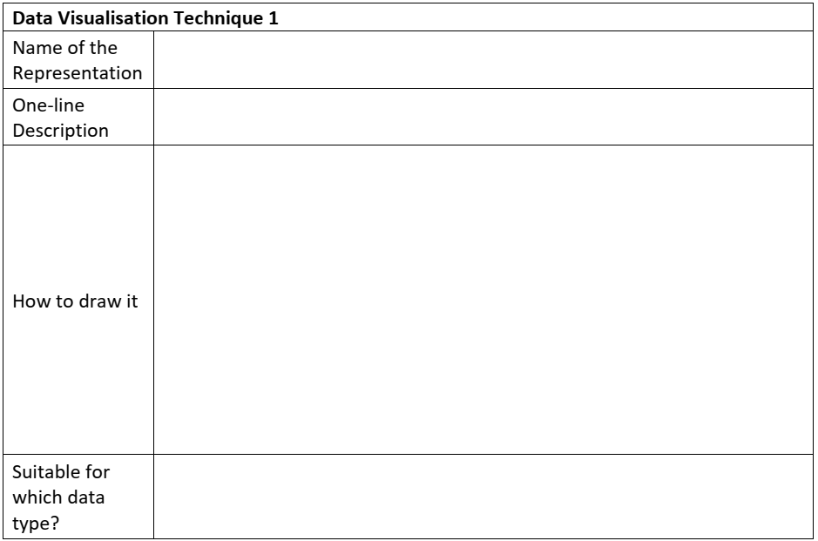
Student worksheet

Slide 6
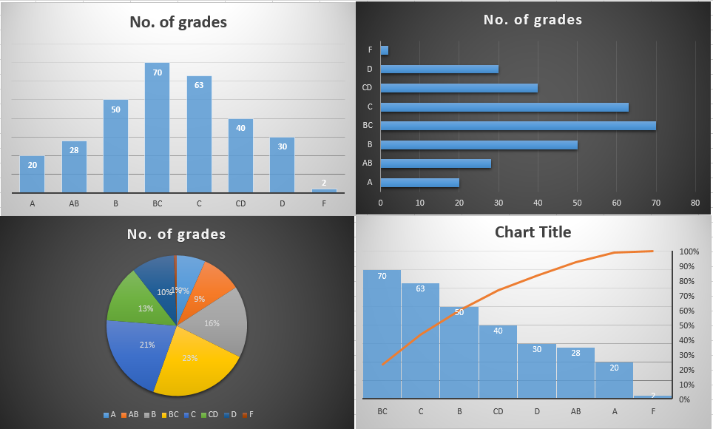
Example in Excel
Grade | No. of grades
A | 20
AB | 28
B | 50
BC | 70
C | 63
CD | 40
D | 30
F | 2

Slide 7
Multidimensional data
http://projector.tensorflow.org/
Visualize a 200 dimensional data

Slide 8
Modeling

Slide 9
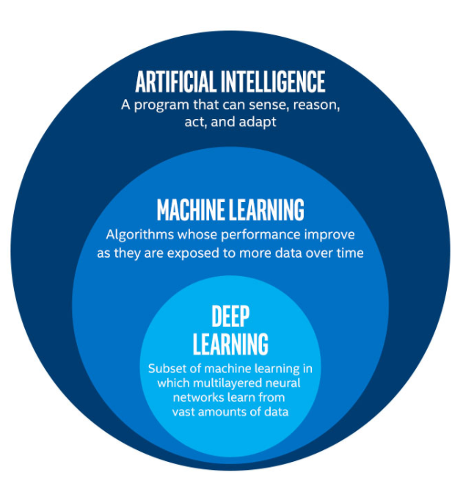
AI ML and DL

Slide 10
AI, ML and DL
Artificial Intelligence, or AI, refers to any technique that enables computers to mimic human intelligence.
Machine Learning, or ML, enables machines to improve at tasks with experience. The machine learns from its mistakes and takes them into consideration in the next execution.
Deep Learning, or DL, enables software to train itself to perform tasks with vast amounts of data. In deep learning, the machine is trained with huge amounts of data which helps it into training itself around the data.

Slide 11
Modeling
AI Modelling refers to developing algorithms, also called models which can be trained to get intelligent outputs.
That is, writing codes to make a machine artificially intelligent.

Slide 12
Types of AI models
AI Models
Rule based
Learning based
Machine Learning
Deep Learning

Slide 13
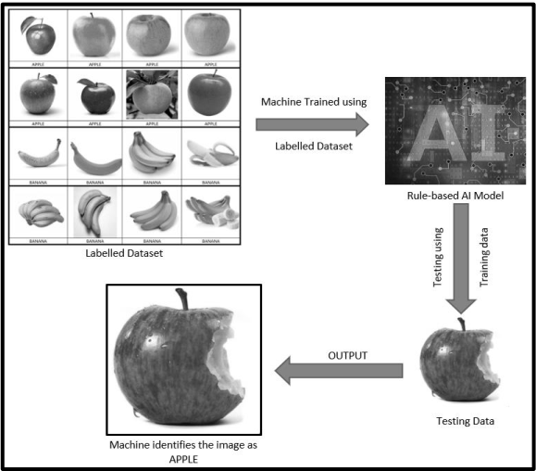
Rule based model

Slide 14
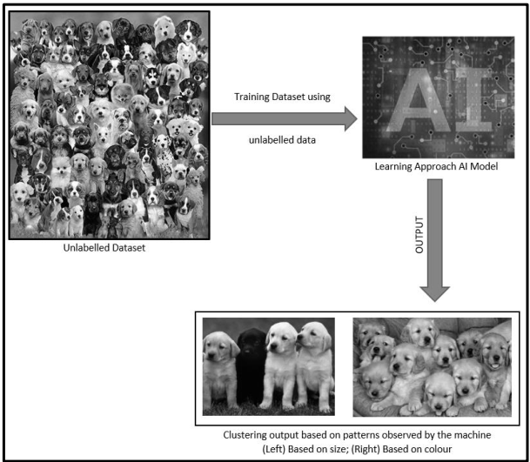
Learning based model
For example, suppose you have a dataset of 1000 images of random stray dogs of your area.
Thus, you would put this into a learning approach based AI machine.
It might cluster the data on the basis of colour, size, fur style, etc.

Slide 15
Decision tree
Decision tree builds classification or regression models in the form of a tree structure.
It breaks down a dataset into smaller and smaller subsets while at the same time an associated decision tree is incrementally developed.
The final result is a tree with decision nodes and leaf nodes.

Slide 16
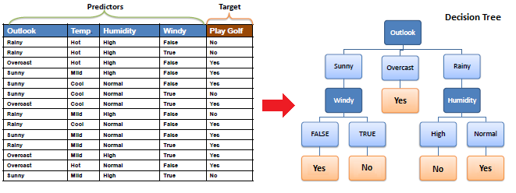
Example

Slide 17
Types of learnings
Learning based
Supervised Learning
Unsupervised Learning
Reinforcement Learning

Slide 18
Supervised Learning
In a supervised learning model, the dataset which is fed to the machine is labelled.
A label is some information which can be used as a tag for data.
For example, students get grades according to the marks they secure in examinations.
These grades are labels which categorise the students according to their marks.
Classification
Regression

Slide 19
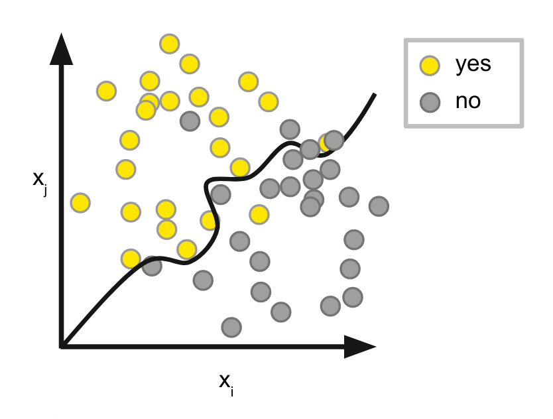
Classification
Where the data is classified according to the labels.
The entries are divided in two classes normally.
The boundary condition is defined to classify.

Slide 20
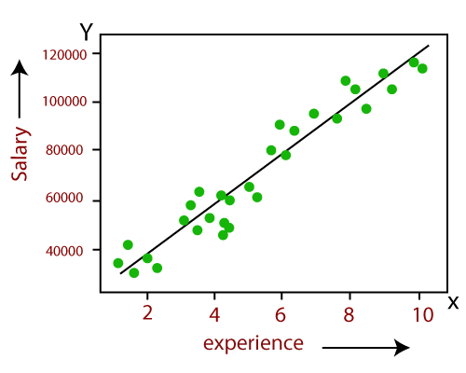
Regression
Regression deals with continuous data.
For example, if we know the growth rate, we can predict the salary of someone after a certain number of years.
Regression is linear as well as non-linear.

Slide 21
Unsupervised Learning
An unsupervised learning model works on unlabelled dataset.
This means that the data which is fed to the machine is random and there is a possibility that the person who is training the model does not have any information regarding it.
The unsupervised learning models are used to identify relationships, patterns and trends out of the data which is fed into it.
It helps the user in understanding what the data is about and what are the major features identified by the machine in it.

Slide 22
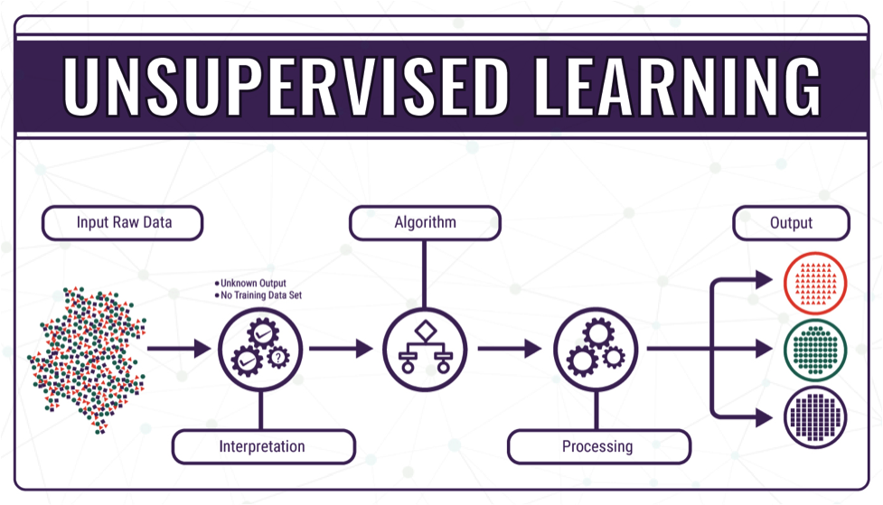

Slide 23
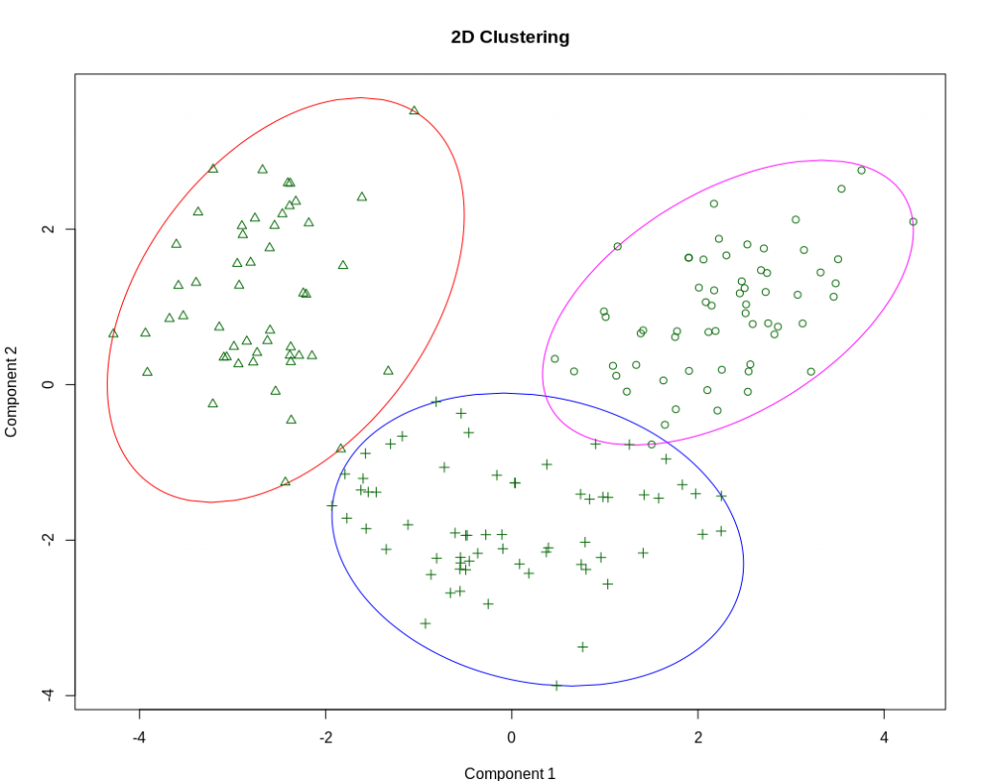
Clustering
Refers to the unsupervised learning algorithm which can cluster the unknown data according to the patterns or trends identified out of it.
The patterns observed might be the ones which are known to the developer or it might even come up with some unique patterns out of it.

Slide 24
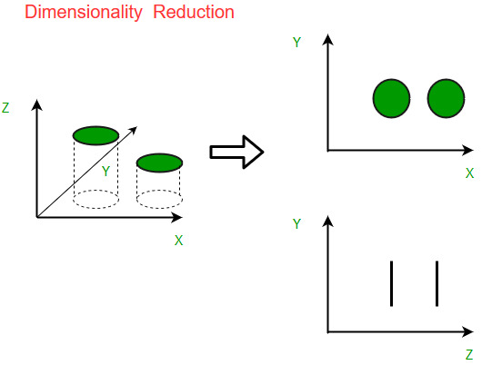
Dimensionality reduction
We humans are able to visualise upto 3-Dimensions only.
If we have a ball in our hand, it is 3-Dimensions right now.
But if we click its picture, the data transforms to 2-D.
Hence, to reduce the dimensions and still be able to make sense out of the data, we use Dimensionality Reduction.

Slide 25
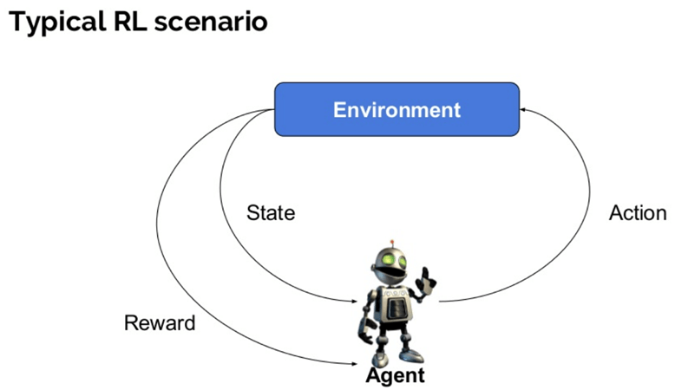
Reinforcement Learning
Reinforcement Learning is defined as a Machine Learning method that is concerned with how software agents should take actions in an environment.
Reinforcement Learning is a part of the deep learning method that helps you to maximize some portion of the cumulative reward.

Slide 26
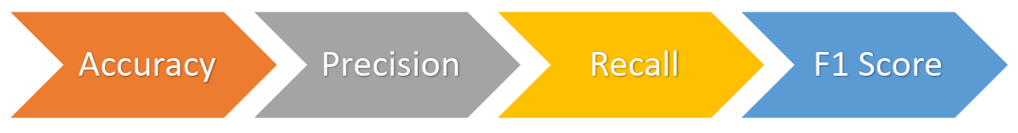
Evaluation
We’ll discuss these in details in the last unit.

Slide 27
Game
Let us continue the Teachable Machine game now.
We will train our model on visual data
Then, we will test it using live webcam data.

