Slide 1
Azure Basic Concepts

Slide 2
Source: https://azure.microsoft.com/en-us/global-infrastructure/geographies/

Slide 3

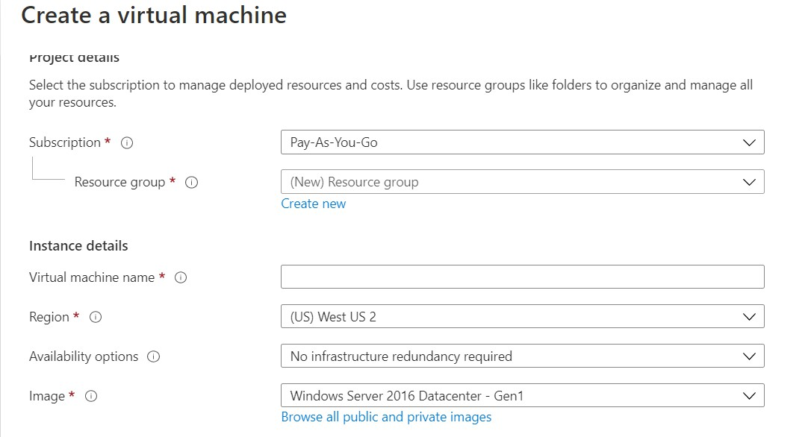
Selecting Regions
Almost every resource in Azure should be placed in a Region

Slide 4
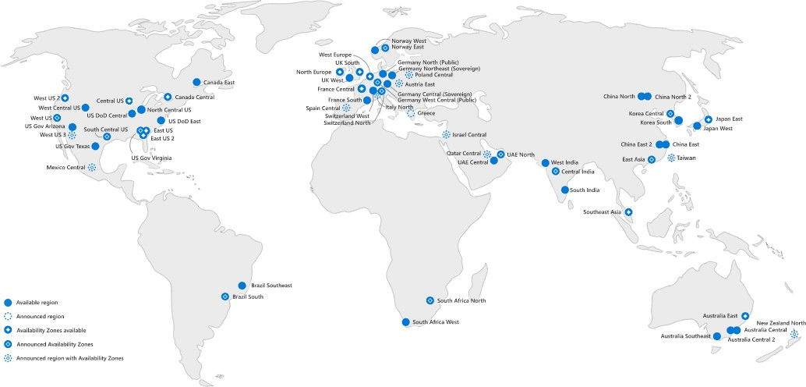
How to Select Region?
Geographical proximity to system’s audience

Slide 5
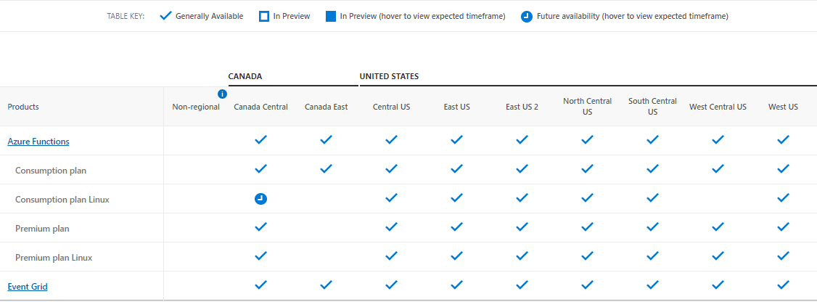
How to Select Region?
Services’ availability
Source: https://azure.microsoft.com/en-us/global-infrastructure/services/

Slide 6
How to Select Region?
Availability Zones

Slide 7
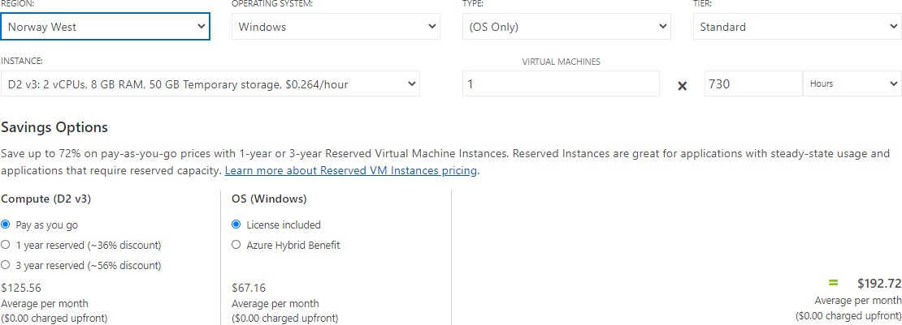
How to Select Region?
Pricing

Slide 8
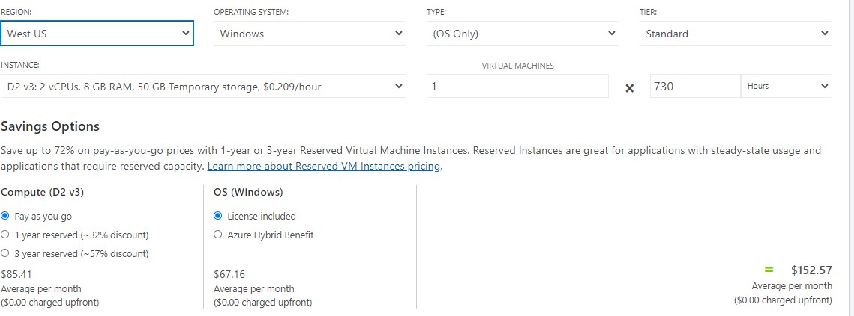
How to Select Region?
Pricing

Slide 9
Resource Groups
A logic container for resources
Used for grouping resources by a logic boundary
Free
Examples:
Development / Test / Production resources
Team A resources, Team B resources, Team C resources

Slide 10

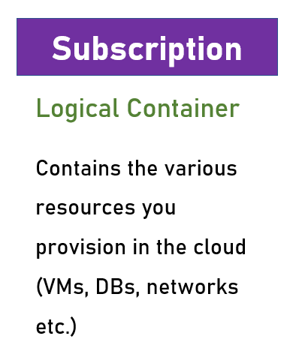
Resource Groups vs Subscriptions

Slide 11
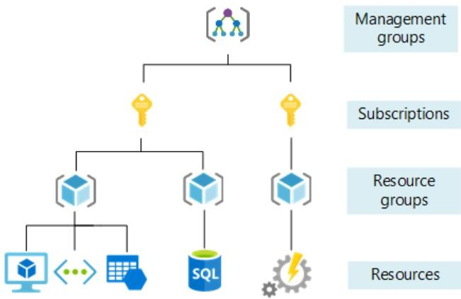
Resource Groups vs Subscriptions
- Manages Subscriptions
Associates accounts
Cost center
Logical Resources
Container
Source: https://docs.microsoft.com/en-us/azure/cloud-adoption-framework/ready/azure-setup- guide/organize-resources?tabs=AzureManagementGroupsAndHierarchy

Slide 12
Resource Groups Naming Conventions
It’s best practice to have an “rg” or “RG” as part of the resource
group name
Could be prefix or suffix
RG-Project-Dev
Finance-Resources-rg

Slide 13
Resource Groups
Almost every resource in Azure is placed in a Resource Group

Slide 14
Storage Account
Used to store almost anything in Azure
Used transparently by various services
For example:
Database backups
VM Disks
Diagnostics data

Slide 15
Storage Account
Used also for explicit data storage
We’ll discuss it later…
Quite cheap

Slide 16
SLA
Service Level Agreement
The uptime % of a cloud service shown below for single year (i.e. annually)
SLA (%) | Yearly Downtime Allowed
95 | 18d 6h 17m 27s
99 | 3d 15h 39m 29s
99.9 | 8h 45m 56s
99.99 | 52m 35s

Slide 17

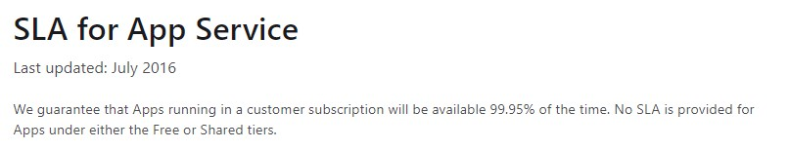
SLA
ALWAYS check the SLA of the service used

Slide 18

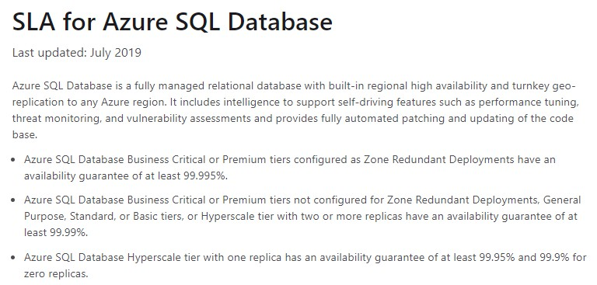
SLA
ALWAYS check the SLA of the service used

Slide 19
SLA Calculation
To get the actual system SLA, multiply the SLAs of the participating
Services, let’s take an example:
App Service SLA = 99.95% Azure SQL SLA = 99.99%
Actual SLA = 99.95 X 99.99 = 99.94% = 5h 15m 34s annual downtime

Slide 20
SLA Calculation
There are many online tools to calculate SLA.
For example, if you want to know how much downtime is allowed with 97% SLA - then SLA calculators will really help you with that.
My favorite tool is: https://uptime.is/

Slide 21
Cost
Almost everything in the cloud costs money
Few pricing models:
Per resource (ie. VM)
Per consumption (ie. Function Apps)
Reservations (ie VM for three years, will get heavy discount)

Slide 22
Cost
ALWAYS check resource’s cost before provisioning
Check for more cost-effective alternatives
Look for reservations when available and relevant

Slide 23
Azure Calculator
https://azure.microsoft.com/en-us/pricing/calculator/

Slide 24
Architects and the Cloud
Software Architects designing regular system need to know:
Non-Functional Requirements
Technology Stack
Component’s Architecture
Communication Patterns

Slide 25
Architects and the Cloud
Cloud-based systems require, in addition:
Infrastructure knowledge
Security
Hands-on
We’ll learn all that in this course ☺

