Slide 1

Microsoft Azure
From Zero to Hero The Complete Guide

Slide 2
Why Cloud?
90% of software companies use the cloud
Global cloud market expected to reach 1.2$
trillion by 2027
Cloud infrastructure spending surpassed 87$ bn in 2022
About a third of companies’ IT budget goes
The world is going to the cloud
Don’t get left behind!
for cloud services

Slide 3


Why Microsoft Azure?
The 2nd largest public cloud
The highest growth rate
The most regions
The most popular in enterprises

Slide 4
Note
You don’t have to know ANYTHING about cloud
You don’t have to know ANYTHING about Azure
We’re going to learn everything from the start
We’re going to have a lot of Azure hands-on

Slide 5

We’ll go from here…
Cloud Architecture
VM
Weather API
VM
Catalog App

Slide 6



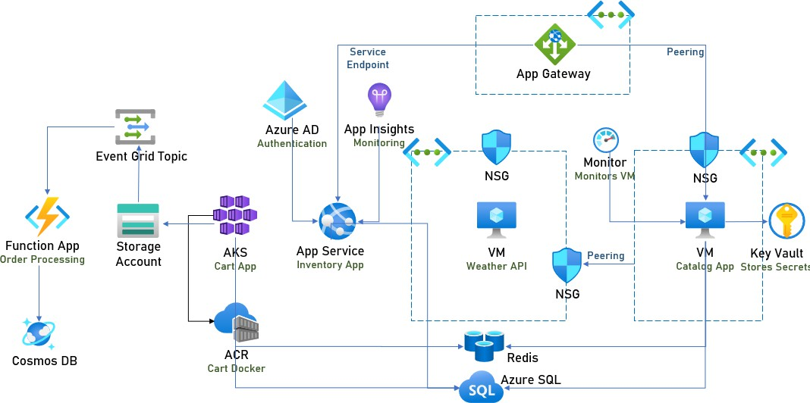

To here…
Cloud Architecture
Traffic Manager
Front Door
Primary
Secondary
App Service
Inventory DR App

Slide 7
By the End of This Course…
You’ll know what is the cloud
You’ll know what is Azure
You’ll know what you can do with it
You’ll learn how to use its services
You’ll learn how to design modern, secure, reliable apps
You’ll become a Cloud Architect!

Slide 8
This Course Is Different
Very practical
Extremely hands-on
Emphasis on what you’ll actually use

Slide 9
But That’s Not All…
At the end of this course -
Create the Azure Account!
The ultimate, practical, guide to help you design great
cloud architecture!

Slide 10










Azure Technology Stack

Slide 11




Azure Certified

Slide 12
Who Is This Course For?
Architects and Architects to be
Developers who want to learn about the cloud
Anyone who is interested in the most important computing platform in the world

Slide 13
How This Course Is Organized
Overview of the cloud and Azure
Overview of main services (demos + hands on)
Architecting modern apps on Azure

Slide 14
Agenda
Welcome
Networking
Introduction to the Cloud
Data
Introduction to Azure
Messaging
First Look at Azure
Azure Active Directory
Basic Concepts
Monitoring
Introducing Our App
Security
Compute
DR

Slide 15
Agenda
Cost Management
Azure Policy
Architecting Apps for Azure
Migrating to the Cloud
Advanced Services
Conclusion

