Slide 1
Introduction to the Cloud

Slide 2
Before the cloud…
If you needed a server, you had to:
Buy it
Install it
Maintain it
Replace it
Have an IT team

Slide 3
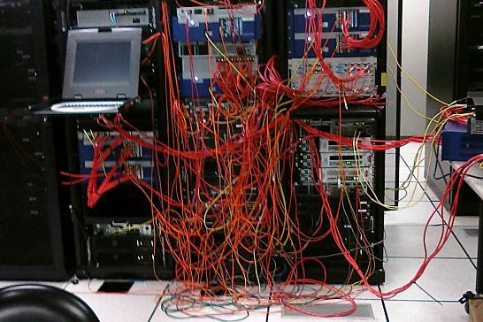
Before the cloud…
You often ended up with this:

Slide 4
Before the cloud…
The same goes with:
Networking
Databases
User Management
And more…

Slide 5
Before the cloud…
But there’s more…

Slide 6

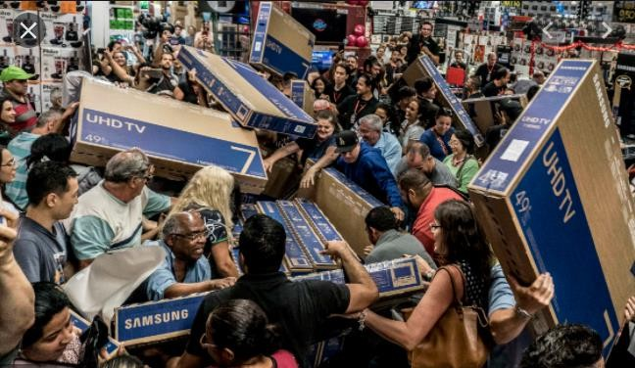

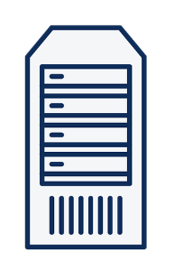
Jan Feb Mar Apr May Jun Jul
Aug Sep Oct
Nov
60% CPU

Slide 7
Jan Feb Mar Apr May Jun Jul
Aug Sep Oct
Nov
120% CPU

Slide 8


Slide 9
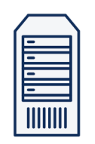

Jan Feb Mar Apr May Jun Jul
Aug Sep Oct
Nov
20% CPU

Slide 10
Jan Feb Mar Apr May Jun Jul
Aug Sep Oct
Nov
90% CPU

Slide 11



Bought
% CPU
Wasted Money
Used
Time

Slide 12
Before the cloud…
If you needed a server, you had to:
Buy it
Install it
Maintain it
Replace it
Have an IT team

Slide 13
Bought
% CPU
Wasted Money
Used
Time

Slide 14


The Cloud:
Compute, Networking, Storage and other services
Managed by SOMEONE ELSE

Slide 15
Cloud Providers
Companies who build huge data centers
Fill it with servers, networking, cooling, electricity etc.
Design and install various services
Make it publicly accessible

Slide 16
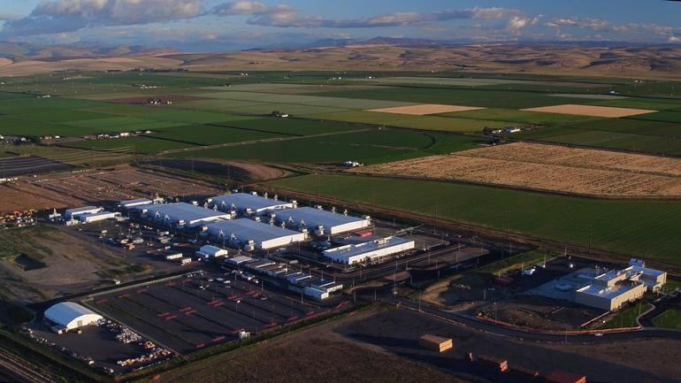
Data Center
Microsoft Azure Datacenter in Washington

Slide 17
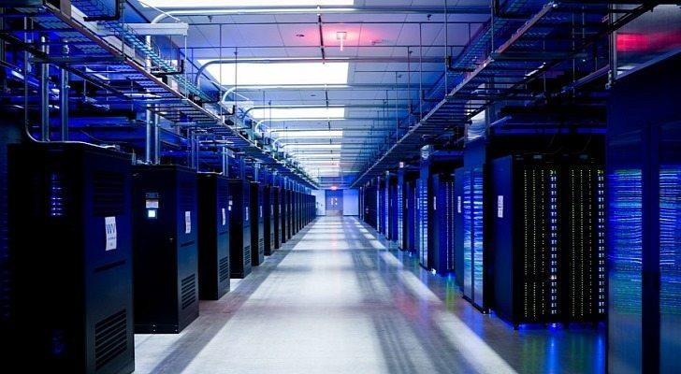

Data Center
~100Ks physical servers / datacenter
Microsoft Azure Datacenter in The Netherlands

Slide 18
Cloud Services
Clouds are huge and the competition is fierce
Offer a lot of additional services:
AI
IOT
Kubernetes
And lots more…

Slide 19
In the cloud era…
If you need a server, you can:
Create it in the cloud within minutes
Use it as you wish
Pay for what you use
Shut it down when not needed
Automatically maintained, patched, secured, monitored

Slide 20
The Cloud:
Compute, Networking, Storage and other services
Managed by SOMEONE ELSE

Slide 21
5 Characteristics of Cloud Computing
On-Demand Self Service
Broad Network Access
Resource Pooling
Rapid Elasticity
Measured Service

Slide 22
On-Demand Self Service
No human interaction is needed for resource provisioning
Resource can be provisioned (created) with a click of a button
Provisioning is available 24/7

Slide 23
Broad Network Access
Resources can be accessed from anywhere using the network
Ideally high broadband
No physical access is required at any time

Slide 24
Resource Pooling
Physical resources are shared between customers
The cloud’s backbone decides which physical resource to allocate for a customer’s virtual services
Some advanced cloud services allow for physical resource separation

Slide 25
Rapid Elasticity
Resources can be scaled up and down as needed, automatically
No need to purchase resources for a one-time peak scenario

Slide 26
Measured Service
Payment is done only for resources actually used
Server time / DB storage / Function calls etc.
Measurement usually done in high-resolution
Server time by the second
No need to invest money in non-used resources

Slide 27
CapEx
OpEx
Capital Expense
Making upfront investment for future use / profit
Operating Expense
Pay for what you actually use

Slide 28
Traditional IT – CapEx Oriented
Major investment for:
Building data center
Purchasing servers
Purchasing air conditioning
Purchasing network devices
…And only then – it can be used…
Purchasing software licenses (DB etc.)

Slide 29
Traditional IT – CapEx Oriented
There’s also OpEx involved:
Electricity
Salaries
Maintenance
And more…

Slide 30
Jan Feb Mar Apr May Jun Jul
Aug Sep Oct
Nov
CapEx

Slide 31
OpEx:
Jan Feb Mar Apr May Jun Jul
Aug Sep Oct
Nov

Slide 32
CapEx
OpEx
Capital Expense
Operating Expense
Making upfront investment for future use / profit
Pay for what you
actually use
Non optimal
Not flexible
This is what you get with
the cloud
Extremely flexible
Most optimal

Slide 33
Types of Cloud Services
IaaS
PaaS
SaaS

Slide 34
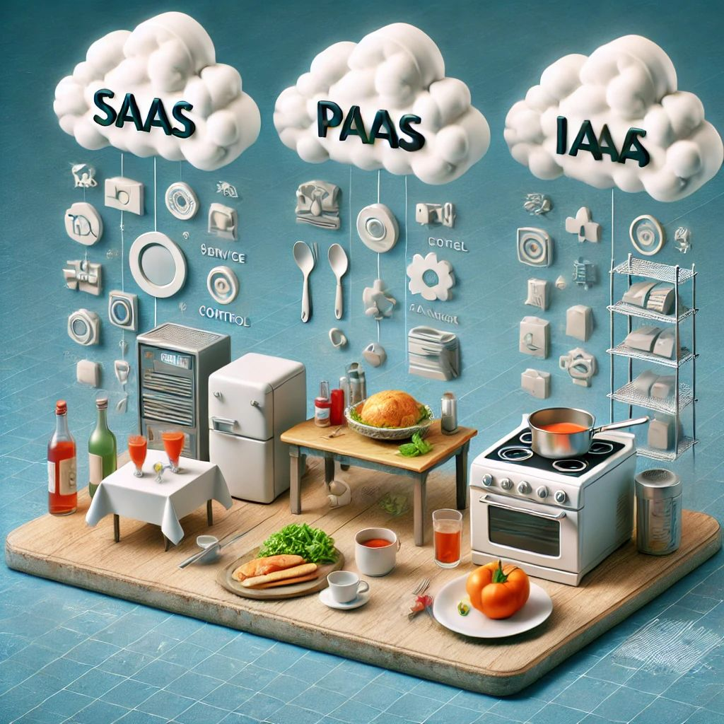
Iaas, PaaS, SaaS
IaaS is like going to the market, buying all the ingredients, and then using your gas to cook a meal. You have all the control, but you also do all the work.
PaaS is like going to a restaurant, buying a pot of soup, and then coming home to make your swallow. You are still involved, but the core elements are taken care of. SaaS is like going to a restaurant, ordering a complete meal, eating it there, and then simply returning home. Everything is being taken care of —no prep, no cooking, and no cleanup.

Slide 35
IaaS
Infrastructure as a Service
The cloud provides the underlying platform
Compute
Networking
Storage
The client handles, and is responsible for all the rest

Slide 36
IaaS
Most common example:
Virtual Machines
The cloud provides the host machine, networking and disks
The client creates the virtual (guest) machine, installs software on it, patches it, maintains it etc.

Slide 37
PaaS
Platform as a Service
The cloud provides platform for running apps
Including: Compute, networking, storage, runtime environment, scaling, redundancy, security, updates, patching, maintenance etc.
The client just needs to bring the code to run

Slide 38
PaaS
Most common example:
Web Apps
The cloud provides the runtime for running web apps
The client uploads the code, and it just runs
The client has no access to the underlying virtual machines

Slide 39
SaaS
Software as a Service
A software running completely in the cloud
The user doesn’t need to install anything on-premises or on his machine
The provider of the software takes care of updates, patches, redundancy, scalability etc.

Slide 40
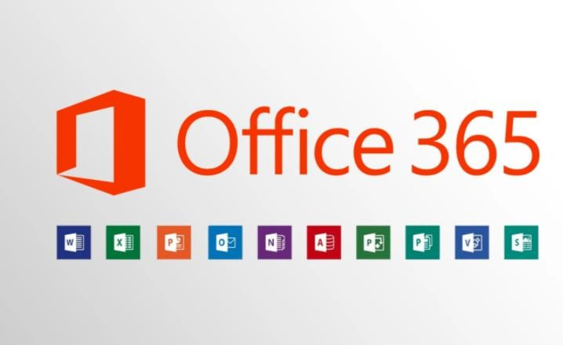
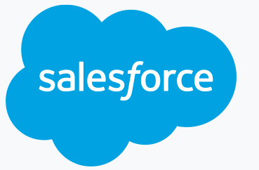
SaaS
Common examples:

Slide 41
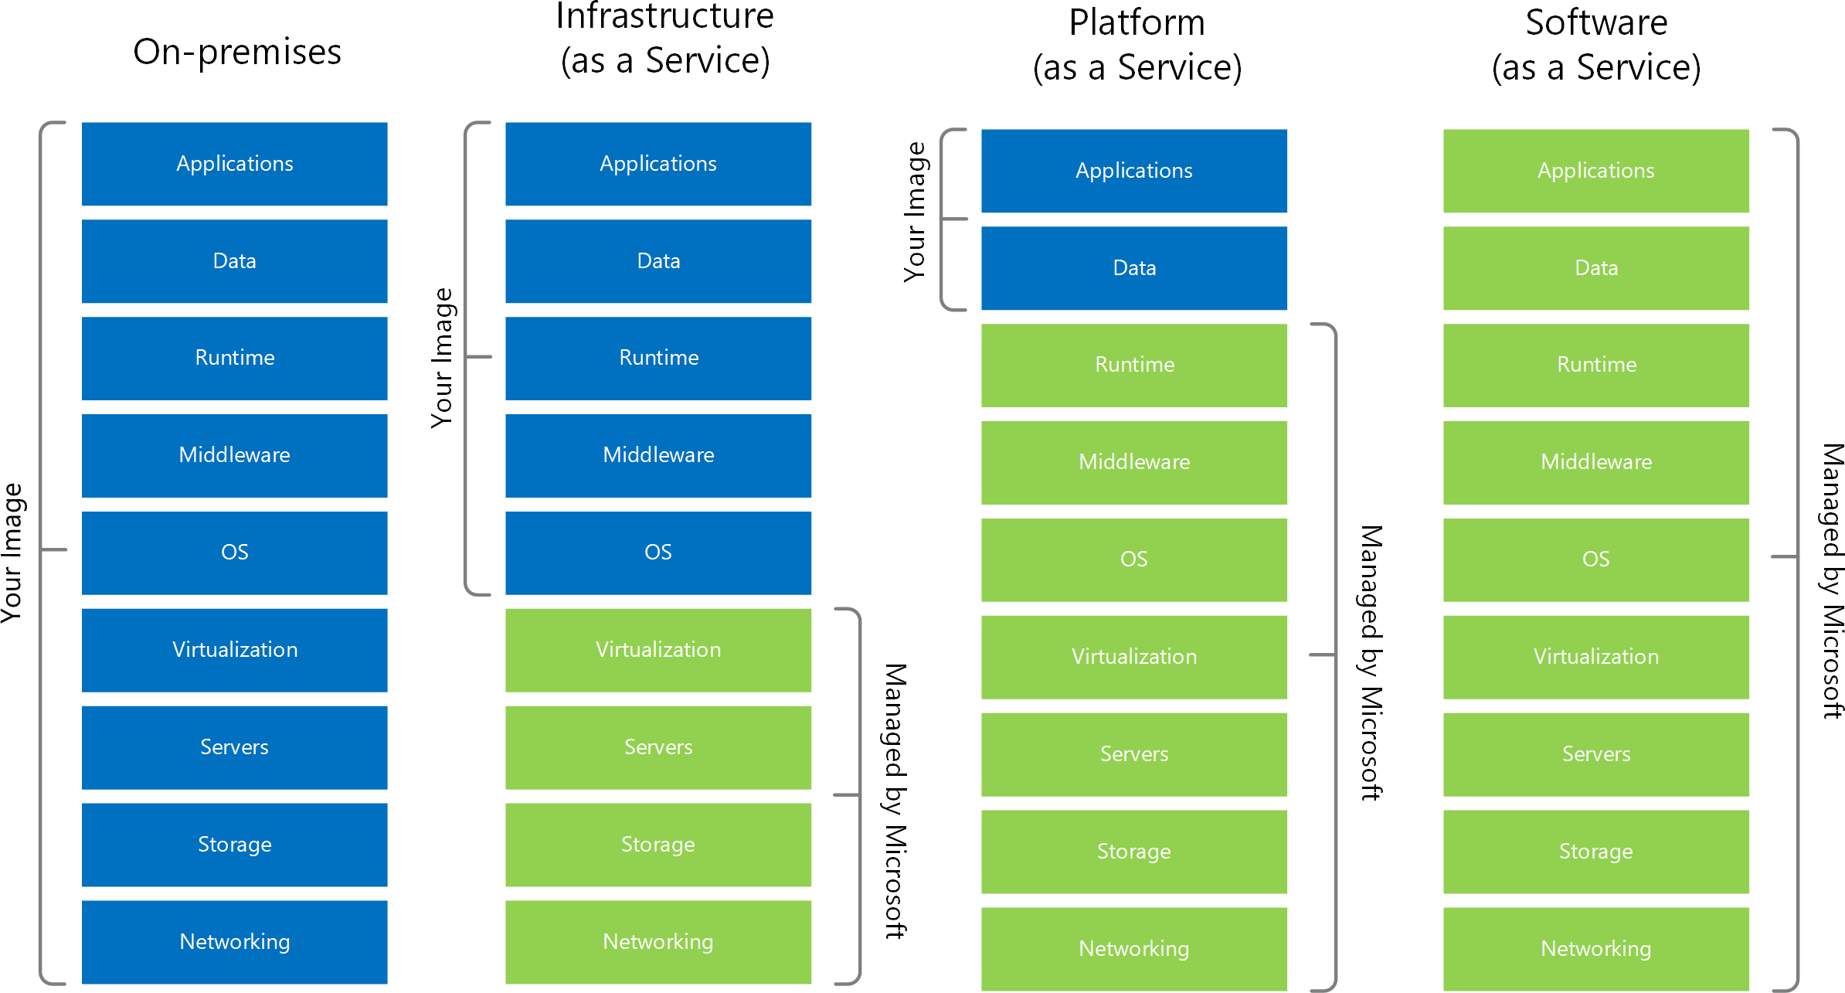
Source: https://docs.microsoft.com/en-us/azure/cloud-adoption-framework/strategy/monitoring-strategy

Slide 42
Additional Service Types
FaaS – Functions as a Service
DBaaS – Database as a Service
DaaS – Desktop as a Service
IOTaaS – IOT as a Service
AIaaS – AI as a Service

Slide 43
Types of Clouds
Public
Private
Hybrid

Slide 44
Public Cloud
The cloud is set up in the public network
Managed by large companies
Accessible through the internet
Available to all clients and users
Clients have no access to underlying infrastructure

Slide 45


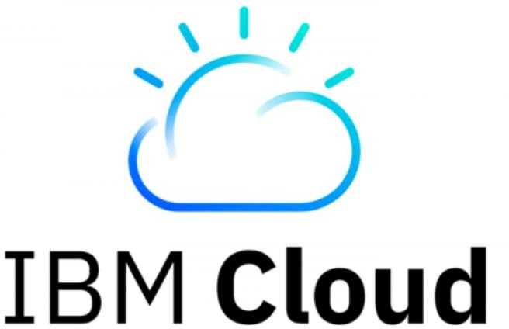

Public Cloud

Slide 46
Private Cloud
A cloud set up in an organization’s premises
Managed by the organization’s IT team
Accessible only in the organization’s network
Available to users from the organizations
Uses private cloud infrastructure and engines
Contains a subset of the public cloud’s capabilities

Slide 47



Private Cloud

Slide 48
Hybrid Cloud
A cloud set up in an organization’s premises…
…but also connected to the public cloud
Workload can be separated between the two clouds
ie. Sensitive data in the organization’s premises, public data in the
public cloud
Usually managed by the public cloud, but not always

Slide 49
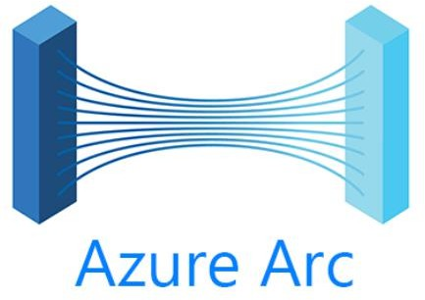
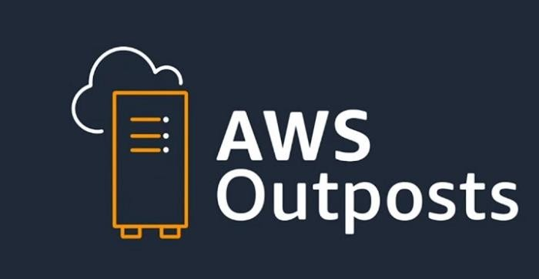
Hybrid Cloud

Slide 50
We’re going to talk about…
Public
Private
Hybrid

Slide 51
Cloud Providers
Companies which build datacenters and provide public cloud
services
IaaS, PaaS, SaaS
Other services

Slide 52
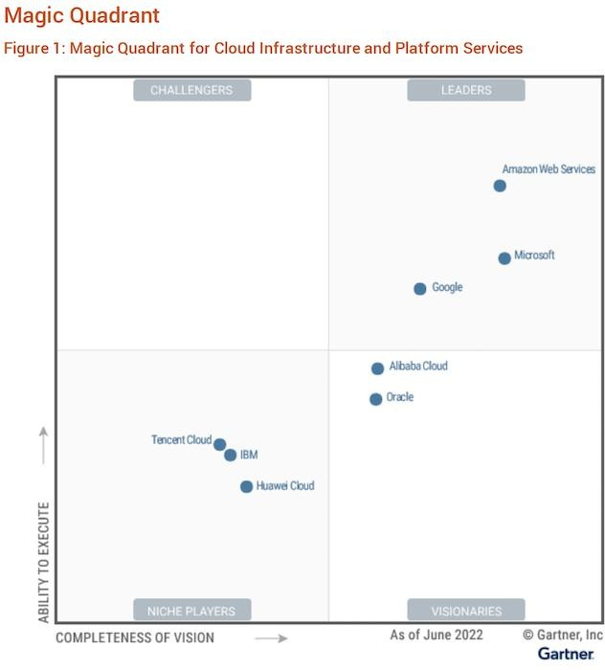
Main
Cloud Providers

Slide 53
Cloud Providers Growth
Q3 2023:
Cloud | % Growth
AWS | 12%
Azure | 29%
Google | 24%
Azure is the fastest growing public cloud, for years

