Slide 1
Customer Shopping Behaviour Analysis
An end-to-end data analytics project | Python · MySQL · Power BI
3,900
18
10
5
Transactions
Features
SQL Queries
Insights
Sachin Shinde | B.E. AI & Data Science | ACPCE Mumbai | May 2026

Slide 2
Project Overview
📂 Data Source
🧹 Python Cleaning
🗄️ MySQL Analysis
📊 Power BI
3,900 customer
transactions
18 features · CSV
pandas EDA
Null imputation
Feature engineering
10 SQL queries
Window functions
CTE & subqueries
6 visuals
4 slicers
KPI dashboard
🎯 Goal: Uncover customer spending patterns, segment behaviour, and deliver actionable business recommendations

Slide 3
Dataset & Data Cleaning
📋 Dataset Summary
🧹 Cleaning Steps
Rows:
3,900 transactions
Loaded CSV with pandas — ran df.info() & df.describe()
Columns:
18 features
Imputed 37 missing Review Ratings via category-wise median
Missing Data:
37 nulls in Review Rating
Renamed all columns to snake_case for consistency
Engineered age_group by binning ages into 4 groups
Demographics:
Age, Gender, Location, Subscription
Created purchase_frequency_days derived feature
Purchase Info:
Item, Category, Amount, Season
Verified & dropped redundant promo_code_used column
Behaviour:
Discount, Frequency, Rating, Shipping
Loaded clean DataFrame to MySQL via SQLAlchemy

Slide 4
SQL Business Analysis — 10 Queries
Q1
Revenue by Gender
Q6
Discount-Dependent Products
Male: $157,890 | Female: $75,191
Hat 50% · Sneakers 49.7% · Coat 49.1%
Q2
High-Spend Discount Users
Q7
Customer Segmentation (CTE)
839 customers spent above avg with discounts
Loyal: 3,116 | Returning: 701 | New: 83
Q3
Top 5 Products by Rating
Q8
Top 3 per Category (Window Fn)
Gloves 3.86 · Sandals 3.84 · Boots 3.82
ROW_NUMBER() — Jewelry, Blouse, Sandals lead
Q4
Shipping Type Comparison
Q9
Repeat Buyers & Subscription
Standard: $58.46 | Express: $60.48
2,518 repeat buyers NOT subscribed
Q5
Subscribers vs Non-Subscribers
Q10
Revenue by Age Group
73% non-subscribed — huge upsell opportunity
Young Adults lead at $62,143

Slide 5
Key Findings & Charts

Slide 6
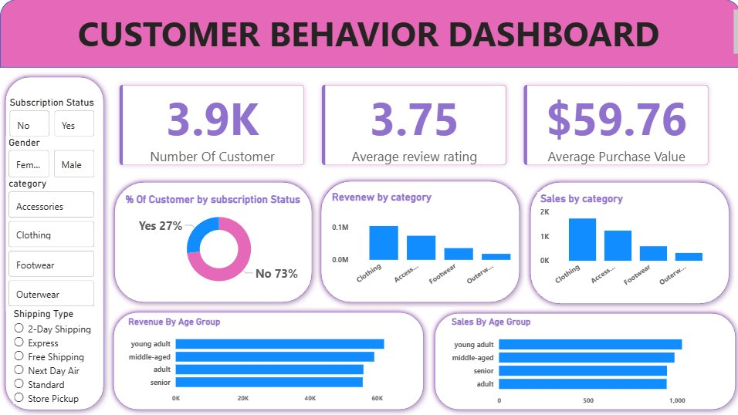
Power BI Dashboard
3.9K
$59.76
3.75
$233K
Customers
Avg Purchase
Avg Rating
Total Revenue
6 visuals · 4 dynamic slicers: Subscription Status, Gender, Category, Shipping Type

Slide 7
Business Recommendations
🔔
01
Boost Subscription Conversion
🎯
04
Target Young Adults
73% non-subscribers. Target 2,518 repeat buyers with exclusive benefits campaign — highest ROI opportunity.
Young Adults = $62,143 — top revenue segment. Prioritize in seasonal marketing and new product launches.
💎
02
Reward Loyal Customers
⭐
05
Promote Top-Rated Products
3,116 loyal customers need retention incentives. Introduce tiered loyalty program to boost lifetime value.
Gloves (3.86), Sandals (3.84), Boots (3.82) — feature in email, homepage, and social campaigns.
🏷️
03
Review Discount Policy
Hat (50%), Sneakers (49.7%), Coat (49.1%) over-rely on discounts. Review margin impact before next campaign.

Slide 8
Tech Stack & Conclusion
Python + pandas
Data cleaning, EDA, feature engineering, DB connection via SQLAlchemy
MySQL
10 business queries — CTE, window functions (ROW_NUMBER), subqueries
Power BI
Interactive dashboard — 6 visuals, 4 dynamic slicers, 3 KPI cards
Jupyter Notebook
End-to-end EDA exploration and analysis documentation
GitHub
Version control, project portfolio — github.com/Sachin5601
github.com/Sachin5601 · eng.sachinshinde@gmail.com · linkedin.com/in/sachin5601

