Slide 1
Summer Training Report On “Config Based UI: A React App that Works on Config UI Received from API”
Submitted To Submitted By
Mr. Rajeev Sharma Sachin Kumar
Roll No - 1902219

Slide 2
Table of Contents
Abstract
Introduction
Problem Statement
Demo Config API
Technologies Used
Implementation
App View
Advantages
System Requirement
Conclusion and Future Scope
References

Slide 3
Abstract
The Config-Based User Interface (UI) project aims to develop a flexible and customizable UI framework for software applications. Traditional user interfaces often lack the ability to adapt to diverse user preferences and requirements. By leveraging configuration files, this project introduces a novel approach to UI design that empowers users to personalize their application's appearance and behavior without modifying the underlying code.
The project begins by developing a UI framework that supports the dynamic loading and parsing of configuration files. These configuration files allow users to specify various aspects of the UI, including colors, fonts, layouts, and functionality. Through a well-defined schema, the system interprets the configuration files and applies the specified settings to the UI components during runtime.

Slide 4
Introduction
Welcome to the project file for our Config-Based UI Project. In today's fast-paced digital world, user interfaces play a critical role in shaping the user experience of software applications. The ability to configure and customize the UI according to specific requirements and preferences has become increasingly important. To address this need, our project aims to develop a Config-Based UI solution that empowers developers and end-users to create dynamic and flexible user interfaces effortlessly.
This project file will serve as a comprehensive guide to understanding the objectives, methodologies, and outcomes of our Config-Based UI Project. We will delve into the fundamental concepts, design principles, and implementation details that make our solution unique and valuable. Whether you are a developer looking to enhance UI configurability or an end-user seeking a personalized experience, this project file will provide valuable insights and resources.

Slide 5
Problem Statement
Problem:
The existing UI development process lacks the ability to easily modify and adapt UI components, styles, and layouts without extensive code changes. This results in increased development time, reduced flexibility, and limited user customization options. Additionally, maintaining different UI configurations for various user groups or platform-specific requirements becomes a cumbersome task.
Objective:
The objective of this project is to develop a Config-Based UI system that allows software developers and designers to create dynamic, flexible, and customizable UIs without the need for extensive code modifications. By introducing a configuration-based approach, the project aims to streamline the UI development process, enhance maintainability, and empower end-users to personalize their interfaces according to their specific needs.

Slide 6
Demo API
{
"configurations": [
{
"name": "Default","components": [
{
"type": "Button","text": "Submit","color": "#ff0000","size": "large"
},
{
"type": "TextInput","placeholder": "Enter your name","color": "#000000",
"fontFamily": "Arial","fontSize": 16
} ]
}]
}

Slide 7
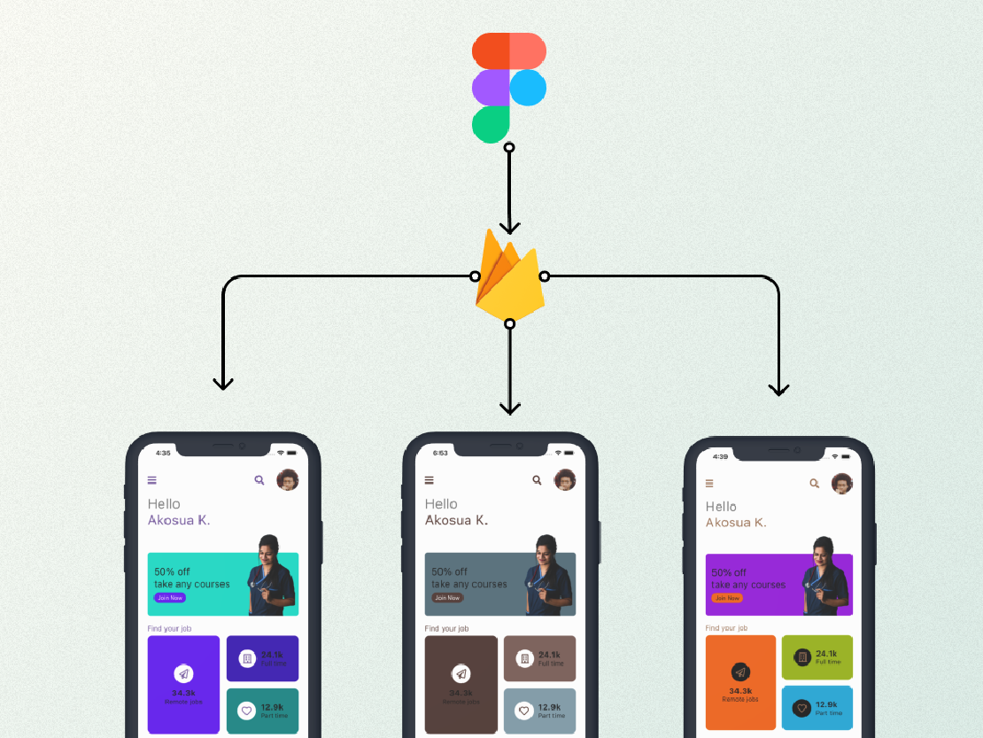
Rendering Config UI

Slide 8
Technologies Used
Express– Express is a popular web application framework for Node.js, a runtime environment that allows JavaScript code to run outside of a web browser. Express provides a minimalistic and flexible approach to building web applications and APIs. It is known for its simplicity, ease of use, and extensibility.
React- Express is a popular web application framework for Node.js, a runtime environment that allows JavaScript code to run outside of a web browser. Express provides a minimalistic and flexible approach to building web applications and APIs. It is known for its simplicity, ease of use, and extensibility.

Slide 9
Technologies Used
Mongo- MongoDB is a popular open-source NoSQL database that provides high performance, scalability, and flexibility for handling large volumes of unstructured data. It is designed to store, retrieve, and manipulate data in a document-oriented format, making it an excellent choice for modern applications with evolving and complex data models.
Node- Node, also known as Node.js, is an open-source, cross-platform JavaScript runtime environment built on Chrome's V8 JavaScript engine. It allows developers to run JavaScript code on the server-side, enabling them to create efficient and scalable network applications.

Slide 10
Implementation
Created a Server which sends API data At localhost:3000/config/api
Created a React App that fetch Config API From above end point and paints the browser
Parcel will run React code by converting code in pure js

Slide 11
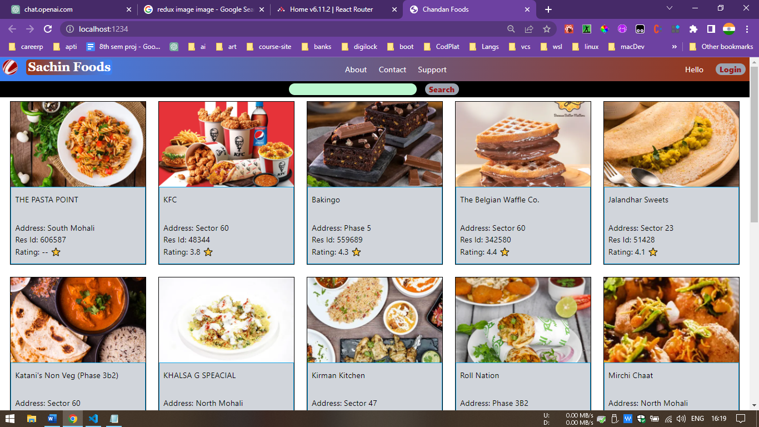
App View

Slide 12
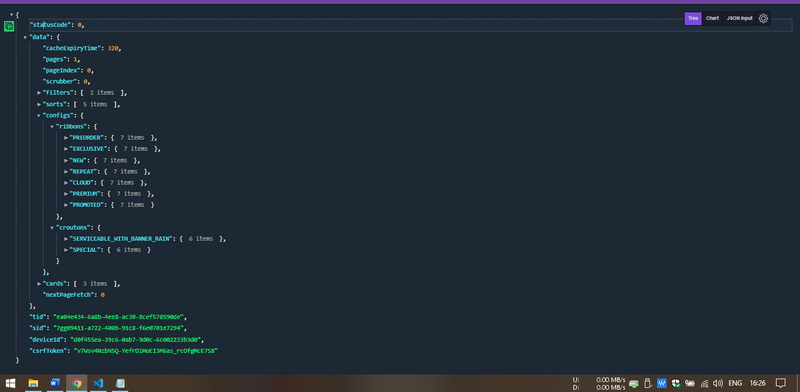
Received API

Slide 13
Advantages
Enhanced Flexibility: Config-Based UI allows for easy customization and modification of UI components, styles, and layouts, providing increased flexibility for developers and end-users.
Simplified Maintenance: By separating UI configurations from the codebase, the maintenance process becomes more straightforward, enabling efficient updates and reducing the risk of introducing bugs or errors.
Faster Development: With a config-based approach, developers can quickly create and iterate on UI designs, reducing the development time required for building and modifying UI components.
User Empowerment: Config-Based UI empowers end-users to personalize their interfaces according to their preferences, allowing for a more tailored and engaging user experience.

Slide 14
System Requirements
Software :
Operating System – Windows 10 and above.
Language – JavaScript
Libraries – Express, React, Parcel ,MongoDB ,React Router DOM
Hardware :
Device which can run a Browser

Slide 15
Conclusion and Future Scope
In conclusion, the configuration-based UI project has been a significant undertaking that has provided valuable insights and outcomes. Throughout this project, we have explored the concept of a configuration-driven user interface, which offers flexibility and adaptability to meet various user requirements.
Config-based UI projects have gained significant popularity in recent years due to their flexibility, scalability, and ease of maintenance. These projects rely on configuration files to define the UI components, layouts, and behavior, making it easier for developers and designers to collaborate and iterate.

Slide 16
References
"Design Systems: Configurable UIs" by Nathan Curtis: https://medium.com/eightshapes-llc/design-systems-configurable-uis-723a2af7598d
This article discusses the concept of configurable UIs within the context of design systems and provides practical insights and considerations.
"Building a Configurable UI Component System" by Sarah Drasner: https://css-tricks.com/building-a-configurable-ui-component-system/

Slide 17


