Slide 1
CS 31006: Computer Networks – Application Layer

Slide 2
Protocol Stack Implementation in a Host
Application
Software, Kernel
Transport
Network
Data Link
Firmware, Device Driver
Physical
Hardware

Slide 3
How Application Data Passes Through Different Layers
Application
HTTP Header
HTTP Data
Transport
TCP Header
HTTP Header
HTTP Data
Network
IP Header
TCP Header
HTTP Header
HTTP Data
Data Link
MAC Header
IP Header
TCP Header
HTTP Header
HTTP Data
Physical
PHY Header
MAC Header
IP Header
TCP Header
HTTP Header
HTTP Data
PHY Trailer

Slide 4
Application Layer Interfacing
Application - 1
Application - 2
Application - 3
Application - 4
UDP
TCP
End to end packet delivery
Connection Establishment
Reliable Data Delivery
Flow and Congestion Control
Ordered Packet Delivery
Transport
Network
Data Link

Slide 5
Application Layer Interfacing
Name Service
(DNS)
Web
(HTTP)
Email
(SMTP, POP, IMAP)
File Transfer
(FTP)
UDP
TCP
End to end packet delivery
Connection Establishment
Reliable Data Delivery
Flow and Congestion Control
Ordered Packet Delivery
Transport
Network
Data Link

Slide 6
The Web – Hypertext Transfer Protocol (HTTP)
Hypertext - A way to represent web content (text along with formatting)
Hypertext Markup Language (HTML) - A scripting language to specify web data along with simple formatting (bold, italics, new line).
A way to convert text based information to graphics based information
Today’s era: Many graphics, scripts and other information are embedded inside HTML – CSS, JavaScript etc.

Slide 7
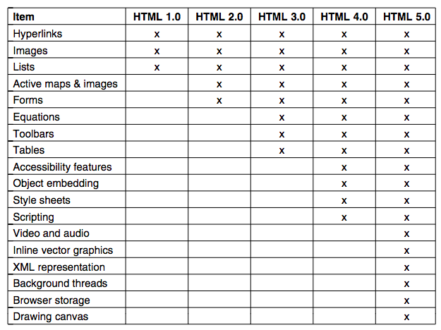
Differences between HTML Versions
Source: Computer Networks (5th Edition) by Tanenbaum, Wetherell

Slide 8
A History of the Web
1989 (CERN – European Center for Nuclear Research) – help large teams to collaborate using a constantly changing collection of reports, blueprints, drawings, photos and other documents
The proposal came from Tim Berners-Lee
A public demonstration at Hypertext ‘91 conference
1993 – The first graphical browser (Mosaic) developed by Marc Andreessen, University of Illinois
Andreessen formed the company Netscape Communications Corp
Microsoft developed Internet Explorer – “browser war” between Internet Explorer and Netscape Navigator
1994 – CERN and MIT signed an agreement to setup World Wide Web Consortium (W3C)

Slide 9
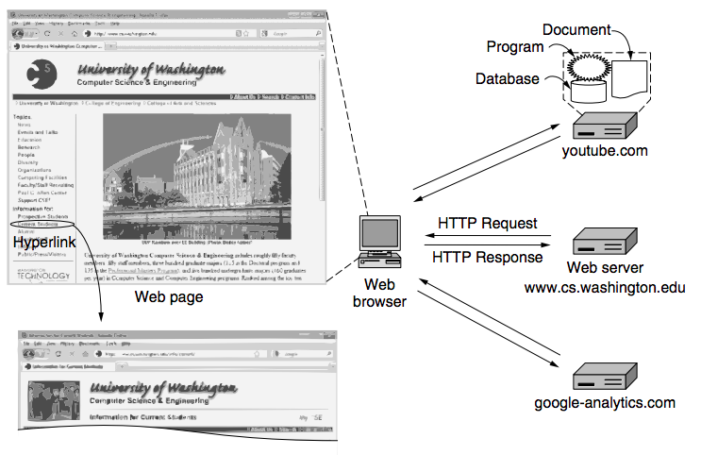
The Web – Architectural Overview
Source: Computer Networks (5th Edition) by Tanenbaum, Wetherell

Slide 10
HTTP – The Client Side
Three questions to be answered for accessing a web page
What is the page called? (courses.html)
Where is the page located? (cse.iitkgp.ac.in/~sandipc/)
How can the page be accessed? (http://)
Uniform Resource Locator (URL): Each page is assigned a URL that effectively serves the page’s worldwide name
URL have three components:
The protocol
The qualified name of the machine one which the page is located
The path uniquely indicating the specific page
http://cse.iitkgp.ac.in/~sandipc/courses.html

Slide 11
The Steps When You Click http://cse.iitkgp.ac.in/~sandipc/courses.html
The browser determines the URL
The browser asks DNS for the IP address of the server cse.iitkgp.ac.in
DNS replies with 203.110.245.250
The browser makes a TCP connection to 203.110.245.250 on port 80, the well known port for the HTTP protocol
It sends over an HTTP request asking for the page /courses.html
The cse.iitkgp.ac.in server sends the page as an HTTP response, for example by sending the file /courses.html
If the page includes URLS that are needed for display, the browser fetches the other URLs using the same process.

Slide 12
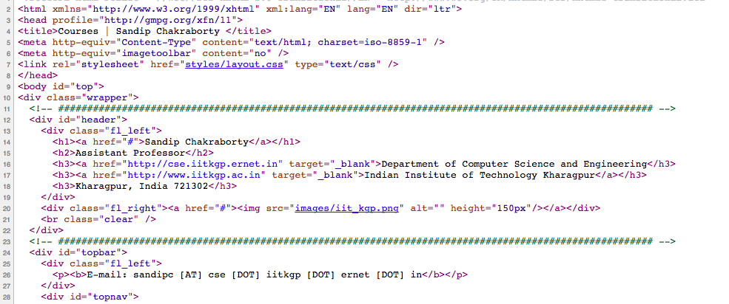
The Steps When You Click http://cse.iitkgp.ac.in/~sandipc/courses.html

Slide 13
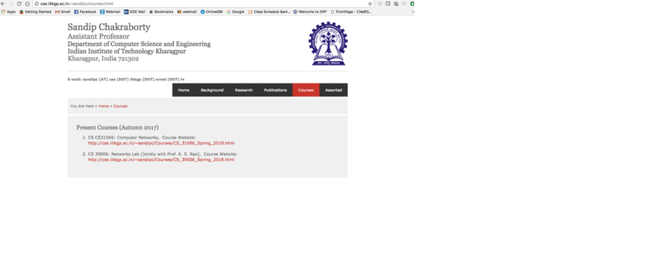
The Steps When You Click http://cse.iitkgp.ac.in/~sandipc/courses.html
The browser displays the page courses.html
The TCP connections are released if there are no other requests to the same server for a short period.

Slide 14
Uniform Resource Identifier (URI)
Generalization of the URLs – specifies the pages only or partially refers the pages without complete locations
/images/iit_kgp.png – may become URL https://cse.iitd.ac.in/images/iit_kgp.png if accessed from cse.iitd.ac.in

Slide 15
HTTP – The Server Side
Accept a TCP connection from a client (a browser).
Get the path to the page, which is the name of the file requested.
Get the file (from disk).
Sends the content of the file to the client.
Release (close) the TCP connection.

Slide 16
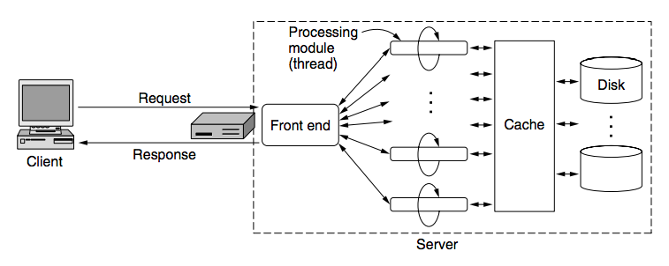
Multi-Threaded Server
Serves multiple client requests simultaneously
Source: Computer Networks (5th Edition) by Tanenbaum, Wetherell

Slide 17
Connections
HTTP uses TCP to set up a connection between the server and the client. In general, HTTP server runs at port 80 (default port) or 8080 (alternate port).
HTTP 1.0 – After the connections were established, a single request was sent over and a single response was sent back. Then the TCP connections are released.
Create separate connections for every content in the web-page. Overhead is high.
Persistent Connection (HTTP 1.1) – send additional requests and additional responses in a single TCP connection (connection reuse).
It is also possible to pipeline requests.

Slide 18
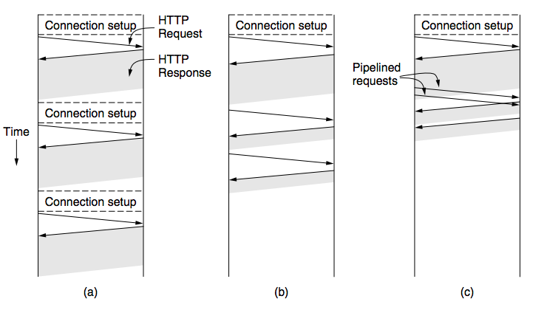
Connections
Persistent Connections: Set at keep-alive information in the HTTP header (HTTP 1.0)
HTTP 1.1 – All connections are by default persistent
Source: Computer Networks (5th Edition) by Tanenbaum, Wetherell
HTTP 1.0
HTTP 1.1 – Persistent Connections
HTTP 1.1 – Persistent Connections (Pipelined)

Slide 19
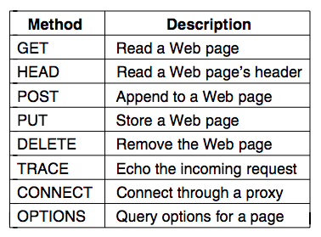
HTTP Request Methods
Specifies what a HTTP Request will do
GET filename HTTP/1.1

Slide 20
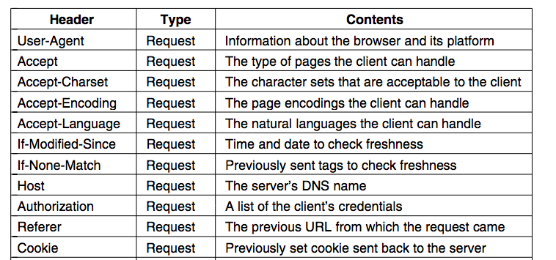
HTTP Request Header Fields (Partial List)

Slide 21
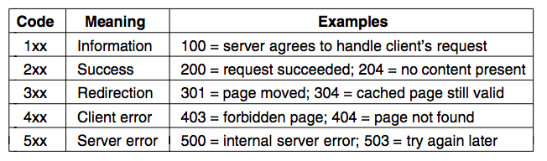
HTTP Response
Specifies the status of the request message.

Slide 22
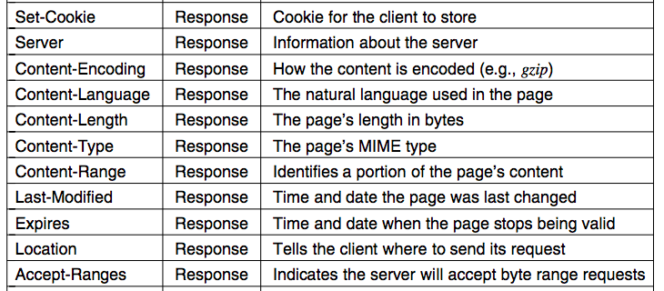
HTTP Response Header Fields (Partial List)

Slide 23
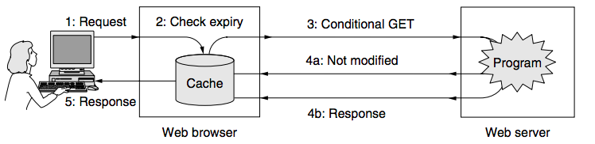
HTTP Caching
Source: Computer Networks (5th Edition) by Tanenbaum, Wetherell

Slide 24
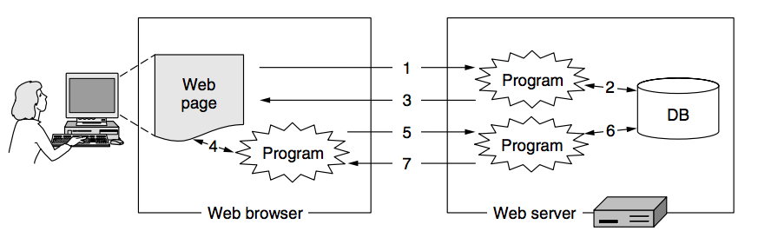
Dynamic Web Applications
Source: Computer Networks (5th Edition) by Tanenbaum, Wetherell

Slide 25
Cookies
HTTP is by default a stateless protocol
Every Response corresponds to the previous Request only, it does not remember any state information, such as last page accessed
Use Cookies to store the state information. Client forwards the additional information along with the Request message by reading the cookie.

Slide 26
HTTP Proxy
Intercepts the TCP connections to process the HTTP data.
HTTP Proxy

Slide 27
Application Layer Interfacing
Name Service
(DNS)
Web
(HTTP)
Email
(SMTP, POP, IMAP)
File Transfer
(FTP)
UDP
TCP
End to end packet delivery
Connection Establishment
Reliable Data Delivery
Flow and Congestion Control
Ordered Packet Delivery
Transport
Network
Data Link

Slide 28
Domain Name System (DNS)
Assign Unique names to an IP address (machine interface)
ARPANET – a file hosts.txt listed all the computer names and their IP addresses.
Resolve the host name conflicts over the Internet – a naming hierarchy needs to be managed
Rooted at an organization Internet Corporation for Assigned Names and Numbers (ICANN)

Slide 29
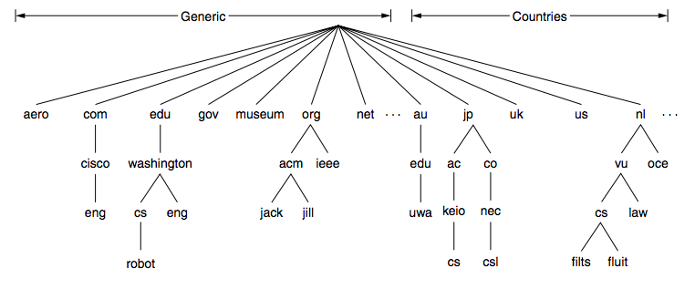
The DNS Name Space
Source: Computer Networks (5th Edition) by Tanenbaum, Wetherell
The top level domains are run by registrars appointed by ICANN
Name registrar for India (.in domain): registry.in (National Internet Exchange of India – NIXI)

Slide 30
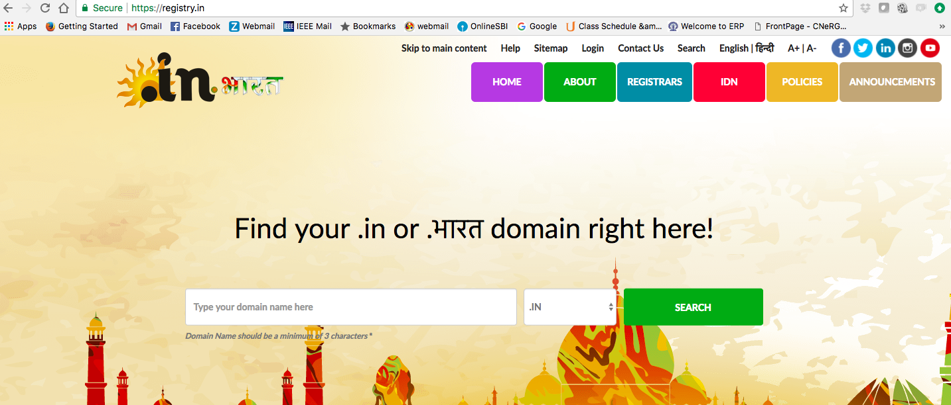
registry.in

Slide 31
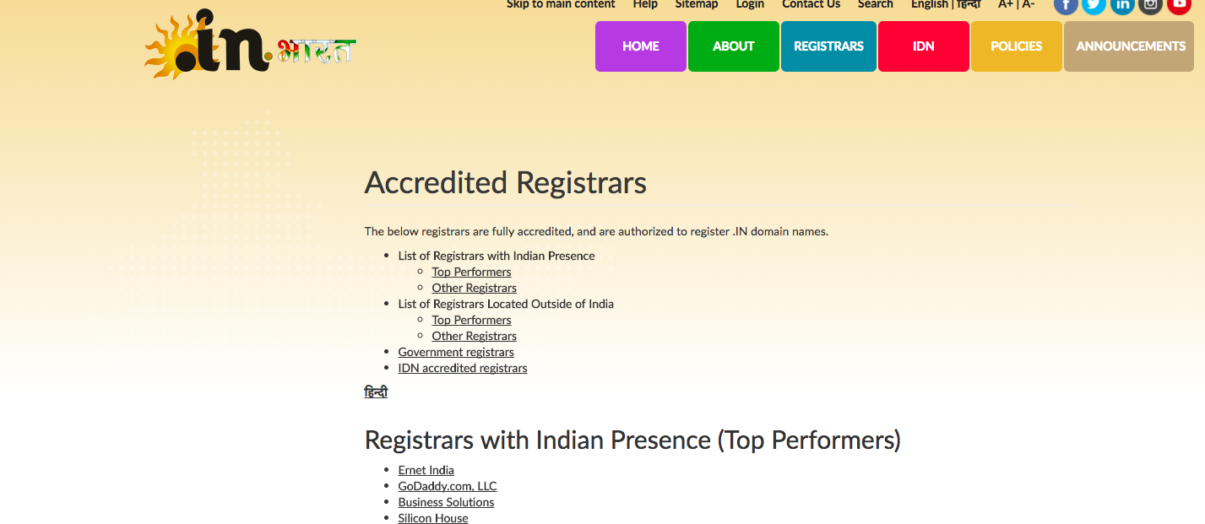
Registrars Under registry.in

Slide 32
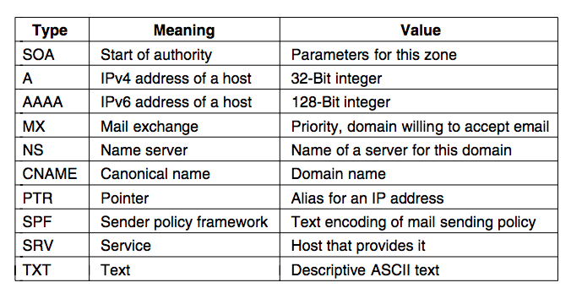
Domain Resource Records
Every domain has a set of resource records associated with it – DNS database

Slide 33
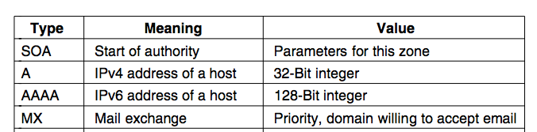
Domain Resource Records
Domain_name: Domain to which the record applies.
Time_to_live: Time for which this record is active – volatile records may be assigned a small value
Class: Normally IN – Internet resources
Type: What type of record it is
Value: Value of the record (IP address for A record type)

Slide 34
Domain Resource Records
A Type Records: cse.iitkgp.ac.in 86400 IN A 203.110.245.250
CNAME Type Records: iitkgp.ac.in 86400 IN CNAME www.iitkgp.ac.in
PTR Type Records: www.iitkgp.ernet.in 86400 IN PTR www.iitkgp.ac.in

Slide 35
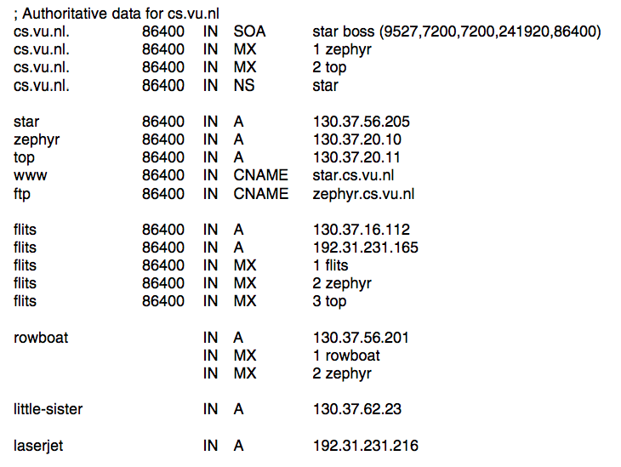
Sample DNS Database
Source: Computer Networks (5th Edition) by Tanenbaum, Wetherell

Slide 36
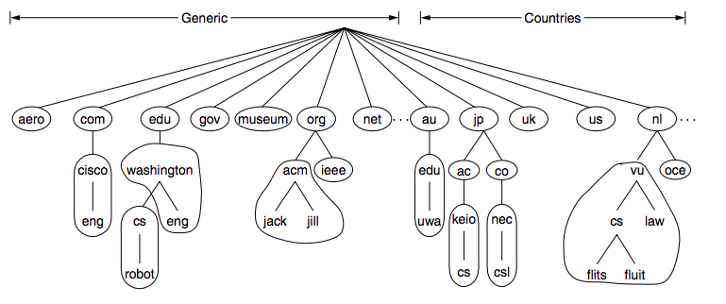
Name Servers
Divide registries into non-overlapping zones – every zone has a name server
Source: Computer Networks (5th Edition) by Tanenbaum, Wetherell

Slide 37
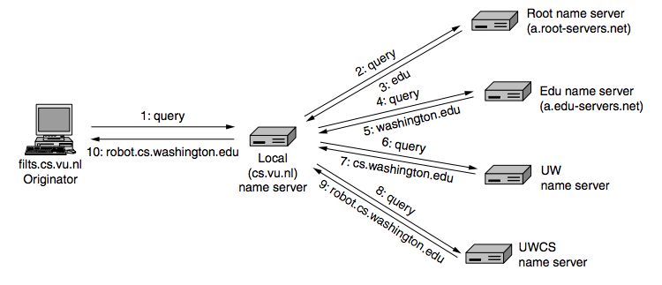
Name Resolution – Looking Up for the Names
Source: Computer Networks (5th Edition) by Tanenbaum, Wetherell

Slide 38
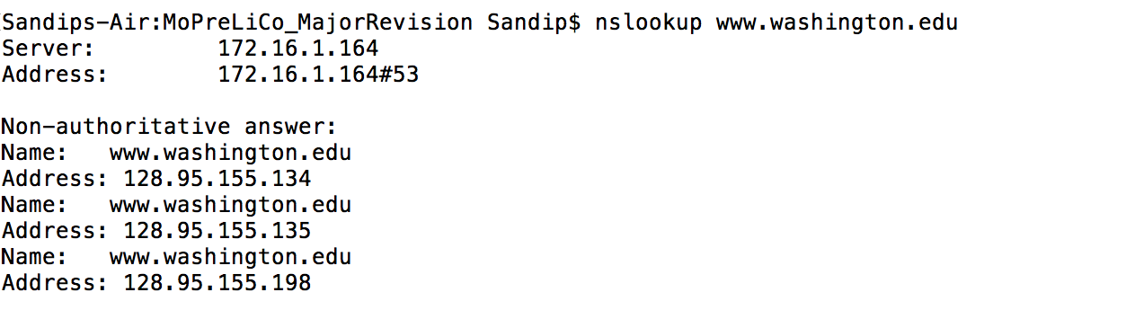
Name Resolution (nslookup)
One of the name servers for IITKGP

Slide 39
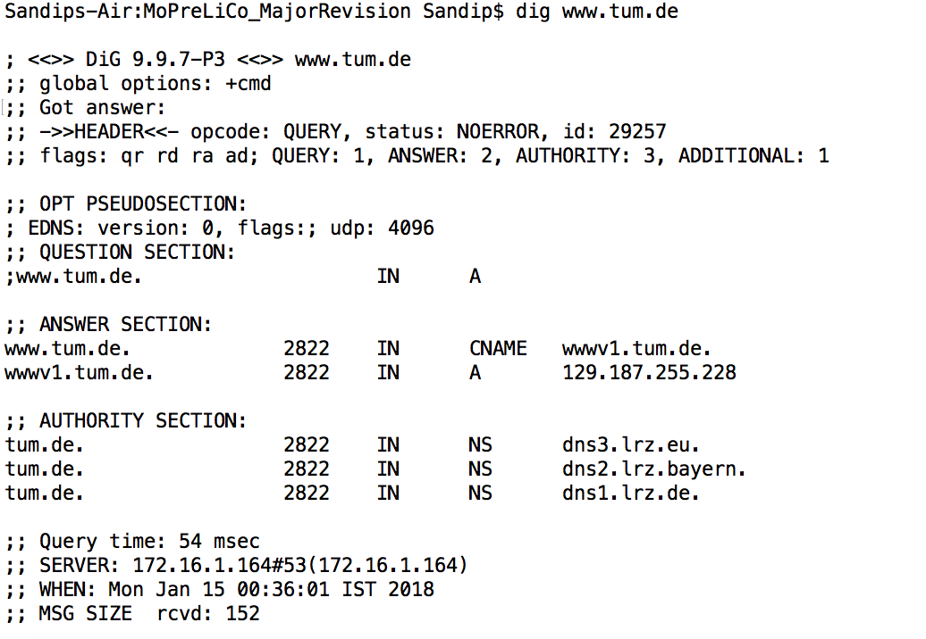
Name Resolution (dig)
An authoritative record is one that comes from the authority that manages the record, and thus is always correct
UDP Message for 4096 bytes

Slide 40
Why DNS Uses UDP
UDP is much faster. TCP requires handshake time. DNR uses a cascading approach for name resolution. With TCP, for every message, a connection setup is required.
DNS requests and responses are generally very small, and fits well within one UDP segment.
UDP is not reliable. In DNS, reliability is ensured at the application layer. After timeout, the DNS client sends back the requests. After few consecutive timeouts (can be set at the client), the request is aborted with an error.

Slide 41
Application Layer Interfacing
Name Service
(DNS)
Web
(HTTP)
Email
(SMTP, POP, IMAP)
File Transfer
(FTP)
UDP
TCP
End to end packet delivery
Connection Establishment
Reliable Data Delivery
Flow and Congestion Control
Ordered Packet Delivery
Transport
Network
Data Link

Slide 42
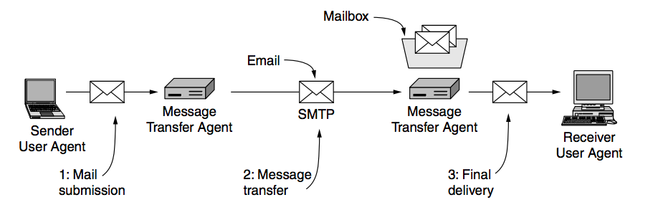
Electronic Mails – Architecture and Services
sukumar@iitg.ernet.in
sandipc@cse.iitkgp.ernet.in
cse.iitkgp.ernet.in
iitg.ernet.in
User Agent: Allow people to read and send emails.
Message Transfer Agents (main servers): Move the message from the source to the destination

Slide 43
Message Transfer Agents
System processes run in the background on mail servers (always available).
Automatically move emails through the system from the originator to the recipient
Uses Simple Mail Transfer Protocol (SMTP) – RFC 821, RFC 5321
Implements mailing lists, an identical copy of message is delivered to everyone in the list (btech@iitkgp.ac.in)
Implements Mailboxes, to store all the emails received for a user

Slide 44
Message Format (RFC 5322)
An envelope containing message header and message body

Slide 45
The Internet Message Format (RFC 5322)
Header fields (for message transport):

Slide 46
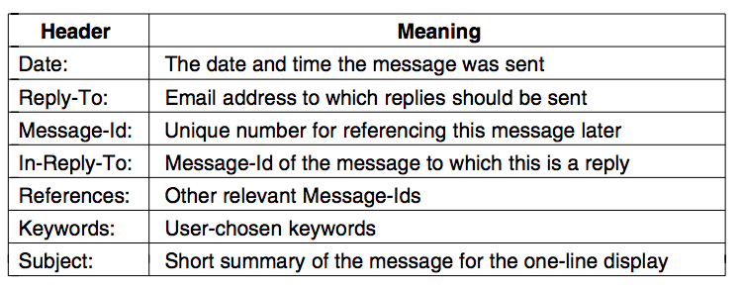
The Internet Message Format (RFC 5322)
Header fields (additional fields for message description):

Slide 47
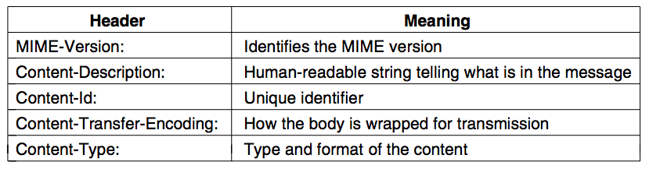
MIME – The Multipurpose Internet Mail Extension
ARPANET: email consisted exclusively of text messages written in English and expressed in ASCII
MIME: Use multi-language and multimedia contents (audio, image etc.) inside an email.
Additional message headers for MIME:

Slide 48
Message Transfer
Uses SMTP Protocol
Email is delivered by having the sending computer establishing TCP connection to port 25 of the receiving computer.
UA – SMTP Client
Port ANY
SMTP
SMTP
SMTP Server
(Port 25)
SMTP Client (Port ANY)
SMTP Server
(Port 25)
SMTP Client (Port ANY)
TCP
TCP
cse.iitkgp.ernet.in
iitg.ernet.in
sandipc@cse.iitkgp.ernet.in

Slide 49
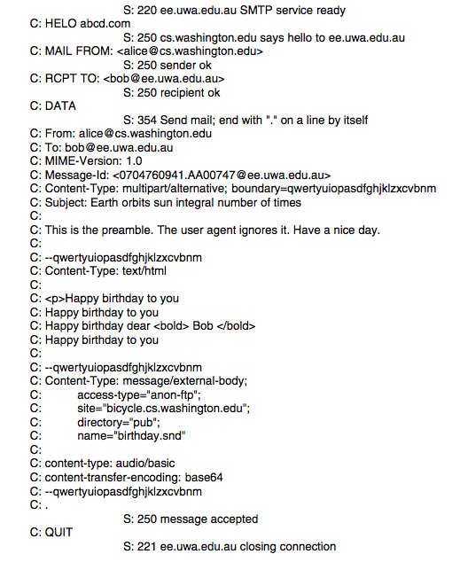
Message Transfer (SMTP)
Source: Computer Networks (5th Edition) by Tanenbaum, Wetherell

Slide 50
Final Delivery
Pull type protocol – UA at the receiver side pulls the emails from mail server after login.
Post Office Protocol, Version 3 (POP3) – an earlier protocol for email delivery
Internet Message Access Protocol, Version 4 (IMAP v4) – RFC 3501
The email server runs an IMAP server at port 143
The user agent runs IMAP client
The client connects to the server and issues mail delivery commands

Slide 51
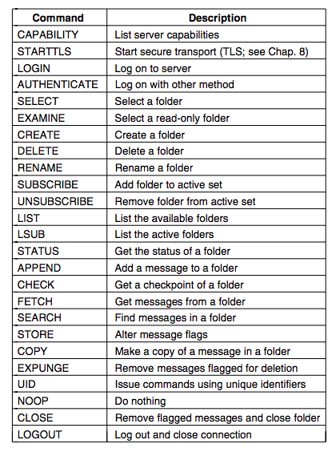
IMAP (Version 4) Commands

Slide 52
Application Layer Interfacing
Name Service
(DNS)
Web
(HTTP)
Email
(SMTP, POP, IMAP)
File Transfer
(FTP)
UDP
TCP
End to end packet delivery
Connection Establishment
Reliable Data Delivery
Flow and Congestion Control
Ordered Packet Delivery
Transport
Network
Data Link

Slide 53
File Transfer Protocol (FTP)
Is built on a client-server model (RFC 959)
The client requests for the file or send the file to the server
The server responses with the file data or store the file at the file server
Works in two modes – Active and Passive
User
(FTP Client)
File Request
File Server
(FTP Server)
File Response Status
File Data

Slide 54
Active and Passive Modes of File Transfer
FTP server uses two different ports:
Port 21 (Command or Control Port): For command message transfer
Port 20 or Client assigned (Data Port): For data transfer
Image Source: http://henrydu.com/blog/how-to/ftp-active-mode-vs-passive-mode-106.html

Slide 55
Why There are Two Channels – Command Channel and Data Channel
Specifically to avoid busy waiting, and keep the command channel lightweight.
You can always use a multiplexing between command/control and data, but FTP is used for large file transfer; if command channel is used for data transfer as well, the commands for other clients may experience a higher queuing delay while one client is being served.
The clients can continue sending and receiving control information while data transfer is being take place

Slide 56
Why There are Two Modes in FTP?
Active Mode: Client informs the port number where it is listening, and the server initiates the TCP connection to that port (TCP server is running at the client side)
What If the client is behind a firewall and can not accept a connection?

Slide 57
Why There are Two Modes in FTP?
Passive Mode: The server selects a random port, and the client initiates a TCP connection to that server port.
The server can serve multiple clients at different server data ports through different threads.
The clients always initiate the command and the data transfer.
Image Source: http://henrydu.com/blog/how-to/ftp-active-mode-vs-passive-mode-106.html

Slide 58
FTP Data Transfer Modes
Stream mode: Data is sent as a continuous stream, relieving FTP from doing any processing. Rather, all processing is left up to TCP. No End-of-file indicator is needed, unless the data is divided into records.
Block mode: FTP breaks the data into several blocks (block header, byte count, and data field) and then passes it on to TCP.
Compressed mode: Data is compressed using a simple algorithm (usually run-length encoding).
Source: Wikipedia

Slide 59
FTP Sample Commands and Response Codes

Slide 60
Next, we’ll go for the Transport Layer ….

