Slide 1
CS 31006: Computer Networks – Moving From End-to-End To Per Hop

Slide 2
What We Have Learnt So Far …
The design of current network architecture is based on experience and requirements
Data Link
Physical
Physical
Transport
Network
Network
Data Link
Data Link
Physical
Physical

Slide 3
What We Have Learnt So Far …
Protocol stack is implemented across different layers of the operating system
Application
Software, Kernel
Transport
Network
Data Link
Firmware, Device Driver
Physical
Hardware

Slide 4
What We Have Learnt So Far …
Each layer adds up its own information in the packet headers
Application
HTTP Header
HTTP Data
Transport
TCP Header
Transport Layer Data
Network
IP Header
Network Layer Data
Data Link
MAC Header
Data Link Layer Data
Physical
PHY Header
MAC Header
IP Header
TCP Header
HTTP Header
HTTP Data
PHY Trailer

Slide 5
Every Layer Adds Up Their Own Services
UDP
TCP
End to end packet delivery
Connection Establishment
Reliable Data Delivery
Flow and Congestion Control
Ordered Packet Delivery
Transport
Addressing
Routing
Network
Framing
Switching
Per Hop Flow Control
Access Control
Data Link

Slide 6
Transport Layer - Understand the Basic End-to-end Principles
Connection Establishment:
Use sequence number selection principles to avoid delayed duplicates – differentiate new connections from old connections
Flow Control:
Use sliding window principle to adjust flow rates based on what receiver can accept
Congestion Control:
Use AIMD principles – ensure efficiency and fairness simultaneously without solving any complex mathematical optimization

Slide 7
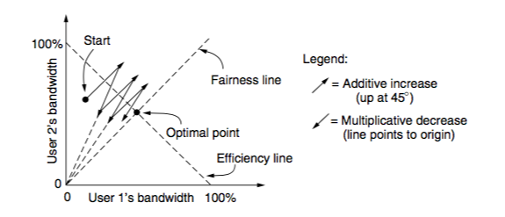
TCP Congestion Control – A Perfect Example of System Engineering
AIMD – support efficiency and fairness simultaneously

Slide 8
TCP Congestion Control – A Perfect Example of System Engineering
Slow Start: Accelerate AIMD convergence

Slide 9
TCP Congestion Control – A Perfect Example of System Engineering
Fast Retransmit: Use triple duplicate ACK to trigger a congestion (faster than timeout), retransmit the lost segment immediately and then apply slow start.
Fast Recovery: Do not apply slow start for thee DUPACKs (packets are still flowing in the network). For every DUPACK, transmit a segment starting from the lost segment. Once a new ACK is received, start AIMD instead of slow start.

Slide 10
Network (Internet) Layer Services
UDP
TCP
End to end packet delivery
Connection Establishment
Reliable Data Delivery
Flow and Congestion Control
Ordered Packet Delivery
Transport
Addressing
Datagram delivery (unreliable)
Routing
Network
Data Link

Slide 11
Internet Architecture – Basic Principles
Internet is organized in a hierarchical fashion.
Router
SW Lab 1
SW Lab 2
CSE Network

Slide 12
Internet Architecture – Basic Principles
Internet is organized in a hierarchical fashion.
SW Lab 1
EE Lab 1
SW Lab 2
EE Lab 2
CSE Network
EEE Network
IITKGP Network

Slide 13
Internet Architecture – Basic Principles
Internet is organized in a hierarchical fashion.
EEE
EEE
CSE
CSE
IITKGP Network
IITBBS Network
ERNET Network

Slide 14
Internet Architecture – Basic Principles
Internet is organized in a hierarchical fashion.
IITKGP
BSNL Public
IITBBS
BSNL Corporate
ERNET Network
BSNL Network
Bharti Airtel Network

Slide 15
Internet Architecture
Autonomous Systems (AS) – A set of LANs for an administrative domain, identified by a unique AS number, and the routing policies are controlled by a single administrator.
Local Area Network (LAN) – A set of devices with a common layer 3 gateway

Slide 16
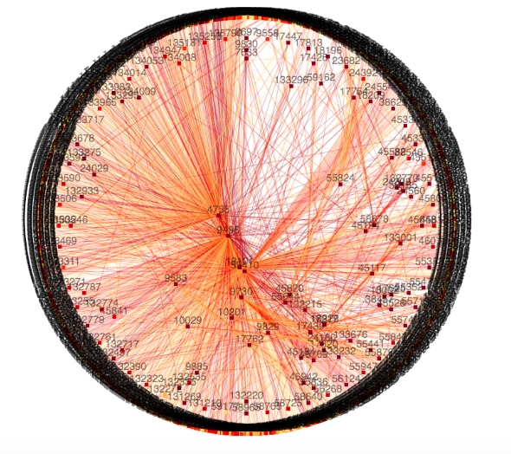
Autonomous System Graph for India
Source: https://labs.apnic.net/vizas/#IN

Slide 17
Internet Architecture
Internet Service Providers (ISP) – An AS provides Internet connectivity to another group of ASes or end users

Slide 18
Peering between ISPs

Slide 19
Communication between Two Nodes over ISPs

Slide 20
IP Addressing – Basic Principles
We need to forward data packets from one network to another network via different intermediate networks.
Host 2
AS 11
AS 10
AS 12
Host 1
AS 13

Slide 21
IP Addressing – Basic Principles
The address should identify a network as well as a host inside a network
Host 2
AS 11
AS 10
AS 12
Host 1
AS 13

Slide 22
IP Addressing
Network address
Host address
Divide the address space (32 bit in IPv4) among network address and host address
The old age – Classful addressing: Fixed number of bits for network address and host address

Slide 23
Classful Addressing
How to identify a class – use the first few bits
0 – Class A, 10 – Class B, 110 – Class C, 1110 – Class D, 1111 – Class E

Slide 24
Network Address and Broadcast Address
Network address – identify a network
All 0’s in the host address part
Ex-1 (Class A): 01111110.00000000.00000000.00000000 (126.0.0.0)
Ex-2 (Class B): 10111101.11101001.00000000.00000000 (189.233.0.0)
Broadcast address – send the data to all the hosts of a network
All 1’s in the host address part
Ex-1 (Class A): 01111110.11111111.11111111.11111111 (126.255.255.255)
Ex-2 (Class B): 10111101.11101001.11111111.11111111 (189.233.255.255)
How many valid hosts can be there in a Class A, in a Class B and in a Class C IP address?

Slide 25
Subnetting and Supernetting – Classless Inter-domain Routing (CIDR)
You have 255 hosts in a network. Which IPv4 address class will you use – Class C or Class B ?
Class C – not possible
Class B – huge address space is lost (using only 255 addresses out of possible 2¹⁶-2 addresses)
Split a large network or combine multiple small networks for efficient use of address space
Subnetting – divide a large network into multiple small networks
Supernetting – combine multiple small networks into a single large network
Subnet mask – denote the number of bits in the network address field

Slide 26
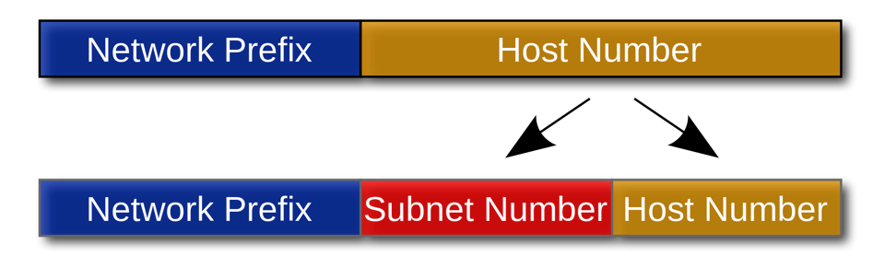
Divide a Network into Subnets

Slide 27
CIDR – Addressing Format
Subnet Address
Host Address
IP Address
10111111
10110100
01010011
11101011
Netmask
11111111
11110000
00000000
00000000
We write the IP address as 191.180.83.235/12 in CIDR notation
The first 12 bits are the network address and rest (32-12)=20 bits are for host address
The subnet mask is 255.240.0.0

Slide 28
CIDR - Manual IP Setting in the OS

Slide 29
Divide a Network into Subnets
Let the IP address of a network is 203.110.0.0/16
We want to divide this network into three subnets
We need 3 bits for subnets – why not 2 bits?
Subnet 1 – 100, Subnet 2– 101, Subnet 3 – 110
Rest 13 bits are used for addressing the hosts of those subnets.
The subnets are – 203.110.128.0/19, 203.110.160.0/19, 203.110.192.0/19

Slide 30


All Zero and All One Subnets
192.168.0.0/16
192.168.128.0/17
192.168.1XXXXXXX.X
192.168.0.0/17
192.168.0XXXXXXX.X
Broadcast address for this subnet is 192.168.255.255, broadcast address for the original network is also 192.168.255.255 – All-One Subnet
The network address for the subnet and the original network is identical – Subnet Zero
We normally avoid “all zero” and “all one” subnets.

Slide 31
CIDR Example
CSE – 2000 Hosts
VGSOM – 500 Hosts
EE – 500 Hosts
203.110.0.0/19

Slide 32
CIDR Example
CSE – 2000 Hosts
VGSOM – 500 Hosts
EE – 500 Hosts
9 bit hosts
9 bit hosts
11 bit hosts
203.110.0.0/19

Slide 33
CIDR Example
Address space – 203.110.0.0/19
13 bits are available to serve all the hosts of IITKGP network
We need to divide these address space among 3 subnets
CSE – 11 bits, VGSOM – 9 bits, EE – 9 bits for host address
We have 2 bits left for identifying three subnets – Is this possible?
Avoid “all zero” and ”all one” subnets
Let us apply CIDR – Combine VGSOM and EE Networks together

Slide 34
CIDR Example
CSE – 2000 Hosts
VGSOM – 500 Hosts
9 bit hosts
EE – 500 Hosts
9 bit hosts
11 bit hosts
10 bit hosts
203.110.0.0/19

Slide 35
CIDR Example
CSE – 11 bits, VGSOM+EE – 10 bits
Network address – 203.110.0.0/19, 203.110.000XXXXX.XXXXXXXX
CSE network address 203.110.00010XXX.XXXXXXXX (203.110.16.0/21)
VGSOM+EE network address 203.110.00001XXX.XXXXXXXX (203.110.8.0/21)

Slide 36
CIDR Example
CSE – 2000 Hosts
VGSOM – 500 Hosts
9 bit hosts
EE – 500 Hosts
9 bit hosts
11 bit hosts
203.110.16.0/21
10 bit hosts
203.110.8.0/21
203.110.0.0/19

Slide 37
CIDR Example
VGSOM – 9 bits, EE – 9 bits
Network address – 203.110.8.0/21, 203.110.00001XXX.XXXXXXXX
VGSOM network address 203.110.0000110X.XXXXXXXX (203.110.12.0/23)
EE network address 203.110.0000101X.XXXXXXXX (203.110.10.0/23)

Slide 38
CIDR Example
CSE – 2000 Hosts
VGSOM – 500 Hosts
9 bit hosts
EE – 500 Hosts
9 bit hosts
11 bit hosts
203.110.12.0/23
203.110.10.0/23
203.110.16.0/21
10 bit hosts
203.110.8.0/21
203.110.0.0/19

Slide 39

CIDR – Routing Table Construction
10.0.2.0/24
R3
172.16.1.1/24
172.16.1.2/24
10.0.2.1/24
eth0
10.0.3.1/24
10.0.3.0/24
172.16.2.2/24
R2
R1
eth1
172.16.2.1/24
10.0.4.1/24
10.0.4.0/24
Network | Netmask | Gateway | Interface
10.0.2.0 | 255.255.255.0 | 172.16.2.2 | eth1
10.0.3.0 | 255.255.255.0 | 172.16.2.2 | eth1
10.0.4.0 | 255.255.255.0 | 172.16.2.2 | eth1
0.0.0.0 | 0.0.0.0 | 172.16.1.1 | eth0
172.16.1.0 | 255.255.255.0 | 172.16.1.1 | eth0
172.16.2.0 | 255.255.255.0 | 172.16.2.2 | eth1
Routing Table for R1

Slide 40
CIDR – Routing Table Construction
10.0.2.0/24
R3
172.16.1.1/24
172.16.1.2/24
10.0.2.1/24
eth0
10.0.3.1/24
10.0.3.0/24
172.16.2.2/24
R2
R1
eth1
172.16.2.1/24
10.0.4.1/24
Routing Table for R1
10.0.4.0/24
Network | Netmask | Gateway | Interface
10.0.2.0 | 255.255.255.0 | 172.16.2.2 | eth1
10.0.3.0 | 255.255.255.0 | 172.16.2.2 | eth1
10.0.4.0 | 255.255.255.0 | 172.16.2.2 | eth1
0.0.0.0 | 0.0.0.0 | 172.16.1.1 | eth0
172.16.1.0 | 255.255.255.0 | 172.16.1.1 | eth0
172.16.2.0 | 255.255.255.0 | 172.16.2.2 | eth1
Compaction of routing table is possible

Slide 41
CIDR – Routing Table Construction
10.0.2.0/24
R3
172.16.1.1/24
172.16.1.2/24
10.0.2.1/24
eth0
10.0.3.1/24
10.0.3.0/24
172.16.2.2/24
R2
R1
eth1
172.16.2.1/24
10.0.4.1/24
10.0.4.0/24
Network | Netmask | Gateway | Interface
10.0.0.0 | 255.255.0.0 | 172.16.2.2 | eth1
0.0.0.0 | 0.0.0.0 | 172.16.1.1 | eth0
172.16.1.0 | 255.255.255.0 | 172.16.1.1 | eth0
172.16.2.0 | 255.255.255.0 | 172.16.2.2 | eth1
Compact
Routing Table for R1

Slide 42


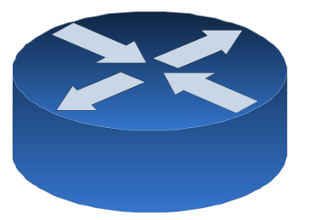
CIDR – Problem of Multihoming
10.0.2.0/24
R3
172.16.1.1/24
172.16.1.2/24
10.0.2.1/24
eth0
10.0.3.1/24
10.0.3.0/24
172.16.2.2/24
R2
R1
eth1
172.16.2.1/24
10.0.4.1/24
eth2
10.0.4.0/24
172.16.3.1/24
10.0.4.2/24
172.16.3.2/24

Slide 43
CIDR – Longest Prefix Match
Supernetting is not always perfect !
There is always a possibility of duplicate entries
Network | Netmask | Gateway | Interface
10.0.0.0 | 255.255.0.0 | 172.16.2.2 | eth1
10.0.5.0 | 255.255.255.0 | 172.16.3.2 | eth2
0.0.0.0 | 0.0.0.0 | 172.16.1.1 | eth0
172.16.1.0 | 255.255.255.0 | 172.16.1.1 | eth0
172.16.2.0 | 255.255.255.0 | 172.16.2.2 | eth1
Where to forward 10.0.5.8 ?

Slide 44
CIDR – Longest Prefix Match
Use Patricia Tree (a compact representation of trie) for matching prefixes.
0
1
00
10
11
0*
00*
100
101
11*

Slide 45
Next, we’ll look how to construct the routing table for the Internet …

