Slide 1
CS 31006: Computer Networks – Transport Layer Primitives

Slide 2
Protocol Stack Implementation in a Host
Application
Software, Kernel
Transport
Network
Data Link
Firmware, Device Driver
Physical
Hardware

Slide 3
How Application Data Passes Through Different Layers
Application
HTTP Header
HTTP Data
Transport
TCP Header
Transport Layer Data
Network
IP Header
Network Layer Data
Data Link
MAC Header
Data Link Layer Data
Physical
PHY Header
MAC Header
IP Header
TCP Header
HTTP Header
HTTP Data
PHY Trailer

Slide 4
Transport Layer Services
UDP
TCP
End to end packet delivery
Connection Establishment
Reliable Data Delivery
Flow and Congestion Control
Ordered Packet Delivery
Transport
Datagram delivery (unreliable)
Network
Data Link

Slide 5
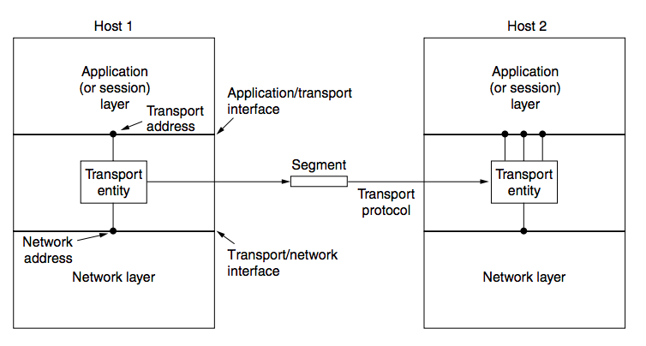
Transport Layer – Interfacing with Application and Network
Port Number
IP Address
Source: Computer Networks (5th Edition) by Tanenbaum, Wetherell

Slide 6
Transport Layer – Interfacing with Application and Network
Source: Computer Networks (5th Edition) by Tanenbaum, Wetherell
Create a logical pipe between the sender and the receiver and monitor the data transmission through this pipe

Slide 7
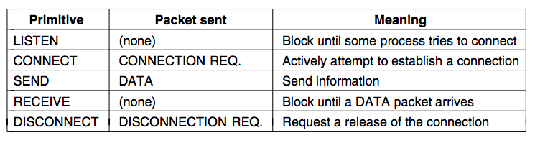
Transport Service Primitives
To allow users to access transport service, the transport layer must provide some operations to the application programs.
Let us look into a hypothetical transport service primitives, that are provided to the application layer
The transport layer needs to remember the state of the pipe, so that appropriate actions can be taken. We need a stateful protocol for transport layer.

Slide 8
Transport Service Primitive – Connection Establishment
Client
Server
CONNECT
CONNECTION REQ
LISTEN
The client and server needs to remember the state
CONNECTION ACK
ESTABLISHED
ESTABLISHED
DATA
SEND
RECEIVE
DISCONNECTION REQ
DISCONNECT
DISCONNECTION ACK

Slide 9
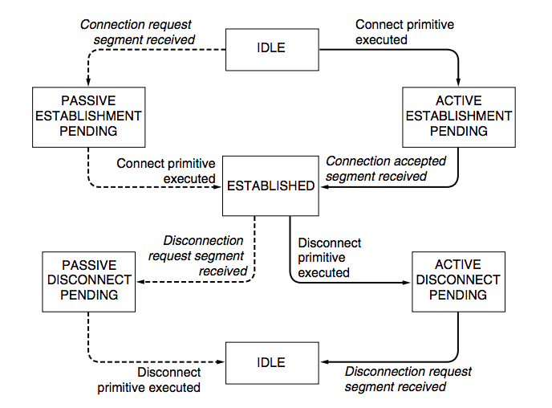
Transport Layer Protocol – State Diagram
SERVER
Source: Computer Networks (5th Edition) by Tanenbaum, Wetherell

Slide 10
Transport Layer Protocol – State Diagram
CLIENT
Source: Computer Networks (5th Edition) by Tanenbaum, Wetherell

Slide 11
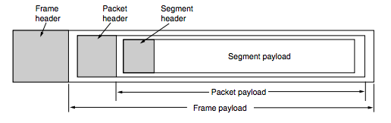
Segment, Packet (or Datagram) and Frame
Source: Computer Networks (5th Edition) by Tanenbaum, Wetherell

Slide 12
Connection Establishment
Client
Server
CONNECT
CONNECTION REQ
LISTEN
CONNECTION ACK
This is a simple primitive for connection establishment – but does this work good?

Slide 13
Connection Establishment
Consider a scenario when the network can lose, delay, corrupt and duplicate packets (the underline network layer uses unreliable data delivery)
Consider retransmission for ensuring reliability – every packet uses different paths to reach the destination
Packets may be delayed and got struck in the network congestion, after the timeout, the sender assumes that the packets have been dropped, and retransmits the packets

Slide 14
Connection Establishment
Client
Server
CONNECT
CONNECTION REQ - 1
LISTEN
It may happen that the server has crashed and reinitiated the connection. So distinguishing between these two is essential
CONNECTION REQ - 2
How will the server differentiate whether CONNECTION REQ-1 is a new connection request or a duplicate of the CONNECTION REQ-2?

Slide 15
Connection Establishment
Protocol correctness versus Protocol performance – an eternal debate in computer networks …
Delayed duplicates create a huge confusion in the packet switching network. A major challenge in packet switching network is to develop correct or at least acceptable protocols for handling delayed duplicates

