Slide 1
Fresh & Rotten Fruit
Classification Using Deep Learning
Comparative Analysis of Custom CNN vs MobileNetV2
Kaggle
6
13,599
10
Dataset
Classes
Images
Epochs
Notes:
Good morning everyone. Today I will present my project titled Fresh and Rotten Fruit Classification Using Deep Learning. The objective of this project is to automatically identify whether a fruit is fresh or rotten using image classification techniques. Two deep learning models were implemented and compared: a Custom CNN and MobileNetV2.

Slide 2
Problem Statement
⏱
⚠
Time-Consuming
Inconsistent Results
Manual fruit inspection is slow and labor-intensive at scale.
Human inspection introduces errors and subjective variation.
🏭
🤖
Scale Challenges
Deep Learning Solution
Large-scale sorting in warehouses and factories requires automation.
Automated image classification delivers fast, consistent, scalable detection.
Notes:
Freshness detection is an important task in agriculture, supermarkets, warehouses, and food processing industries. Manual inspection requires significant time and labor, and human errors can occur. Therefore, this project uses deep learning to automate fruit freshness detection.

Slide 3
Dataset
Source
6 Classification Classes
Kaggle — Fresh and Rotten Fruits Dataset
Fresh Apples
Fresh Bananas
Training Parameters
Image Size
128 × 128 px
Fresh Oranges
Rotten Apples
Batch Size
16
Epochs
10
Train Images
8,723
Rotten Bananas
Rotten Oranges
Validation
2,178
Test Images
2,698
Notes:
The dataset was downloaded from Kaggle. It consists of six classes representing fresh and rotten apples, bananas, and oranges. All images were resized to 128 by 128 pixels. The models were trained using a batch size of 16 for 10 epochs.

Slide 4
Research Questions
01
Can a CNN accurately classify fresh and rotten fruits?
02
Does MobileNetV2 outperform the custom CNN?
03
Which model produces the highest accuracy?
04
Which fruit classes are most difficult to classify?
Notes:
The main objective was to compare a custom CNN with MobileNetV2 and determine which model provides better classification performance.

Slide 5
Proposed Methodology
Dataset
Preprocessing
Augmentation
Train/Test Split
Custom CNN
MobileNetV2
Prediction
Evaluation
Custom CNN
MobileNetV2 (Transfer Learning)
Conv2D (32 filters, ReLU)
Pretrained MobileNetV2 (ImageNet)
MaxPooling2D
Frozen base layers
Conv2D (64 filters, ReLU)
GlobalAveragePooling2D
MaxPooling2D
Dense(128, ReLU)
Conv2D (128 filters, ReLU)
Dropout(0.5)
MaxPooling2D
Softmax (6 classes)
Flatten → Dense(256) → Dropout(0.5)
Trainable params: 164,742
Softmax (6 classes)
Total params: 2,422,726
Notes:
First, the dataset was preprocessed. Images were resized and normalized. Data augmentation techniques such as rotation, zoom, and flipping were applied to improve generalization. Two models were trained independently. Finally, both models were evaluated using several performance metrics.

Slide 6
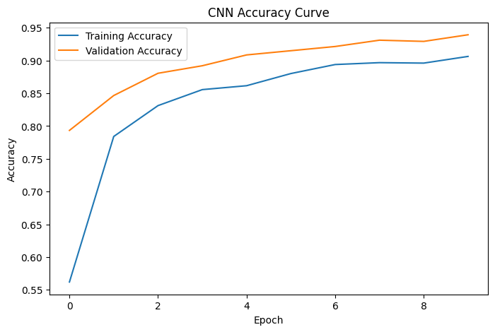
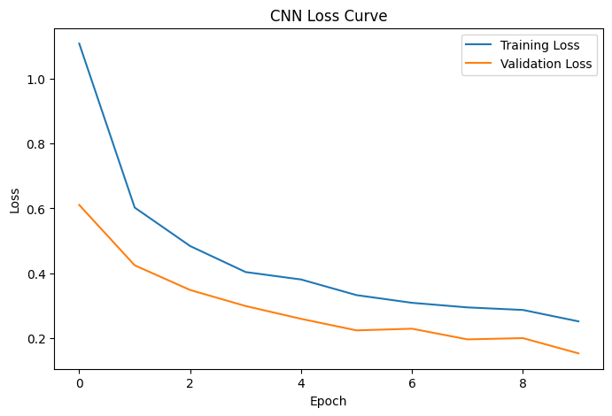
Training Process — CNN Learning Curves
Both models trained for 10 epochs. Training accuracy rose steadily while validation accuracy converged, indicating strong generalisation.
Epoch 1: Train 56.2% | Val 79.3%
Epoch 5: Train 86.2% | Val 90.9%
Epoch 10: Train 91.5% | Val 95.4%
Notes:
Both models were trained for 10 epochs. During training, training accuracy increased while loss decreased steadily. The validation accuracy also improved, indicating that the models learned meaningful image features.

Slide 7
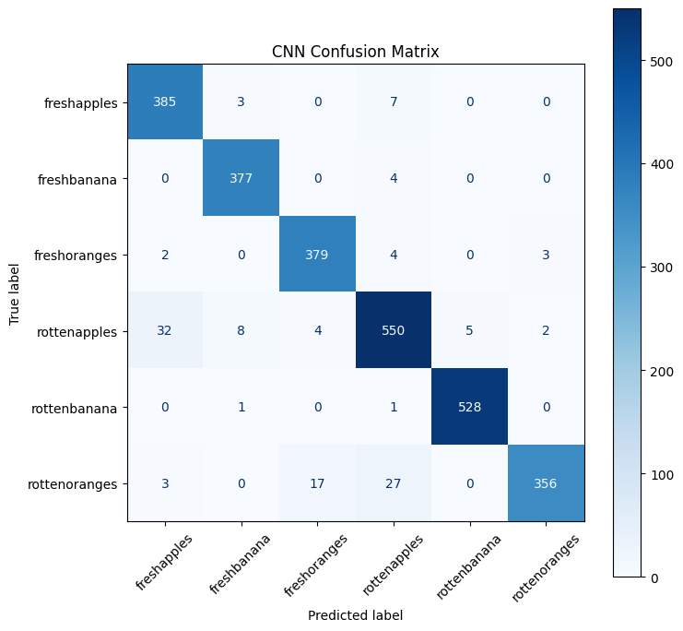
Model Evaluation — CNN Confusion Matrix
Class | Prec | Recall | F1 | N
Fresh Apples | 0.91 | 0.97 | 0.94 | 395
Fresh Bananas | 0.97 | 0.99 | 0.98 | 381
Fresh Oranges | 0.95 | 0.98 | 0.96 | 388
Rotten Apples | 0.93 | 0.92 | 0.92 | 601
Rotten Bananas | 0.99 | 1.00 | 0.99 | 530
Rotten Oranges | 0.99 | 0.88 | 0.93 | 403
CNN Overall Accuracy
95.44%
Notes:
This confusion matrix represents the performance of the CNN. Most predictions appear along the diagonal, indicating correct classification. A few errors occur between visually similar fresh and rotten fruits.

Slide 8
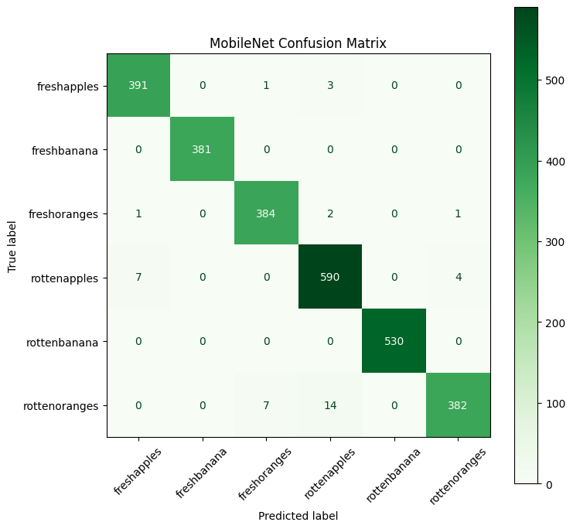
Model Evaluation — MobileNetV2 Confusion Matrix
Class | Prec | Recall | F1 | N
Fresh Apples | 0.98 | 0.99 | 0.98 | 395
Fresh Bananas | 1.00 | 1.00 | 1.00 | 381
Fresh Oranges | 0.98 | 0.99 | 0.98 | 388
Rotten Apples | 0.97 | 0.98 | 0.98 | 601
Rotten Bananas | 1.00 | 1.00 | 1.00 | 530
Rotten Oranges | 0.99 | 0.95 | 0.97 | 403
MobileNetV2 Overall Accuracy
98.52%
Notes:
This is the confusion matrix for MobileNetV2. Compared to CNN, MobileNet produced fewer misclassifications, demonstrating better overall performance.

Slide 9
Performance Comparison
Metric | Custom CNN | MobileNetV2
Accuracy | 95.44% | 98.52%
Precision | 95.52% | 98.53%
Recall | 95.44% | 98.52%
F1-Score | 95.42% | 98.51%
MobileNetV2 outperforms Custom CNN by +3.08% accuracy, leveraging pretrained ImageNet weights for superior generalisation.
Notes:
This table compares the performance of both models. According to the experimental results, MobileNetV2 achieved better overall performance than the custom CNN. The higher precision, recall, and F1-score indicate that MobileNet generalized better on unseen test images.

Slide 10
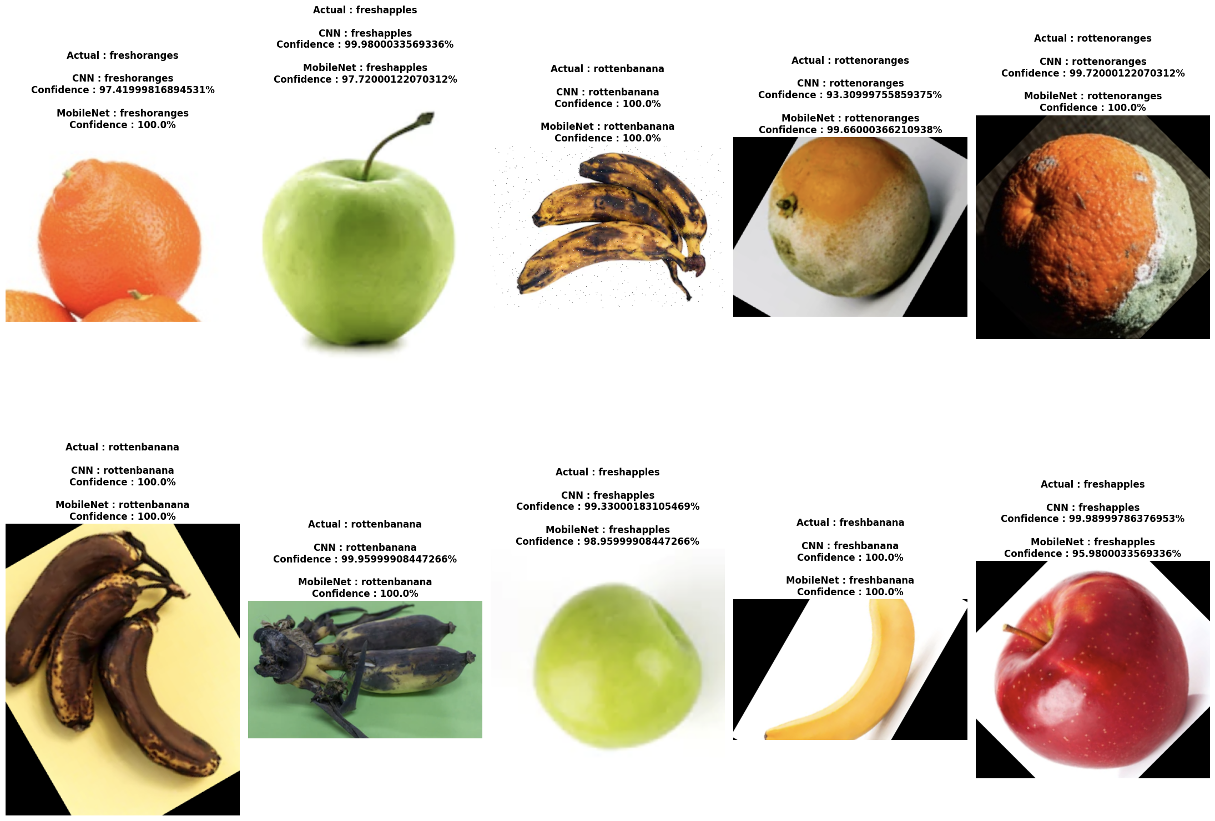
Sample Predictions — Both Models
10 random test images with actual labels, CNN and MobileNetV2 predictions, and confidence scores.
Notes:
These are sample predictions from the testing dataset. For each image, the actual label is compared with predictions from both models. Both models correctly classified most of the images. The confidence scores demonstrate that the models are highly confident in their predictions.

Slide 11
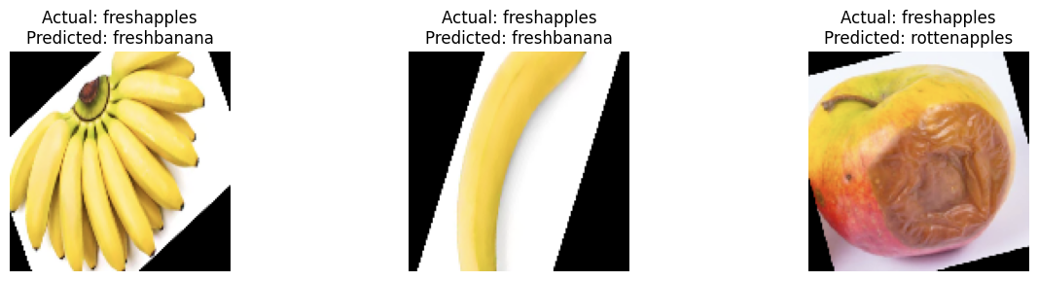
CNN — Misclassified Images (123 of 2,698)
Only 123 images were misclassified — most errors involve visually similar fresh/rotten textures and lighting conditions.
Similar Texture
Lighting
Color Overlap
Fresh & rotten share surface texture under certain conditions
Shadows and reflections mislead the model
Some rotten fruits retain fresh-like coloration
Notes:
These images were incorrectly classified. Most errors occurred because the fresh and rotten fruits share similar colors, textures, and lighting conditions. Such visual similarities make classification more challenging.

Slide 12
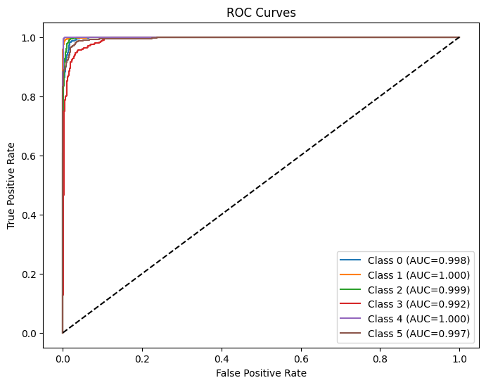
ROC Curves — CNN Per-Class Performance
Area Under Curve (AUC) measures per-class discrimination ability. Values close to 1.0 indicate excellent classification.
Notes:
ROC curves show per-class discrimination. All classes achieved AUC close to 1.0, indicating strong classification capability.

Slide 13
Limitations
01
Limited Fruit Variety
04
Visual Similarity
Dataset covers only apples, bananas, and oranges. Real deployments require more categories.
Fresh and rotten fruits can look alike, making border cases inherently difficult.
02
Controlled Conditions
05
Deployment Gap
Images captured under laboratory-like lighting; real-world performance may vary.
Models have not been validated on edge devices or in real-time webcam settings.
03
Dataset Size
~13,599 images may be insufficient for highly diverse real-world scenarios.
Notes:
Although the results are encouraging, several limitations remain. The dataset includes only apples, bananas, and oranges. Images were collected under relatively controlled conditions. Future work should include more fruit categories and more diverse environmental conditions.

Slide 14
Conclusion
✓
Successfully implemented and evaluated Custom CNN (95.44% accuracy)
✓
Successfully implemented MobileNetV2 with transfer learning (98.52% accuracy)
✓
MobileNetV2 outperforms Custom CNN by +3.08% on all metrics
✓
Models evaluated with confusion matrices, ROC curves, and classification reports
✓
Deep learning is highly effective for automated fruit quality inspection
Notes:
In conclusion, this project demonstrates that deep learning can accurately classify fresh and rotten fruits. Both CNN and MobileNetV2 performed well. However, MobileNetV2 achieved superior overall performance due to transfer learning and its optimized architecture. This approach can support automated quality inspection in agriculture and food industries.

Slide 15
Future Work
01
02
03
Expand Dataset
Real-Time Detection
Mobile Application
Include more fruit types and collect images under diverse lighting and environmental conditions.
Enable live fruit freshness detection using a webcam or conveyor camera.
Build a lightweight iOS/Android app for on-the-go fruit quality checking.
04
05
06
Edge Deployment
Fine-Tuning
Multi-Label Detection
Deploy the model on edge devices (Raspberry Pi, Jetson Nano) for in-field use.
Unfreeze MobileNetV2 layers for domain-specific fine-tuning to push accuracy further.
Extend to detect ripeness levels (underripe / ripe / overripe) beyond binary classification.
Notes:
Future work includes expanding the dataset, incorporating more fruit categories, deploying the model on mobile devices, and enabling real-time fruit detection using a camera.

Slide 16
Thank You
Questions & Discussion
95.44%
98.52%
2,698
MobileNetV2
CNN Accuracy
MobileNet Accuracy
Test Images
Winner
Notes:
Thank you for your attention. I would be happy to answer any questions.

