Slide 1
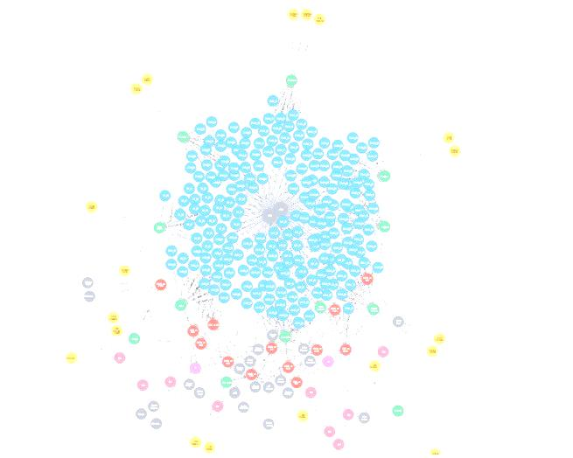
Advanced Information System Cricket use case using Neo4j
Manoj Kumar Ellur
Shunmuga Prabhu Siddharthan
Sachin Baral Ramesh
Anusha Nagaraj
Vinay Kumar Chikkanarashima Murthy

Slide 2

Neo4j is an open source and popular NoSQL graph database and CQL (Cypher Query Language) is the language used to communicate with this database
Neo4j database is built using Java Program language
Data’s are stored in nodes and relationships(edge)

Slide 3

Neo4j Advantages
No Schema
It is easy to relate data
Unique constraints is supported
ACID (Atomicity, Consistency, Isolation and Durability) rules is fully supported
Query result can be exported in JSON & CSV format
It is scalable
Very fast in terms of data retrieval

Slide 4
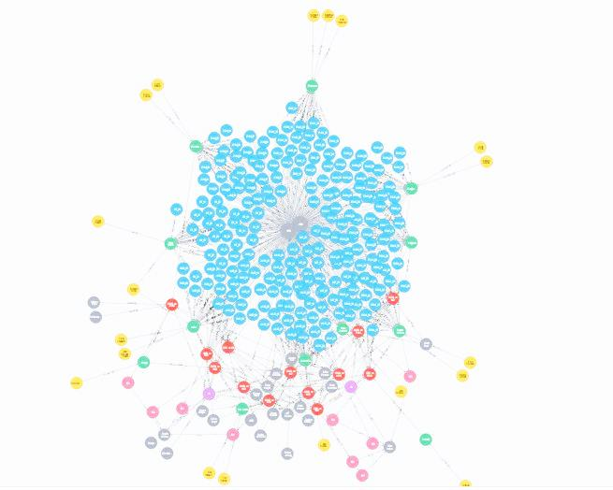

Neo4j Disadvantages
It doesn’t support Sharding
Number of nodes, properties and relationship is limited

Slide 5
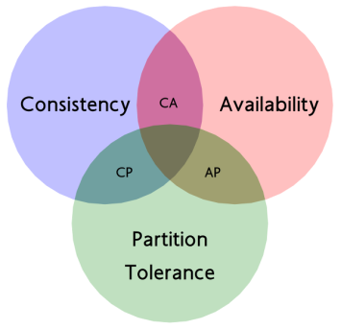
CAP Theorem
Consistency
Servers will have the same data and the database will provide the same answer for everyone
Availability
Servers will provide a response for every request (the response may not be the latest data)
Partition Tolerance
Even when individual server fails, the system will continue to operate

Slide 6
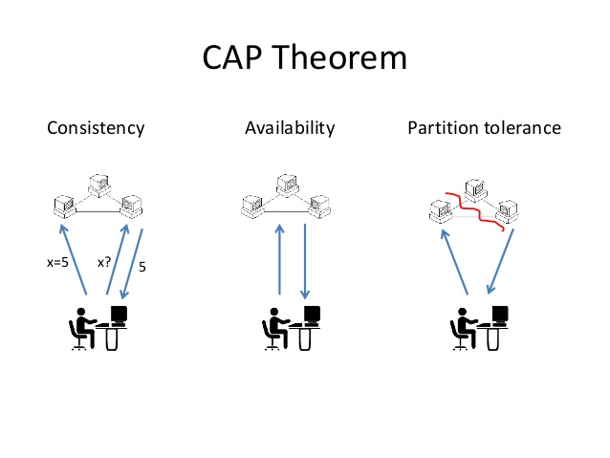
Neo4j CAP Theorem
Consistency and Availability
Neo4j is present in the CA side of the CAP triangle
Partition Tolerance
Neo4j is not partition tolerant

Slide 7
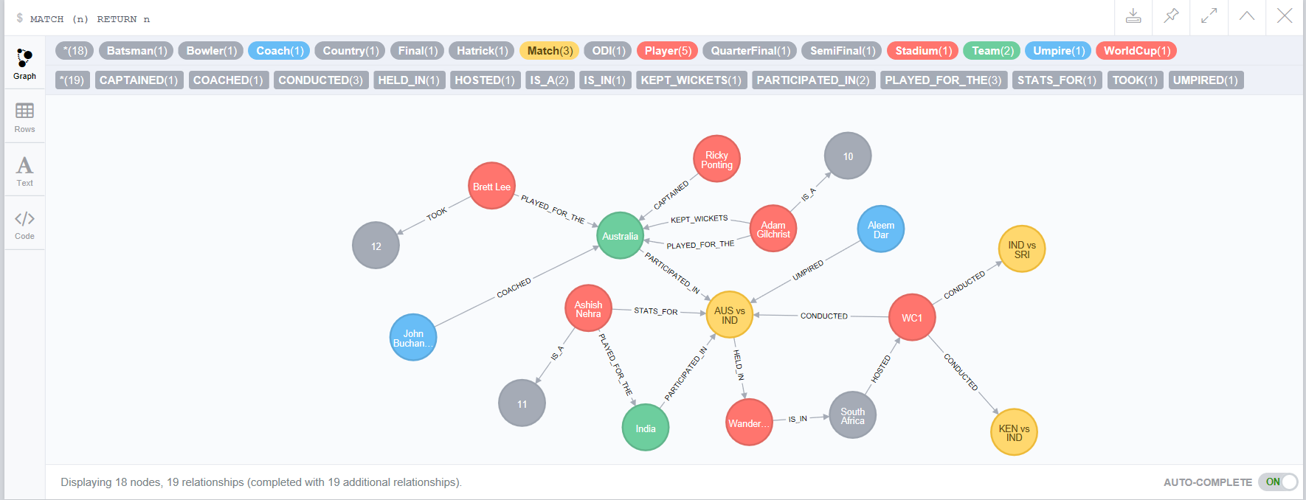
Cricket use case Data Model

Slide 8
Cricket user stories
USER STORY 1 - HEAD TO HEAD
"The Media wants to come up with the previous head on record of the two teams that are going to compete in the upcoming match to give a clear picture of the team who is having the upper hand in terms of confidence going into next match“
USER STORY 2 - TOP 11 PLAYERS
"The International Cricket Council wants to come up with a "World XI" team consisting of 11 best performers among all teams. To accomplish this, the council determines the best players as per individual criteria such as Best pace bowler Best spinner Best openers Best middle order batsmen Best all rounder's etc.“
USER STORY 3 - TEAM RANKING
The International Cricket Council wants to release the latest team rankings considering the previous 5 WC's data in hand.
USER STORY 4 - GAME COACHING
"The Indian team's coach wants to focus on areas of improvement of a player for which he considers the available history data of a player's performance in WC and determines as what all areas the improvement should be made“
USER STORY 5 - THE QUIZ
"The media conducts a quiz for entertainment to the cricket fans based on the history of WC data. It comes up with questions and the corresponding options obtained by querying the history data."

Slide 9


Slide 10
References
https://www.tutorialspoint.com/neo4j/index.htm
http://www.slideshare.net/rahuldausa/what-is-no-sql-and-cap-theorem
https://blog.synyx.de/2013/09/neo4j-jug-karslruhe/

Slide 11


