Slide 1
E-Commerce
Vinay Kumar
Anusha Nagaraj
Shunmuga Prabhu Siddharthan
Sachin

Slide 2
Introduction
E-Commerce website is an online application that facilitates trading of product or service over the internet. In this, we are building a web application for shopping laptops. We are bringing the vendors and the buyers situated across the globe under one roof for making the trade possible.

Slide 3
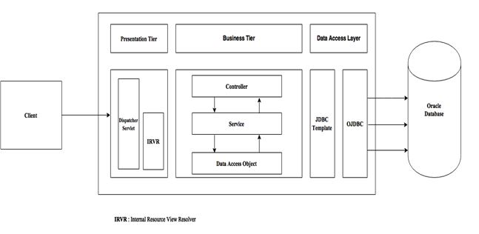
Project Architecture

Slide 4
Technologies Used
UI:-
Libraries
Jquery-3.1.1
Data table-1.10.12
Jquery UI-1.12.1
Java
Bcrypt-0.2
PDF box-1.8.9
Dynamic reports-3.1.3
Spring:-3.1.0
OJDBC-6

Slide 5
Features
Administrator:-
View order details of all
Generate vendor/customer wise purchase report
Vendors:-
Register/login
Add, modify and delete product
Order details
Generate order report.
Customers:-
Register/login
Product search
Add/delete in favorite
Place order
Choose payment option
Delivery address
Invoice for the order

Slide 6
Further Enhancement
Data intelligence
UI enhancement
Email notification

