Slide 1
INVERTED SEARCH
Name : Sachin Belavi

Slide 2
INTRODUCTION:
What is Inverted search?
Definition: A method used in information retrieval systems to index text data.
Commonly used in search engines to quickly locate documents containing a given word or set of words.

Slide 3
Objectives:
Develop an inverted index for a given set of documents.
Implement search functionality using the inverted index.
Evaluate the performance and efficiency of the inverted search method.

Slide 4
Methodology
Steps Involved:
1. hashing / array of pointer
2. Single Linked List
Typical steps are :
Create data base
Display data base
Save data base
Search data base
Update data base

Slide 5
What is a Database?
Definition:
A database is an organized collection of structured information,
or data, typically stored electronically. It enables efficient retrieval,
management, and updating of data for various applications.

Slide 6
CREATE DATA BASE
File Processing :
Open and read words from files in the linked list.
Character Classification:
Classify the first character to assign an index.
Main Node Creation:
Create and link main nodes for new words.
Word and File Check:
Check and update existing words and files in the list.
Updating Nodes:
Update word and file counts; add new sub nodes if needed.

Slide 7
DISPLAY DATABASE
The function display database prints the database contents in a tabular format.
It iterates through each index of the hash table array and prints the information for each main node and its associated sub nodes.
The format includes index, word, file count, and filename/word count pairs.

Slide 8
SAVE DATABASE
File Extension Validation:
Checks if the input file has a .txt extension.
File Opening:
Opens the file for writing.
Database Writing:
Iterates through the database and writes its contents to the file.
Main Node and Sub node Iteration:
Loops through main nodes and associated sub nodes to write their data.
Error Handling:
Handles errors related to file opening and extension validation.

Slide 9
SEARCH DATABASE
Index Determination:
Determines the index in the array of pointer based on the first character of
the word.
Search Results Display:
Prints the search results in tabular format, including file count and
filename/word count pairs.
Main Node Traversal:
Traverses the main nodes at the determined index to find matching
words.
Sub node Iteration:
Iterates through sub nodes to print associated filenames and word counts.

Slide 10
UPDATE DATABASE
File Extension and Empty Check:
Validates the file extension and checks if the file is empty.
Data Processing:
Reads data from the file and updates the database accordingly.
Node Creation and Update:
Creates new main nodes and subnodes based on the file data and updates
the database structure.
Error Handling:
Handles errors related to file opening, data processing, and memory
allocation.

Slide 11
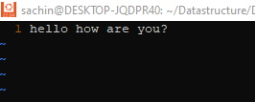


practical
File1.txt
File2.txt
SINGLE LINK LIST CREATION

Slide 12
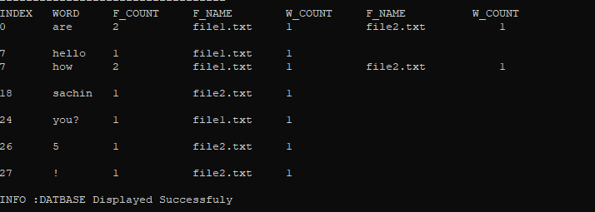
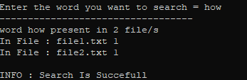
Display Data Base
Search data Base

Slide 13


