Slide 1
Multi-cluster words in Model-Based Clustering of Short Text streams
Name: Bellamkonda Sachin Under Super Vision of
Roll Number:17MA20008 Dr.Pawan Kumar

Slide 2
Introduction
Text Streams
- Text Streams are data coming continuously over the time.
- This data coming continuously is difficult to classify.
- Because of new topic emerging over the time, this is concept drift problem.
- We are now concentrating about short text stream data (Example : Tweets , News)
Short Text Streams
- Short Text Stream has less occurrences of words in the document. This is data sparsity.
- As this is a streaming data we cannot store and iterate all data and also the concept drift
problem because new topics continuously emerge over time.

Slide 3
Problem Statement :
What is the effect of multi cluster words/ homograph words have on short text streams?

Slide 4
Objective:
Solving the problem of concept drift.
Removing outdated document batches with new batches arriving.
Removing multi-cluster words in clusters.

Slide 5
Sl.No | Author | Title | Methodology | Problems Identified
1 | Jian Hua Yin et. all | Model-based Clustering of Short Text Streams | MStream, MStreamF | Data sparsity, Data Drift
2 | Xueqi Cheng et. all | BTM: Topic Modeling over Short Texts | Biterm Topic Model | Scalability, Limited contexts
3 | Xuan-Hieu Phan et.all | A Hidden Topic-Based Framework toward Building Applications with Short Web Documents | Latent Dirichlet Allocation | Short and sparse data problem, synonyms and homonyms
4 | Peipei Li et. all | Learning From Short Text Streams With Topic Drifts | LDA, BTM, SVM | Difficult in senses of ambiguous words, no enough information
5 | Md Rashadul Hasan Rakib et. all | Short Text Stream Clustering via Frequent Word Pairs and Reassignment of Outliers to Clusters | MStreamF, OSDM | Sparseness of short texts, retaining the streams of texts as they grow over time, and concept drift

Slide 6
Why is topic drift problem is significant in text streams?
Fixed Number of Clusters
Streaming DATA
Emerging of New topics continuously
1.Tech
2.Sports
3.Food
4.Fashion
New Topic
1.Politics
No new clusters are created as number of clusters is fixed.
Problem with static traditional clustering models :
Number of clusters is fixed no new clusters cannot be created if new topic emerges.
Resulting in documents ending up in wrong clusters
Old batch of documents must be deleted as it will become hard to run algorithm with huge chunk of documents.

Slide 7
Why multi-cluster words are significant?
Animals Cricket Travel
Bat lives in dark.
Cricket bat is costly
1.Cat-2
2.Elephant-3
3.zoo-5
4.grass-2
5.chicken-4
6.meat-3
7.dangerous-2
8.friendly-3
9.dog-5
10.bat-1
1.sachin-2
2.bat-2
3.ground-1
4.pitch-2
5.GOAT-3
6.india-1
7.Australia-1
8.six-1
9.dhoni-2
10.winning-1
11.cricket-3
1.Travelling-2
2.Zoo-1
3.Noise-1
4.Enjoy-3
5.out-5
6.dangerous-1
7.race-1
8.Food
9.costly-2

Slide 8
Why sparsity problem is significant in short text streams?
Dhoni meets Airforce majors
It is not mentioned regarding what purpose
What category it should belong?
Sports or Army
Problem with sparsity:
Documents won’t have enough information to cluster them into certain topic.

Slide 9
Methodology Stream of Documents as Batches
Documents
Documents
Documents
Document with words
Model

Slide 10
Methodology
MStream
1.Model based clustering algorithm
2.Number of clusters are not fixed, tackles concept drift problem
3.For each topic is assigned to single cluster rather than distribution.
4.Each cluster contains frequency of words in it.
5.Removing high entropy words.
MStreamF
1.Extension of MStream with forgetting rules.
2.Removes outdated documents by deleting outdated batches of documents from clusters.

Slide 11
Dataset
Tweets | This dataset contains of 30322 tweets that are highly 269 queries in the TREC microblog
News | This dataset contains 11,109 news titles belongs to 109 clusters.
News-T | This dataset is sorted version of News as in real world news topics belongs to certain period.
Tweets-T | Similarly, This dataset is sorted version of Tweets as in real world certain topics belongs to particular period.

Slide 12
Results:
Evaluation Metrics:
Normalised Mutual Information (NMI) is a evaluation metrics for finding results of clusters. It is normalization of Mutual Information(MI) score to scale between 0 to 1. 0 means no mutual information, 1 means perfectly related.
 | MStream | MStreamF | HMStream | HMStreamF
News | 0.7712 | 0.7647 | 0.8529 | 0.7612
Tweets | 0.8313 | 0.8008 | 0.8548 | 0.8278
News-T | 0.8742 | 0.8758 | 0.8749 | 0.8816
Tweets-T | 0.8370 | 0.8809 | 0.8745 | 0.9036

Slide 13
Results:
Complete Score is a measure of all data points which are that are members of obtained clusters which are actually members of same cluster.
Above table shows us NMI and Complete score values for all algorithms on News data.
 | NMI Value | Complete Score
MStream | 0.7712 | 0.8005
MStreamF | 0.7647 | 0.7932
HMStream | 0.8529 | 0.8705
HMStreamF | 0.7612 | 0.7676

Slide 14
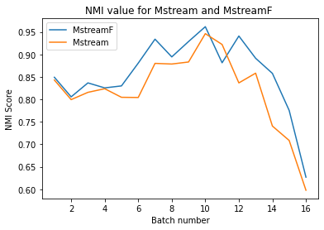
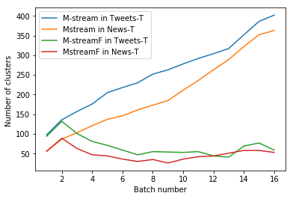

Slide 15
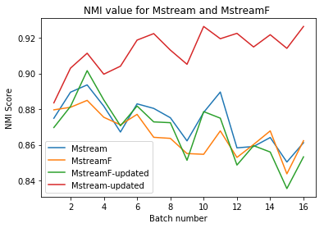

Slide 16
Conclusion:
MStreamF algorithm worked better on Tweets-T and News-T data compared to MStream
MStreamF efficiently handles outdated documents by deleting old batches of documents when new batches continuous to come.
Removing multi-cluster words increased the performance of MStream but for MStreamF it is more or less the same.
MStream and MStreamF both worked well on short data streams handling concept drift problem and data sparsity problem.

Slide 17
Future work:
Finding a better way to deal with multi cluster words ambiguity in short text streams.

Slide 18
Thank You

